Slide 1
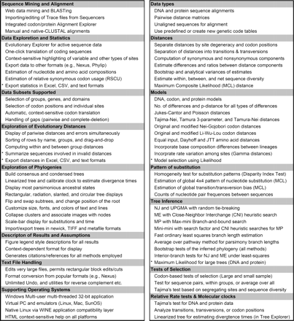
Figure 1: A list of primary features in MEGA. An asterix marks features that are expected to be included in versions ...
Notes:
Figure 1: A list of primary features in MEGA. An asterix marks features that are expected to be included in versions 4.1, 4.2, and 5.
Unless provided in the caption above, the following copyright applies to the content of this slide: © The Author 2008. Published by Oxford University Press. For Permissions, please email: journals.permissions@oxfordjournals.org

Slide 2
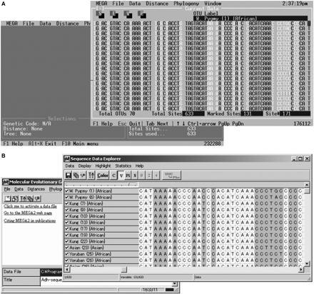
Figure 2: Screenshots of the first version of MEGA containg a character-based point-and-click interface for use on DOS ...
Notes:
Figure 2: Screenshots of the first version of MEGA containg a character-based point-and-click interface for use on DOS (A). MEGA 1 evolved into a Windows program (MEGA 2) with an extensive GUI (B). The main MEGA windows are overlaid with the Input Sequence Data Explorer, in which columns containing at least two different types of nucleotides (variable sites) are highlighted.
Unless provided in the caption above, the following copyright applies to the content of this slide: © The Author 2008. Published by Oxford University Press. For Permissions, please email: journals.permissions@oxfordjournals.org

Slide 3
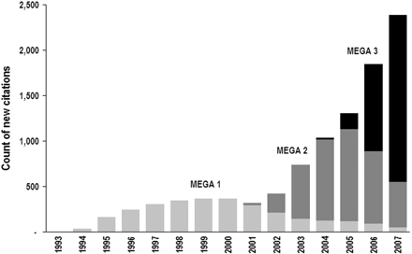
Figure 3: Number of MEGA citations each year (ISI Web of Science, February 2008 edition).
Notes:
Figure 3: Number of MEGA citations each year (ISI Web of Science, February 2008 edition).
Unless provided in the caption above, the following copyright applies to the content of this slide: © The Author 2008. Published by Oxford University Press. For Permissions, please email: journals.permissions@oxfordjournals.org

