Slide 1
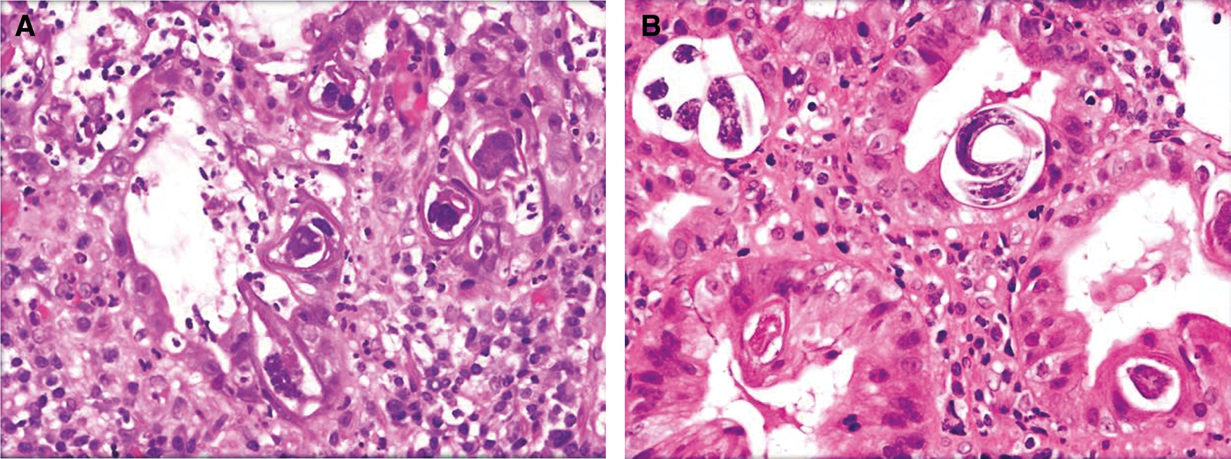
Image 1 A,S. stercoralis in the mucosal crypts with transverse sections through the posterior region of the worm. ...
Notes:
Image 1 A,S. stercoralis in the mucosal crypts with transverse sections through the posterior region of the worm. Each section contains an intestine and 2 sections of the reproductive tube (hematoxylin and eosin, original magnification ×400). B, Additional sections of gastric mucosa with adult female S. stercoralis in the mucosal crypts (hematoxylin and eosin, original magnification ×400).
Unless provided in the caption above, the following copyright applies to the content of this slide: © American Society for Clinical Pathology, 2016. All rights reserved. For permissions, please e-mail: journals.permissions@oup.com

Slide 2
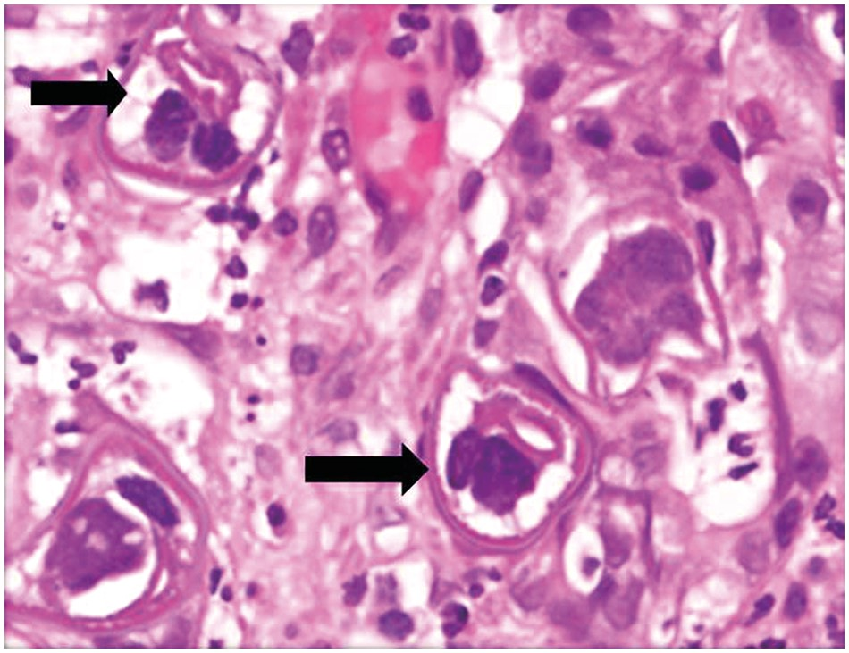
Image 2 High power of Image 1B showing a transverse section of the posterior portion of the worm with the intestine ...
Notes:
Image 2 High power of Image 1B showing a transverse section of the posterior portion of the worm with the intestine and reproductive organs (black arrow, hematoxylin and eosin, original magnification ×600).
Unless provided in the caption above, the following copyright applies to the content of this slide: © American Society for Clinical Pathology, 2016. All rights reserved. For permissions, please e-mail: journals.permissions@oup.com

