Slide 1
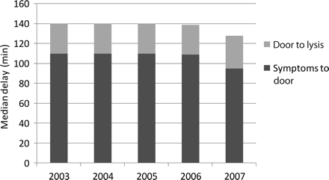
Figure 1 Temporal trends in delay times in patients with acute myocardial infarction undergoing fibrinolysis.
Notes:
Figure 1 Temporal trends in delay times in patients with acute myocardial infarction undergoing fibrinolysis.
Unless provided in the caption above, the following copyright applies to the content of this slide: Published on behalf of the European Society of Cardiology. All rights reserved. © The Author 2010. For permissions please email: journals.permissions@oxfordjournals.org

Slide 2
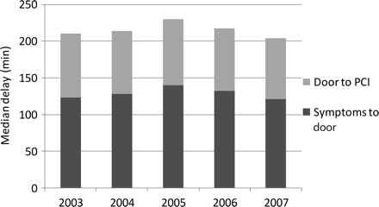
Figure 2 Temporal trends in delay times in patients with acute myocardial infarction undergoing percutaneous coronary ...
Notes:
Figure 2 Temporal trends in delay times in patients with acute myocardial infarction undergoing percutaneous coronary intervention.
Unless provided in the caption above, the following copyright applies to the content of this slide: Published on behalf of the European Society of Cardiology. All rights reserved. © The Author 2010. For permissions please email: journals.permissions@oxfordjournals.org

