Slide 1
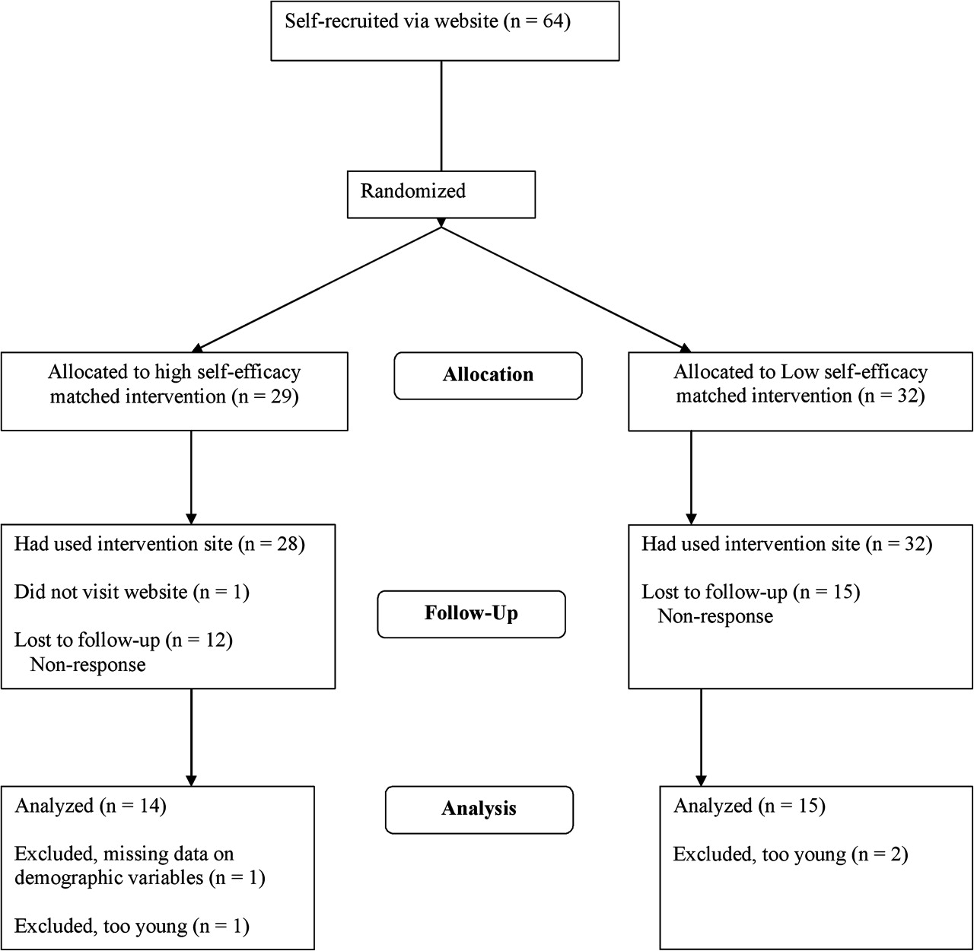
Fig. 1. Participant flow chart.
Notes:
Fig. 1. Participant flow chart.
Unless provided in the caption above, the following copyright applies to the content of this slide: © 2007 The Author(s).This is an Open Access article distributed under the terms of the Creative Commons Attribution Non-Commercial License (http://creativecommons.org/licenses/by-nc/2.0/uk/) which permits unrestricted non-commercial use, distribution, and reproduction in any medium, provided the original work is properly cited.

Slide 2
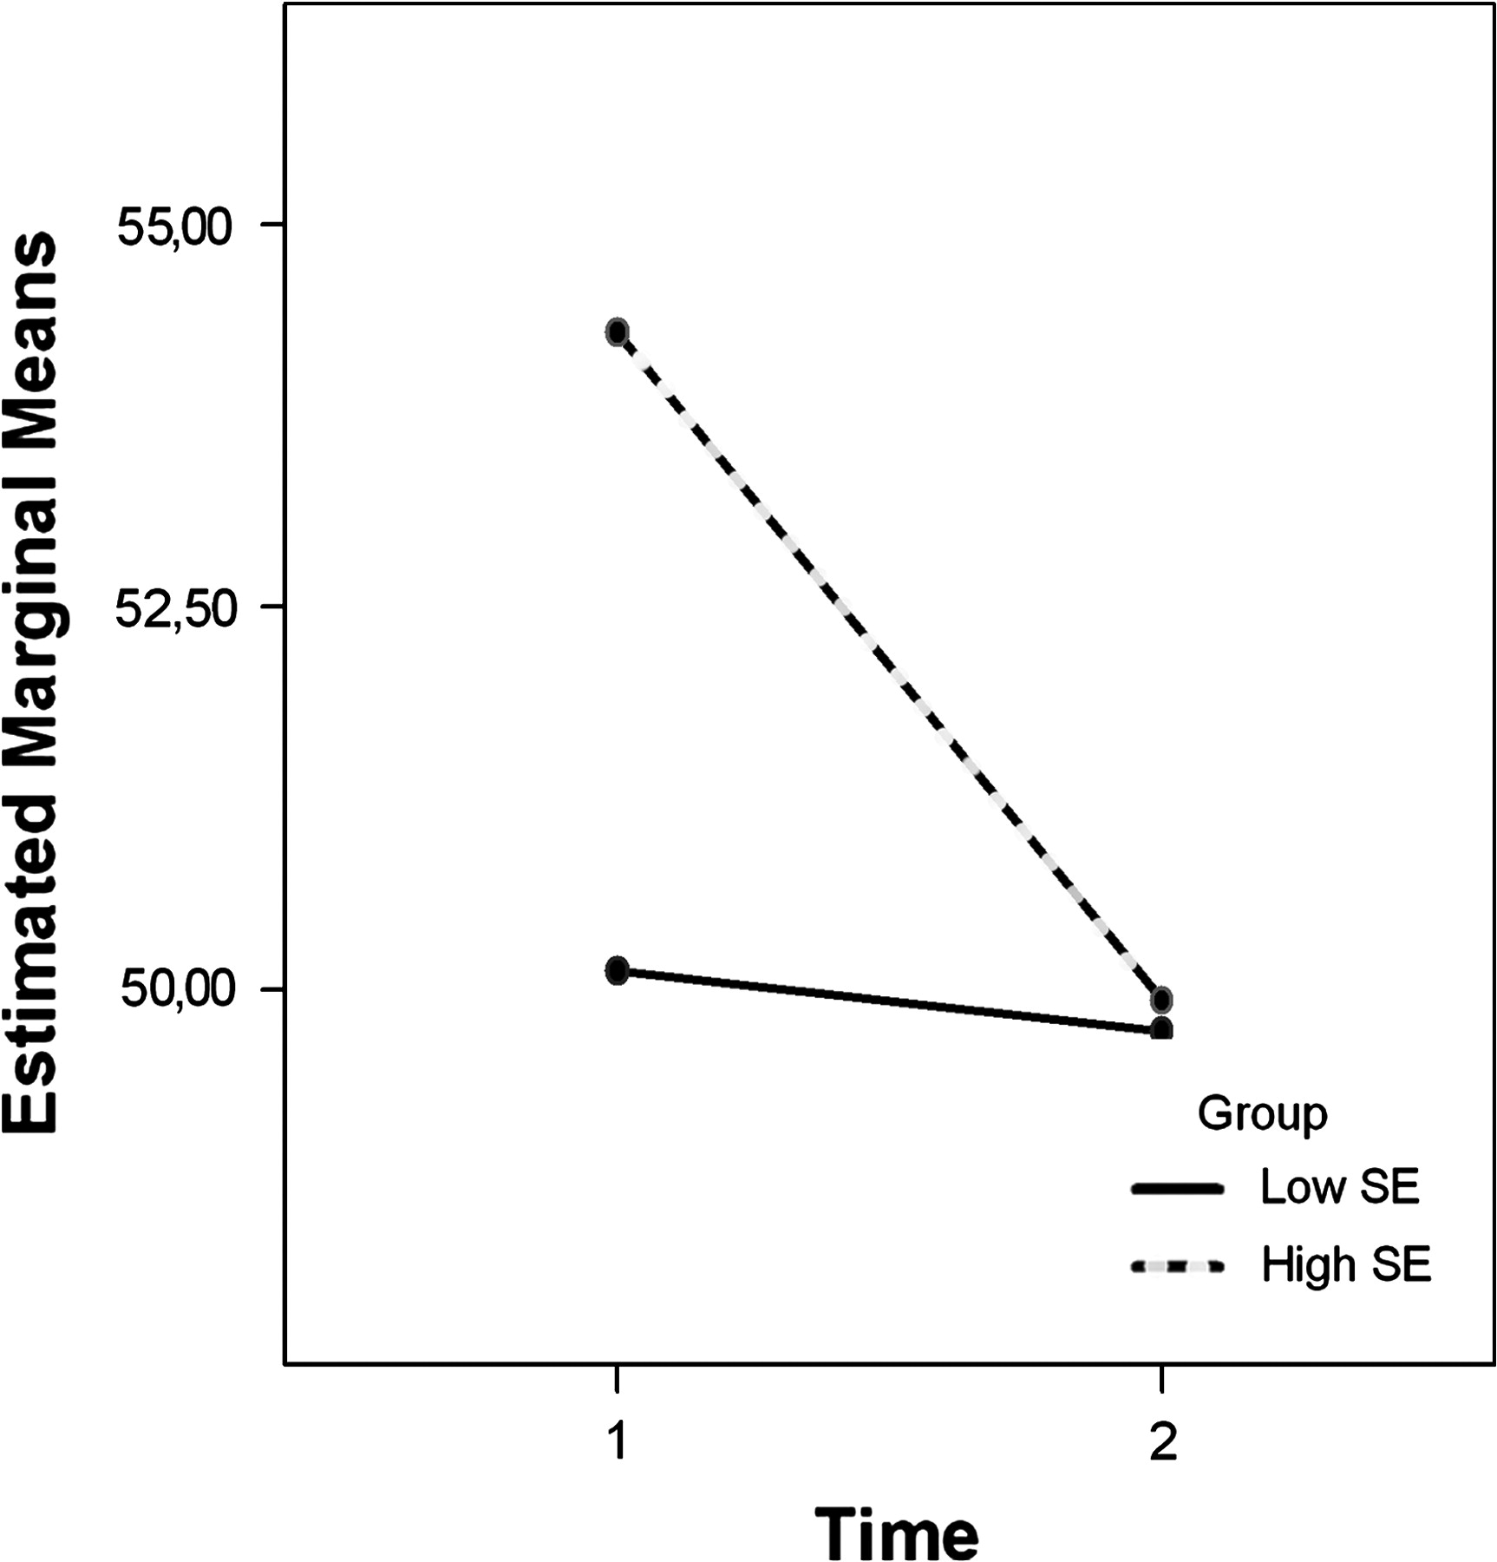
Fig. 3. Change in SE (PC total) per group.
Notes:
Fig. 3. Change in SE (PC total) per group.
Unless provided in the caption above, the following copyright applies to the content of this slide: © 2007 The Author(s).This is an Open Access article distributed under the terms of the Creative Commons Attribution Non-Commercial License (http://creativecommons.org/licenses/by-nc/2.0/uk/) which permits unrestricted non-commercial use, distribution, and reproduction in any medium, provided the original work is properly cited.

Slide 3
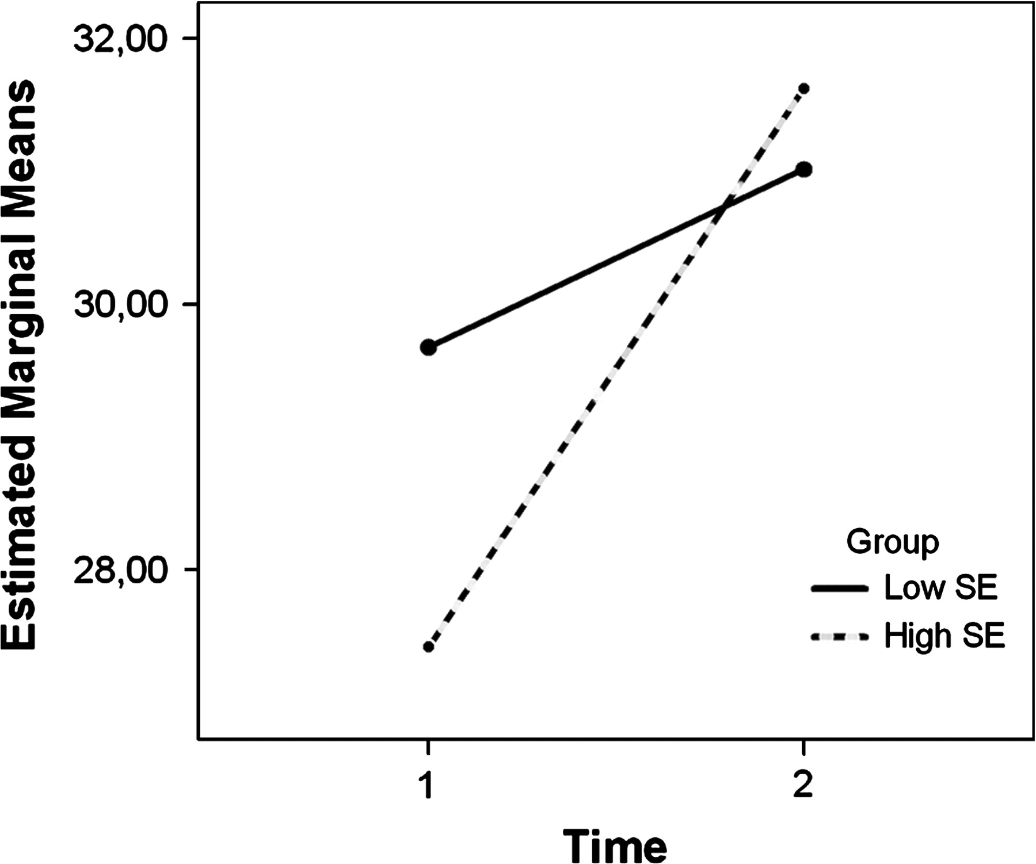
Fig. 2. Change in self-care (SDSCA total) from baseline to 1 month after intervention per group.
Notes:
Fig. 2. Change in self-care (SDSCA total) from baseline to 1 month after intervention per group.
Unless provided in the caption above, the following copyright applies to the content of this slide: © 2007 The Author(s).This is an Open Access article distributed under the terms of the Creative Commons Attribution Non-Commercial License (http://creativecommons.org/licenses/by-nc/2.0/uk/) which permits unrestricted non-commercial use, distribution, and reproduction in any medium, provided the original work is properly cited.

