Slide 1
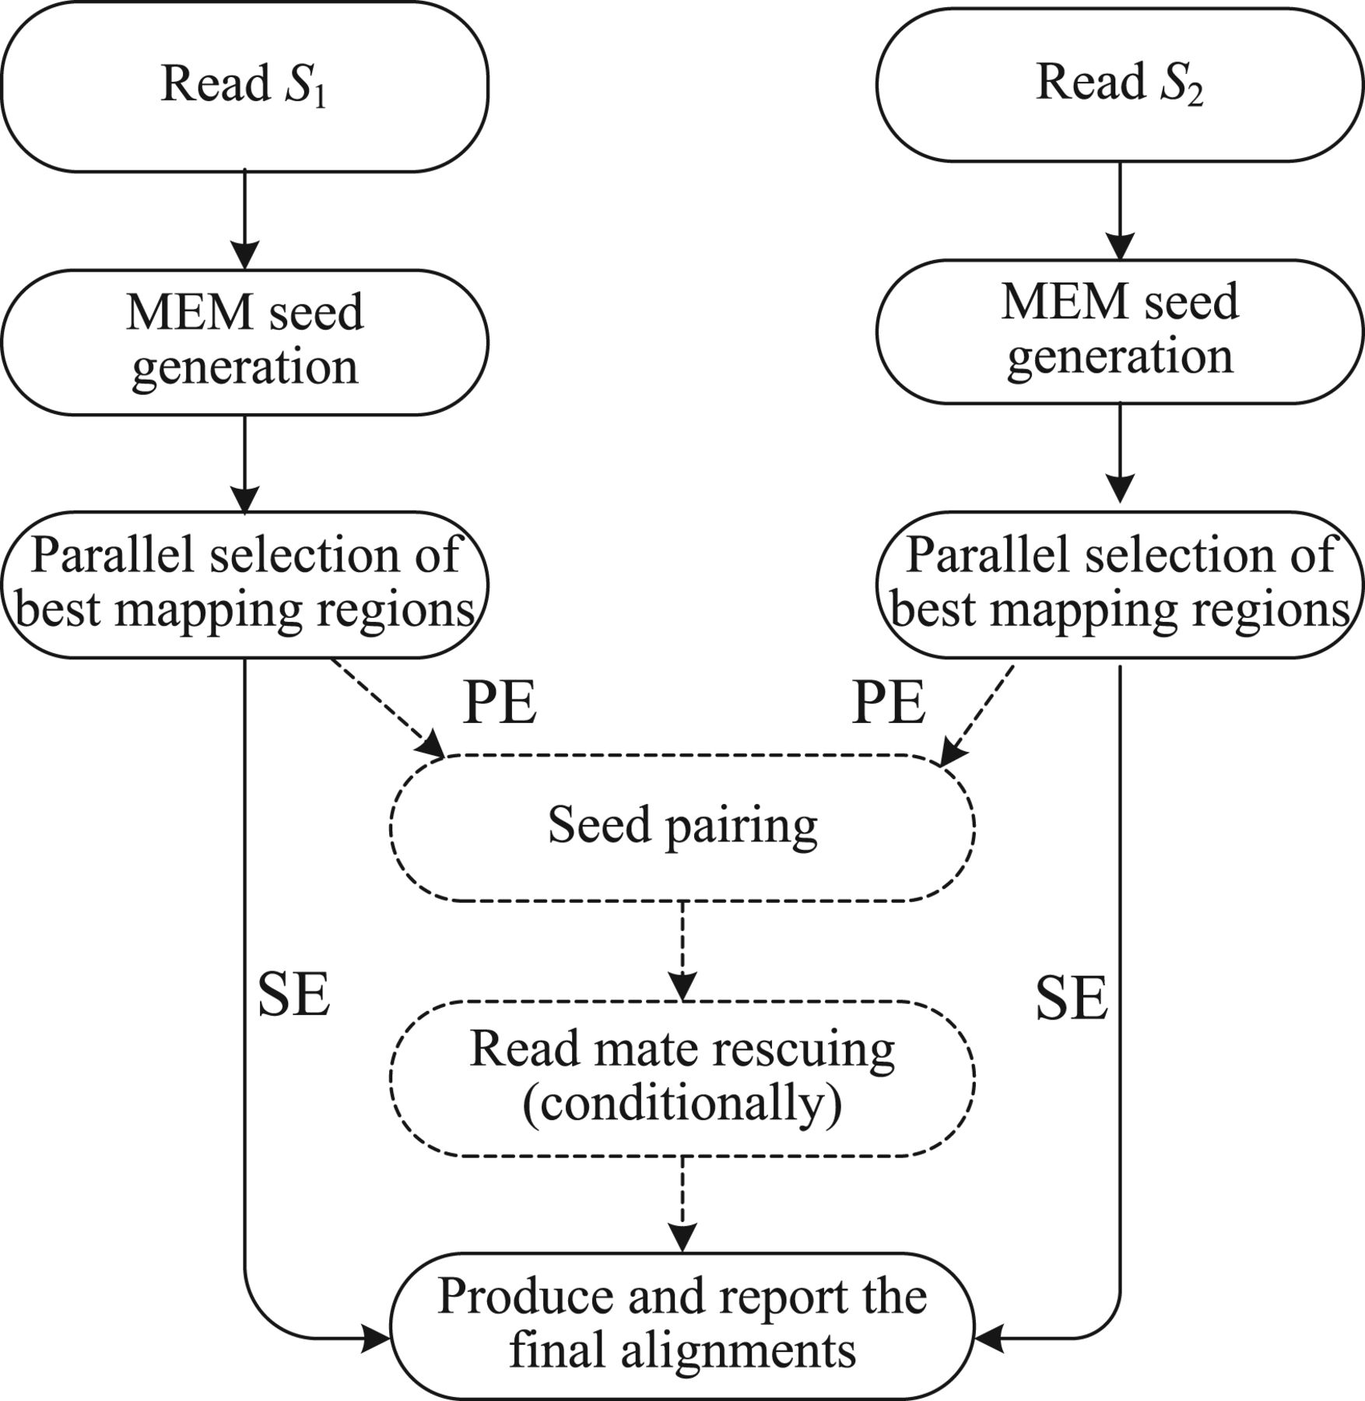
Fig. 1. Pipeline of our aligner for the SE and the PE alignment: the dashed lines show the additional two stages for ...
Notes:
Fig. 1. Pipeline of our aligner for the SE and the PE alignment: the dashed lines show the additional two stages for the PE alignment
Unless provided in the caption above, the following copyright applies to the content of this slide: © The Author(s) (2012). Published by Oxford University Press.This is an Open Access article distributed under the terms of the Creative Commons Attribution License (http://creativecommons.org/licenses/by/3.0), which permits unrestricted use, distribution, and reproduction in any medium, provided the original work is properly cited.

Slide 2
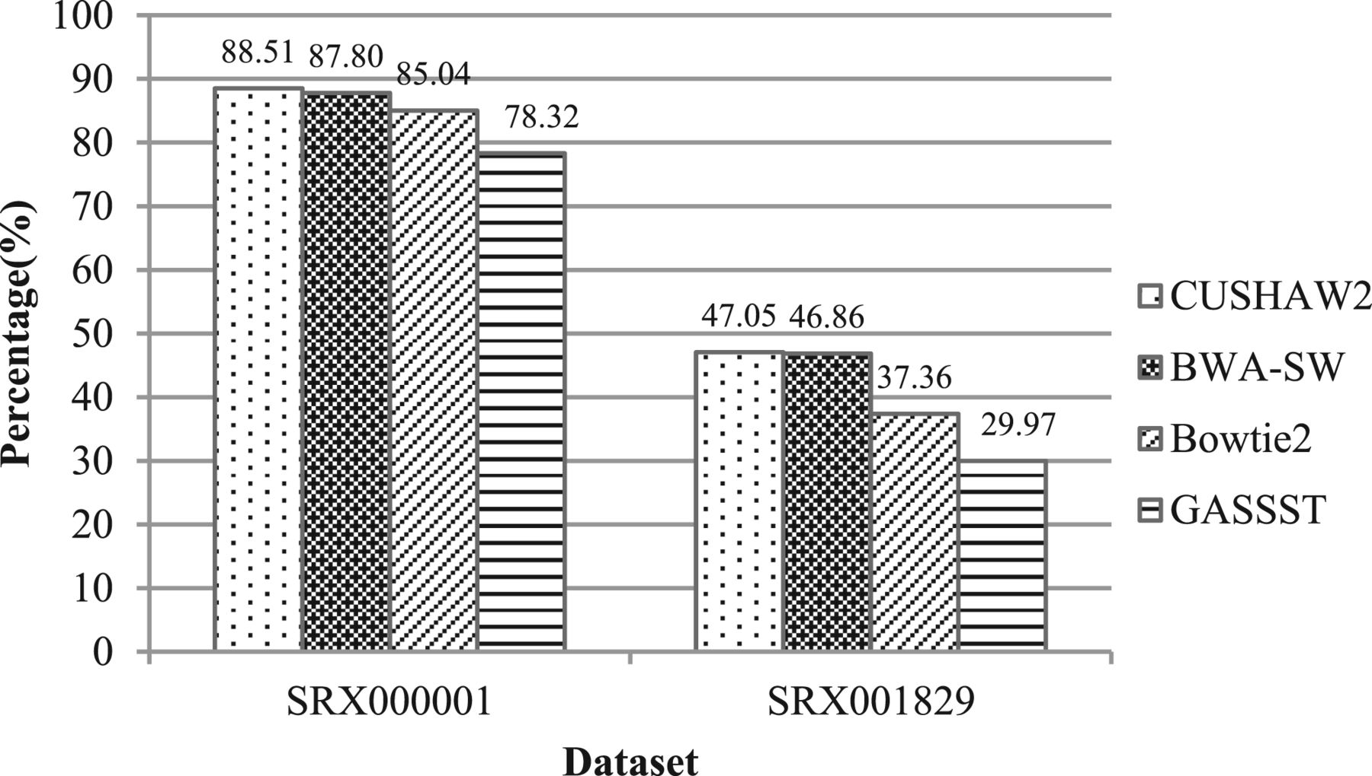
Fig. 2. Alignment results using the 454 datasets
Notes:
Fig. 2. Alignment results using the 454 datasets
Unless provided in the caption above, the following copyright applies to the content of this slide: © The Author(s) (2012). Published by Oxford University Press.This is an Open Access article distributed under the terms of the Creative Commons Attribution License (http://creativecommons.org/licenses/by/3.0), which permits unrestricted use, distribution, and reproduction in any medium, provided the original work is properly cited.

Slide 3
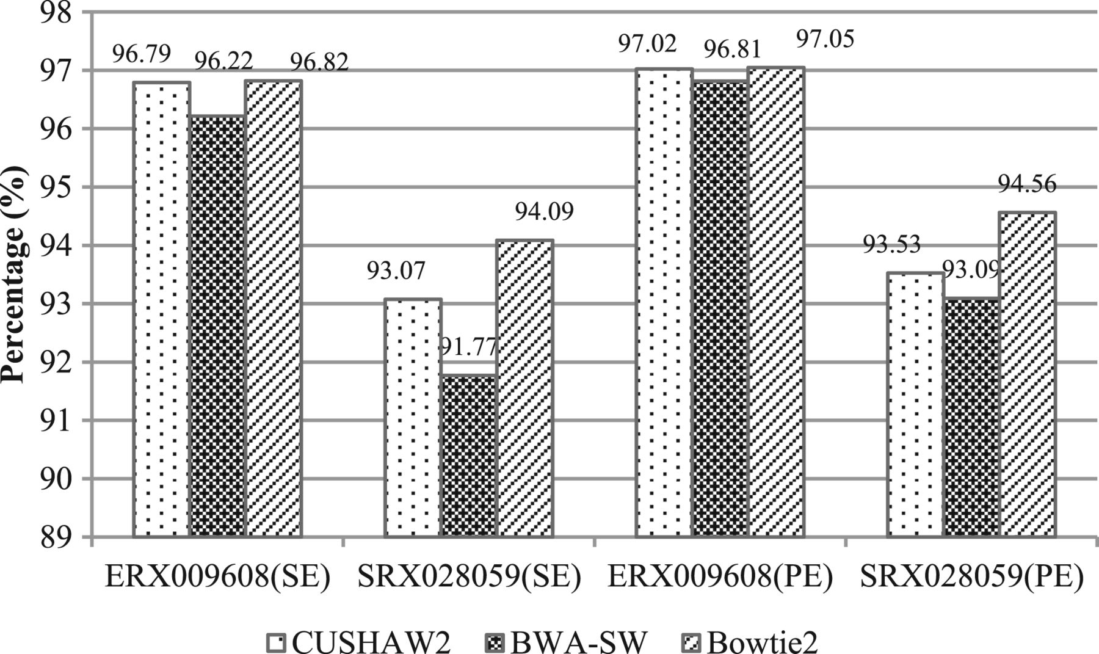
Fig. 3. Alignment results using the Illumina datasets
Notes:
Fig. 3. Alignment results using the Illumina datasets
Unless provided in the caption above, the following copyright applies to the content of this slide: © The Author(s) (2012). Published by Oxford University Press.This is an Open Access article distributed under the terms of the Creative Commons Attribution License (http://creativecommons.org/licenses/by/3.0), which permits unrestricted use, distribution, and reproduction in any medium, provided the original work is properly cited.

Slide 4
Fig. 4. Scalability comparison between all aligners for the SE and PE alignment
Notes:
Fig. 4. Scalability comparison between all aligners for the SE and PE alignment
Unless provided in the caption above, the following copyright applies to the content of this slide: © The Author(s) (2012). Published by Oxford University Press.This is an Open Access article distributed under the terms of the Creative Commons Attribution License (http://creativecommons.org/licenses/by/3.0), which permits unrestricted use, distribution, and reproduction in any medium, provided the original work is properly cited.

