Slide 1
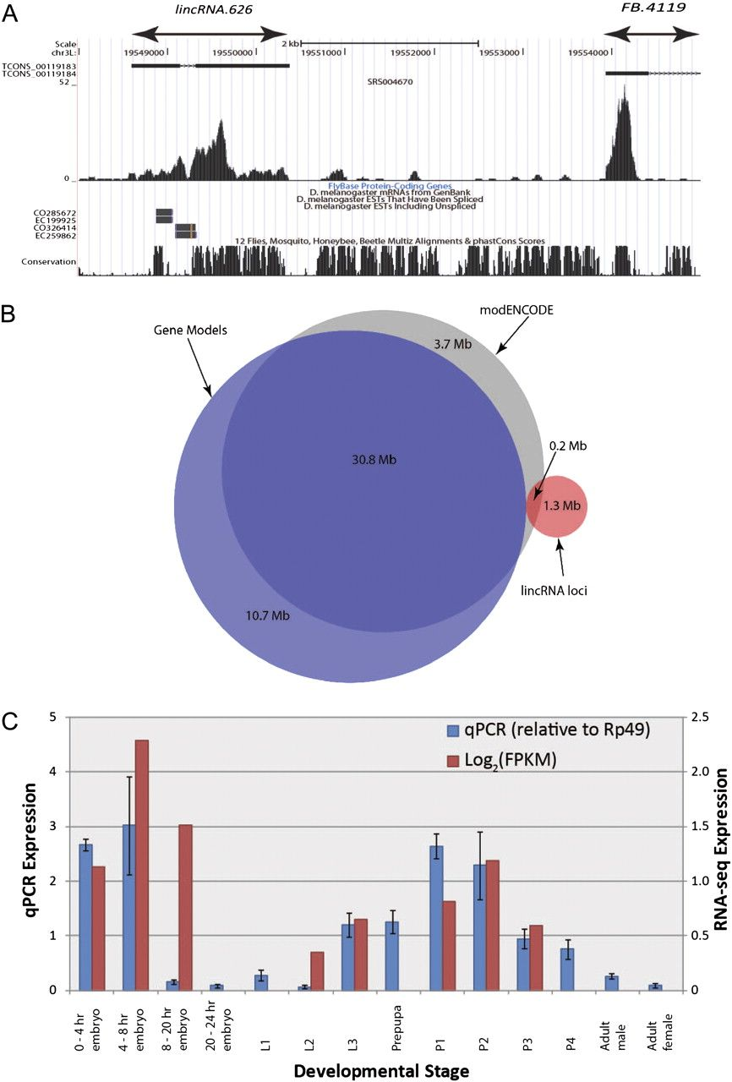
FIG. 1.— (A) Definition of genomically adjacent protein-coding gene model (FB.4119) and a novel putative lincRNA locus ...
Notes:
FIG. 1.— (A) Definition of genomically adjacent protein-coding gene model (FB.4119) and a novel putative lincRNA locus (lincRNA.626). The black boxes denote exons called by Cufflinks for this tissue, with arrowed lines representing introns separating exons within the same transcript. A histogram of read counts that support these models’ sequences is shown below (from embryonic tissues, 4–6 h after egg laying). Note that only Cufflinks transcripts >200 bp are displayed. At the foot of this UCSC genome browser snapshot (Kent et al. 2002) is the FlyBase annotation corresponding to FB.4119, supporting messenger RNAs and ESTs, and a PhastCons track showing genome sequence conservation across multiple arthropods. (B) Venn diagram showing strong overlap between modENCODE (Graveley et al. 2011) and gene model exons and a low degree (13%) of overlap between the lincRNA exons defined in this study and modENCODE exons. (C) Concordance of qRT–PCR data with stage-matched log2(FPKM) expression values from RNA-seq analysis for lincRNA.626. Mean log2(FPKM) values are calculated and plotted for qRT–PCR experiments which cover more than one modENCODE developmental time point. Error bars represent 95% confidence intervals for qRT–PCR.
Unless provided in the caption above, the following copyright applies to the content of this slide: © The Author(s) 2012. Published by Oxford University Press on behalf of the Society for Molecular Biology and Evolution.This is an Open Access article distributed under the terms of the Creative Commons Attribution Non-Commercial License (http://creativecommons.org/licenses/by-nc/3.0), which permits unrestricted non-commercial use, distribution, and reproduction in any medium, provided the original work is properly cited.

Slide 2
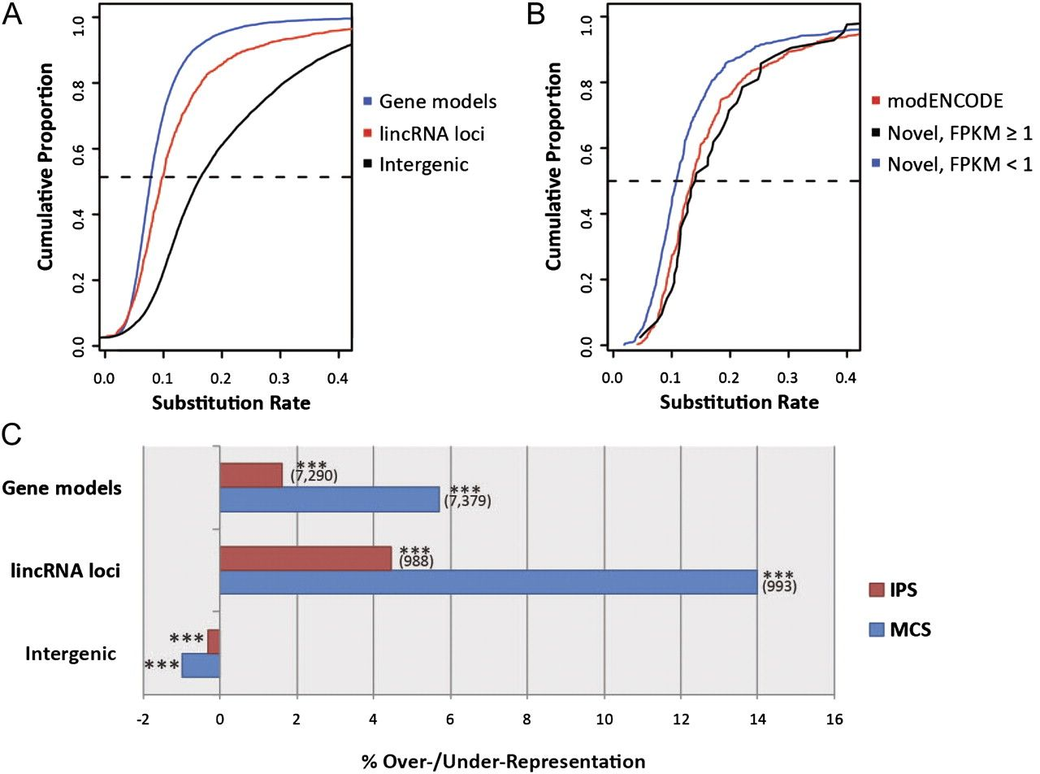
FIG. 2.— Evidence for substantial purifying selection acting on putative lincRNA sequences. (A) Cumulative frequency ...
Notes:
FIG. 2.— Evidence for substantial purifying selection acting on putative lincRNA sequences. (A) Cumulative frequency distributions of exonic nucleotide substitution rates when aligned between Drosophila melanogaster and D. yakuba: Substitution rates of gene models are indicated in blue, and those for lincRNA loci are in red. The black line plots the cumulative substitution rates for untranscribed intergenic regions. The dashed line indicates the 50th percentile. (B) Cumulative frequency distributions of exonic nucleotide substitution rates when aligned between D. melanogaster and D. yakuba for lincRNA loci identified by modENCODE (red), novel lincRNAs with a maximum FPKM ≥1 (black), and novel lincRNAs with a maximum FPKM <1. (C) Enrichments or deficits of conserved sequence (indel-purified segments, in red, and MCS, in blue) within exonic sequences from gene models and lincRNA loci, and intergenic space, relative to genome-wide random expectations (***P < 0.001). Numbers of gene models and lincRNA loci overlapping each conserved sequence type are displayed in brackets
Unless provided in the caption above, the following copyright applies to the content of this slide: © The Author(s) 2012. Published by Oxford University Press on behalf of the Society for Molecular Biology and Evolution.This is an Open Access article distributed under the terms of the Creative Commons Attribution Non-Commercial License (http://creativecommons.org/licenses/by-nc/3.0), which permits unrestricted non-commercial use, distribution, and reproduction in any medium, provided the original work is properly cited.

Slide 3
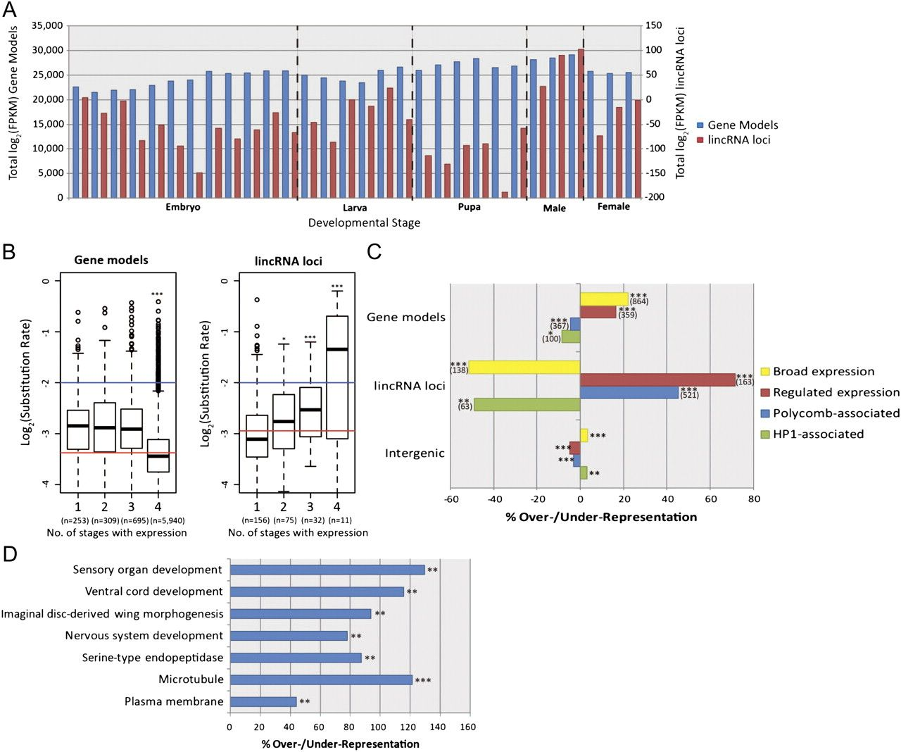
FIG. 3.— (A) Expression levels of gene models and putative lincRNA loci across 30 developmental time points. Summed ...
Notes:
FIG. 3.— (A) Expression levels of gene models and putative lincRNA loci across 30 developmental time points. Summed log2(FPKM) values for each time point are plotted for gene models (left vertical axis) and lincRNA loci (right axis). (B) Box and whiskers plots of log2(substitution rates) for gene models (left) and lincRNA loci (right) for increasing breadth of expression across one or more of four developmental stages (linear regression, ***P < 0.001). Red lines indicate log2(mean substitution rate) for the genes examined here. Blue lines indicate the log2(mean substitution rate) for presumed neutrally evolving short introns. Note that only genes and lincRNAs that are expressed at greater than 1 FPKM in at least one developmental stage are graphed here. (C) Enrichments or deficits of different chromatin types within gene models, lincRNA loci, and untranscribed intergenic sequence relative to genome-wide random expectations (*P < 0.05, **P < 0.01, and ***P < 0.001). Numbers of gene models and lincRNA loci overlapping each chromatin type are displayed in brackets. Repressive (“Black”) chromatin is depleted approximately 8% for both lincRNAs and gene models and modestly (0.6%) enriched in intergenic regions. (D) GO terms with associated protein-coding gene territories, which contain a significantly greater than expected density of lincRNA loci using a genome-wide association test (P < 0.01, FDR < 0.6). The top two terms are “cellular component” terms, whereas “serine-type endopeptidase activity” is a “molecular function” term and remaining terms are drawn from the “biological process” ontology.
Unless provided in the caption above, the following copyright applies to the content of this slide: © The Author(s) 2012. Published by Oxford University Press on behalf of the Society for Molecular Biology and Evolution.This is an Open Access article distributed under the terms of the Creative Commons Attribution Non-Commercial License (http://creativecommons.org/licenses/by-nc/3.0), which permits unrestricted non-commercial use, distribution, and reproduction in any medium, provided the original work is properly cited.

Slide 4
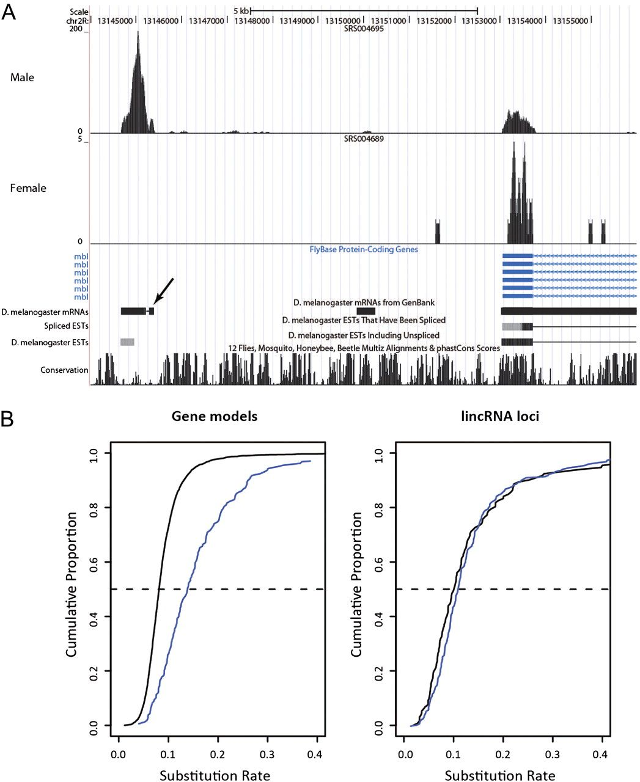
FIG. 4.— (A) Example UCSC genome browser view of a spliced putative lincRNA locus in the vicinity of the mbl ...
Notes:
FIG. 4.— (A) Example UCSC genome browser view of a spliced putative lincRNA locus in the vicinity of the mbl protein-coding gene which has read support for expression in one sex but not the other. The small exon at the right of the lincRNA (indicated by an arrow) is supported by messenger RNA but not EST evidence and has been annotated by Graveley et al. as a protein-coding gene (CG43108). Note that this annotation has not been added to the UCSC genome browser. (B) Cumulative distributions of the nucleotide substitution rate for gene models (left) and lincRNA loci (right) with different sex-specific expression profiles. Blue—male-specific; solid black—no sex specificity. The dashed line indicates the 50th percentile.
Unless provided in the caption above, the following copyright applies to the content of this slide: © The Author(s) 2012. Published by Oxford University Press on behalf of the Society for Molecular Biology and Evolution.This is an Open Access article distributed under the terms of the Creative Commons Attribution Non-Commercial License (http://creativecommons.org/licenses/by-nc/3.0), which permits unrestricted non-commercial use, distribution, and reproduction in any medium, provided the original work is properly cited.

Slide 5
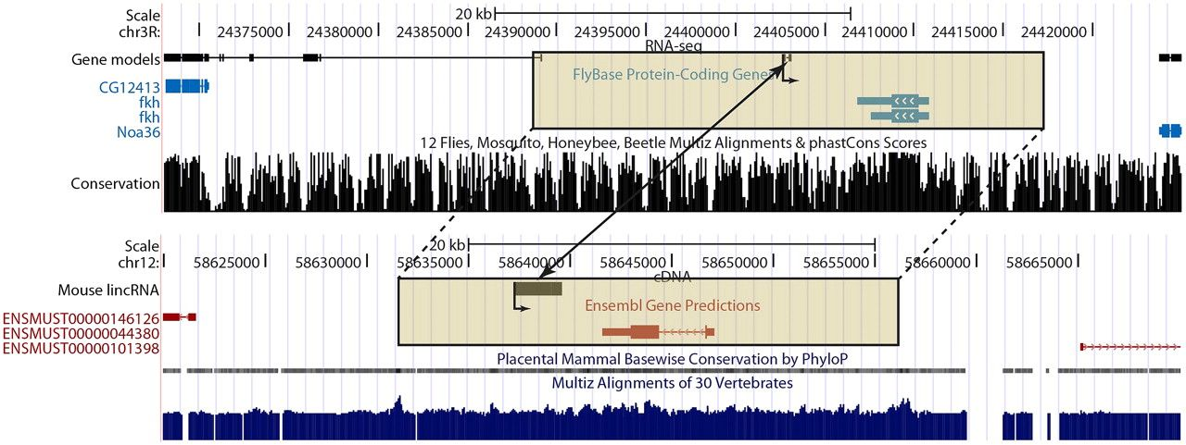
FIG. 5.— An example of positionally equivalent putative lincRNA loci in both Drosophila melanogaster and Mus. ...
Notes:
FIG. 5.— An example of positionally equivalent putative lincRNA loci in both Drosophila melanogaster and Mus. musculus. The arrows within the protein-coding gene models and originating at the lincRNA transcriptional start sites indicate the shared orientation of transcription in both species. The boxed genomic regions indicate the orthologous protein-coding gene neighborhoods for D. melanogaster (fkh) and M. musculus (Foxa1). Note that only multiexonic transcripts are shown for the D. melanogaster gene models. The positionally equivalent lincRNA loci are indicated by the two-headed arrow.
Unless provided in the caption above, the following copyright applies to the content of this slide: © The Author(s) 2012. Published by Oxford University Press on behalf of the Society for Molecular Biology and Evolution.This is an Open Access article distributed under the terms of the Creative Commons Attribution Non-Commercial License (http://creativecommons.org/licenses/by-nc/3.0), which permits unrestricted non-commercial use, distribution, and reproduction in any medium, provided the original work is properly cited.

