Slide 1
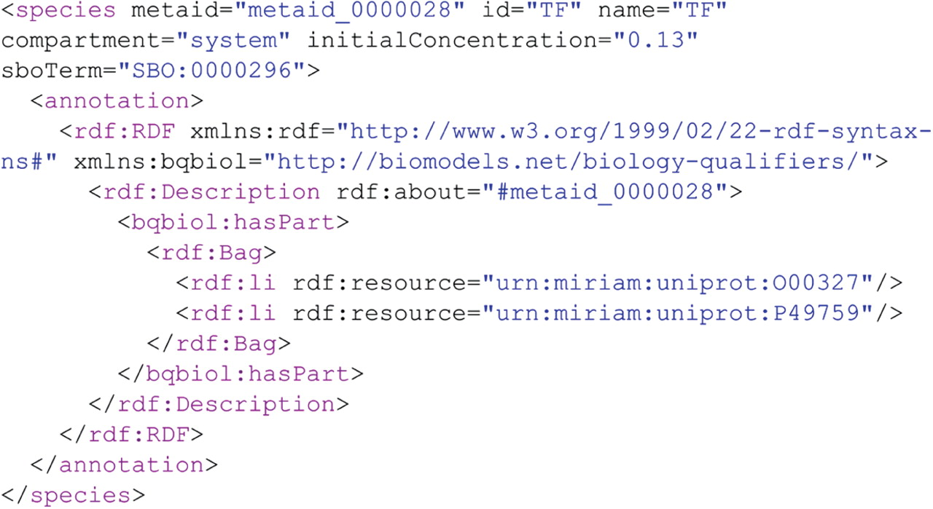
Figure 1: Piece of the SBML encoded model from Hong CI. Please note the usage of SBO terms and MIRIAM URIs in the ...
Notes:
Figure 1: Piece of the SBML encoded model from Hong CI. Please note the usage of SBO terms and MIRIAM URIs in the annotation of the model components.
Unless provided in the caption above, the following copyright applies to the content of this slide: © The Author 2009. Published by Oxford University Press. For Permissions, please email: journals.permissions@oxfordjournals.org

Slide 2
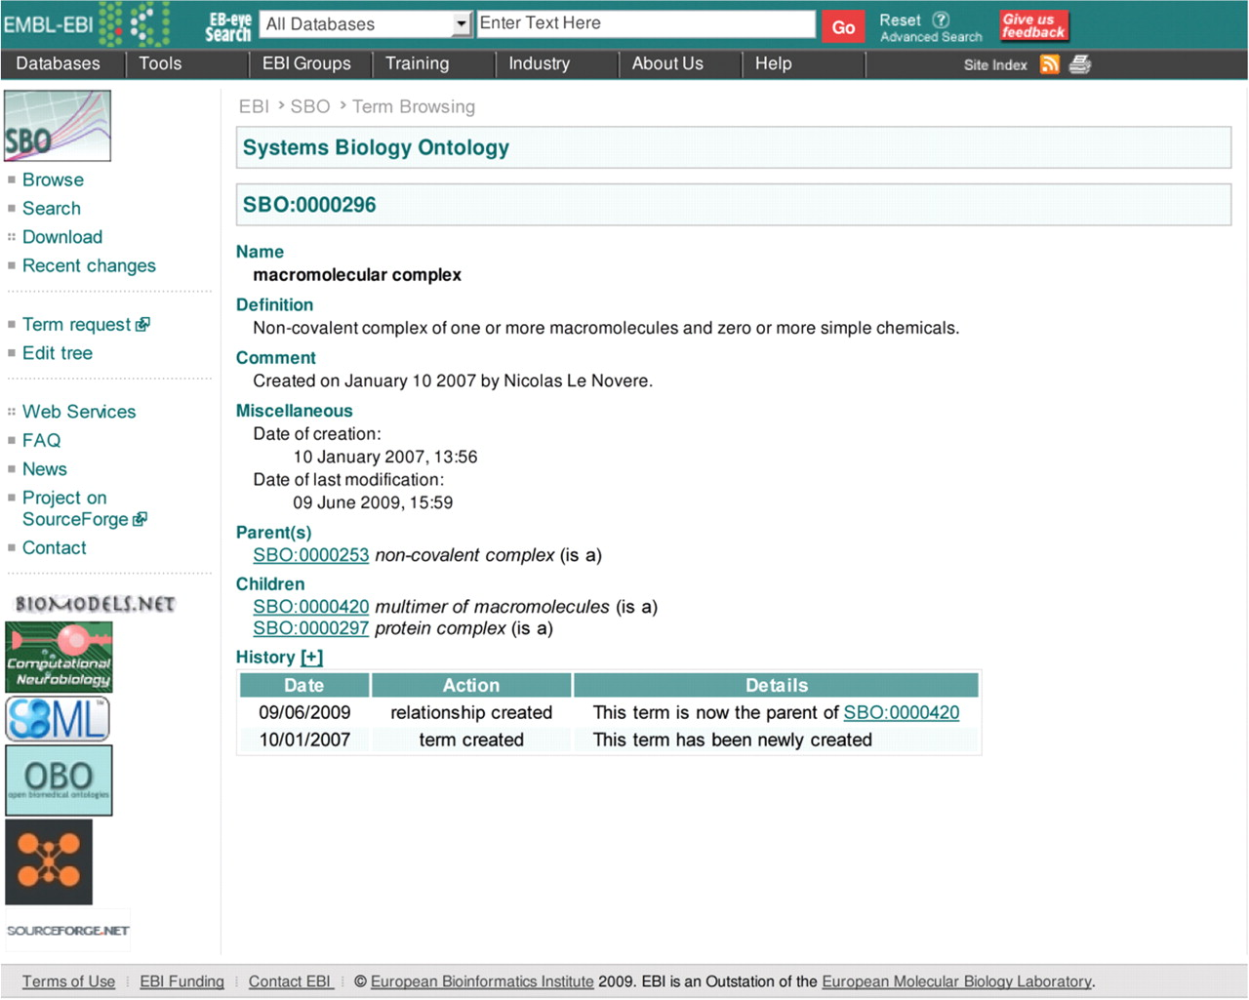
Figure 2: Details of the SBO term: macromolecular complex (SBO:0000296).
Notes:
Figure 2: Details of the SBO term: macromolecular complex (SBO:0000296).
Unless provided in the caption above, the following copyright applies to the content of this slide: © The Author 2009. Published by Oxford University Press. For Permissions, please email: journals.permissions@oxfordjournals.org

Slide 3
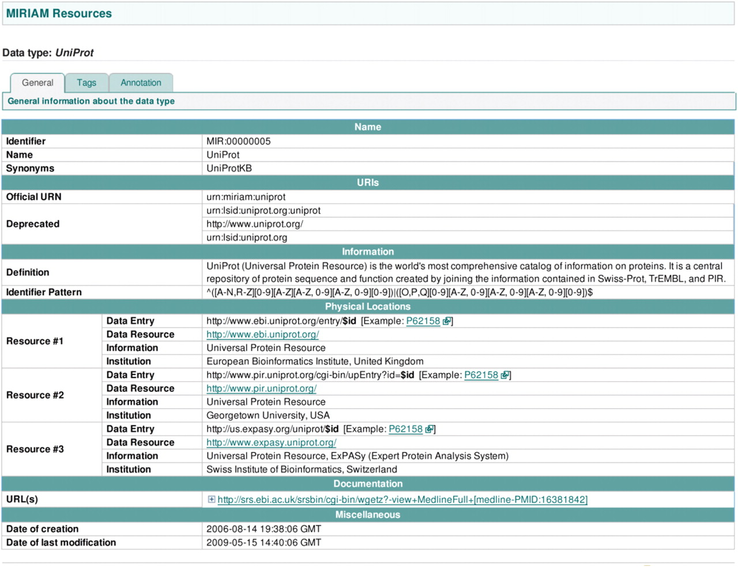
Figure 3: Uniprot record from MIRIAM Resources: there are three different resources or physical locations where the ...
Notes:
Figure 3: Uniprot record from MIRIAM Resources: there are three different resources or physical locations where the data about this dataset is stored and can be retrieved.
Unless provided in the caption above, the following copyright applies to the content of this slide: © The Author 2009. Published by Oxford University Press. For Permissions, please email: journals.permissions@oxfordjournals.org

