Slide 1
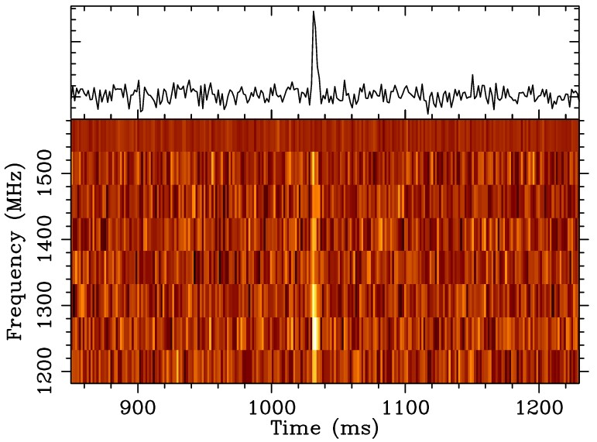
Figure 1. The pulse profile and dynamic spectrum of FRB 140514 with pulse width 2.8$^{+3.5}_{-0.7}$ ms, dedispersed to ...
Notes:
Figure 1. The pulse profile and dynamic spectrum of FRB 140514 with pulse width 2.8$^{+3.5}_{-0.7}$ ms, dedispersed to DM = 562.7 pc cm−3 and summed to eight frequency channels across the band. The total time plotted has been reduced to 400 ms for greater clarity. Frequency channels between 1520 and 1580 MHz are excised due to narrow-band radio interference from the Thuraya 3 satellite which transmits in this band.
Unless provided in the caption above, the following copyright applies to the content of this slide: © 2014 The Authors Published by Oxford University Press on behalf of the Royal Astronomical Society

Slide 2
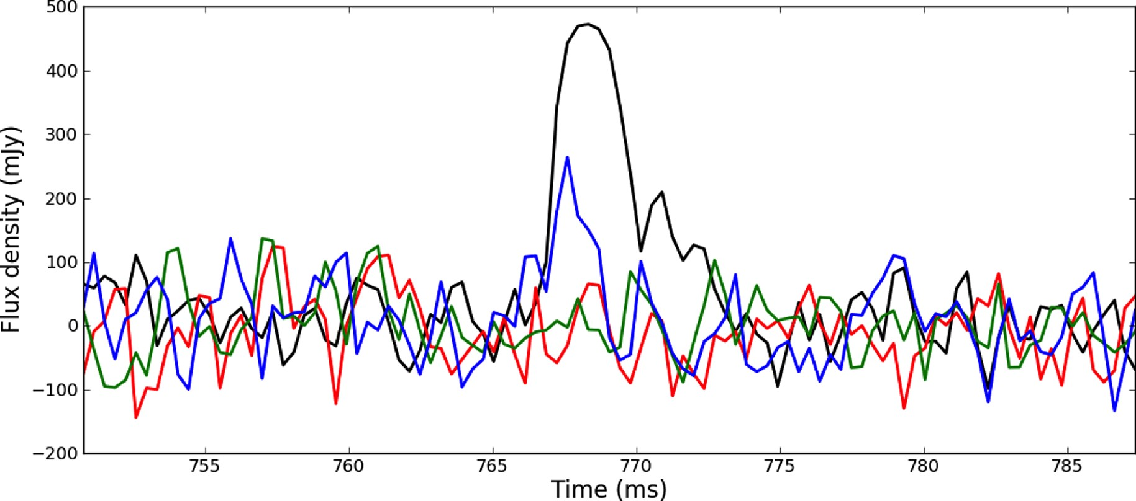
Figure 2. The full-Stokes parameters of FRB 140514 recorded in the centre beam of the multibeam receiver with BPSR. ...
Notes:
Figure 2. The full-Stokes parameters of FRB 140514 recorded in the centre beam of the multibeam receiver with BPSR. Total intensity, and Stokes Q, U, and V are represented in black, red, green, and blue, respectively. FRB 140514 has 21 ± 7 per cent (3σ) circular polarization averaged over the pulse, and a 1σ upper limit on linear polarization of L < 10 per cent. On the leading edge of the pulse the circular polarization is 42 ± 9 per cent (5σ) of the total intensity. The data have been smoothed from an initial sampling of 64 μs using a Gaussian filter of FWHM 90 μs.
Unless provided in the caption above, the following copyright applies to the content of this slide: © 2014 The Authors Published by Oxford University Press on behalf of the Royal Astronomical Society

Slide 3
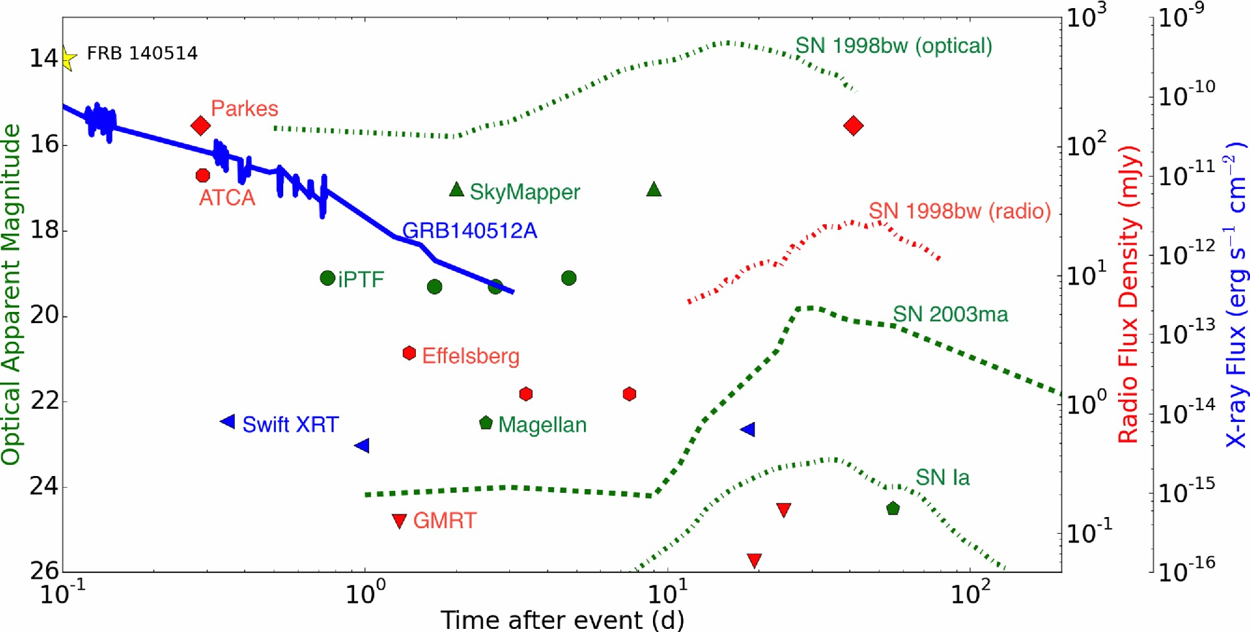
Figure 3. The limits for optical in apparent magnitude (green), radio flux density in mJy (red), and X-ray flux in ...
Notes:
Figure 3. The limits for optical in apparent magnitude (green), radio flux density in mJy (red), and X-ray flux in erg cm−2 s−1 (blue) of our observations of the field of FRB 140514 from eight telescopes that fully sampled the Parkes beam. Colours of data points refer to the axis scale of the same colour. Light curves from GRB140512A (z = 0.725), 1.4 GHz radio data and R-band optical data for supernova SN1998bw (z ∼ 0.008), R-band data for SLSN SN2003ma (z = 0.289) and an R-band light curve for a typical Type Ia SN (z = 0.5) have been included for reference (Galama et al. 1998; Evans et al. 2007; Rest et al. 2011; Kulkarni et al. 2014).
Unless provided in the caption above, the following copyright applies to the content of this slide: © 2014 The Authors Published by Oxford University Press on behalf of the Royal Astronomical Society

