Slide 1
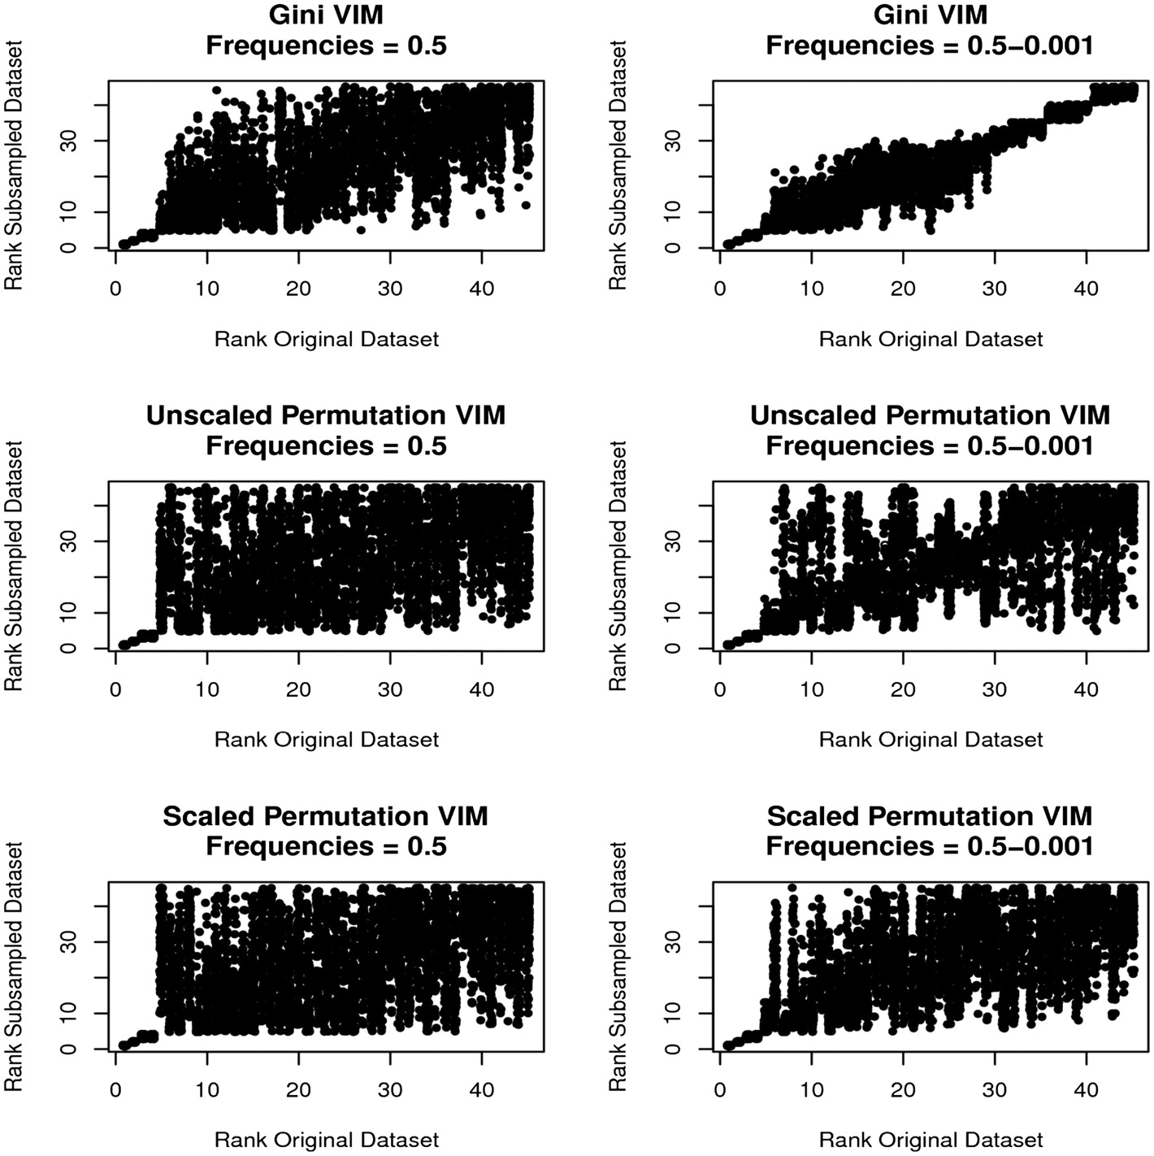
Figure 1: MDG, MDA and MDA_{scaled} rankings of predictors in 100 90% subsamples versus rankings from the full ...
Notes:
Figure 1: MDG, MDA and MDAscaled rankings of predictors in 100 90% subsamples versus rankings from the full data set with equal and varying predictor category frequencies. Left column: ranks for five associated predictors with minor category frequencies of 0.5; right column: ranks for five associated and 40 unassociated predictors with frequencies ranging from 0.5 to 0.001. Top row: MDG; middle row: MDA; bottom row: MDAscaled.
Unless provided in the caption above, the following copyright applies to the content of this slide: © The Author 2011. Published by Oxford University Press. For Permissions, please email: journals.permissions@oup.com

Slide 2
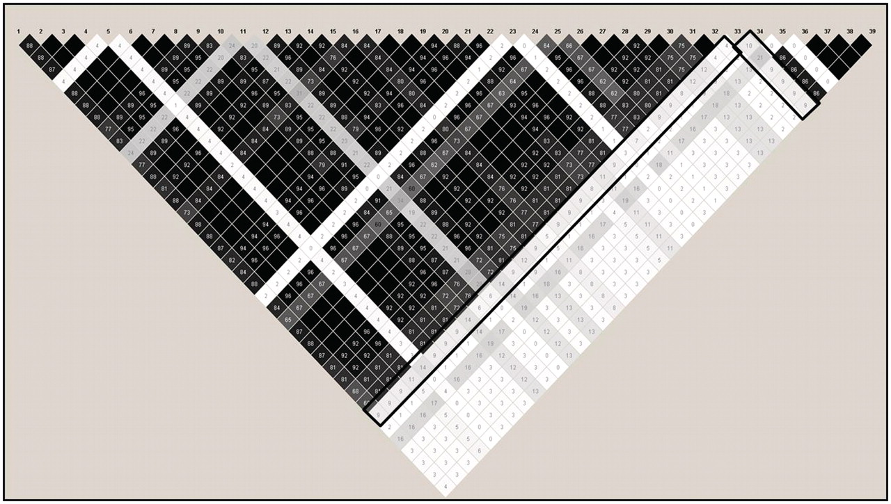
Figure 2: LD plot for the top-ranked SNP using MDG under H₀. Black box around pairwise correlation ...
Notes:
Figure 2: LD plot for the top-ranked SNP using MDG under H0. Black box around pairwise correlation (r2) values for the top-ranked SNP using MDG. Shading indicates strength of r2 values, with black indicating perfect LD (r2 of 1.0) and white boxes indicating no correlation (r2 = 0). Grey boxes indicate intermediate values.
Unless provided in the caption above, the following copyright applies to the content of this slide: © The Author 2011. Published by Oxford University Press. For Permissions, please email: journals.permissions@oup.com

Slide 3
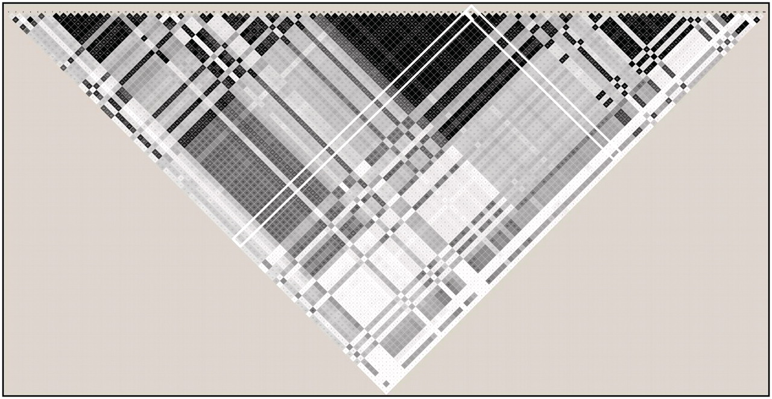
Figure 3: LD plot for the truly associated SNP under H_{A}. White box around pairwise correlation ...
Notes:
Figure 3: LD plot for the truly associated SNP under HA. White box around pairwise correlation (r2) values for the truly associated SNP under HA. Shading indicates strength of r2 values, with black indicating perfect LD (r2 = 1.0) and white boxes indicating no correlation (r2 = 0). Grey boxes indicate intermediate values.
Unless provided in the caption above, the following copyright applies to the content of this slide: © The Author 2011. Published by Oxford University Press. For Permissions, please email: journals.permissions@oup.com

