Slide 1
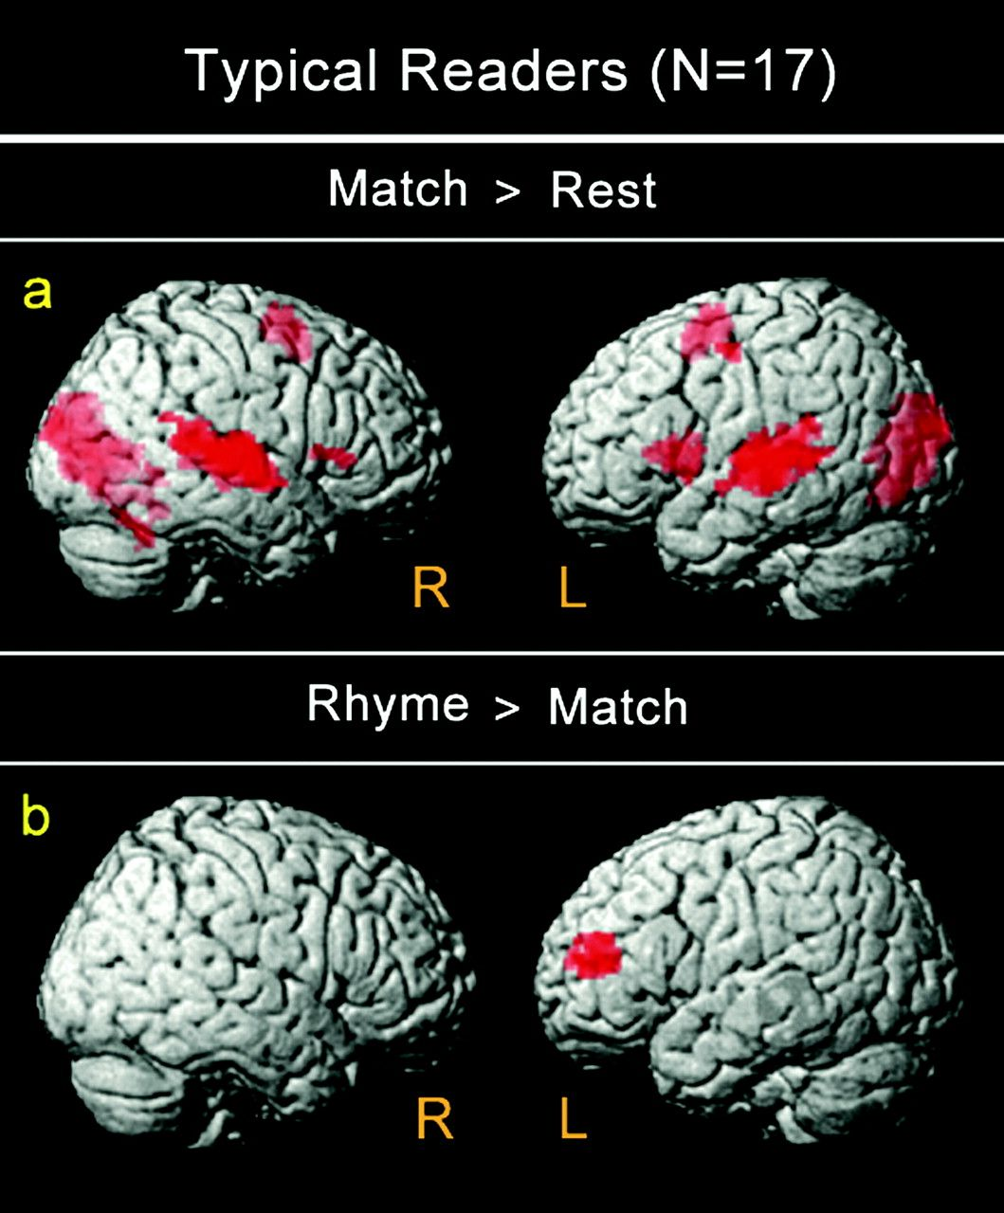
Figure 1. Brain activation for typically developing readers (Experiment 1a) during (a) Match > Rest and (b) Rhyme > ...
Notes:
Figure 1. Brain activation for typically developing readers (Experiment 1a) during (a) Match > Rest and (b) Rhyme > Match.
Unless provided in the caption above, the following copyright applies to the content of this slide: © The Author 2011. Published by Oxford University Press. All rights reserved. For permissions, please e-mail: journals.permissions@oup.com

Slide 2
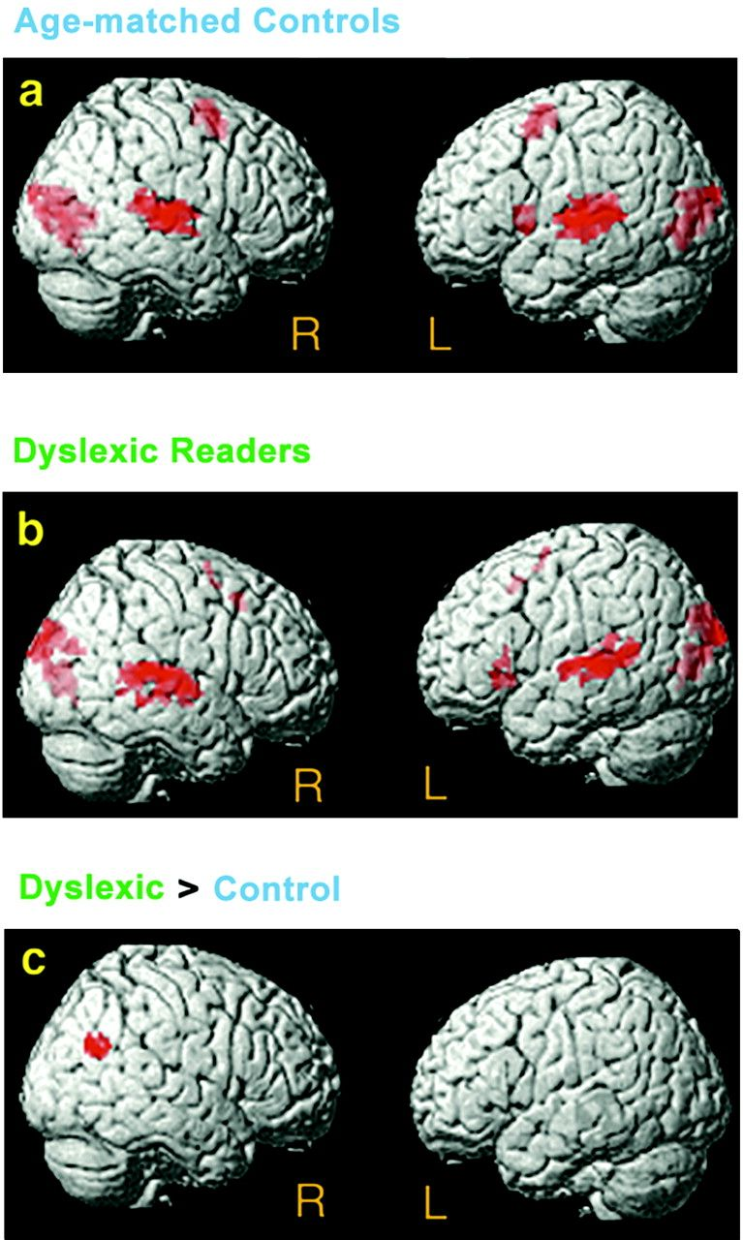
Figure 2. Activation for Match > Rest (Experiment 1b). (a) Typically reading age-matched controls (n = 12) and (b) ...
Notes:
Figure 2. Activation for Match > Rest (Experiment 1b). (a) Typically reading age-matched controls (n = 12) and (b) children with dyslexia (n = 12) showed activations in bilateral superior temporal gyri, left insular cortex/frontal gyrus, medial frontal, and bilateral occipital/cuneus regions. (c) Children with dyslexia exhibited significantly greater right temporoparietal activation as compared with age-matched controls.
Unless provided in the caption above, the following copyright applies to the content of this slide: © The Author 2011. Published by Oxford University Press. All rights reserved. For permissions, please e-mail: journals.permissions@oup.com

Slide 3
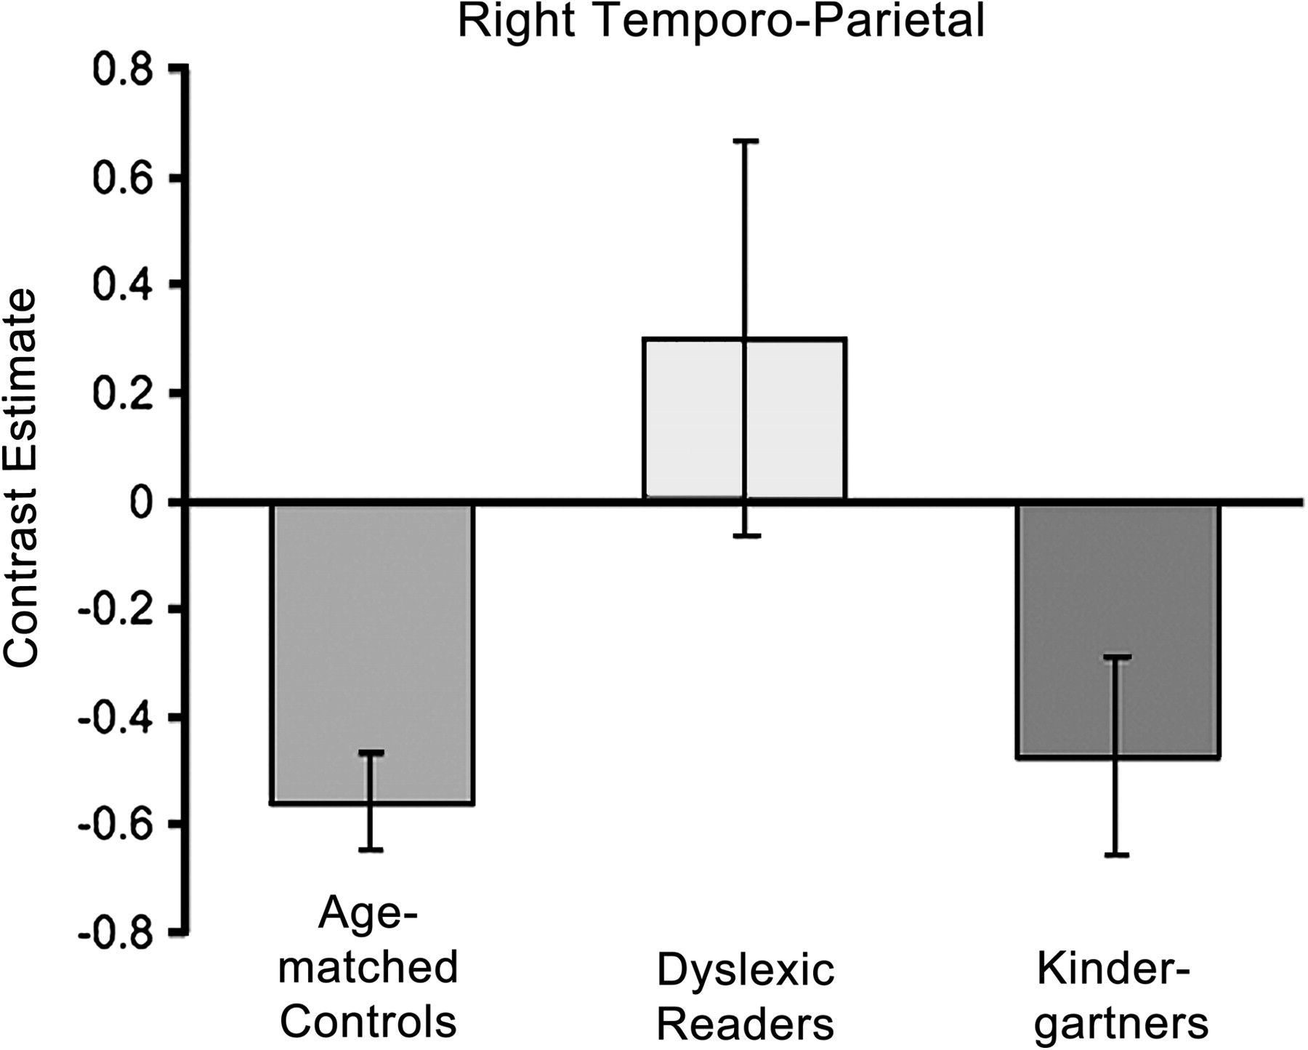
Figure 3. Mean contrast estimates for right temporoparietal region of difference between children with dyslexia and ...
Notes:
Figure 3. Mean contrast estimates for right temporoparietal region of difference between children with dyslexia and age-matched controls for Match > Rest (Experiment 1b). Kindergarteners showed deactivation similar in magnitude to typical readers. Error bars represent the standard error of the mean.
Unless provided in the caption above, the following copyright applies to the content of this slide: © The Author 2011. Published by Oxford University Press. All rights reserved. For permissions, please e-mail: journals.permissions@oup.com

Slide 4
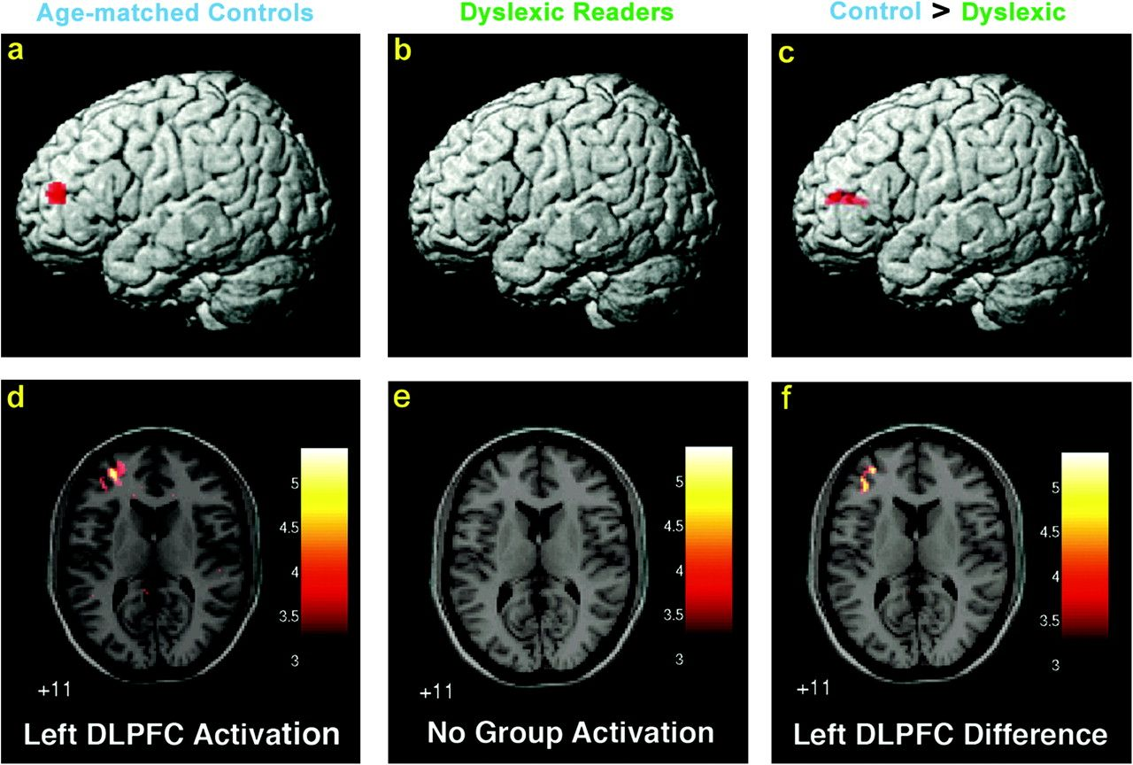
Figure 4. Activation for Rhyme > Match (Experiment 1b). Lateral (top row—a, b, and c) and axial views (bottom row—d, e, ...
Notes:
Figure 4. Activation for Rhyme > Match (Experiment 1b). Lateral (top row—a, b, and c) and axial views (bottom row—d, e, and f). (a, d) Age-matched controls (n = 12). (b, e) Children with dyslexia (n = 12). (c, f) Children with dyslexia exhibited significantly less activation in left DLPFC as compared with age-matched controls.
Unless provided in the caption above, the following copyright applies to the content of this slide: © The Author 2011. Published by Oxford University Press. All rights reserved. For permissions, please e-mail: journals.permissions@oup.com

Slide 5
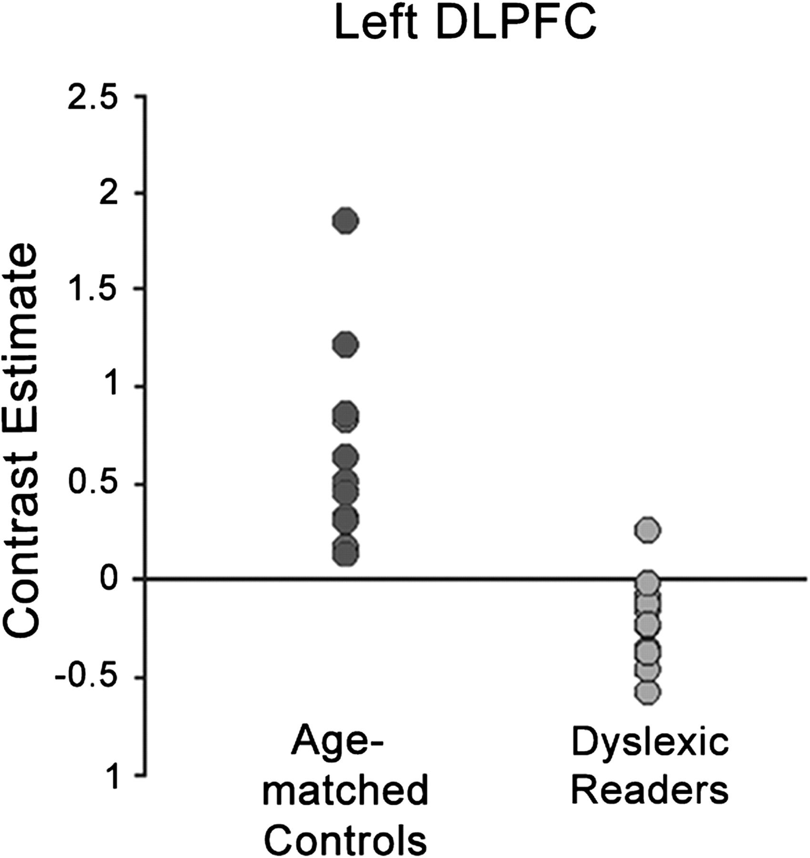
Figure 5. Mean contrast values for each typically reading age-matched control child and each child with dyslexia in the ...
Notes:
Figure 5. Mean contrast values for each typically reading age-matched control child and each child with dyslexia in the left DLPFC region of difference between the 2 groups for Rhyme > Match. All 12 age-matched controls showed activation, but only 1 of 12 children with dyslexia showed activation (Experiment 1b).
Unless provided in the caption above, the following copyright applies to the content of this slide: © The Author 2011. Published by Oxford University Press. All rights reserved. For permissions, please e-mail: journals.permissions@oup.com

Slide 6
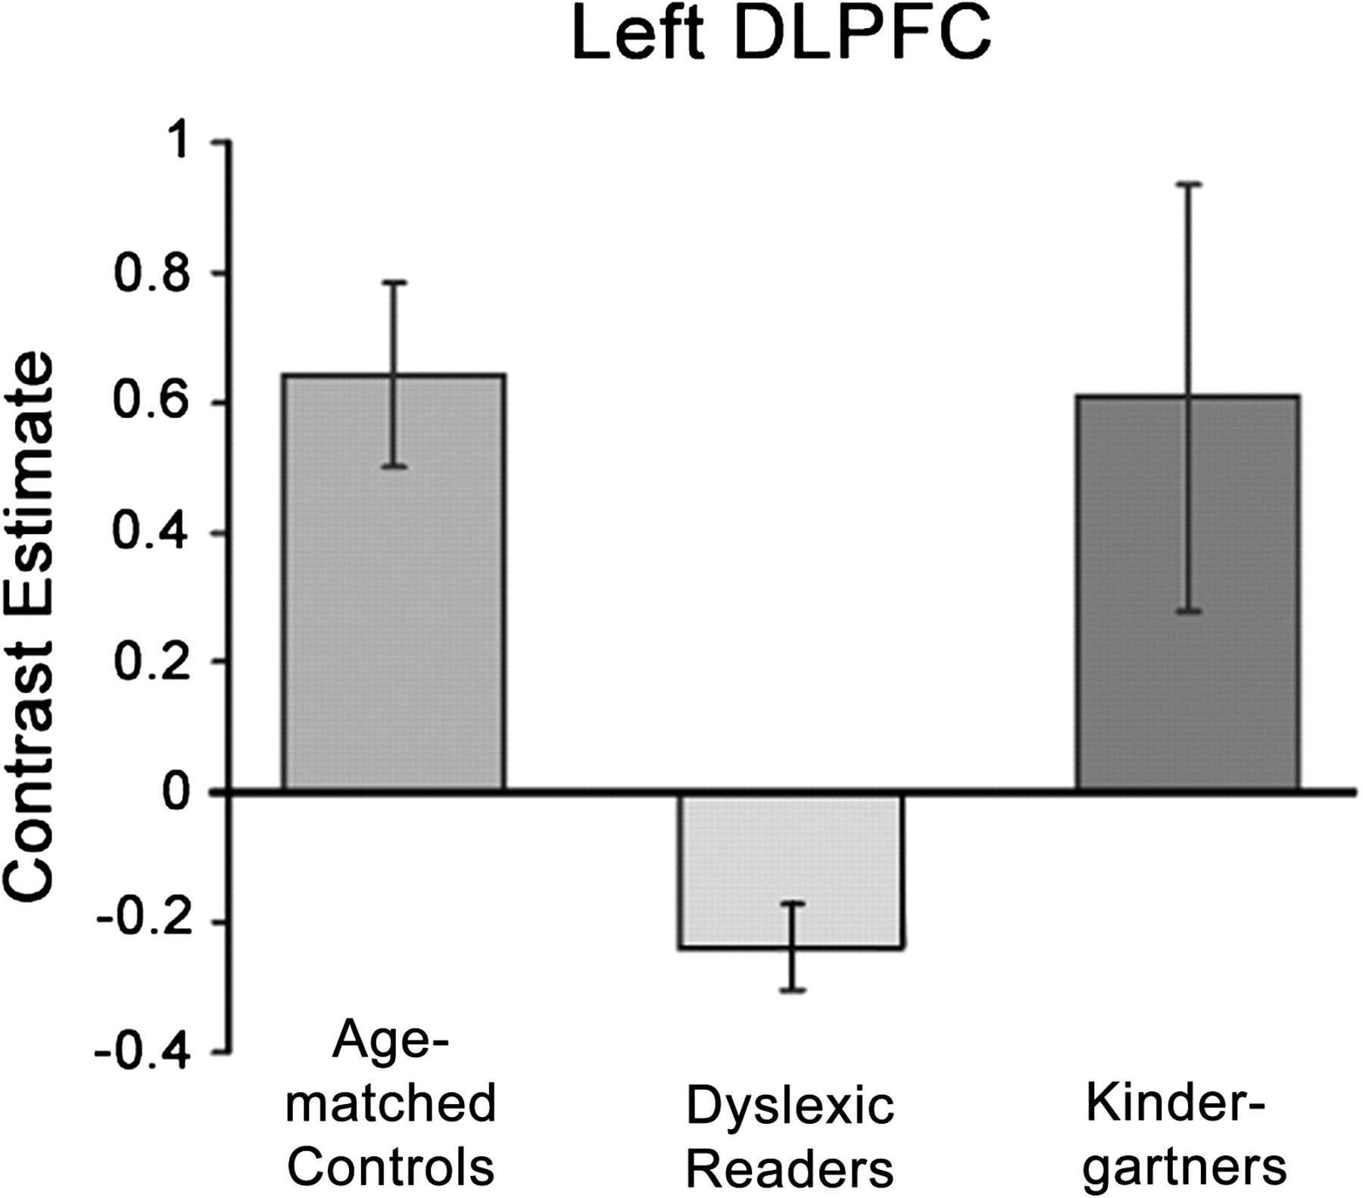
Figure 6. Mean contrast estimates for left DLPFC region of difference between children with dyslexia and age-matched ...
Notes:
Figure 6. Mean contrast estimates for left DLPFC region of difference between children with dyslexia and age-matched controls for Rhyme > Match (Experiment 1b). Kindergarteners showed activation similar in magnitude to typical readers. Error bars represent the standard error of the mean.
Unless provided in the caption above, the following copyright applies to the content of this slide: © The Author 2011. Published by Oxford University Press. All rights reserved. For permissions, please e-mail: journals.permissions@oup.com

Slide 7
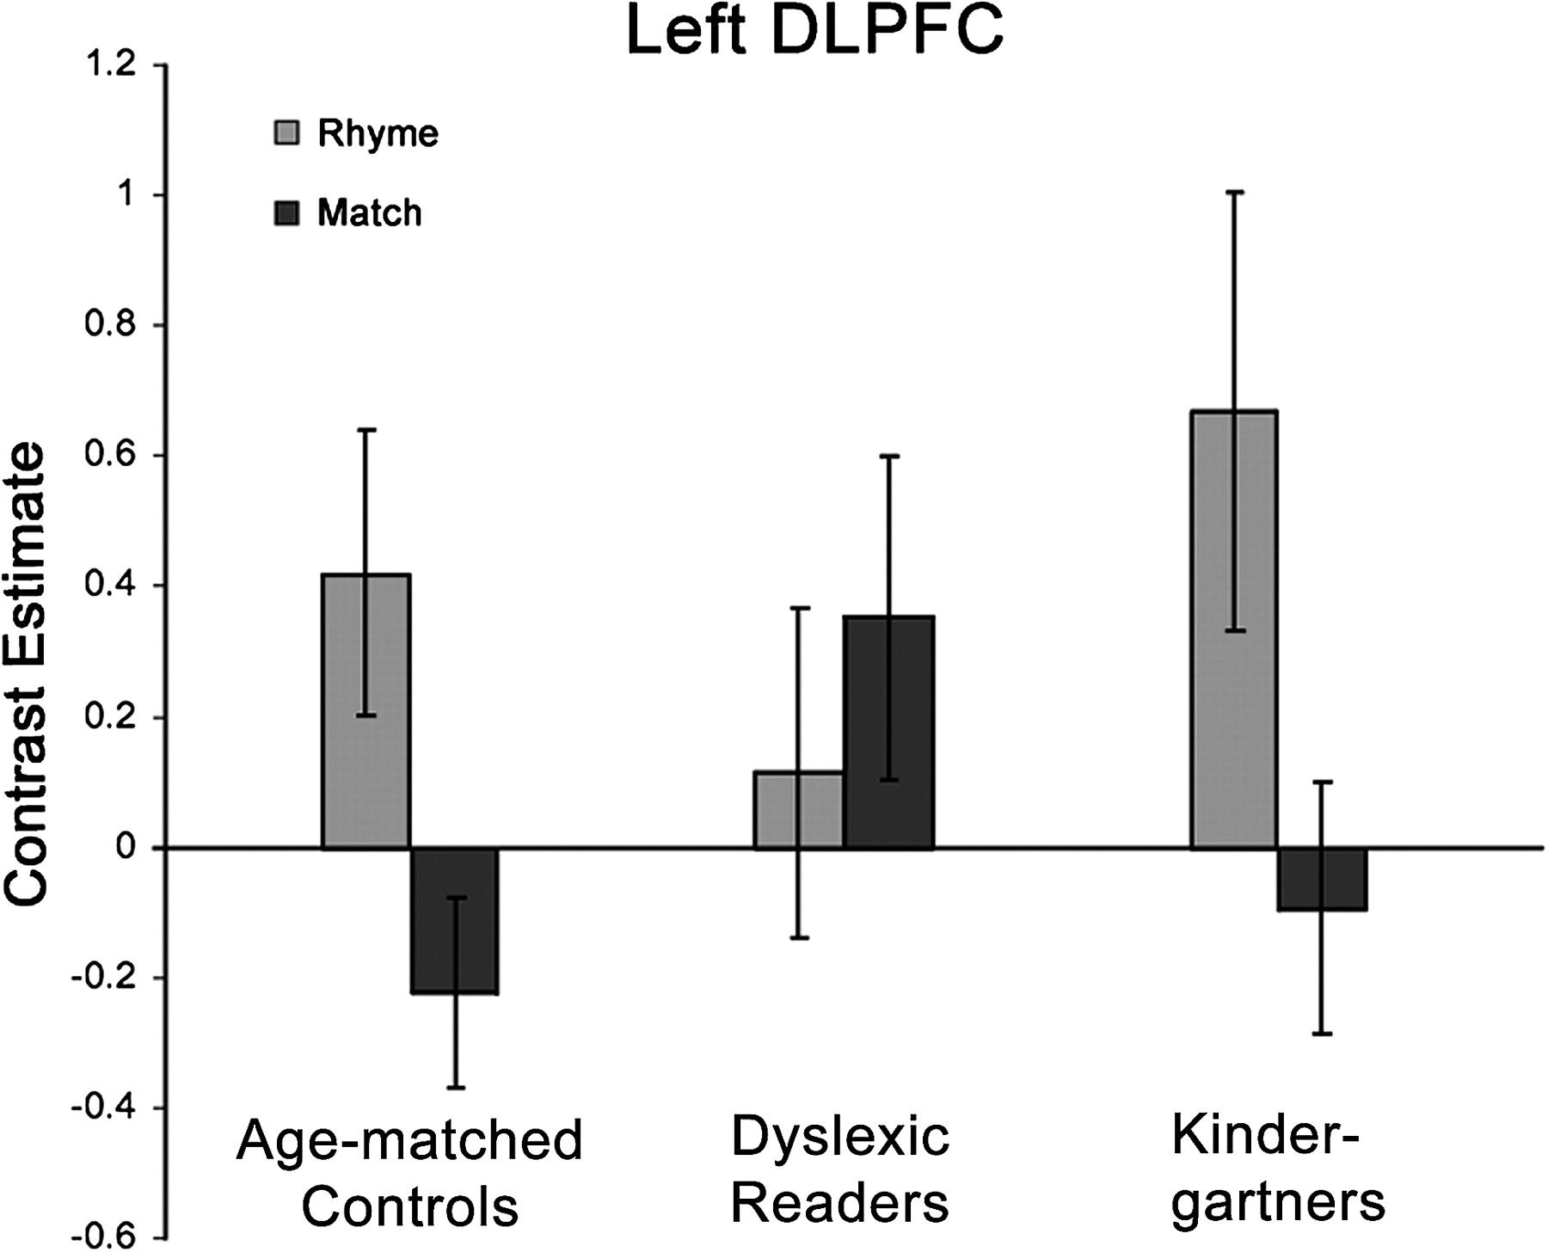
Figure 7. Mean contrast estimates for Rhyme > Rest and Match > Rest in the left DLPFC region of difference between ...
Notes:
Figure 7. Mean contrast estimates for Rhyme > Rest and Match > Rest in the left DLPFC region of difference between children with dyslexia and age-matched controls for Rhyme > Match contrast (Experiment 1b). Age-matched controls and kindergarteners showed a similar pattern of greater activation for Rhyme than Rest and greater activation for Rest than Match conditions. Children with dyslexia showed a reverse pattern of greater activation for Match than both Rhyme and Rest. Error bars represent the standard error of the mean.
Unless provided in the caption above, the following copyright applies to the content of this slide: © The Author 2011. Published by Oxford University Press. All rights reserved. For permissions, please e-mail: journals.permissions@oup.com

