Slide 1
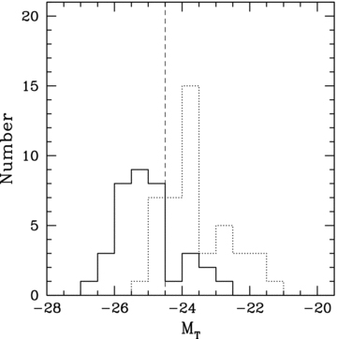
Figure 1 Distribution of total absolute magnitude (M_{T}) in K band for our sample (solid line) and for BAM06 ...
Notes:
Figure 1 Distribution of total absolute magnitude (MT) in K band for our sample (solid line) and for BAM06 lenticulars (dotted line). The vertical dashed line corresponds to total absolute magnitude MT=−24.5, which we use to divide low- and high-luminosity lenticulars.
Unless provided in the caption above, the following copyright applies to the content of this slide: © 2009 The Authors. Journal compilation © 2009 RAS

Slide 2
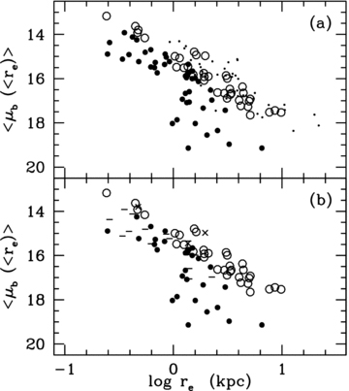
Figure 2 Dependence of the mean surface brightness within bulge effective radius (〈μ_{b}(<r_{e})〉) on ...
Notes:
Figure 2 Dependence of the mean surface brightness within bulge effective radius (〈μb(<re)〉) on bulge effective radius re (a) for bright (as open circles) and faint lenticulars (filled circles). Coma ellipticals (as dots) are overplotted for comparison. (b) for bright lenticulars with bars (as crosses) and faint lenticulars with bars (as dashed) as classified in RC3 catalogue.
Unless provided in the caption above, the following copyright applies to the content of this slide: © 2009 The Authors. Journal compilation © 2009 RAS

Slide 3
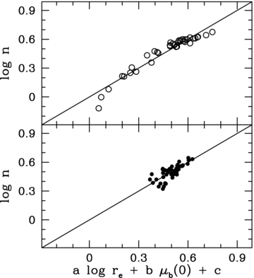
Figure 3 An edge-on view of the PP for lenticulars. Top panel: PP for bright lenticulars; log n= 0.251 ± 0.045 log ...
Notes:
Figure 3 An edge-on view of the PP for lenticulars. Top panel: PP for bright lenticulars; log n= 0.251 ± 0.045 log re− 0.094 ± 0.012 μb(0) + 1.377 ± 0.138. Bottom panel: PP for faint lenticulars; log n= 0.185 ± 0.029, log re− 0.041 ± 0.004 μb(0) + 0.935 ± 0.046.
Unless provided in the caption above, the following copyright applies to the content of this slide: © 2009 The Authors. Journal compilation © 2009 RAS

Slide 4
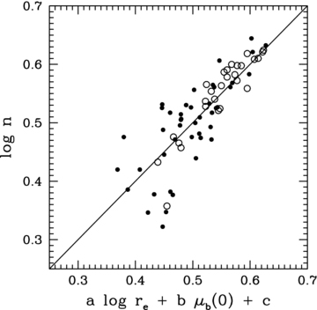
Figure 4 PP for bright lenticulars (open circles) with restricted n value. Faint lenticulars (filled circles) are over ...
Notes:
Figure 4 PP for bright lenticulars (open circles) with restricted n value. Faint lenticulars (filled circles) are over plotted on the same photometric plane. These show a higher scatter than the bright ones.
Unless provided in the caption above, the following copyright applies to the content of this slide: © 2009 The Authors. Journal compilation © 2009 RAS

Slide 5
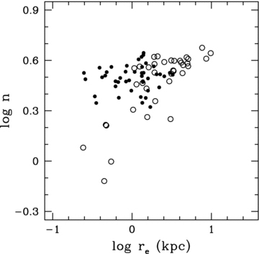
Figure 5 The Sérsic index n plotted against bulge effective radius r_{e} in kpc. Symbols are as in Fig. 2.
Notes:
Figure 5 The Sérsic index n plotted against bulge effective radius re in kpc. Symbols are as in Fig. 2.
Unless provided in the caption above, the following copyright applies to the content of this slide: © 2009 The Authors. Journal compilation © 2009 RAS

Slide 6
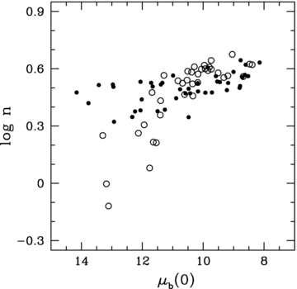
Figure 6 The Sérsic index n as a function of unconvolved bulge central surface brightness. Symbols are as in Fig. 2.
Notes:
Figure 6 The Sérsic index n as a function of unconvolved bulge central surface brightness. Symbols are as in Fig. 2.
Unless provided in the caption above, the following copyright applies to the content of this slide: © 2009 The Authors. Journal compilation © 2009 RAS

Slide 7
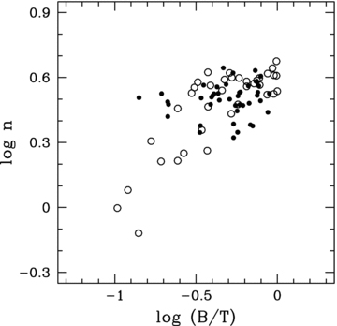
Figure 7 The Sérsic index n versus bulge-to-total luminosity ratio. Symbols are as in Fig. 2.
Notes:
Figure 7 The Sérsic index n versus bulge-to-total luminosity ratio. Symbols are as in Fig. 2.
Unless provided in the caption above, the following copyright applies to the content of this slide: © 2009 The Authors. Journal compilation © 2009 RAS

Slide 8
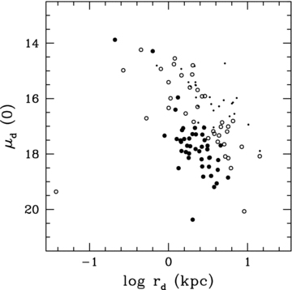
Figure 8 Unconvolved disc central surface brightness μ_{d}(0) as a function of disc scalelength. Early-type ...
Notes:
Figure 8 Unconvolved disc central surface brightness μd(0) as a function of disc scalelength. Early-type spirals (as dots) are overplotted for comparison. Other symbols are as in Fig. 2.
Unless provided in the caption above, the following copyright applies to the content of this slide: © 2009 The Authors. Journal compilation © 2009 RAS

Slide 9
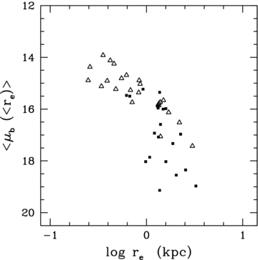
Figure 9 Dependence of the mean surface brightness within bulge effective radius (〈μ_{b}(<r_{e})〉) on ...
Notes:
Figure 9 Dependence of the mean surface brightness within bulge effective radius (〈μb(<re)〉) on bulge effective radius re as a function of environment. Faint field lenticulars are shown as open triangles while faint cluster lenticulars are plotted as filled squares.
Unless provided in the caption above, the following copyright applies to the content of this slide: © 2009 The Authors. Journal compilation © 2009 RAS

Slide 10
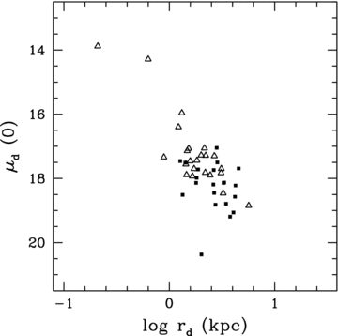
Figure 10 Unconvolved disc central surface brightness μ_{d}(0) is plotted against disc scalelength ...
Notes:
Figure 10 Unconvolved disc central surface brightness μd(0) is plotted against disc scalelength rd as a function of environment. Symbols are as in Fig. 9.
Unless provided in the caption above, the following copyright applies to the content of this slide: © 2009 The Authors. Journal compilation © 2009 RAS

Slide 11
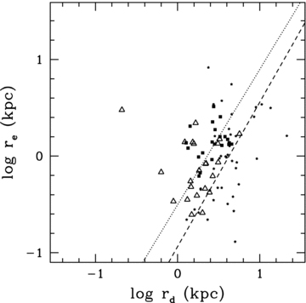
Figure 11 Dependence of the r_{e}−r_{d} relation on the environment in K band for the faint ...
Notes:
Figure 11 Dependence of the re−rd relation on the environment in K band for the faint lenticulars. Late-type spirals (as asterisks) are overplotted for comparison. Other symbols are as in Fig. 9. The dotted line is the best fit to the faint lenticulars (field as well as cluster) excluding the one obvious outlier while the dashed line is the best fit to late-type spirals. Note that these two lines have similar slopes but a different intercept.
Unless provided in the caption above, the following copyright applies to the content of this slide: © 2009 The Authors. Journal compilation © 2009 RAS

