Slide 1
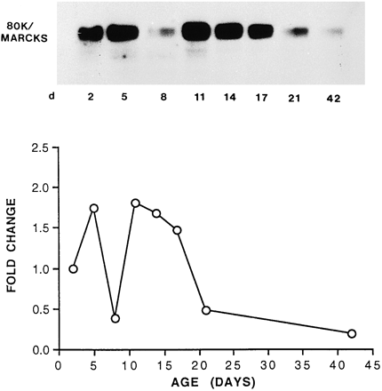
Fig. 2 Changes in 80K/MARCKS protein expression in the developing rat myocardium. Twenty-five micrograms of ...
Notes:
Fig. 2 Changes in 80K/MARCKS protein expression in the developing rat myocardium. Twenty-five micrograms of heat-stable protein from whole ventricular tissue was loaded onto each lane of an 8% SDS/PAGE gel and electrophoresed at 45 V overnight. Separated proteins were transferred to a PVDF membrane, incubated overnight at 4°C with a murine anti-80K/MARCKS antibody (1:2500 dilution) and detected by incubation with 125I-labelled protein A (0.1 μCi/ml) for 1 h at room temperature. Results were analysed by autoradiography. Lower graph shows the % change in levels of 80K/MARCKS protein expression during myocardial development. The autoradiographs were quantified by laser densitometry and results presented as % change relative to those values expressed in 2-day-old myocardial tissue.
Unless provided in the caption above, the following copyright applies to the content of this slide: Copyright © 1997, European Society of Cardiology

Slide 2
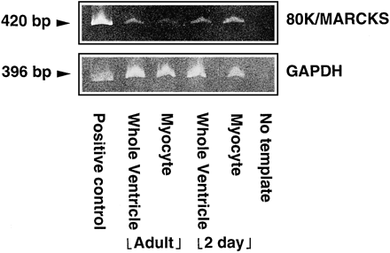
Fig. 1 Expression of 80K/MARCKS mRNA in neonatal and adult myocytes and whole ventricles, by RT-PCR. One microlitre ...
Notes:
Fig. 1 Expression of 80K/MARCKS mRNA in neonatal and adult myocytes and whole ventricles, by RT-PCR. One microlitre of diluted cDNA, produced by reverse transcription of mRNA obtained from neonatal (2-day) and adult myocyte and whole ventricle samples, was amplified and the resultant 80K/MARCKS or GAPDH PCR products visualised on 9% acrylamide gels stained with ethidium bromide. Although the 80K/MARCKS PCR product (420 bp) is expressed in all cardiac samples, levels are higher in neonatal (2-day) than in adult cardiac myocytes.
Unless provided in the caption above, the following copyright applies to the content of this slide: Copyright © 1997, European Society of Cardiology

Slide 3
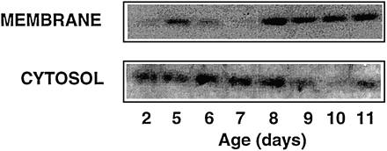
Fig. 3 Subcellular distribution of the 80K/MARCKS protein during myocardial development. One hundred micrograms of ...
Notes:
Fig. 3 Subcellular distribution of the 80K/MARCKS protein during myocardial development. One hundred micrograms of subfractionated heat stable protein prepared from ventricular tissue (2- and 5–11-day-old animals) were loaded onto an 8% SDS/PAGE gel, electrophoresed and transferred to PVDF membrane as described in the legend of Fig. 2. The membranes were then probed with an anti-80K/MARCKS antibody (1:2500 dilution) overnight at 4°C. Reacting antigens were detected by incubation of the blot with a donkey anti-rabbit horseradish peroxidase antibody (1:2000 dilution) for 30 min followed by incubation with Amersham ECL reagents. Similar results were obtained in 2 separate experiments.
Unless provided in the caption above, the following copyright applies to the content of this slide: Copyright © 1997, European Society of Cardiology

Slide 4
Fig. 4 An autoradiograph showing 80K/MARCKS protein expression in cardiac myocytes. Twenty micrograms of heat-stable ...
Notes:
Fig. 4 An autoradiograph showing 80K/MARCKS protein expression in cardiac myocytes. Twenty micrograms of heat-stable protein obtained from neonatal (2-day) and adult cardiac myocytes and whole ventricular tissue extracts were analysed by Western analysis as described in Fig. 3. Similar results were obtained in 2 separate experiments. 3T3 = Swiss 3T3 fibroblasts; NM = neonatal myocytes; AM = adult myocytes; NWV = neonatal whole ventricle; AWV = adult whole ventricle.
Unless provided in the caption above, the following copyright applies to the content of this slide: Copyright © 1997, European Society of Cardiology

Slide 5
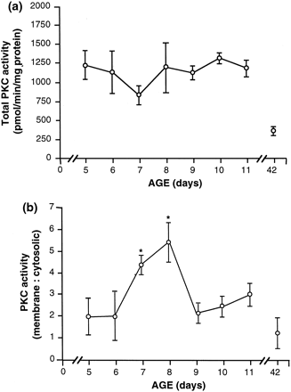
Fig. 5 Changes in PKC activity in the developing rat myocardium. (a) Changes in total PKC activity during myocardial ...
Notes:
Fig. 5 Changes in PKC activity in the developing rat myocardium. (a) Changes in total PKC activity during myocardial development. PKC activity levels were measured as described in Section 2. Values are expressed as pmol/min/mg total protein. (b) Changes in cytosolic and membrane PKC activity levels during myocardial development. PKC was extracted from ventricular tissue and separated into membrane and cytosolic fractions as described in Section 2. Activatable PKC was purified by binding to a DEAE-cellulose column and eluted with 0.3 mol/l NaCl. Eluted PKC was concentrated using Microcon filters (Amicon, UK) and enzyme activity was assayed using the Amersham PKC assay system kit in accordance with the manufacturer's instructions. Results are expressed as a ratio of cytosolic/membrane PKC activity levels and show the mean±standard deviation values obtained from 3 separate experiments. *P<0.05, ANOVA and Tukey's t-test.
Unless provided in the caption above, the following copyright applies to the content of this slide: Copyright © 1997, European Society of Cardiology

