Slide 1
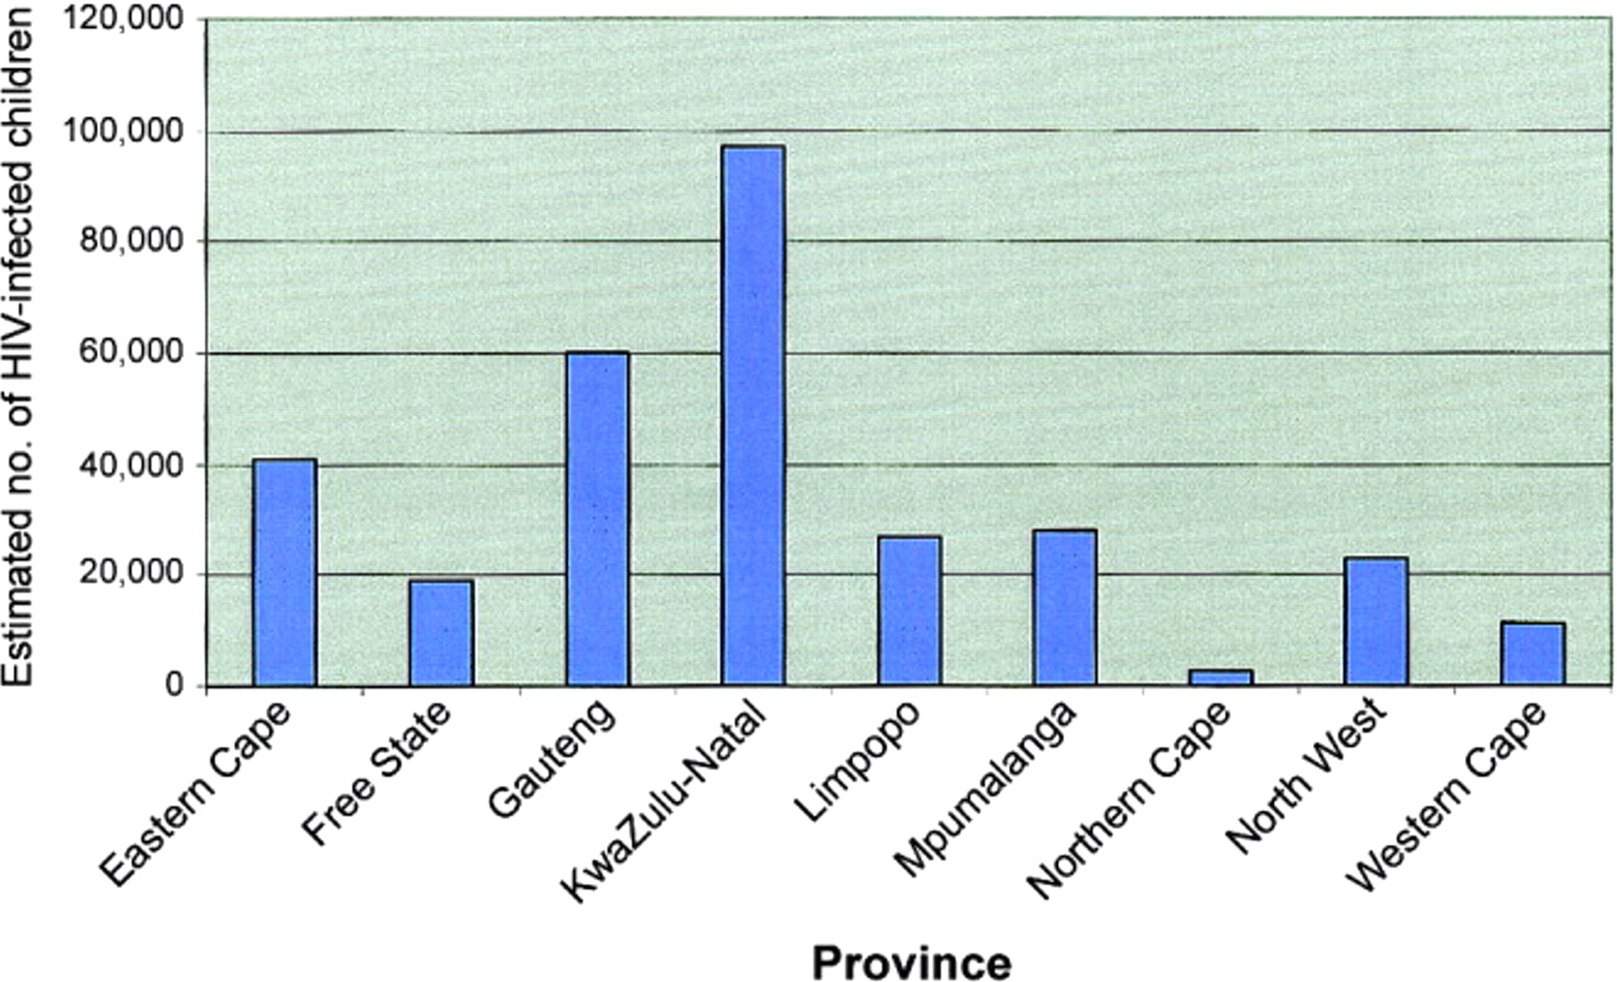
Figure 1. Estimated nos. of HIV-infected children <15 years of age in South Africa, by province, mid-2006. Data are ...
Notes:
Figure 1. Estimated nos. of HIV-infected children <15 years of age in South Africa, by province, mid-2006. Data are from Actuarial Society of South Africa AIDS and Demographic Model (ASSA2003) [2].
Unless provided in the caption above, the following copyright applies to the content of this slide: © 2007 by the Infectious Diseases Society of America.

Slide 2
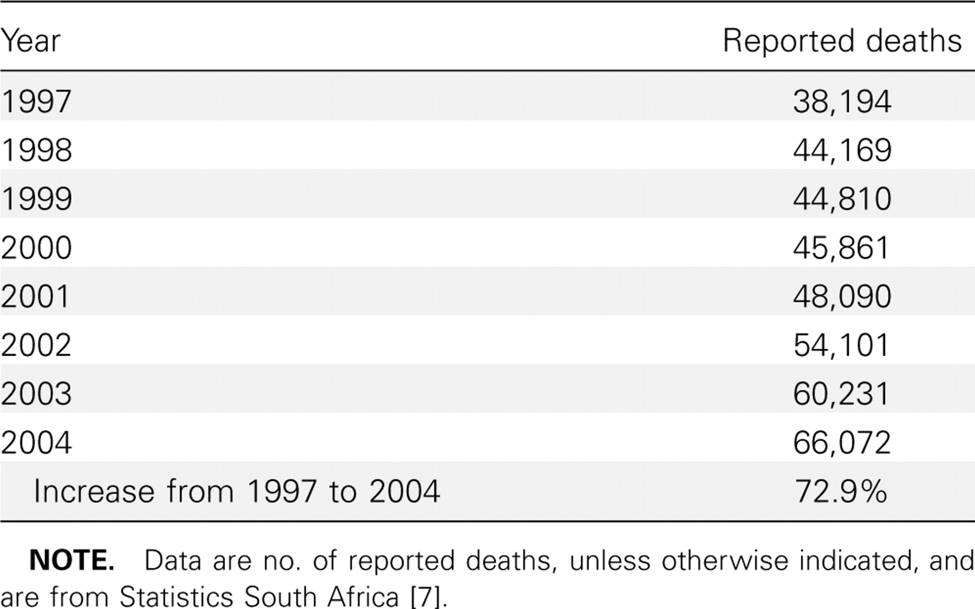
Table 1. Increase in nos. of reported deaths of children <15 years of age in South Africa, 1997–2004.
Notes:
Table 1. Increase in nos. of reported deaths of children <15 years of age in South Africa, 1997–2004.
Unless provided in the caption above, the following copyright applies to the content of this slide: © 2007 by the Infectious Diseases Society of America.

Slide 3
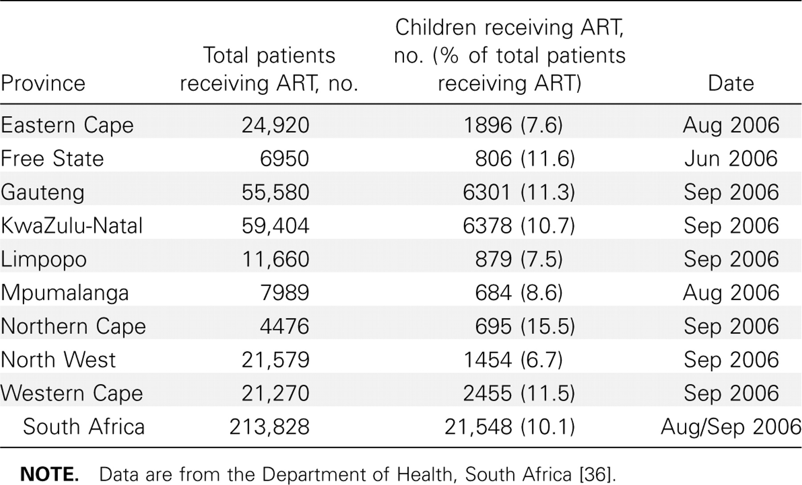
Table 2. Breakdown of nos. of children <14 years of age receiving antiretroviral therapy (ART), by province, in ...
Notes:
Table 2. Breakdown of nos. of children <14 years of age receiving antiretroviral therapy (ART), by province, in mid-2006 (public sector).
Unless provided in the caption above, the following copyright applies to the content of this slide: © 2007 by the Infectious Diseases Society of America.

Slide 4
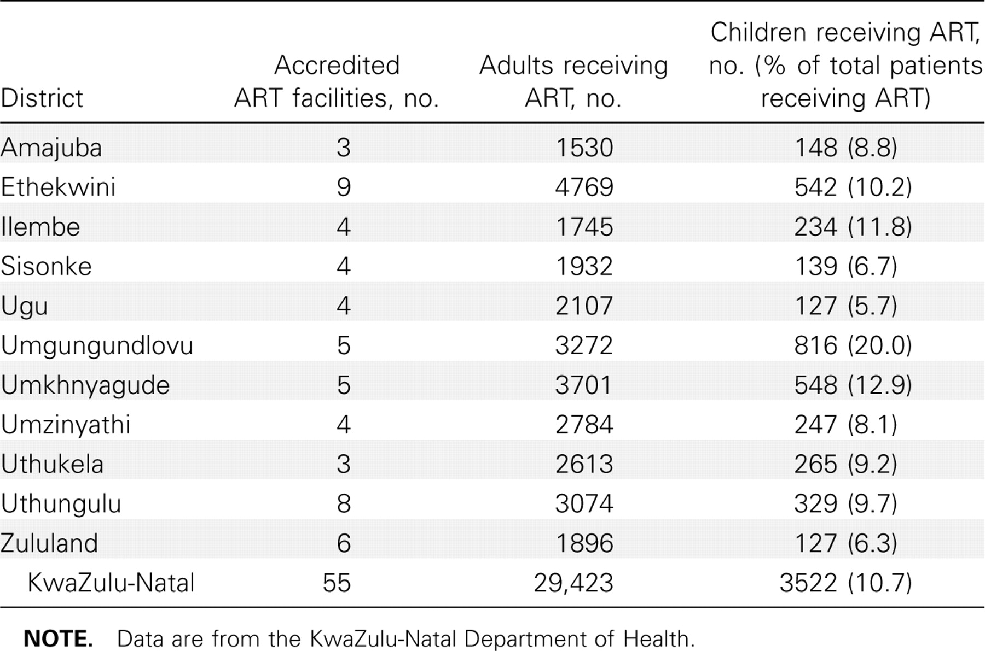
Table 3. Children <14 years of age receiving antiretroviral therapy (ART), by district in KwaZulu-Natal, March 2006.
Notes:
Table 3. Children <14 years of age receiving antiretroviral therapy (ART), by district in KwaZulu-Natal, March 2006.
Unless provided in the caption above, the following copyright applies to the content of this slide: © 2007 by the Infectious Diseases Society of America.

Slide 5
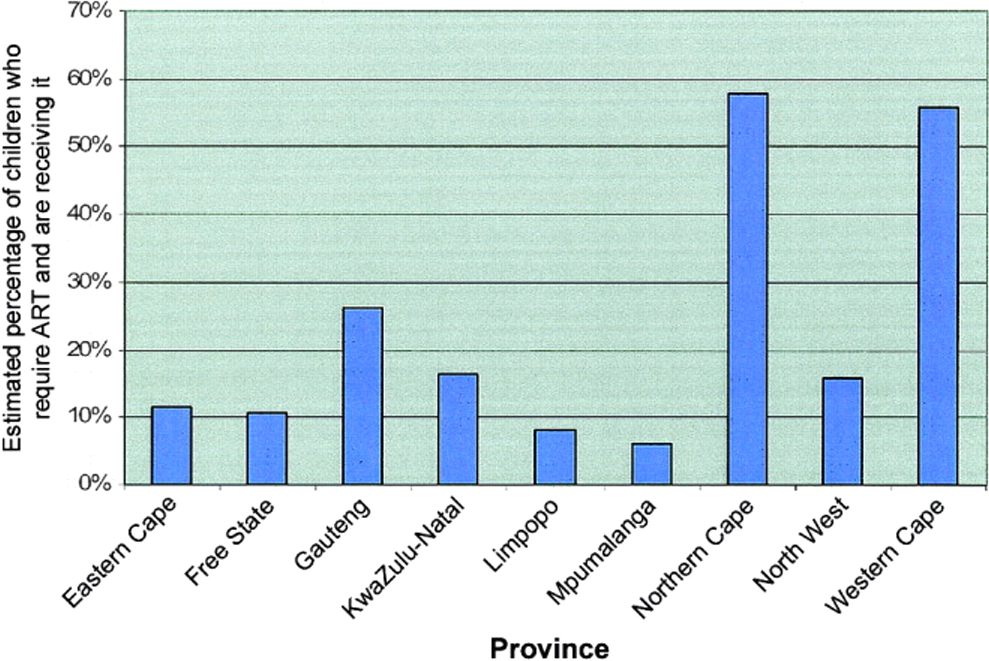
Figure 2. Estimated percentages of children in South Africa who urgently need antiretroviral therapy (ART) and are ...
Notes:
Figure 2. Estimated percentages of children in South Africa who urgently need antiretroviral therapy (ART) and are receiving it, by province, 2006. Data are compiled from mid-2006 estimates extracted from Actuarial Society of South Africa AIDS and Demographic Model (ASSA2003) [2] and table 3, under the assumption that 40% of HIV-infected children require ART.
Unless provided in the caption above, the following copyright applies to the content of this slide: © 2007 by the Infectious Diseases Society of America.

Slide 6
Figure 3. Breakdown of nos. of children receiving antiretroviral therapy, by health facility level, in Gauteng, South ...
Notes:
Figure 3. Breakdown of nos. of children receiving antiretroviral therapy, by health facility level, in Gauteng, South Africa. Data were provided by the Gauteng Department of Health. CHC, community health center; hosp, hospital.
Unless provided in the caption above, the following copyright applies to the content of this slide: © 2007 by the Infectious Diseases Society of America.

