Slide 1
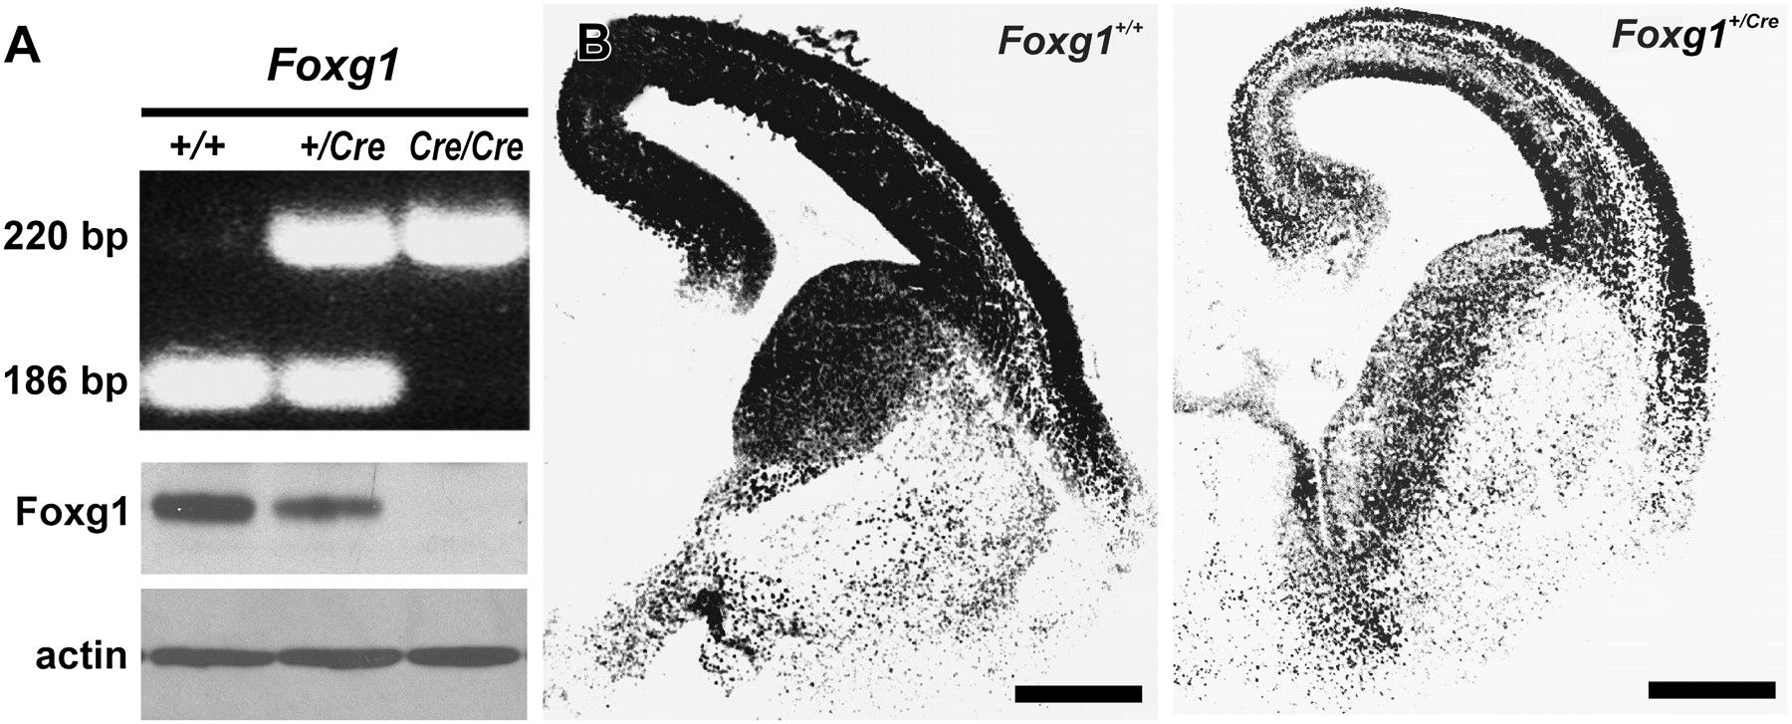
Figure 1. Expression of Foxg1. (A) A representative gel of PCR products from amplification of genomic DNA from ...
Notes:
Figure 1. Expression of Foxg1. (A) A representative gel of PCR products from amplification of genomic DNA from Foxg1+/+, Foxg1+/Cre, and Foxg1Cre/Cre mice. The 186- and 220-bp bands result from amplification of the Foxg1 wild-type and null allele, respectively. Foxg1 immunoblots showed decreased Foxg1 protein in the Foxg1+/Cre cortex and the absence of Foxg1 protein in the Foxg1Cre/Cre. (B) Immunohistochemical preparations show differential expression of Foxg1 in forebrains of 15.5-day-old wild-type and heterozygous mice. Scale bars are 500 μm.
Unless provided in the caption above, the following copyright applies to the content of this slide: © The Author 2007. Published by Oxford University Press. All rights reserved. For permissions, please e-mail: journals.permissions@oxfordjournals.org

Slide 2
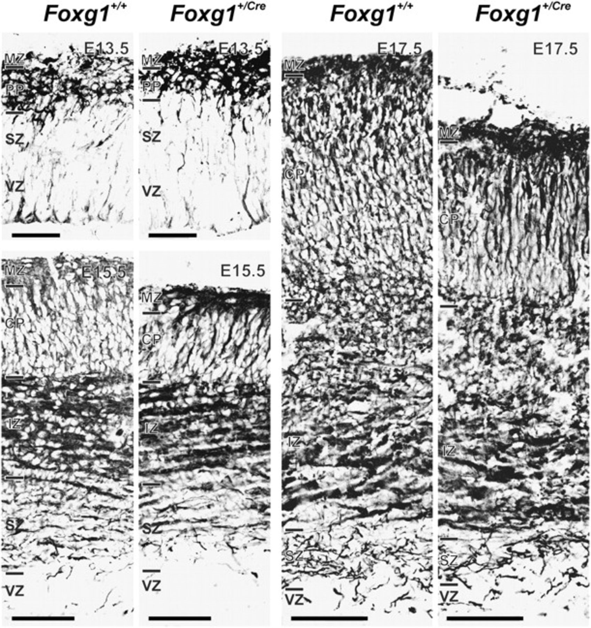
Figure 2. Cortical growth defects in the Foxg1^{+/Cre} fetal brain. The full depth of the cerebral wall is ...
Notes:
Figure 2. Cortical growth defects in the Foxg1+/Cre fetal brain. The full depth of the cerebral wall is shown for Foxg1+/+ and Foxg1+/Cre fetuses on E13.5, E15.5, and E17.5. Samples were immunostained for Tuj1 expression. Disparity in thickness of the cortical plate (CP)was evident on E15.5 and E17.5 (see Table 1). IZ, intermediate zone; MZ, marginal zone; PP, preplate; SZ, subventricular zone; VZ, ventricular zone. Scale bars are 100 μm (G13.5) and 200 μm (E15.5 and E17.5).
Unless provided in the caption above, the following copyright applies to the content of this slide: © The Author 2007. Published by Oxford University Press. All rights reserved. For permissions, please e-mail: journals.permissions@oxfordjournals.org

Slide 3
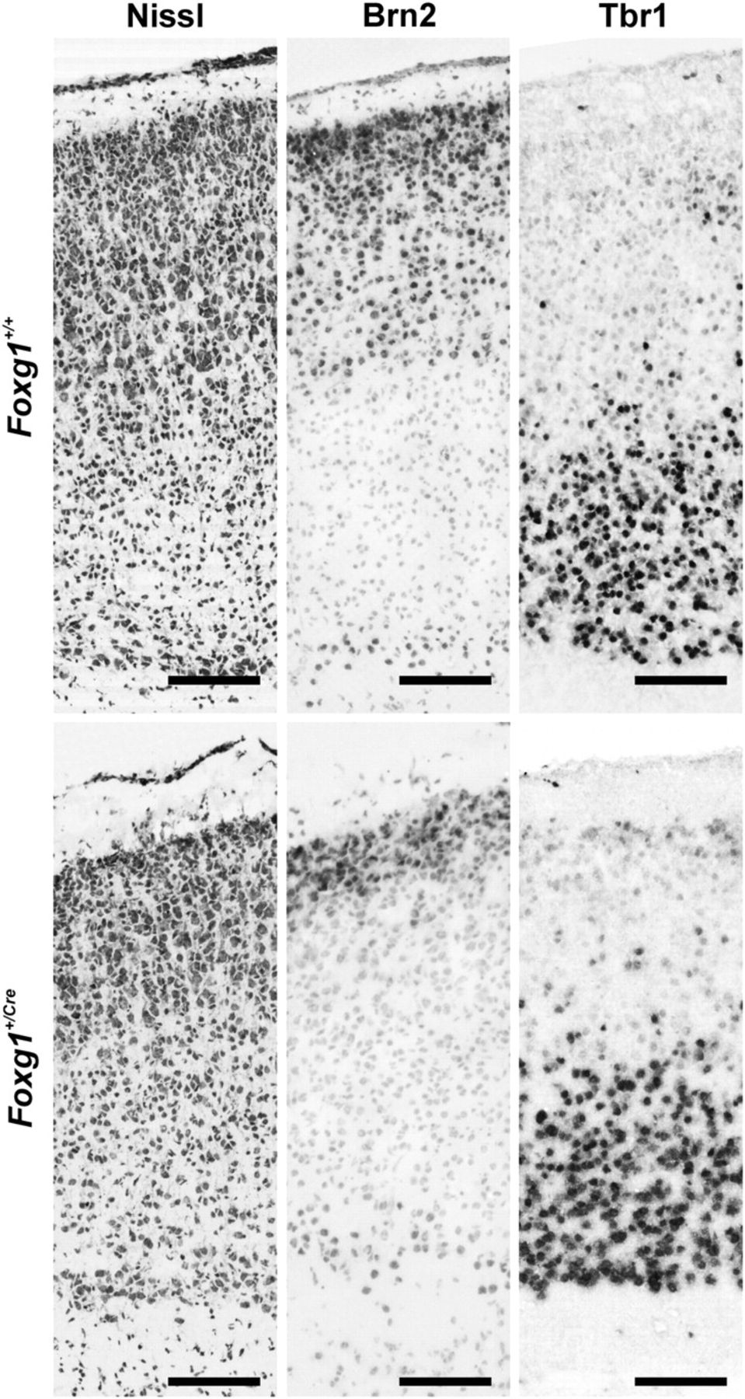
Figure 3. Brn2 and Tbr1 expression in cortex of Foxg1^{+/+} and Foxg1^{+/Cre} mice on postnatal day 6. ...
Notes:
Figure 3. Brn2 and Tbr1 expression in cortex of Foxg1+/+ and Foxg1+/Cre mice on postnatal day 6. The organization of cerebral cortex in the Foxg1+/+ and Foxg1+/Cre mice is depicted in the cresyl violet–stained sections (left). Brn2 and Tbr1 (middle and right, respectively) were expressed in separate compartments of cortex. Brn2 expression in superficial cortex was reduced in Foxg1+/Cre mice, whereas Tbr1 expression was similar in the deep laminae of both genotypes of mice (see Table 2). Scale bars are 100 μm.
Unless provided in the caption above, the following copyright applies to the content of this slide: © The Author 2007. Published by Oxford University Press. All rights reserved. For permissions, please e-mail: journals.permissions@oxfordjournals.org

Slide 4
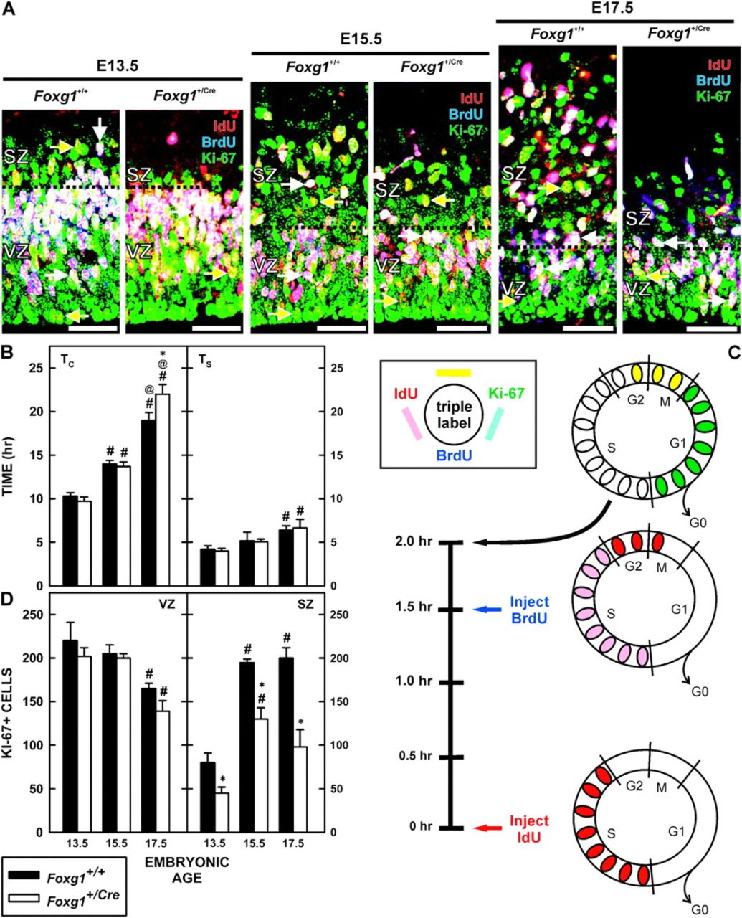
Figure 4. Cell proliferation in Foxg1 haploinsufficient mice. (A) Pregnant dams were injected with IdU and BrdU 1.5 h ...
Notes:
Figure 4. Cell proliferation in Foxg1 haploinsufficient mice. (A) Pregnant dams were injected with IdU and BrdU 1.5 h apart and fetuses were collected 30 min later. Representative images of IdU/BrdU/Ki-67 triple labeling from brains of Foxg1+/+ and Foxg1+/Cre mice on E13.5, E15.5, and E17.5 shows the distributions of BrdU−/IdU+/Ki-67+ (yellow arrows) close to the ventricular surface and BrdU+/IdU+/Ki-67+ (white arrows) in the outer third of the VZ and intermingled in the SZ. Note that the depth of the VZ was similar between the 2 genotypes at all ages, whereas the SZ was clearly reduced in the Foxg1+/Cre fetuses. Scale bars are 100 μm. (B) Total cell-cycle length (TC) (left) and the length of S-phase (TS) (right) were determined for Foxg1+/+ and Foxg1+/Cre mice on E13.5, E15.5, and E17.5. * denotes a significant difference relative to the wild type at the same age, # indicates a significant difference from the mean TC on E13.5 (within genotype), and @ denotes significant differences relative to the expression on E15.5 (within genotype). (C) The illustration describes the experimental paradigm for determining the cell-cycle kinetics (see Quantitative Analyses, Materials and Methods) and the color scheme to immunolabeling in the micrographs. (D) The total number of proliferating (Ki-67+ cells) cells in a 62 500 μm2 field in the VZ (left) and SZ (right) is shown. Separate analyses for Foxg1+/+ and Foxg1+/Cre mice were performed. Notations as for (B).
Unless provided in the caption above, the following copyright applies to the content of this slide: © The Author 2007. Published by Oxford University Press. All rights reserved. For permissions, please e-mail: journals.permissions@oxfordjournals.org

Slide 5
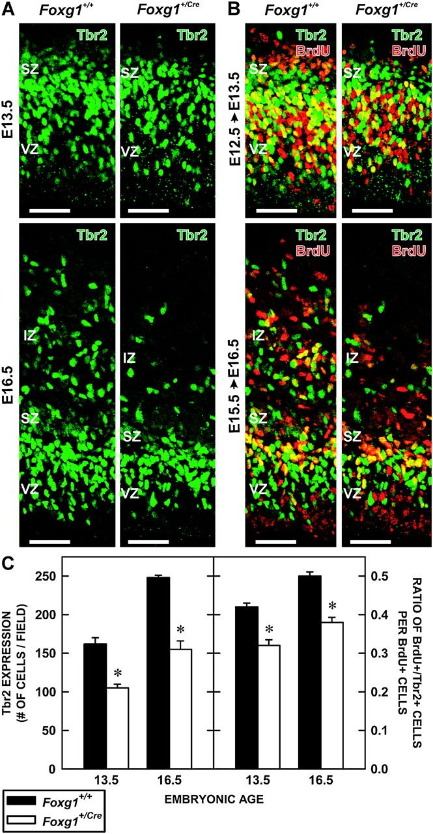
Figure 5. Production of IPCs in Foxg1^{+/+} and Foxg1^{+/Cre} fetuses. (A) Sections of the cerebral ...
Notes:
Figure 5. Production of IPCs in Foxg1+/+ and Foxg1+/Cre fetuses. (A) Sections of the cerebral walls of Foxg1+/+ and Foxg1+/Cre fetuses on E13.5 (top) and E16.5 (bottom) were immunolabeled with an antibody to Tbr2, an IPC cell marker. Scale bars are 100 μm. (B) Pregnant dams were injected with BrdU on E12.5 (top) or E15.5 (bottom) and their fetuses collected 16 (E13.5) or 24 h later (E16.5), respectively. Sections were processed for BrdU (red) and Tbr2 (green) immunolabeling. Yellow cells coexpressed BrdU and Tbr2. Scale bars are 100 μm. (C) The 2 graphs depict the total number of Tbr2+ cells in a defined portion of the cerebral wall of Foxg1+/+ and Foxg1+/Cre mice at E13.5 and E16.5 (left) and an estimation of Tbr2-cell production as determined by the number of Tbr2+/BrdU+ cells divided by the total BrdU+ population (right). Asterisks identify statistically significant (P < 0.05) differences between genotypes.
Unless provided in the caption above, the following copyright applies to the content of this slide: © The Author 2007. Published by Oxford University Press. All rights reserved. For permissions, please e-mail: journals.permissions@oxfordjournals.org

Slide 6
Figure 6. p21 expression among Tbr2+ cells. (A) p21+ cells were evident in the VZ and SZ (green arrows) of brains of ...
Notes:
Figure 6. p21 expression among Tbr2+ cells. (A) p21+ cells were evident in the VZ and SZ (green arrows) of brains of Foxg1+/+ (left) and Foxg1+/Cre (right) fetuses on E13.5 (top) and E16.5 (bottom). In both genotypes, p21+/Tbr2+ cells (yellow arrows) were present. Scale bars are 100 μm. (B) Quantification of p21+ cell number in Foxg1+/+ and Foxg1+/Cre at E13.5 and E16.5 reveals a temporal increase in p21+ cells in both genotypes, though significantly more so in the Foxg1+/Cre cortex. Asterisks identify statistically significant differences between genotypes (P < 0.05).
Unless provided in the caption above, the following copyright applies to the content of this slide: © The Author 2007. Published by Oxford University Press. All rights reserved. For permissions, please e-mail: journals.permissions@oxfordjournals.org

Slide 7
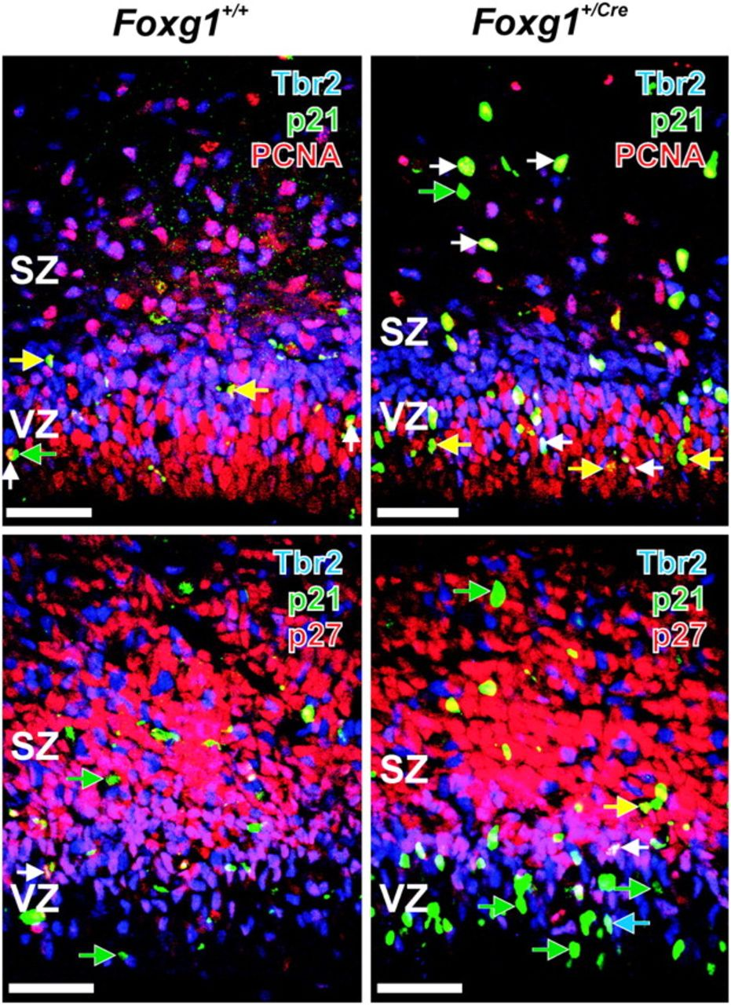
Figure 7. Expression of Tbr2 and p21 in proliferating and postproliferative cells. (Top) Sections of brains from ...
Notes:
Figure 7. Expression of Tbr2 and p21 in proliferating and postproliferative cells. (Top) Sections of brains from 16.5-day-old Foxg1+/+ (left) and Foxg1+/Cre (right) fetuses were immunolabeled with antibodies to Tbr2 (blue), p21 (green), and PCNA (red), a marker of proliferating cells. Tbr2+/p21+/PCNA+ cells are indicated by white arrows, Tbr2−/p21+/PCNA+ cells are indicated by yellow arrows, and green arrows indicate Tbr2−/p21+/PCNA− cells. (Bottom) Most p21+ cells, both Tbr2- (green arrow) and Tbr2+ (blue arrows) did not coexpress p27, though examples of p21–p27 coimmunoreactivity were present (white and yellow arrows). Scale bars are 100 μm.
Unless provided in the caption above, the following copyright applies to the content of this slide: © The Author 2007. Published by Oxford University Press. All rights reserved. For permissions, please e-mail: journals.permissions@oxfordjournals.org

