Slide 1
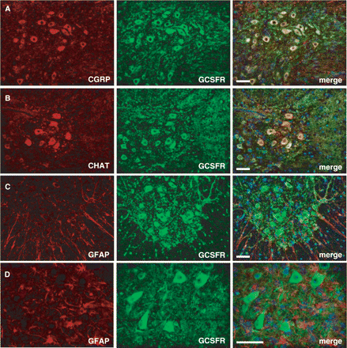
Fig. 1 G-CSFR is expressed on motoneurons in the spinal cord of wt mice. (A–D), Immunohistochemistry shows ...
Notes:
Fig. 1 G-CSFR is expressed on motoneurons in the spinal cord of wt mice. (A–D), Immunohistochemistry shows expression of the receptor on large motoneurons in the spinal cord. Double immunfluorescence of G-CSFR and CGRP (calcitonin gene-related peptide) or CHAT (choline acetyltransferase) in the mouse spinal cord ventral horn. CGRP and CHAT are used as marker for motoneurons. Double immunfluorescence of G-CSFR and GFAP revealed the absence of G-CSFR in astrocytes. (A–C: × 20 original magnification; all size bars 50 µm; D: × 40 original magnification, size bar 25 µm).
Unless provided in the caption above, the following copyright applies to the content of this slide: © 2008 The Author(s)This is an Open Access article distributed under the terms of the Creative Commons Attribution Non-Commercial License (http://creativecommons.org/licenses/by-nc/2.0/uk/) which permits unrestricted non-commercial use, distribution, and reproduction in any medium, provided the original work is properly cited.

Slide 2
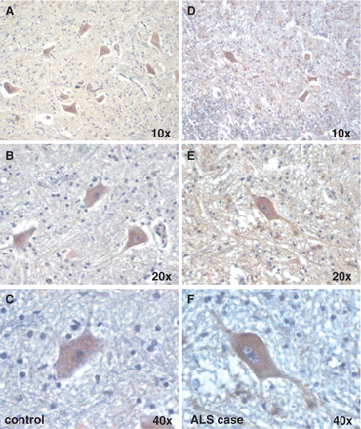
Fig. 2 The G-CSF receptor is expressed on motoneurons in humans. (A–C) Immunohistochemical stainings from the ...
Notes:
Fig. 2 The G-CSF receptor is expressed on motoneurons in humans. (A–C) Immunohistochemical stainings from the ventral horn of the spinal cord of a control patient. (D–F) Stainings from an ALS patient (original magnifications from × 10–40 are indicated).
Unless provided in the caption above, the following copyright applies to the content of this slide: © 2008 The Author(s)This is an Open Access article distributed under the terms of the Creative Commons Attribution Non-Commercial License (http://creativecommons.org/licenses/by-nc/2.0/uk/) which permits unrestricted non-commercial use, distribution, and reproduction in any medium, provided the original work is properly cited.

Slide 3
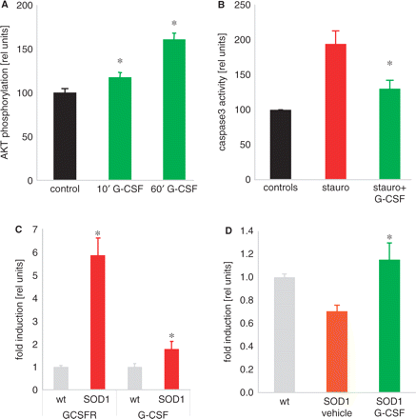
Fig. 3 G-CSF diminishes caspase-activation in a motoneuron cell line, is upregulated together with its receptor in ...
Notes:
Fig. 3 G-CSF diminishes caspase-activation in a motoneuron cell line, is upregulated together with its receptor in SOD1(G93A) transgenic mice. Treatment with G-CSF induces Bcl-Xl expression in the spinal cord of SOD1 mice. (A) G-CSF activates the PI3K-Akt pathway, as demonstrated by an ELISA for phosphorylated Akt (n = 4 per treatment, P < 0.05). (B) Staurosporin-elicited caspase3 activation is diminished by concomitant G-CSF addition (n = 4 per treatment, P < 0.05). (C) G-CSF receptor (G-CSFR) and G-CSF are upregulated in SOD1-tg mice. Quantitative PCR on wt and SOD1-tg mice at 19 weeks of age (n = 6–7; *P < 0.05). (D) Bcl-Xl is upregulated by G-CSF treatment in SOD1-tg mice at 19 weeks of age (n = 6–7; *P < 0.05).
Unless provided in the caption above, the following copyright applies to the content of this slide: © 2008 The Author(s)This is an Open Access article distributed under the terms of the Creative Commons Attribution Non-Commercial License (http://creativecommons.org/licenses/by-nc/2.0/uk/) which permits unrestricted non-commercial use, distribution, and reproduction in any medium, provided the original work is properly cited.

Slide 4
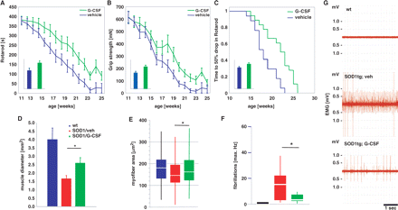
Fig. 4 G-CSF improves motor function in SOD1-tg mice. SOD1 transgenic mice were treated with subcutaneous G-CSF (30 ...
Notes:
Fig. 4 G-CSF improves motor function in SOD1-tg mice. SOD1 transgenic mice were treated with subcutaneous G-CSF (30 µg/kg/day) or vehicle (vehicle, n = 17; G-CSF, n = 18) starting at week 11 of age, where signs of muscle denervation are already obvious on EMG. The drugs were continuously administered for 8 weeks with an osmotic minipump (Alzet 2004) that was implanted in a paravertebral position at 11 weeks of age and exchanged at week 15. (A) Rotarod performance. Graph depicts means ± SEM over 14 weeks. Inset: AUC, bar graph depicts area under the curve analysis of the individual performance curves. (B) Grip strength. Graph depicts means ± SEM over 14 weeks (mN). Inset: AUC, bar graph depicts area under the curve analysis of the individual performance curves. There is considerable improvement in both motor parameters in the treated group (∼40% by AUC analysis; P < 0.05). (C) Kaplan–Meier analysis of the time passed until rotarod performance dropped below 50% of the initial value. Inset: AUC analysis. There is a significant difference between vehicle and G-CSF treatment in all parameters shown (log-rank test; P < 0.05). (D–G) G-CSF diminishes denervation atrophy in hind limb muscles of SOD1-tg mice. Shown are (D) the diameter of the M. rectus femoris of the M. quadriceps group in wt, vehicle-treated and G-CSF-treated SOD1-tg mice. There is a significant increase in the muscle diameter by G-CSF treatment. (E) Analysis of individual fibre diameters in the quadriceps group. There is a significant increase in fibre diameter by G-CSF treatment compared with the vehicle-treated group. Shown is a box-blot with median (white) and the 25% and 75% quartiles as box. (F and G) Quantification of single fiber potentials by electromyography of the M. gastrocnemius in wt, vehicle- and G-CSF-treated SOD1-tg mice at week 14. There is a significant decrease in fibrillations by G-CSF treatment. (F) Maximal frequency of fibrillation. (G) Exemplary traces from the wt, vehicle- and G-CSF-treated SOD1-tg mice at week 14 (*P < 0.05).
Unless provided in the caption above, the following copyright applies to the content of this slide: © 2008 The Author(s)This is an Open Access article distributed under the terms of the Creative Commons Attribution Non-Commercial License (http://creativecommons.org/licenses/by-nc/2.0/uk/) which permits unrestricted non-commercial use, distribution, and reproduction in any medium, provided the original work is properly cited.

Slide 5
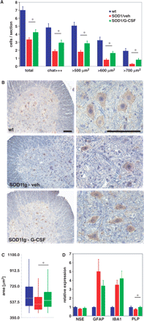
Fig. 5 G-CSF improves motoneuron survival in SOD1-tg mice. (A) Quantification of surviving motoneurons in wt, ...
Notes:
Fig. 5 G-CSF improves motoneuron survival in SOD1-tg mice. (A) Quantification of surviving motoneurons in wt, vehicle-treated and G-CSF-treated SOD-1tg mice at 15 weeks of age. We counted 11 sections per mouse spinal cord, 100 µm apart, over a length of 1 mm isolated from the lumbar spinal cord. A total of 14 mice were counted from the vehicle (5), verum (5) and wt (4) groups. There is an increase in motoneurons by G-CSF treatment compared with vehicle, particularly in strongly CHAT-positive and larger motoneurons. (B) Examples of the histological evaluation of CHAT-positive cells in the ventral horn of the lumbar spinal cord of 15 weeks wt and SOD-1tg mice treated with either vehicle or G-CSF. Left, ×10 original magnification; right: ×40 original magnification; size bar 100 µm. (C) Morphometric evaluation of the size distribution of surviving motoneurons at 15 weeks of age. There is an upward shift in median size distribution by G-CSF treatment (ANOVA on ranks; P < 0.05). (D) Evaluation of marker expression for different neural cell types by quantitative PCR at week 19. There is no difference in GFAP (astrocytes) or IBA1 (microglia) between vehicle and G-CSF treatment; however, a relative prevention of PLP (oligodendrocyte) decrease in the SOD-tg animals.
Unless provided in the caption above, the following copyright applies to the content of this slide: © 2008 The Author(s)This is an Open Access article distributed under the terms of the Creative Commons Attribution Non-Commercial License (http://creativecommons.org/licenses/by-nc/2.0/uk/) which permits unrestricted non-commercial use, distribution, and reproduction in any medium, provided the original work is properly cited.

Slide 6
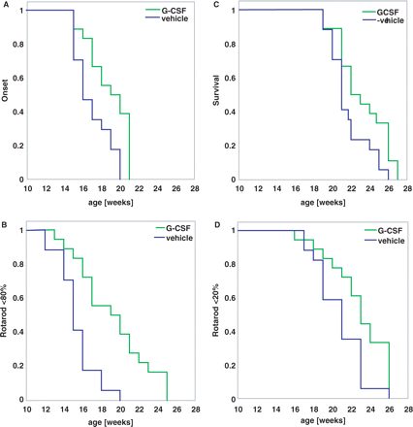
Fig. 6 Timed data for disease onset and endpoint. Kaplan–Meier graphs showing time to disease onset (A and B) or ...
Notes:
Fig. 6 Timed data for disease onset and endpoint. Kaplan–Meier graphs showing time to disease onset (A and B) or time to end-stage disease (C and D). (A) Clinical onset of disease defined by detectable signs of motor deterioration in at least one limb. (B) Time to drop below 80% of rotarod performance as an objective indicator of initial significant motor deterioration defined as onset. (C) Clinical end stage of disease defined as inability of the mouse to right itself within 30 s. (D) Time to drop of rotarod performance below 20% as an objective indicator of a significant terminal motor deterioration defined as disease end stage. (log-rank test; P < 0.05).
Unless provided in the caption above, the following copyright applies to the content of this slide: © 2008 The Author(s)This is an Open Access article distributed under the terms of the Creative Commons Attribution Non-Commercial License (http://creativecommons.org/licenses/by-nc/2.0/uk/) which permits unrestricted non-commercial use, distribution, and reproduction in any medium, provided the original work is properly cited.

Slide 7
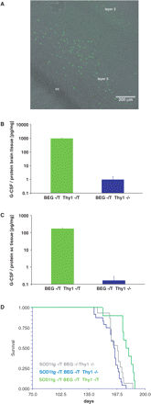
Fig. 7 Survival in SOD1(G93A) transgenic mice crossed with transgenic mice expressing G-CSF in the CNS. (A) Double ...
Notes:
Fig. 7 Survival in SOD1(G93A) transgenic mice crossed with transgenic mice expressing G-CSF in the CNS. (A) Double transgenic mice harbouring transgenes for the bidirectional construct BEG (pBI; EYFP; G-CSF) under control of the tta-responsive promotor and a thy1-tta driver express the marker EYFP in the cortex predominantly in layers II and V. Shown is a coronal frontotemporal section of the cortex. (B and C) Levels of G-CSF protein determined by ELISA in the brains and spinal cords of the double transgenic mice. There is a strong elevation of G-CSF concentration in the CNS of the transgenic mice. (D) Survival plot of SOD1(G93A)tg mice crossed with the BEG6 line. The survival analysis includes 24 Thy1-/BEG+/SOD1+, 10 Thy1+/BEG+/SOD1+ and 15 Thy1-/BEG-/SOD1+ mice. Blue lines show the survival in the littermates lacking the Thy1-tta driver that do not overexpress G-CSF in the CNS; green lines, mice that express G-CSF in the CNS. Survival is prolonged by 16.1 days (=10%; Mantel–Haenszel hazard ratio: 5.92; P < 0.0001) in the G-CSF overexpressers compared with the Thy1−/BEG+/SOD1+ littermates, and by 11.5 days (=7%; Mantel–Haenszel hazard ratio: 3.99; P < 0.005) when compared with Thy1−/BEG−/SOD1+ littermates.
Unless provided in the caption above, the following copyright applies to the content of this slide: © 2008 The Author(s)This is an Open Access article distributed under the terms of the Creative Commons Attribution Non-Commercial License (http://creativecommons.org/licenses/by-nc/2.0/uk/) which permits unrestricted non-commercial use, distribution, and reproduction in any medium, provided the original work is properly cited.

