Slide 1
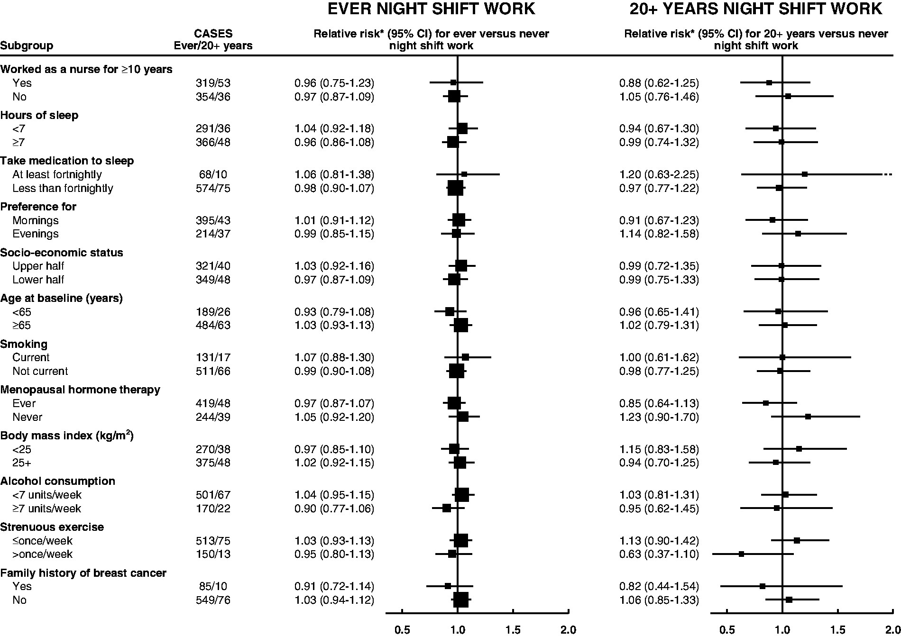
Figure 1. Relative risk of breast cancer in Million Women Study participants who worked night shifts by selected ...
Notes:
Figure 1. Relative risk of breast cancer in Million Women Study participants who worked night shifts by selected characteristics. *Relative to never night shift workers, stratified by region and with attained age as the underlying time variable and adjustment for socioeconomic status, parity and age at first birth, body mass index, alcohol intake, strenuous physical activity, family history of breast cancer, age at menarche, oral contraceptive use, smoking, living with a partner, and use of menopausal hormone therapy. Relative risks (RRs) are represented by squares (with their 95% confidence intervals [CIs] as lines), each with area inversely proportional to the variance of the log RR, thereby indicating the amount of statistical information for that particular RR. Breast cancer incidence rate ratio by history of night shift work in 522 246 Million Women Study participants Breast cancer casesMinimally adjustedMultivariable-adjustedNight shift workNo.Mean y of night shift work (SD)RR*RR† (95% CI)Ever worked at night Never4136–1.001.00 Ever6738.8 (8.9)1.021.00 (0.92 to 1.08)Years of night shift work‡ Never4136–1.001.00 <104003.5 (2.2)0.950.93 (0.83 to 1.03) 10–1914012.5 (2.8)1.181.14 (0.96 to 1.35) ≥208926.8 (7.1)1.031.00 (0.81 to 1.23) Ptrend.68§*Relative to never night shift workers, stratified by region and with attained age as the underlying time variable. CI = confidence interval; RR = incidence rate ratio from Cox regression models. †Relative to never night shift workers, stratified by region and with attained age as the underlying time variable, and adjusted for socioeconomic status, parity and age at first birth, body mass index, alcohol intake, strenuous physical activity, family history of breast cancer, age at menarche, oral contraceptive use, smoking, living with a partner, and use of menopausal hormone therapy. ‡Duration of night shift work was unknown for 8184 night shift workers, among whom there were 44 cases of breast cancer. §P is from a two-sided test for trend using mean years of night shift work within each duration category.
Unless provided in the caption above, the following copyright applies to the content of this slide: © The Author 2016. Published by Oxford University Press. All rights reserved. For Permissions, please e-mail: journals.permissions@oup.com.This is an Open Access article distributed under the terms of the Creative Commons Attribution License (http://creativecommons.org/licenses/by/4.0/), which permits unrestricted reuse, distribution, and reproduction in any medium, provided the original work is properly cited.

Slide 2
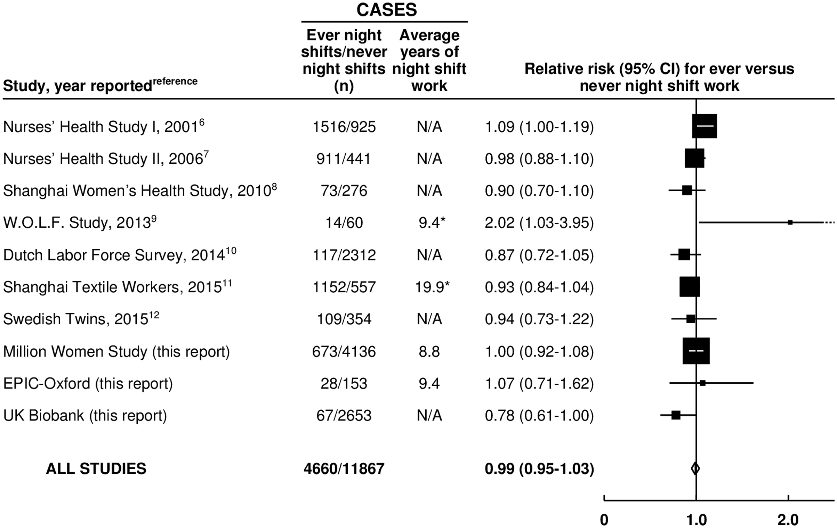
Figure 2. Meta-analysis of prospective studies on the risk of breast cancer in women who ever vs never worked night ...
Notes:
Figure 2. Meta-analysis of prospective studies on the risk of breast cancer in women who ever vs never worked night shifts. *All women. Study-specific relative risks (RRs) are represented by squares (with their 95% confidence intervals [CIs] as lines), each with area inversely proportional to the variance of the log RR. RRs were combined using inverse- variance-weighted averages of the log RRs in the separate studies, yielding a result and its 95% CI, which is plotted as a diamond.
Unless provided in the caption above, the following copyright applies to the content of this slide: © The Author 2016. Published by Oxford University Press. All rights reserved. For Permissions, please e-mail: journals.permissions@oup.com.This is an Open Access article distributed under the terms of the Creative Commons Attribution License (http://creativecommons.org/licenses/by/4.0/), which permits unrestricted reuse, distribution, and reproduction in any medium, provided the original work is properly cited.

Slide 3
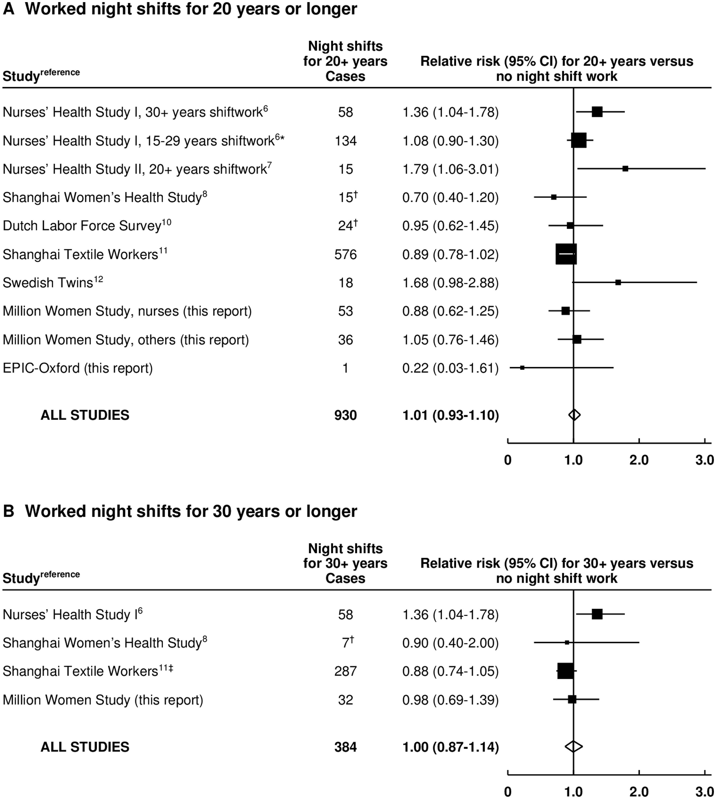
Figure 3. Meta-analysis of prospective studies on the risk of breast cancer associated with long-duration night shift ...
Notes:
Figure 3. Meta-analysis of prospective studies on the risk of breast cancer associated with long-duration night shift work. A) Worked night shifts for 20 or more years vs never worked night shifts. B) Worked night shifts for 30 or more years vs never worked night shifts. *Results for 20 to 29 years not reported separately. †Approximate numbers, estimated from confidence limits. ‡Worked night shifts for more than 27.5 years. Study-specific relative risks (RRs) are represented by squares (with their 95% confidence intervals [CIs] as lines), each with area inversely proportional to the variance of the log RR. RRs were combined using inverse-variance-weighted averages of the log RRs in the separate studies, yielding a result and its 95% CI, which is plotted as a diamond.
Unless provided in the caption above, the following copyright applies to the content of this slide: © The Author 2016. Published by Oxford University Press. All rights reserved. For Permissions, please e-mail: journals.permissions@oup.com.This is an Open Access article distributed under the terms of the Creative Commons Attribution License (http://creativecommons.org/licenses/by/4.0/), which permits unrestricted reuse, distribution, and reproduction in any medium, provided the original work is properly cited.

