Slide 1
Fig. 1. (A) Colour Doppler ultrasonography of the common carotid artery of a patient with large-vessel arteritis ...
Notes:
Fig. 1. (A) Colour Doppler ultrasonography of the common carotid artery of a patient with large-vessel arteritis showing the typical ‘halo sign’, i.e. a concentric hypoechogenic mural thickening representing vessel wall oedema. (B) CT angiography of the same patient, showing a symmetrical circumferential thickening of both carotid vessel walls (3.5 mm) and narrowing of the lumen.
Unless provided in the caption above, the following copyright applies to the content of this slide: © The Author 2008. Published by Oxford University Press on behalf of the British Society for Rheumatology. All rights reserved. For Permissions, please email: journals.permissions@oxfordjournals.org

Slide 2
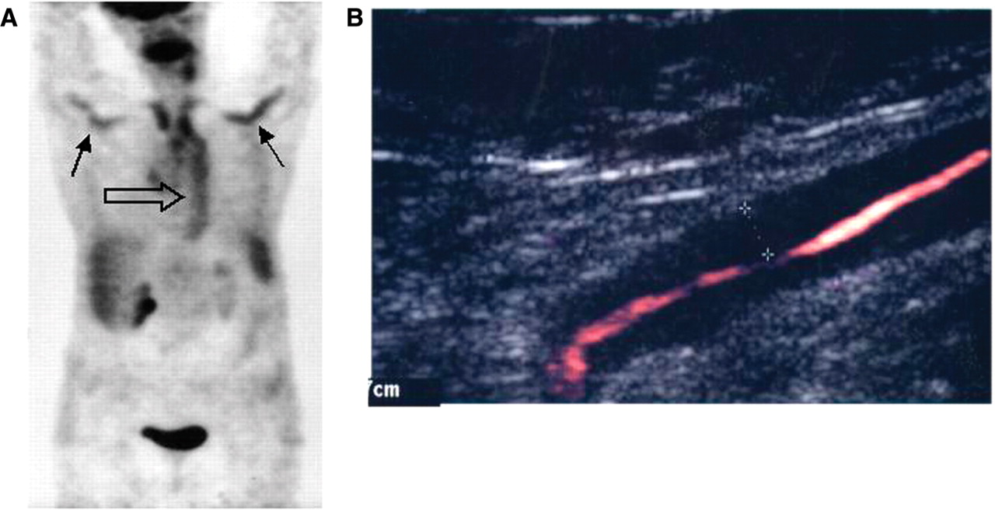
Fig. 2. (A) PET scan of a patient with large-vessel (Takayasu) vasculitis showing increased tracer uptake in the ...
Notes:
Fig. 2. (A) PET scan of a patient with large-vessel (Takayasu) vasculitis showing increased tracer uptake in the axillary (arrows) arteries and in the aorta (open arrow). (B) Colour Doppler ultrasonography of the left axillary artery of the same patient showing vessel wall oedema (‘halo sign’, dotted line). Both increased tracer uptake on PET scan and the presence of a halo on ultrasonography are consistent with active vessel wall inflammation.
Unless provided in the caption above, the following copyright applies to the content of this slide: © The Author 2008. Published by Oxford University Press on behalf of the British Society for Rheumatology. All rights reserved. For Permissions, please email: journals.permissions@oxfordjournals.org

Slide 3
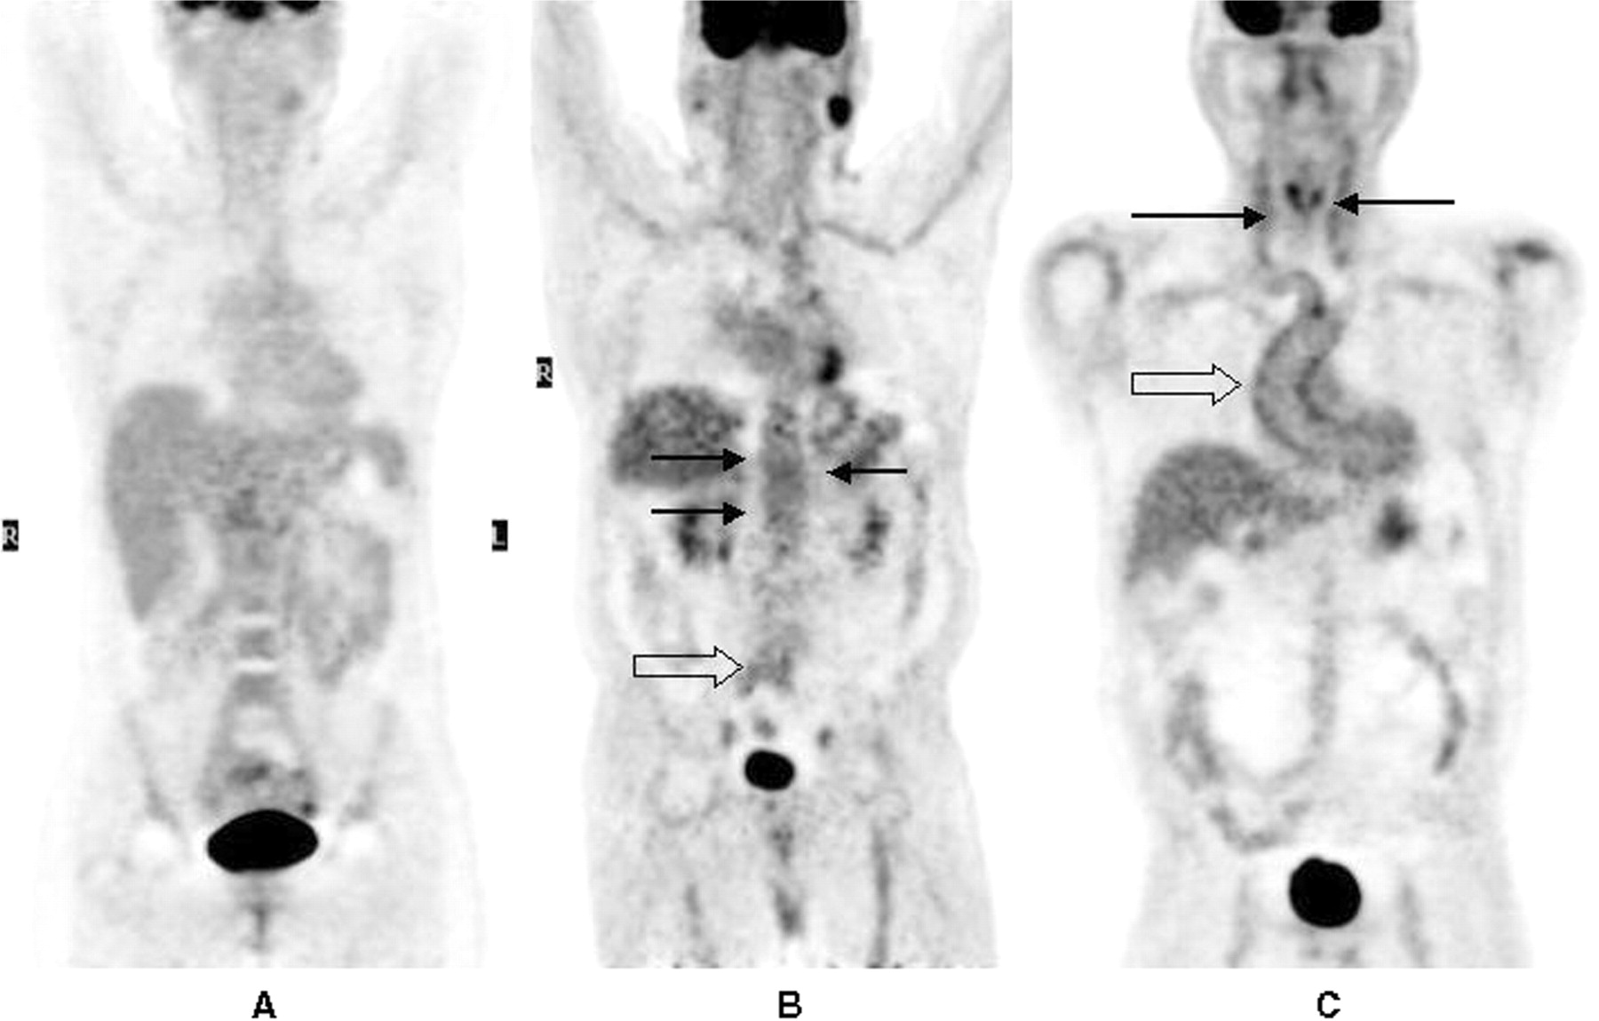
Fig. 3. PET scan of a normal subject (A), of a patient with atherosclerosis (B) and of a patient with large-vessel ...
Notes:
Fig. 3. PET scan of a normal subject (A), of a patient with atherosclerosis (B) and of a patient with large-vessel vasculitis (C). Note (in B) the 'spotted' uptake of grade 1+ in the abdominal aorta (arrows) and at the aortic bifurcation (open arrow), suggestive of atherosclerosis. In (C) the PET scan shows marked (>grade 1+) tracer uptake in the ascending aorta (open arrow) as well as in the supra-aortic vessels (arrows). In (C) the high tracer uptake, the smooth appearance of the lesions and the vessel sites involved (in particular, open arrow: aorta, arrows: carotid arteries) suggest the vasculitic nature of the alterations shown by PET.
Unless provided in the caption above, the following copyright applies to the content of this slide: © The Author 2008. Published by Oxford University Press on behalf of the British Society for Rheumatology. All rights reserved. For Permissions, please email: journals.permissions@oxfordjournals.org

