Slide 1
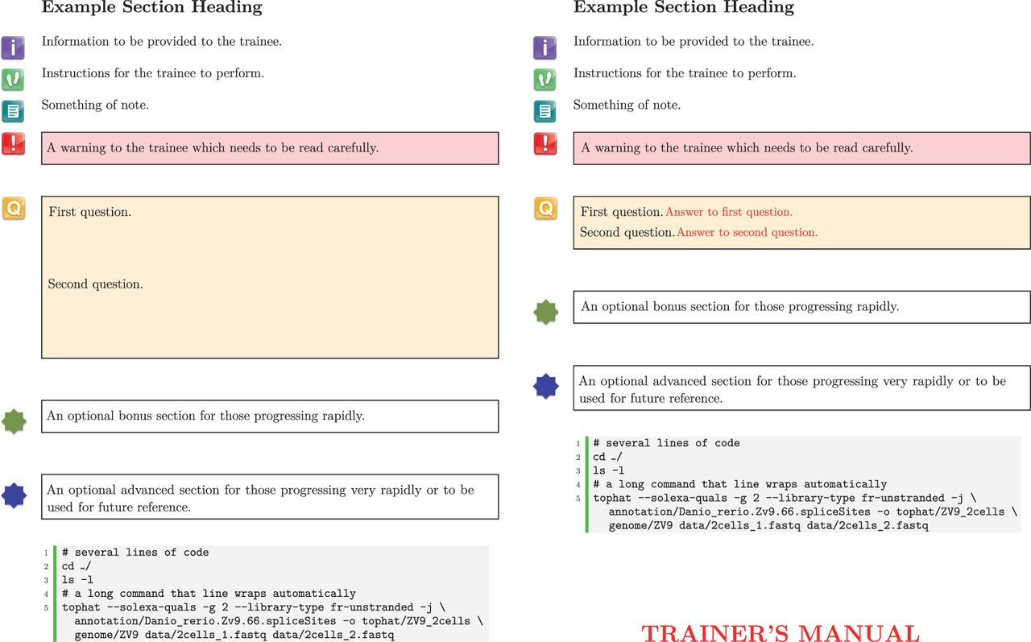
Figure 1: Both trainee (left) and trainer (right) handouts are maintained as a single LaTeX document. The difference ...
Notes:
Figure 1: Both trainee (left) and trainer (right) handouts are maintained as a single LaTeX document. The difference seen in styling is achieved simply by using the trainermanual option when loading the btp package.
Unless provided in the caption above, the following copyright applies to the content of this slide: © The Author 2013. Published by Oxford University Press.This is an Open Access article distributed under the terms of the Creative Commons Attribution Non-Commercial License (http://creativecommons.org/licenses/by-nc/3.0/), which permits unrestricted non-commercial use, distribution, and reproduction in any medium, provided the original work is properly cited.

