Slide 1
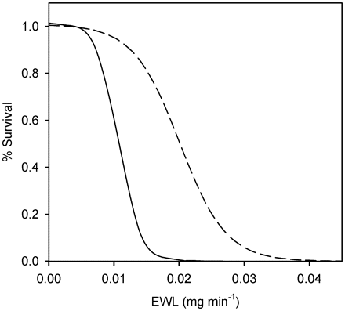
Fig. 4 Proportions of bat populations surviving based on changes in the average rates of EWL for individuals in the ...
Notes:
Fig. 4 Proportions of bat populations surviving based on changes in the average rates of EWL for individuals in the simulated populations, based on the hypothesis that infection with G.destructans causes an increase in EWL. The dashed line represents survival for bats which have the opportunity to cluster and the solid line represents survival for bats roosting solitarily. Based on Thomas and Cloutier’s (1992) findings, to result in a level of mortality similar to that observed with WNS, (∼20% survival), average EWL would need to increase in magnitude equivalent to the effect of reducing RH in the hibernaculum from 99% to 93% for solitary bats and from 99% to 87% for clustered bats.
Unless provided in the caption above, the following copyright applies to the content of this slide: © The Author 2011. Published by Oxford University Press on behalf of the Society for Integrative and Comparative Biology. All rights reserved. For permissions please email: journals.permissions@oup.com.

Slide 2
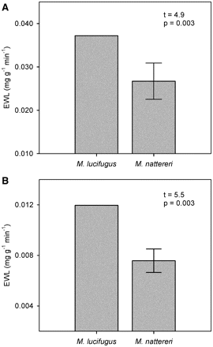
Fig. 3 Values for mass-predicted, torpid EWL of little brown bats and Natterer’s bats in relatively dry (A, ...
Notes:
Fig. 3 Values for mass-predicted, torpid EWL of little brown bats and Natterer’s bats in relatively dry (A, RH = 4.0 ± 1.3%), and relatively humid air (B, RH = RH = 67.0 ± 10.4%). Values for little brown bats are predicted from Equation (3) of Thomas and Cloutier (1992) based on the ambient humidity in which we measured EWL for Natterer’s bats. Values for Natterer’s bats were significantly lower than the predicted values for little brown bats. See text for statistical results.
Unless provided in the caption above, the following copyright applies to the content of this slide: © The Author 2011. Published by Oxford University Press on behalf of the Society for Integrative and Comparative Biology. All rights reserved. For permissions please email: journals.permissions@oup.com.

Slide 3
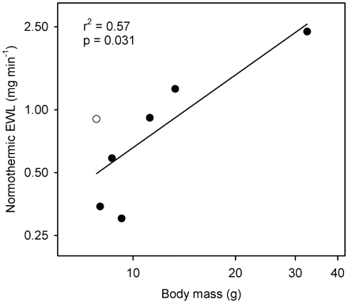
Fig. 2 Relationship between body mass and normothermic EWL for seven bat species, including our new data for ...
Notes:
Fig. 2 Relationship between body mass and normothermic EWL for seven bat species, including our new data for Natterer’s bats. Both axes are plotted on a log scale. Little brown bats, the species hardest hit by WNS, are represented by the empty circle. Ambient humidity during EWL measurement was comparable across species in this analysis and body mass—EWL residuals were significantly higher for little brown bats than the average for all other species. See text for regression results.
Unless provided in the caption above, the following copyright applies to the content of this slide: © The Author 2011. Published by Oxford University Press on behalf of the Society for Integrative and Comparative Biology. All rights reserved. For permissions please email: journals.permissions@oup.com.

Slide 4
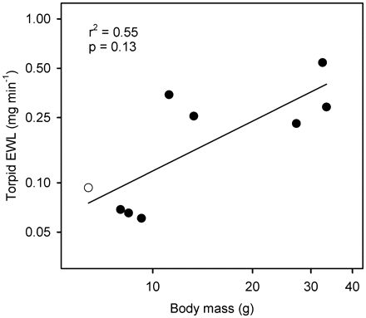
Fig. 1 Relationship between body mass and torpid EWL for nine bat species including our new data for Natterer’s ...
Notes:
Fig. 1 Relationship between body mass and torpid EWL for nine bat species including our new data for Natterer’s bats. Both axes are plotted on a log scale. Little brown bats, the species hardest hit by WNS, are represented by the empty circle. Body mass—EWL residuals were not significantly higher for little brown bats than the average for all species but few studies reported ambient humidity during measurement for other species which could have introduced unexplained variation. See text for regression results.
Unless provided in the caption above, the following copyright applies to the content of this slide: © The Author 2011. Published by Oxford University Press on behalf of the Society for Integrative and Comparative Biology. All rights reserved. For permissions please email: journals.permissions@oup.com.

