Slide 1
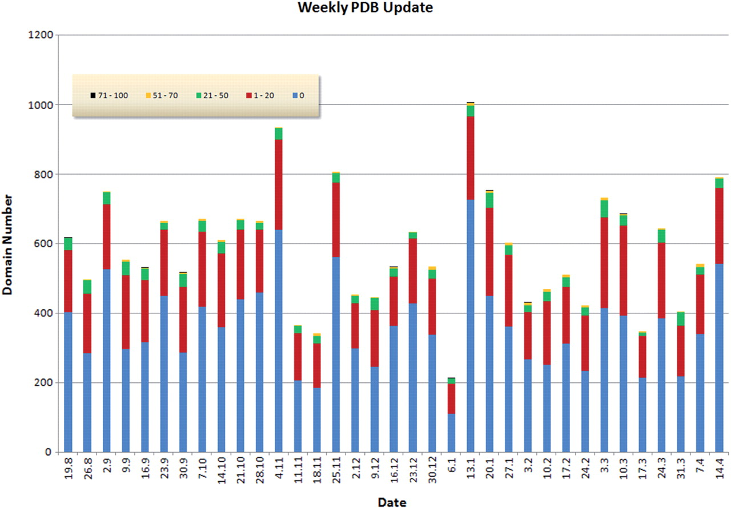
Figure 1. Novelty of structures found in the weekly releases of PDB. The data and graphics are obtained from the COPS ...
Notes:
Figure 1. Novelty of structures found in the weekly releases of PDB. The data and graphics are obtained from the COPS web server. The figure covers the period from 19 August 2008 to 14 April 2009. The bars indicate the number of domains found in the weekly releases of PDB (adding to a total of 20 373 domains). Novelty, N, is defined as the number of residues of a new domain that are not covered by the most similar structure already in COPS, divided by the length of the new domain (i.e. expressed as a percentage). A novelty of 20%, for example, indicates that the new domain has a structural similarity to a previously known domain which covers 80% of the new domain, and hence only 20% is new. The coloring used for the bars represents the novelty, i.e. blue corresponds to N = 0 (zero novelty), red to the range 1 ≤ N ≤ 20% and so on, as indicated by the insert. Over the period considered here there are on average five domains per release that have a novelty >50% and 29 domains that have a novelty in the range 21 ≤ N ≤ 50%. Hence, each release adds a significant amount of new structures which is immediately accessible through the COPS web server. On the other hand, there are many structures that are identical (blue, roughly 370 domains per release) or very similar to previously known folds (red, roughly 180 domains per release).
Unless provided in the caption above, the following copyright applies to the content of this slide: © 2009 The Author(s)This is an Open Access article distributed under the terms of the Creative Commons Attribution Non-Commercial License (http://creativecommons.org/licenses/by-nc/2.0/uk/) which permits unrestricted non-commercial use, distribution, and reproduction in any medium, provided the original work is properly cited.

Slide 2
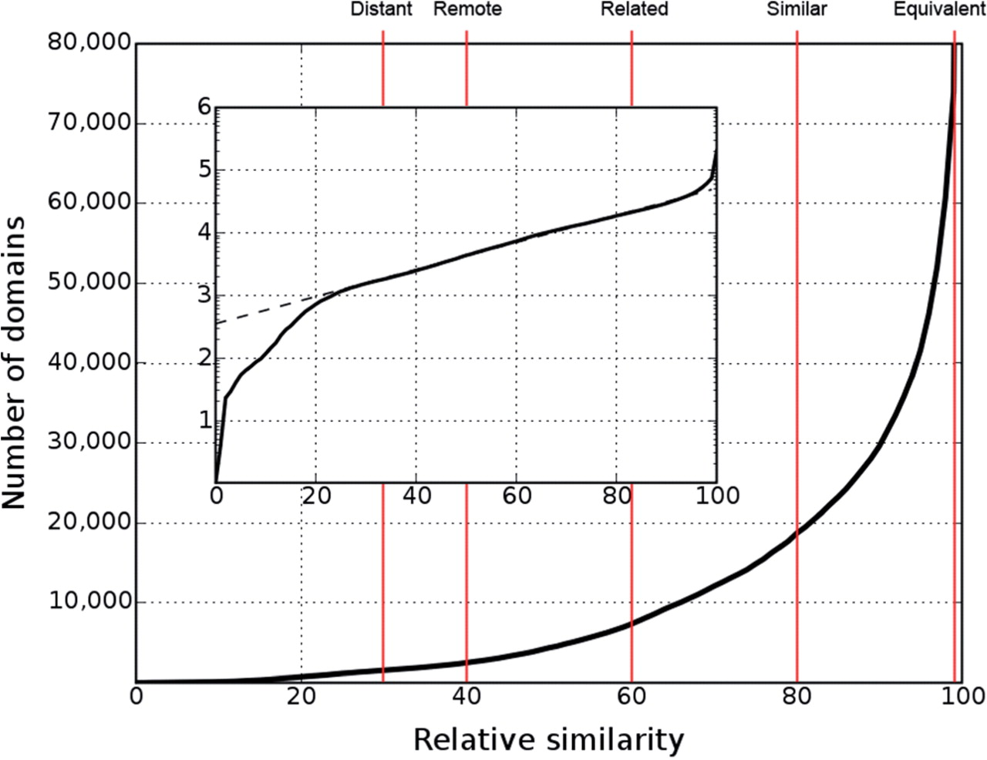
Figure 2. Number of distinguishable folds (domains) as a function of relative similarity s. As shown in the insert, in ...
Notes:
Figure 2. Number of distinguishable folds (domains) as a function of relative similarity s. As shown in the insert, in the range 20 ≤ s ≤ 95 the logarithm (log10) of the number of distinguishable folds rises linearly as a function of relative similarity s. Hence, within this range the number of distinguishable folds, n, follows an exponential law n ≈ 10λs, where λ is the slope of log10n in the linear range (9). Red lines denote the relative similarity cut-offs of the layers defined in COPS. The descriptive name of each layer is shown at the top end of the respective line. The names are chosen to relate the numerical definitions to their intuitive meaning (8). The layers may also be referred to by their short names (the character L+the relative similarity: L30, L40, L60, L80, L99).
Unless provided in the caption above, the following copyright applies to the content of this slide: © 2009 The Author(s)This is an Open Access article distributed under the terms of the Creative Commons Attribution Non-Commercial License (http://creativecommons.org/licenses/by-nc/2.0/uk/) which permits unrestricted non-commercial use, distribution, and reproduction in any medium, provided the original work is properly cited.

Slide 3
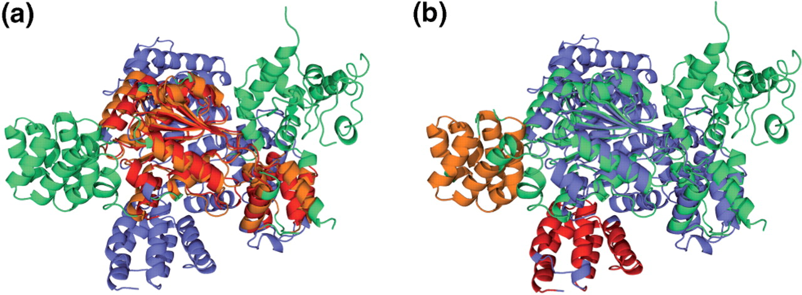
Figure 4. Superimposition of chains 1z6t-A and 2a5y-B. Both chains are not superimposeable as a whole, although the ...
Notes:
Figure 4. Superimposition of chains 1z6t-A and 2a5y-B. Both chains are not superimposeable as a whole, although the constituting domains have considerable structural similarities (Figure 3b). The TopMatch algorithm (11) provides several solutions (alternative alignments) for the comparison of two protein structures, which is most auxiliary in the current example where chains have undergone major conformational changes. (a) Alignment with c1z6tA2 and c1z6tA3 superimposed on domains c2a5yB2 and c2a5yB3. (b) Alternative alignment, showing structural equivalences of c1z6tA1 (red) and domain c2a5yB1 (orange) while the chains remain in the superimposition displayed in Figure 4a.
Unless provided in the caption above, the following copyright applies to the content of this slide: © 2009 The Author(s)This is an Open Access article distributed under the terms of the Creative Commons Attribution Non-Commercial License (http://creativecommons.org/licenses/by-nc/2.0/uk/) which permits unrestricted non-commercial use, distribution, and reproduction in any medium, provided the original work is properly cited.

Slide 4
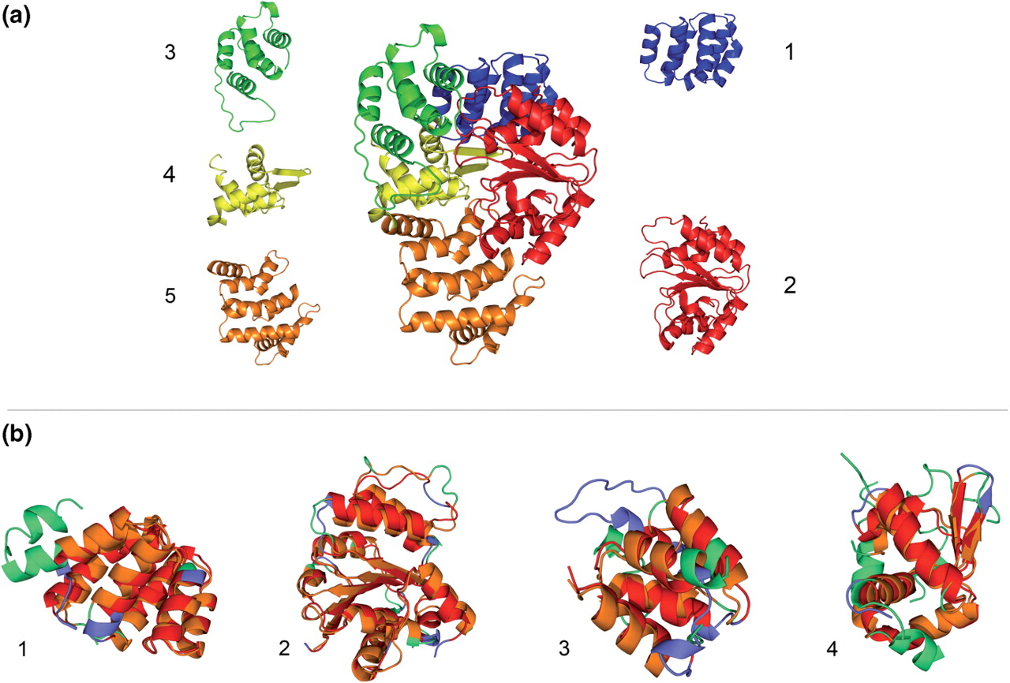
Figure 3. Automatic domain decomposition (a) and structural neighbors (b) of the human Apaf-1 [PDB code 1z6t (14)] as ...
Notes:
Figure 3. Automatic domain decomposition (a) and structural neighbors (b) of the human Apaf-1 [PDB code 1z6t (14)] as provided by the COPS web server. (a) Chain A of 1z6t surrounded by the respective domains from the automatic domain decomposition. The colors indicate the position of the domains in the chain and the numbers denote the order on the amino acid sequence from N- to C-terminus. The borders of the chopped domains are in high agreement with the domain decomposition provided by the authors (14). (b) Superimpositions of the first four domains defined in (a) with the respective structural neighbors identified in chain B of the CED-4-CED-9 complex [PDB code 2a5y, (15)] of C. elegans in COPS. The domains of 1z6t are colored blue, domains of 2a5y are colored green and structurally equivalent regions are colored red and orange, respectively. Again, the numbers denote the order on the amino acid sequence from N- to C-terminus. (b1) COPS domain c1z6tA1 (CARD domain) with c2a5yB1, (b2) c1z6tA2 (α/β domain) with c2a5yB2, (b3) c1z6tA3 (helical domain I) with c2a5yB3 and (b4) c1z6tA4 (winged-helix domain) with c2a5yB4. Superimpositions were calculated with TopMatch (11).
Unless provided in the caption above, the following copyright applies to the content of this slide: © 2009 The Author(s)This is an Open Access article distributed under the terms of the Creative Commons Attribution Non-Commercial License (http://creativecommons.org/licenses/by-nc/2.0/uk/) which permits unrestricted non-commercial use, distribution, and reproduction in any medium, provided the original work is properly cited.

