Slide 1
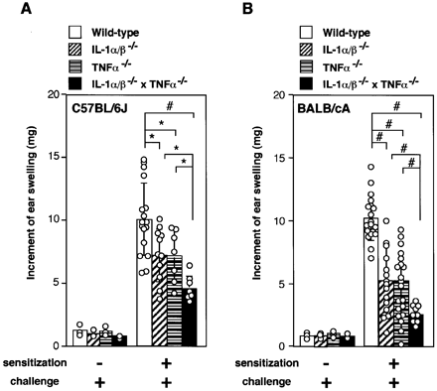
Fig. 1. Effect of IL‐1 and TNF‐α deficiency on TNCB‐induced CHS. Ear swelling following TNCB‐induced CHS was ...
Notes:
Fig. 1. Effect of IL‐1 and TNF‐α deficiency on TNCB‐induced CHS. Ear swelling following TNCB‐induced CHS was measured in IL‐1α/β–/–, TNF‐α–/– and IL‐1α/β–/– × TNF‐α–/– mice. (A) TNCB‐induced CHS using C57BL/6J wild‐type, IL‐1α/β–/–, TNF‐α–/– and IL‐1α/β–/– × TNF‐α–/– mice. (B) TNCB‐induced CHS using BALB/cA wild‐type, IL‐1α/β–/–, TNF‐α–/– and IL‐1α/β–/– × TNF‐α–/– mice. Each circle represents an individual mouse. Averages ± SD for groups of mice are shown. Student’s t‐test was used for statistical evaluation of the results. *P < 0.05 and #P < 0.001.
Unless provided in the caption above, the following copyright applies to the content of this slide:

Slide 2
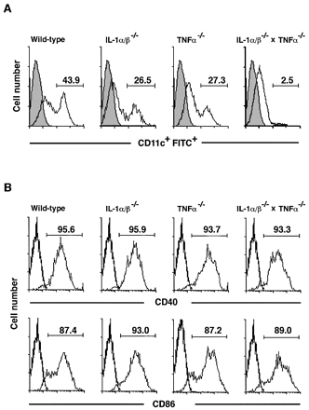
Fig. 2. Effect of IL‐1 and TNF‐α deficiency on LC migration and maturation. Mice were sensitized ...
Notes:
Fig. 2. Effect of IL‐1 and TNF‐α deficiency on LC migration and maturation. Mice were sensitized epicutaneously with 0.5% FITC. After 24 h, draining LN were harvested and analyzed for FITC staining (A) and CD40/CD86 expression (B) by flow cytometry. (A) Content of FITC+ cells within the CD11c+ population derived from wild‐type, IL‐1α/β–/–, TNF‐α–/– and IL‐1α/β–/– × TNF‐α–/– mice. Shaded area shows non‐treated mice. (B) The expression of CD40 and CD86 among CD11c+ FITC+ cells from wild‐type, IL‐1α/β–/–, TNF‐α–/– and IL‐1α/β–/– × TNF‐α–/– mice. Solid lines show isotype‐matched control Ig staining. One representative result from four independent experiments is shown.
Unless provided in the caption above, the following copyright applies to the content of this slide:

Slide 3
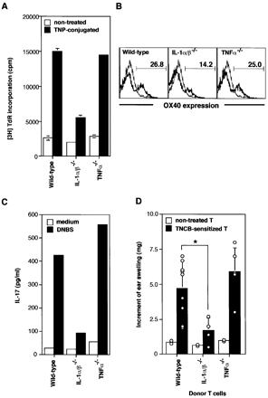
Fig. 3. Effect of IL‐1 and TNF‐α deficiency on hapten‐specific T cell induction. (A) LN were harvested 5 days ...
Notes:
Fig. 3. Effect of IL‐1 and TNF‐α deficiency on hapten‐specific T cell induction. (A) LN were harvested 5 days after sensitization with 3.0% TNCB. T cells were purified using MACS separation columns. LN T cells (5×105 cells) from TNCB‐sensitized mice were cultured for 72 h with either irradiated TNP‐conjugated APC (2×105 cells) or non‐treated APC from C57BL/6J splenocytes depleted of T cells. The proliferative response was assessed by [3H]thymidine incorporation. The result was reproduced in three independent experiments. (B) LN cells (4×105 cells) from 0.2% DNFB‐sensitized mice were cultured in the absence or presence of 40 µg/ml DNBS for 72 h. After 72 h of culture, cells were harvested and stained with FITC–anti‐mouse CD4 mAb and PE–anti‐mouse OX40 mAb. The expression of OX40 on CD4+ T cells was analyzed by FACS. Thin lines indicate isotype‐matched control Ig staining and solid lines demonstrate staining with anti‐OX40 mAb. The result was reproducible in three independent experiments. (C) IL‐17 levels in supernatants from (B) were measured by ELISA. The result was reproducible in three independent experiments. (D) LN T cells (2×107 cells) from non‐treated or TNCB‐sensitized wild‐type, IL‐1α/β–/– and TNF‐α–/– mice were injected i.v. into non‐sensitized wild‐type mice. Ear swelling following TNCB‐induced CHS was measured 5 days later, as performed in Fig. 1. Each circle represents an individual mouse. An average ± SD for each group of mice is shown. Student’s t‐test was used for statistical evaluation of the results. *P < 0.05.
Unless provided in the caption above, the following copyright applies to the content of this slide:

Slide 4
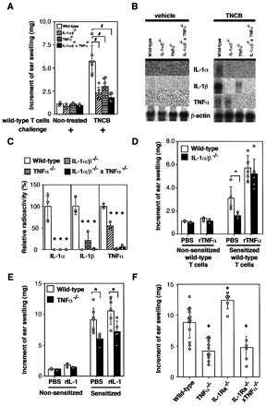
Fig. 4. Roles of IL‐1 and TNF‐α in the elicitation phase of CHS. (A) Non‐treated or TNCB‐sensitized wild‐type ...
Notes:
Fig. 4. Roles of IL‐1 and TNF‐α in the elicitation phase of CHS. (A) Non‐treated or TNCB‐sensitized wild‐type LN T cells were injected i.v. into non‐sensitized wild‐type, IL‐1α/β–/–, TNF‐α–/– and IL‐1α/β–/– × TNF‐α–/– mice. One day later, mice were challenged with 1.0% TNCB and ear swelling was measured after 24 h. (B) Northern blot hybridization analysis of cytokine expression in the vehicle‐ or TNCB‐challenged ear skin from TNCB‐sensitized mice measured in (A). (C) Cytokine mRNA levels relative to those of wild‐type control mice. Ratios of examined expression to TNCB‐sensitized and ‐challenged wild‐type control expression were determined by the radioactive intensity of the bands shown in (B). The radioactive intensity of each band was normalized to the β‐actin band signal. The relative values of deficient mice against wild‐type mice are shown. Each circle represents an individual mouse. An average ± SD for each group of mice is shown. Wild‐type (n = 3), IL‐1α/β–/– (n = 3), TNF‐α–/– (n = 3) and IL‐1α/β–/– × TNF‐α–/– (n = 3) mice. (D) Non‐treated or TNCB‐sensitized wild‐type LN T cells were injected i.v. into non‐sensitized wild‐type and IL‐1α/β–/– mice. One day after transplantation, mice were challenged with 1.0% TNCB and injected with 50 ng of rTNF‐α intradermally. Ear swelling was measured after 24 h. (E) Five days after sensitization with 3.0% TNCB, wild‐type and TNF‐α–/– mice were challenged with 1.0% TNCB and injected 50 ng of rIL‐1α/β intradermally. Ear swelling was measured after 24 h. Each circle represents an individual mouse. An average and SD for each group of mice is shown. (F) Ear swelling following TNCB‐induced CHS was measured in wild‐type, IL‐1Ra–/–, TNF‐α–/– and IL‐1Ra–/– × TNF‐α–/– mice as shown in Fig. 1. Each circle represents an individual mouse. Averages ± SD for groups of mice are shown. Student’s t‐test was used for statistical evaluation of the results. *P < 0.05 and #P < 0.001.
Unless provided in the caption above, the following copyright applies to the content of this slide:

Slide 5
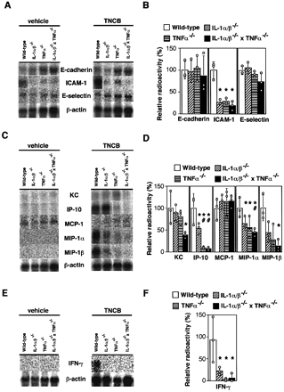
Fig. 5. Effect of IL‐1 and TNF‐α deficiency on the mRNA expression of adhesion molecules and chemokines. mRNA ...
Notes:
Fig. 5. Effect of IL‐1 and TNF‐α deficiency on the mRNA expression of adhesion molecules and chemokines. mRNA levels for adhesion molecules (A and B), chemokines (C and D) and IFN‐γ (E and F) were measured in vehicle‐ or TNCB‐challenged ear skin of wild‐type, IL‐1α/β–/–, TNF‐α–/– and IL‐1α/β–/– × TNF‐α–/– mice using Northern blot hybridization. (A, C and E) Northern blot analysis. (B, D and F) Quantitated relative radioactivity of the mRNA bands on the autoradiograms. *P < 0.05 versus wild‐type mice and #P < 0.05 versus IL‐1α/β–/– mice.
Unless provided in the caption above, the following copyright applies to the content of this slide:

Slide 6
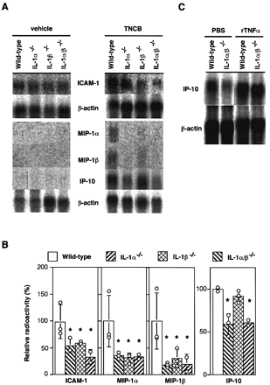
Fig. 6. mRNA expression of adhesion molecules and chemokines in IL‐1α–/–, IL‐1β–/– and ...
Notes:
Fig. 6. mRNA expression of adhesion molecules and chemokines in IL‐1α–/–, IL‐1β–/– and IL‐1α/β–/– mice. mRNA levels relative to wild‐type control levels for the adhesion molecules and chemokines in vehicle‐ or TNCB‐challenged ear skin of wild‐type, IL‐1α–/–, IL‐1β–/– and IL‐1α/β–/– mice were measured as described in Fig. 5. (A) Northern blot analysis. (B) Quantitated relative radioactivity of the mRNA bands on the autoradiograms. *P < 0.05 versus wild‐type mice. (C) The reduced IP‐10 mRNA expression in the skin of IL‐1α/β–/– mice after treatment with TNCB recovered following an injection with rTNF‐α. Five days after TNCB‐sensitized T cell injection, mice were challenged with 1.0% TNCB and given 50 ng of TNF‐α by intradermal injection in the ear. mRNA was collected from the ear 3 h after TNF‐α injection and analyzed by Northern blot hybridization.
Unless provided in the caption above, the following copyright applies to the content of this slide:

Slide 7
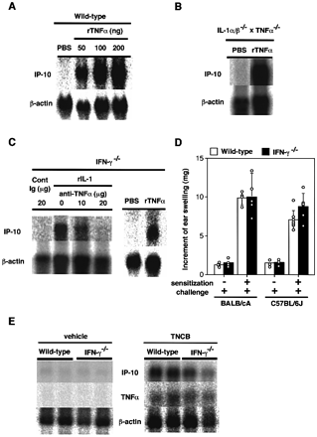
Fig. 7. IFN‐γ‐independent IP‐10 production by TNF‐α. rIL‐1 or rTNF‐α was injected intradermally into the ear ...
Notes:
Fig. 7. IFN‐γ‐independent IP‐10 production by TNF‐α. rIL‐1 or rTNF‐α was injected intradermally into the ear skin of wild‐type, IFN‐γ–/–, IL‐1α/β–/– × TNF‐α–/– mice. At 3 h after the injection, total mRNA from the ear was prepared. IP‐10 mRNA expression was analyzed by (A) Northern blot hybridization. rTNF‐α was injected intradermally into the ears of wild‐type mice. Dose‐dependent expression of IP‐10 was measured. (B) rTNF‐α (100 ng) was injected intradermally into the ears of IL‐1α/β–/– × TNF‐α–/– mice. (C) The effect of anti‐TNF‐α on rIL‐1‐induced IP‐10 expression was analyzed by intradermal injection of rIL‐1 (100 ng) concurrently with either anti‐TNF‐α or control Ig (20 µg) into the ears of IFN‐γ–/– mice. The effect of rTNF‐α (100 ng) injection was also analyzed. (D) TNCB‐induced CHS using wild‐type and IFN‐γ–/– mice on the BALB/cA background, and wild‐type and IFN‐γ–/– mice on the C57BL/6J background. Ear swelling was measured after 24 h. Each circle represents an individual mouse. An average ± SD for each group of mice is shown. (E) The effect of IFN‐γ deficiency on IP‐10 and TNF‐α expression in vehicle‐ or TNCB‐challenged ear skin was analyzed. Each lane represents an individual mouse.
Unless provided in the caption above, the following copyright applies to the content of this slide:

Slide 8
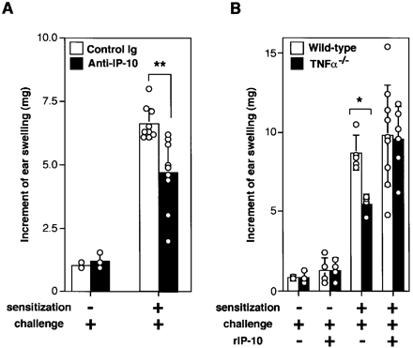
Fig. 8. The role of IP‐10 in CHS. Five days after sensitization with 3.0% TNCB, mice were challenged with ...
Notes:
Fig. 8. The role of IP‐10 in CHS. Five days after sensitization with 3.0% TNCB, mice were challenged with 1.0% TNCB and injected with either 100 µg of anti‐mouse IP‐10 mAb or 1 µg of rmIP‐10 intradermally into the ear. Ear swelling was then measured. (A) Wild‐type mice were treated with either control Ig or anti‐IP‐10 mAb. (B) Wild‐type mice or TNF‐α–/– mice were treated with PBS or rIP‐10 before or after sensitization with TNCB and then ear swelling was measured. Each circle represents an individual mouse. An average ± SD for each group of mice is shown. Student’s t‐test was used for statistical evaluation of the results. *P < 0.05 and **P < 0.001.
Unless provided in the caption above, the following copyright applies to the content of this slide:

