Slide 1
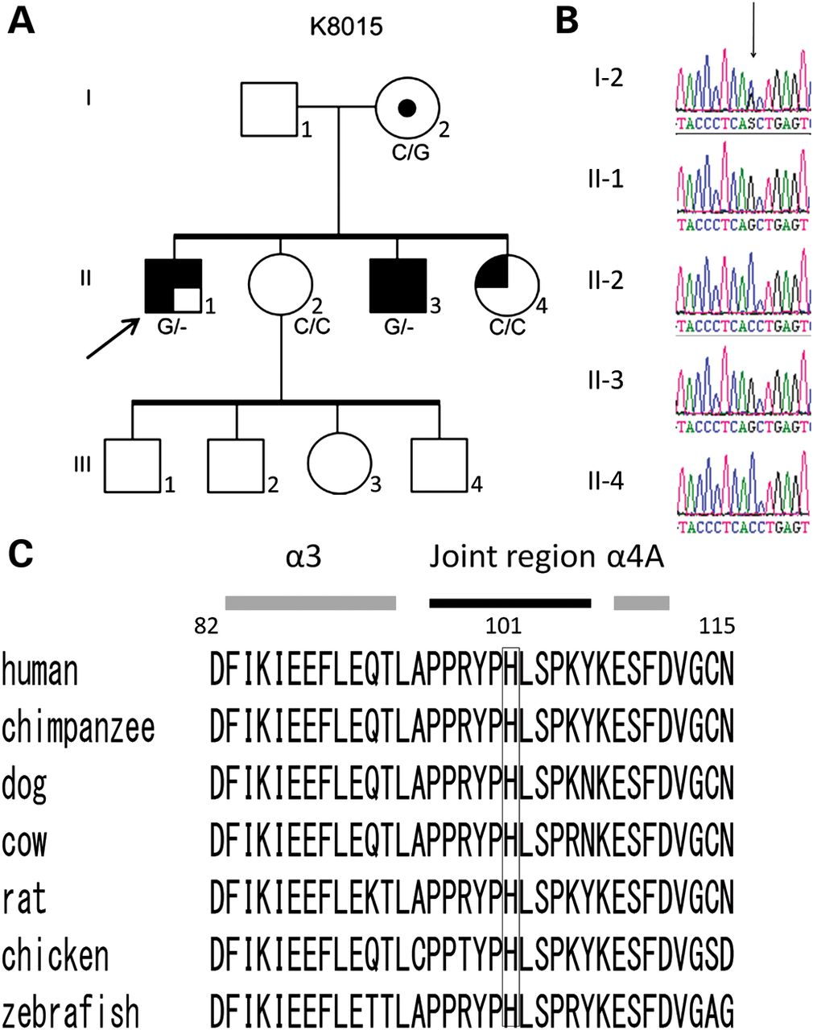
Figure 1. Analysis of CLIC2 mutation in family K8015. (A) Pedigree of K8015. The proband is indicated with an arrow. ...
Notes:
Figure 1. Analysis of CLIC2 mutation in family K8015. (A) Pedigree of K8015. The proband is indicated with an arrow. The genotype (C and/or G) at position c.303 of the CLIC2 gene is indicated below each individual sequence. Symbols correspond to the following clinical feature: , ID; , seizures; , abnormal positioning of the thumb; , macrocephaly. (B) Sanger sequencing. Ideograms for individuals in K8015 showing the two affected males and their mother have the position c.303. (C) Alignment of CLIC2 protein orthologs. Numbers show the amino acid position of human CLIC2 protein. The H101 position is conserved down to zebrafish. Shaded bars and closed bar indicate α-helices and joint region, respectively.
Unless provided in the caption above, the following copyright applies to the content of this slide: © The Author 2012. Published by Oxford University Press. All rights reserved. For Permissions, please email: journals.permissions@oup.com

Slide 2
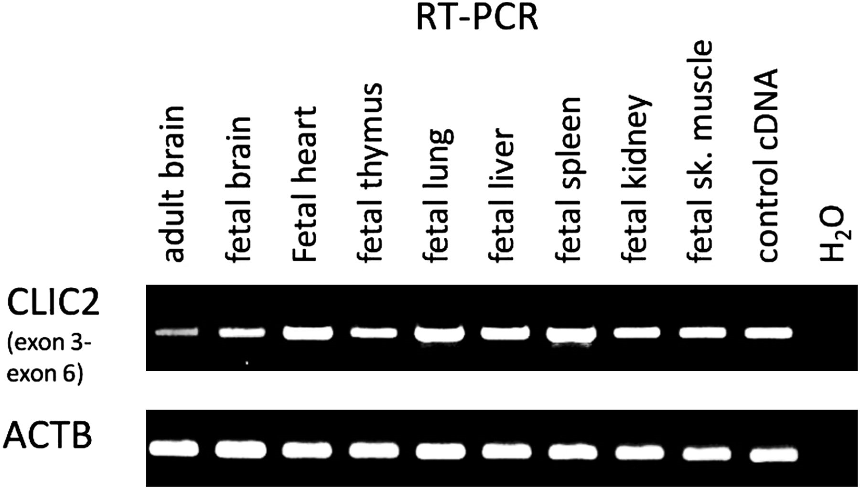
Figure 2. CLIC2 expression. RT–PCR analysis of CLIC2 in various human fetal tissues was conducted using cDNA ...
Notes:
Figure 2. CLIC2 expression. RT–PCR analysis of CLIC2 in various human fetal tissues was conducted using cDNA preparations available in an MTC panel (Clontech) and primers covering exons 3–6. CLIC2 was expressed in all tissues including the fetal brain. It is highly expressed in the fetal lung and spleen. The expression of ACT8 was used as a control.
Unless provided in the caption above, the following copyright applies to the content of this slide: © The Author 2012. Published by Oxford University Press. All rights reserved. For Permissions, please email: journals.permissions@oup.com

Slide 3
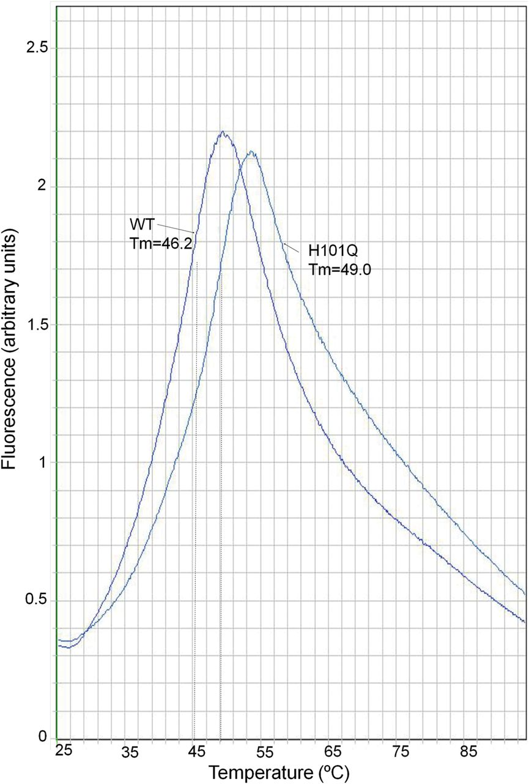
Figure 3. Heat denaturation of CLIC2 and the H101Q. Heat denaturation of CLIC2 and the H101Q variant determined by ...
Notes:
Figure 3. Heat denaturation of CLIC2 and the H101Q. Heat denaturation of CLIC2 and the H101Q variant determined by differential scanning fluorimetry with SYPRO orange. The vertical dashed lines indicate the Tm. The spectra are representative of triplicate determinations.
Unless provided in the caption above, the following copyright applies to the content of this slide: © The Author 2012. Published by Oxford University Press. All rights reserved. For Permissions, please email: journals.permissions@oup.com

Slide 4
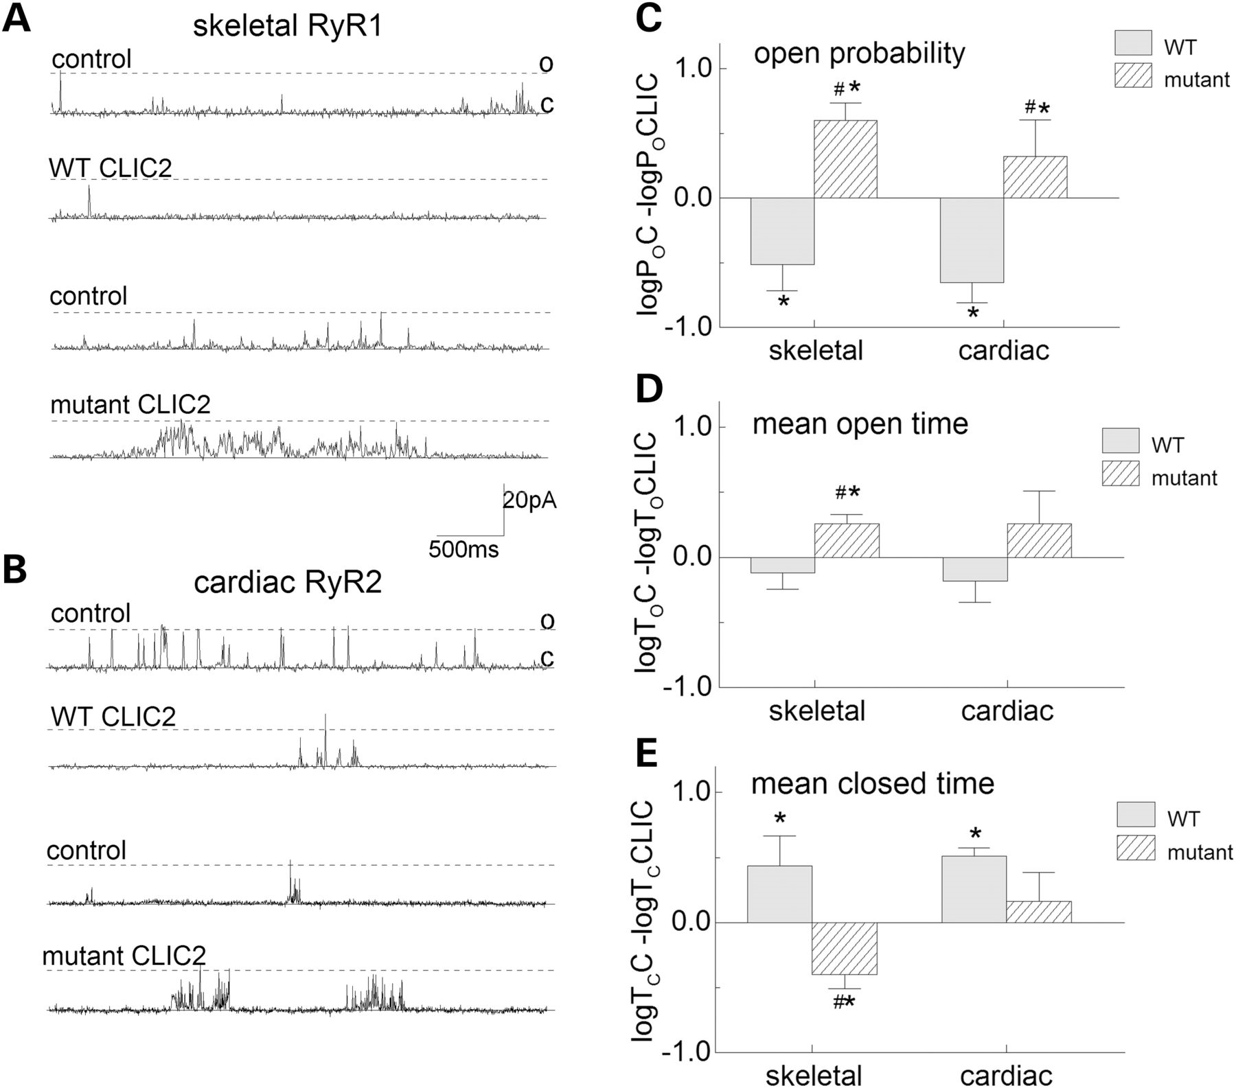
Figure 4. Actions of WT and H101Q mutant CLIC2 channels on skeletal RyR1 and cardiac RyR2 channels incorporated into ...
Notes:
Figure 4. Actions of WT and H101Q mutant CLIC2 channels on skeletal RyR1 and cardiac RyR2 channels incorporated into lipid bilayers. (A) Three second current recordings from skeletal RyR1 channels at pH 7.2. Activity of one channel before and after exposure to WT CLIC2 (upper two records) and a second channel before and after exposure to the H101Q mutant protein (lower records). (B) Records of 3 s of activity from cardiac RyR2 channels. Activity of one channel before and after exposure to WT CLIC2 (upper two records) and from a second channel before and after exposure to the H101Q mutant protein (lower two records). In (A) and (B), channel activity is recorded at +40 mV and channel opening is upward from the closed level (c) to the maximum single channel current (broken line, o). Effects of average relative open probability (C), mean open time (D) and mean closed time (E). For each parameter the logarithm (to the base 10) of the relative change is shown. For example, the log of the control open probability (log PoC) is subtracted from the log of the open probability in the presence of CLIC2 (log PoCLIC) was calculated for each channel and average data presented. The log relative Po is given to reduce the effect of the normal variability in control RyR channel activity (58). The asterisk indicates a significant difference from control and the hash symbol indicates a significant difference between the effects of the WT CLIC2 and the H101Q mutant protein.
Unless provided in the caption above, the following copyright applies to the content of this slide: © The Author 2012. Published by Oxford University Press. All rights reserved. For Permissions, please email: journals.permissions@oup.com

Slide 5
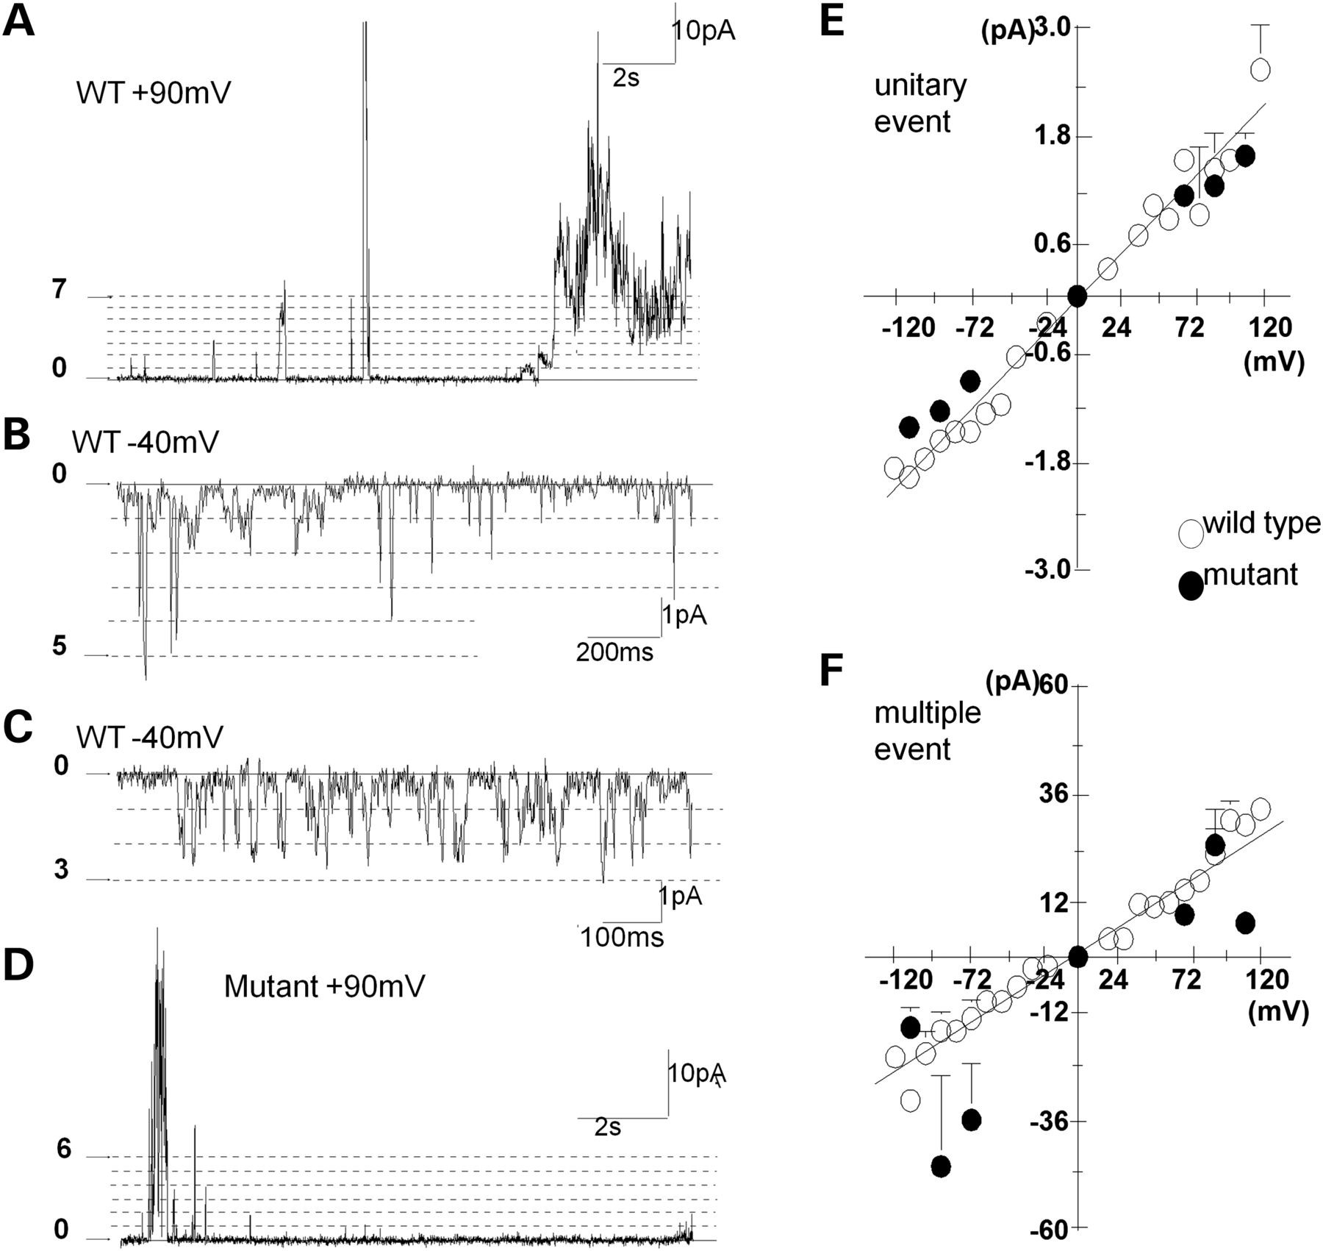
Figure 5. WT and H101Q mutant CLIC2 channel activity recorded at pH 5.0 with 1 mm GSSG. (A–D) Current recordings ...
Notes:
Figure 5. WT and H101Q mutant CLIC2 channel activity recorded at pH 5.0 with 1 mm GSSG. (A–D) Current recordings following the incorporation of CLIC2 channels. The broken lines indicate conductance levels which were multiples of the unitary conductance [∼2 pA at +90 mV in (A) and (D) or ∼1 pA at −40 mV in (B) and (C)]. (A–C) Examples of different gating modes recorded during one experiment in which WT CLIC2 protein was added to the bilayer solution. (A) Continuous 16 s recording in which the channel is initially opening to the unitary conductance or multiples up to 7× the unitary conductance. After ∼8 min, there is a coordinated opening to ∼30× the unitary conductance. Finally, after ∼13 min, a prolonged burst of uncoordinated activity reaching the same maximum levels. (B) Approximately 5 min later in the experiment, periods of opening to levels 1–5 were apparent. (C) After a further 5 min, there were more rapid openings between levels 0 and 3. (D) A recording from a bilayer following incorporation of H101Q mutant CLIC2 channels. The gating is similar to that seen in the WT channel shown in (A). Average current–voltage relationship of unitary events (E) and maximal currents (F) for WT CLIC2 channels (open circles) and H101Q mutant CLIC2 channels (filled circles).
Unless provided in the caption above, the following copyright applies to the content of this slide: © The Author 2012. Published by Oxford University Press. All rights reserved. For Permissions, please email: journals.permissions@oup.com

