Slide 1
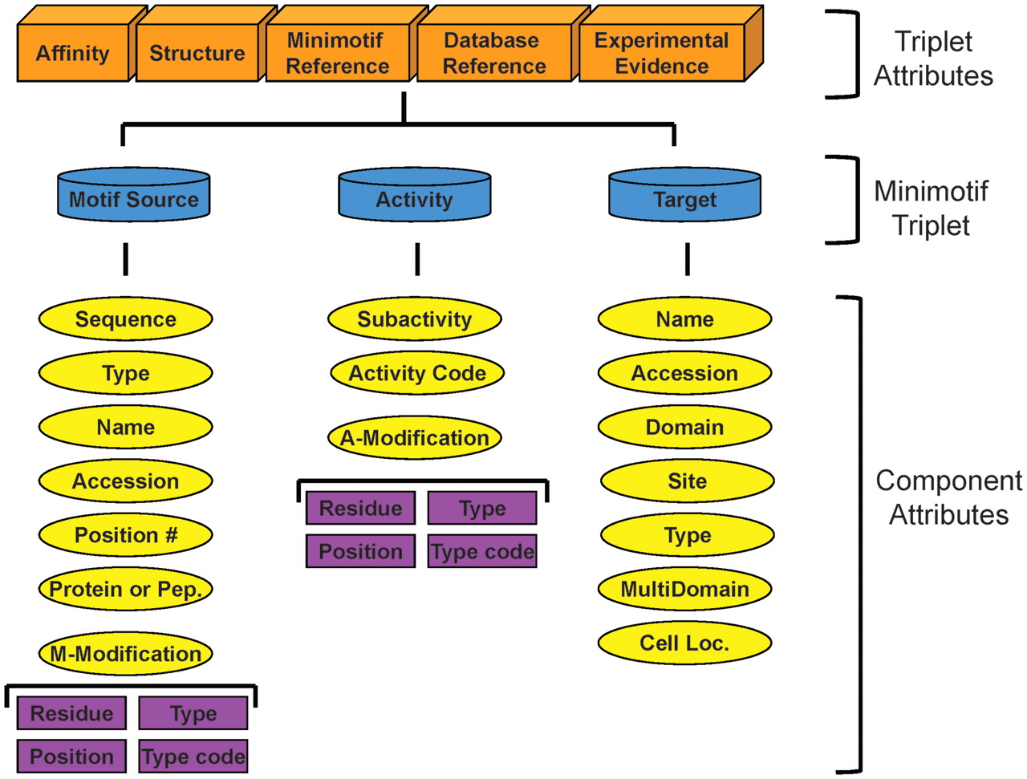
Figure 1. Revised minimotif model. The key elements of the minimotif syntax are colored blue. Orange boxes indicate ...
Notes:
Figure 1. Revised minimotif model. The key elements of the minimotif syntax are colored blue. Orange boxes indicate attributes that are unique to specific minimotif triplets. Yellow ovals are for different attributes of minimotif triplet elements. All attributes except those in the purple boxes were previously described in our minimotif model and the purple boxes are new attributes to define motif modifications and activity modifications (12).
Unless provided in the caption above, the following copyright applies to the content of this slide: © The Author(s) 2011. Published by Oxford University Press.This is an Open Access article distributed under the terms of the Creative Commons Attribution Non-Commercial License (http://creativecommons.org/licenses/by-nc/3.0), which permits unrestricted non-commercial use, distribution, and reproduction in any medium, provided the original work is properly cited.

Slide 2
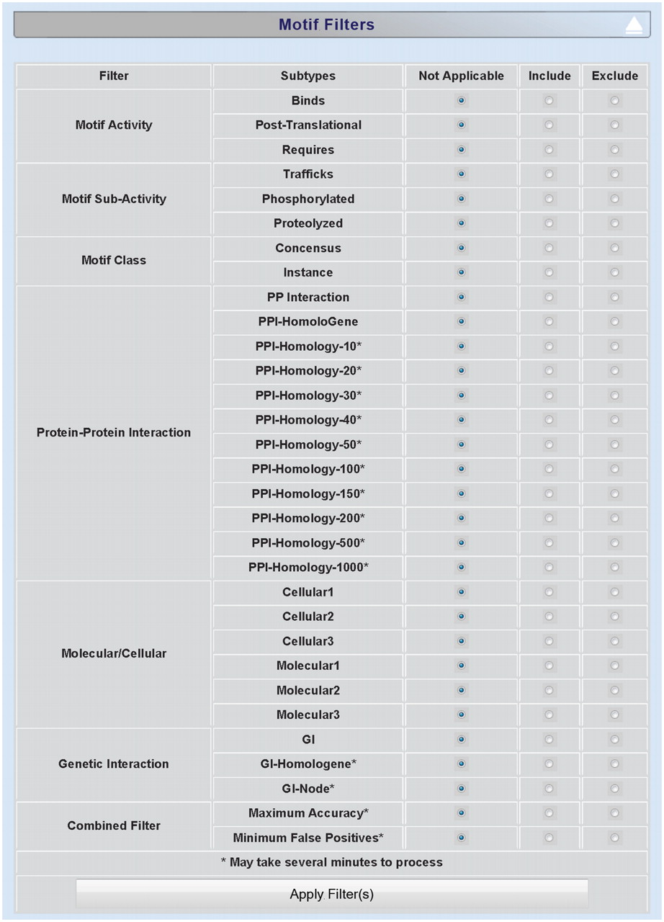
Figure 2. Screenshot of minimotif filter selection page. Screenshot of MnM 3 filter section for choosing approaches for ...
Notes:
Figure 2. Screenshot of minimotif filter selection page. Screenshot of MnM 3 filter section for choosing approaches for filtering out false-positive minimotifs.
Unless provided in the caption above, the following copyright applies to the content of this slide: © The Author(s) 2011. Published by Oxford University Press.This is an Open Access article distributed under the terms of the Creative Commons Attribution Non-Commercial License (http://creativecommons.org/licenses/by-nc/3.0), which permits unrestricted non-commercial use, distribution, and reproduction in any medium, provided the original work is properly cited.

Slide 3
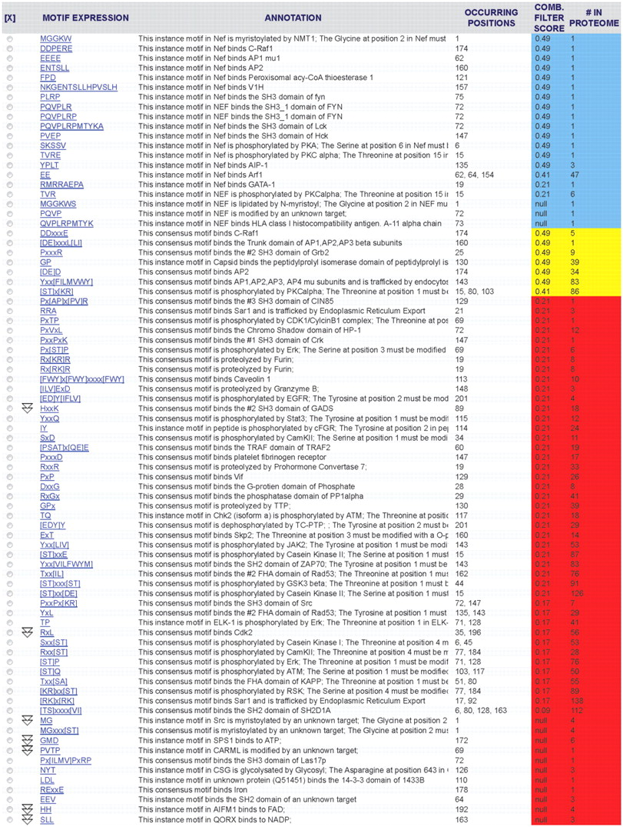
Figure 3. Results table in MnM 3 from analysis of HIV-1 Nef protein. Nef (NP_057857) was analyzed to produce the ...
Notes:
Figure 3. Results table in MnM 3 from analysis of HIV-1 Nef protein. Nef (NP_057857) was analyzed to produce the minimotif predictions shown. Column 1 shows the minimotif sequence, column 2 shows the function of the minimotif, column 3 shows the amino acid position(s) for the start residue in the minimotif, column 4 shows the combined filter score, and column 5 shows the number of occurrences of each motif in the entire HIV-1 proteome. Rows colored blue are for minimotifs that are experimentally validated, yellow are above a threshold for high accuracy prediction, and red are below this threshold or do not have data to calculate a combined filter score (null).
Unless provided in the caption above, the following copyright applies to the content of this slide: © The Author(s) 2011. Published by Oxford University Press.This is an Open Access article distributed under the terms of the Creative Commons Attribution Non-Commercial License (http://creativecommons.org/licenses/by-nc/3.0), which permits unrestricted non-commercial use, distribution, and reproduction in any medium, provided the original work is properly cited.

