Slide 1
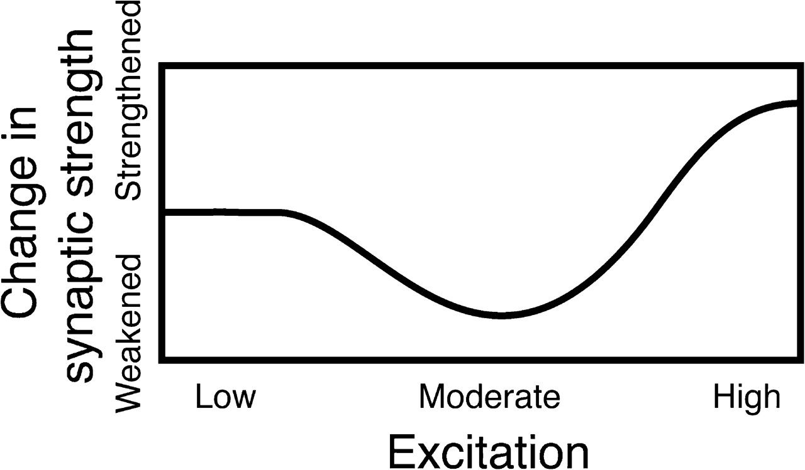
Figure 1. Hypothesized nonmonotonic relationship between the level of excitation of a neuron and modification of ...
Notes:
Figure 1. Hypothesized nonmonotonic relationship between the level of excitation of a neuron and modification of synapses involving that neuron. Moderate levels of excitation result in synaptic weakening, whereas stronger levels of excitation result in synaptic strengthening.
Unless provided in the caption above, the following copyright applies to the content of this slide: © The Author 2010. Published by Oxford University Press. All rights reserved. For permissions, please e-mail: journals.permissions@oxfordjournals.org

Slide 2
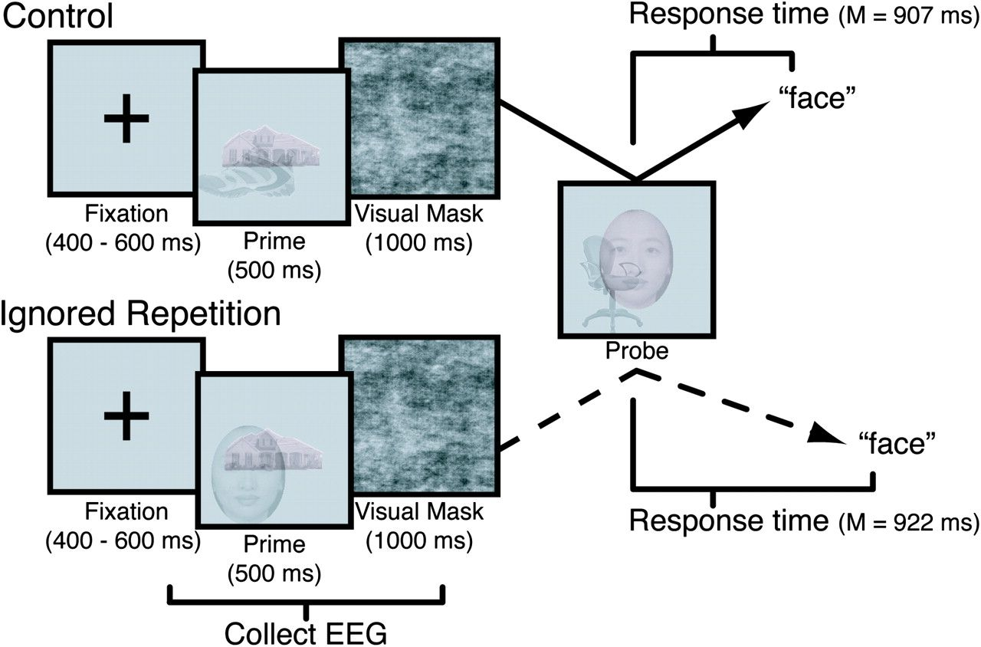
Figure 2. Negative priming task design comparing control trials and ignored repetition trials. In both the prime ...
Notes:
Figure 2. Negative priming task design comparing control trials and ignored repetition trials. In both the prime display and the probe display, subjects were instructed to attend to the centered red-tinted image (i.e., the target) and to ignore the offset grayscale image (i.e., the distractor). On control trials, the categories used in the probe display did not overlap with the categories used in the prime display. On ignored repetition trials, the probe target was identical to the prime distractor, and the probe distractor was sampled from a category that was not used in the prime display.
Unless provided in the caption above, the following copyright applies to the content of this slide: © The Author 2010. Published by Oxford University Press. All rights reserved. For permissions, please e-mail: journals.permissions@oxfordjournals.org

Slide 3
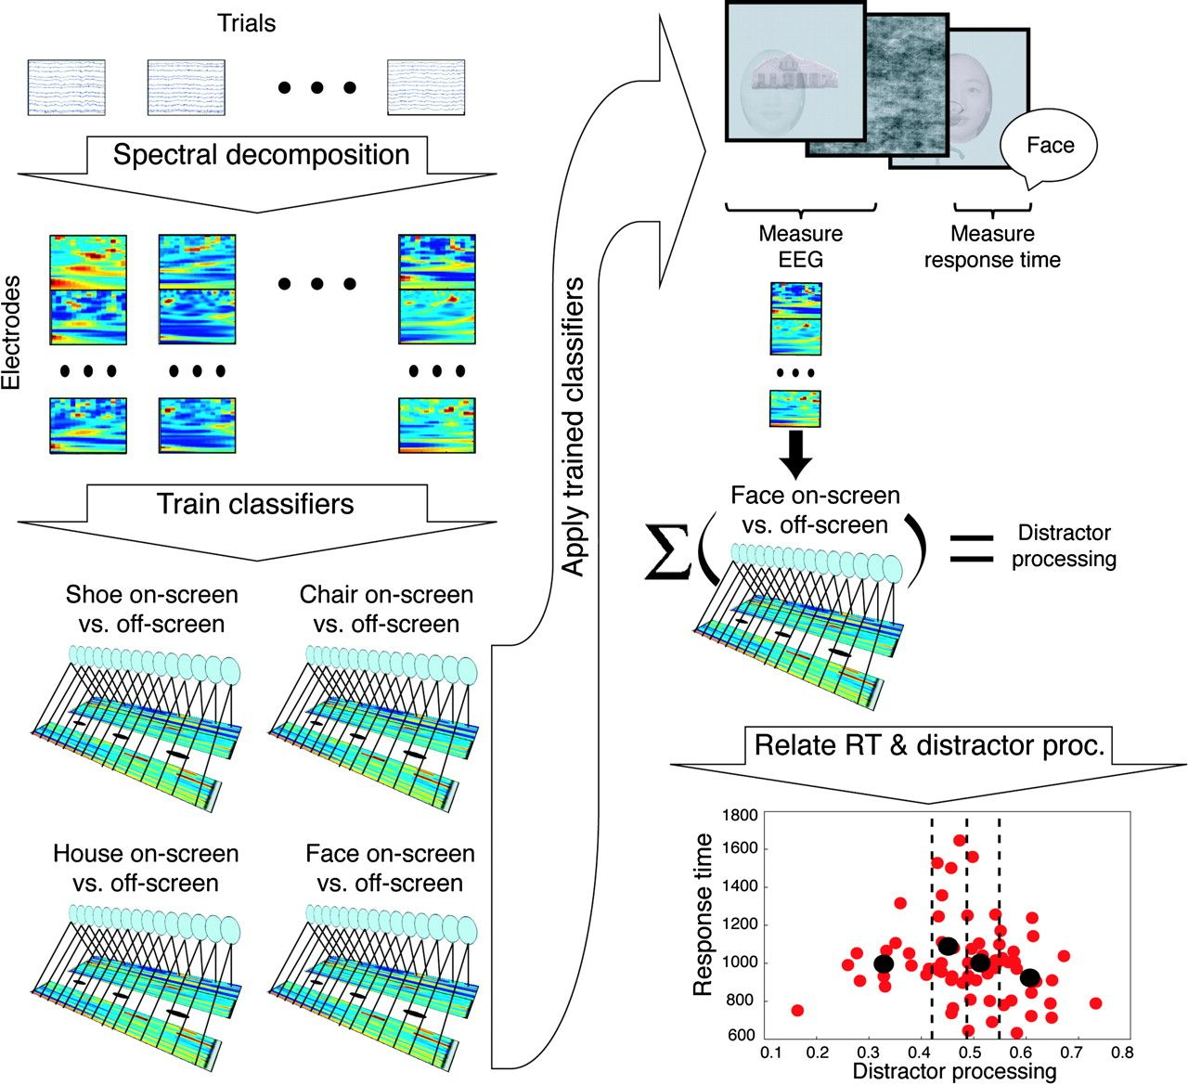
Figure 3. Overview of the EEG data analysis procedure. This procedure was run separately for each individual subject. ...
Notes:
Figure 3. Overview of the EEG data analysis procedure. This procedure was run separately for each individual subject. The spectral power of the rereferenced EEG around each trial was computed and downsampled to 50 samples per second. The spectral features from all of the electrodes were concatenated and used as inputs to pattern classifiers. The classifiers were trained using ridge regression to recognize when each stimulus category was being processed as the target image; a separate classifier was trained for each combination of stimulus category and time bin. Next, the trained classifiers were used to measure how strongly the prime distractor image was processed on each trial. Finally, subjects’ RTs (to the probe image) on individual trials were aligned to the classifier output from the respective trials. To assess the relationship between probe image RTs and prime image distractor processing, trials were sorted into quartiles based on the processing of the prime distractor (as measured by the classifier). We then computed the mean RT to the probe for each of the distractor-processing quartiles.
Unless provided in the caption above, the following copyright applies to the content of this slide: © The Author 2010. Published by Oxford University Press. All rights reserved. For permissions, please e-mail: journals.permissions@oxfordjournals.org

Slide 4
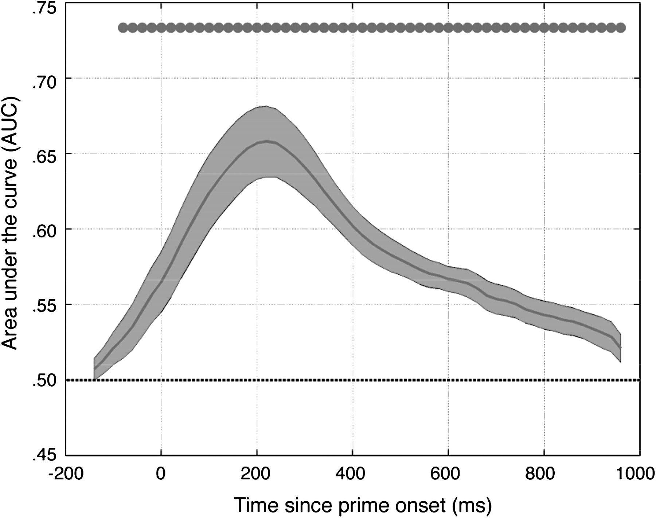
Figure 4. Average sensitivity of the classifier to the category of the prime target stimulus, combining across the 4 ...
Notes:
Figure 4. Average sensitivity of the classifier to the category of the prime target stimulus, combining across the 4 categories. Sensitivity was computed in a cross-validated fashion (i.e., different sets of trials were used for classifier training and testing). The solid black line plots the AUC computed at each time bin. The shaded region around this line indicates the standard error across subjects. The dotted black line along 0.5 marks chance performance. The dots along the top of the figure indicate which of the time bin–specific classifiers performed significantly above chance at the P < 0.05 level.
Unless provided in the caption above, the following copyright applies to the content of this slide: © The Author 2010. Published by Oxford University Press. All rights reserved. For permissions, please e-mail: journals.permissions@oxfordjournals.org

Slide 5
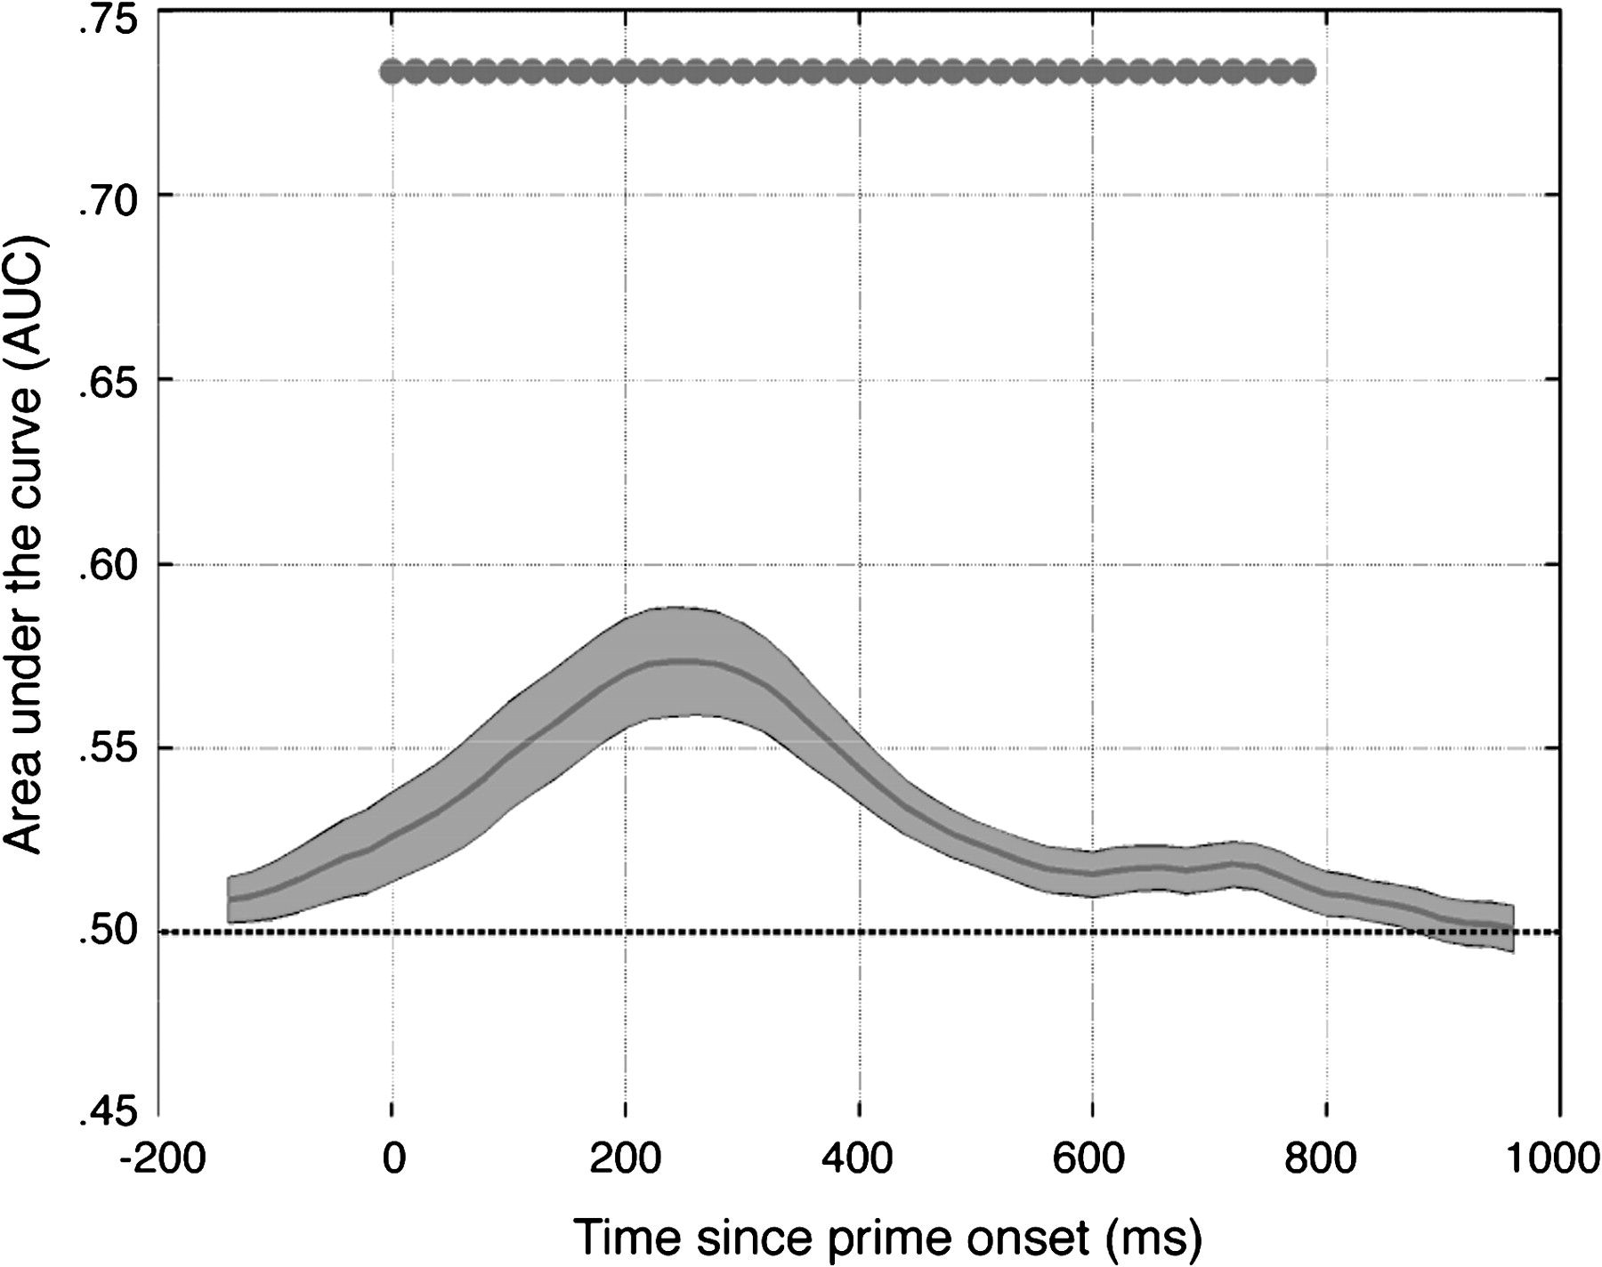
Figure 5. Average sensitivity of the classifier to the category of the prime distractor stimulus, combining across the ...
Notes:
Figure 5. Average sensitivity of the classifier to the category of the prime distractor stimulus, combining across the 4 categories. The classifier was trained on trials where the category was on-screen as the “target” stimulus and then tested on (other) trials where the category was on-screen as the “distractor” stimulus. The solid black line plots the AUC computed at each time bin. The shaded region around this line indicates the standard error across subjects. The dotted black line along 0.5 marks chance performance. The dots along the top of the figure indicate which of the time bin–specific classifiers performed significantly above chance at the P < 0.05 level.
Unless provided in the caption above, the following copyright applies to the content of this slide: © The Author 2010. Published by Oxford University Press. All rights reserved. For permissions, please e-mail: journals.permissions@oxfordjournals.org

Slide 6
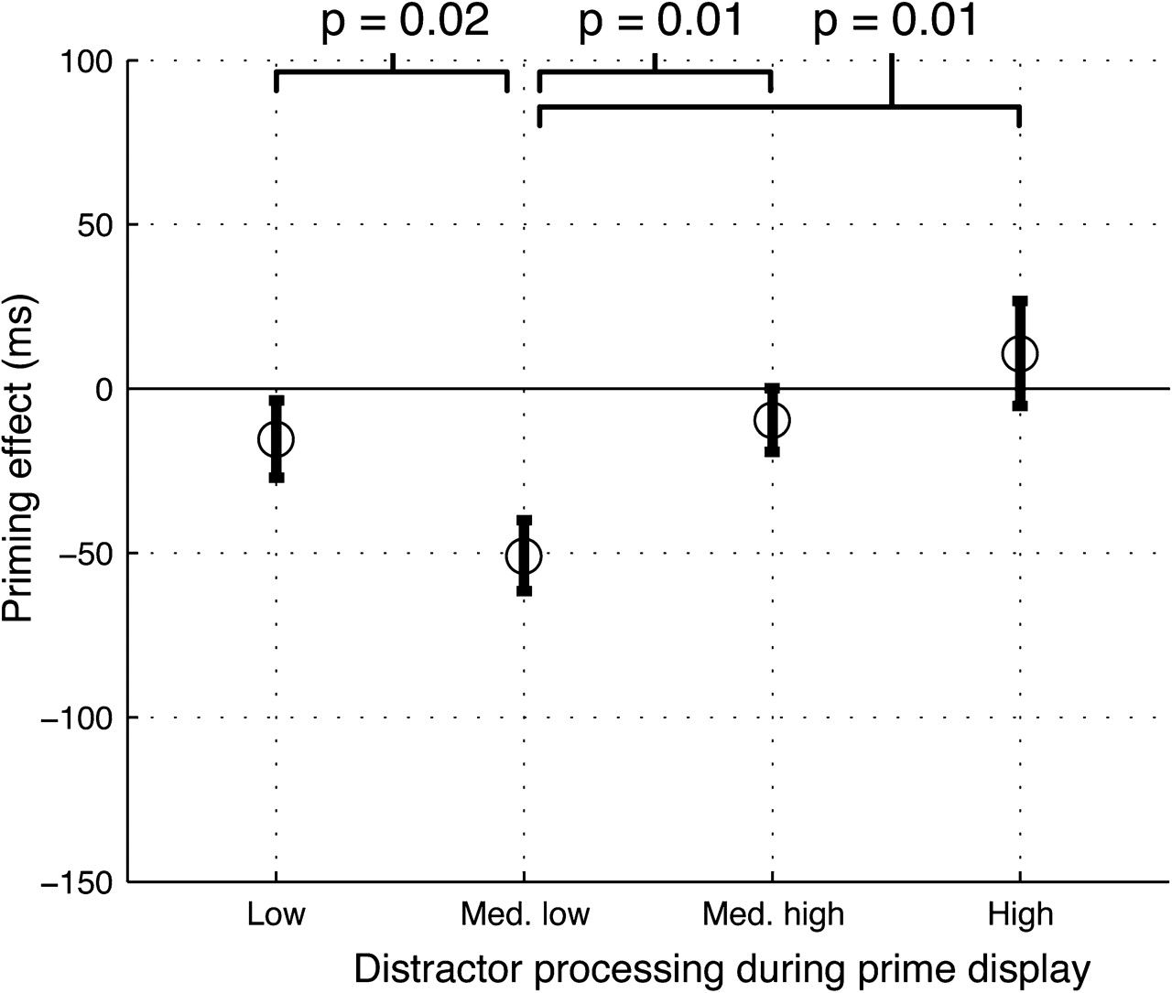
Figure 6. Comparison of priming effects as a function of prime distractor processing. Trials were split into quartiles ...
Notes:
Figure 6. Comparison of priming effects as a function of prime distractor processing. Trials were split into quartiles based on the level of prime distractor processing, and then, priming effects were computed separately for each quartile. The priming effect in the medium-low distractor-processing quartile was significantly more negative than that in the other 3 quartiles. Significance values reflect the reliability of the difference across subjects. Error bars indicate standard errors (across subjects) on the mean priming effect within each quartile.
Unless provided in the caption above, the following copyright applies to the content of this slide: © The Author 2010. Published by Oxford University Press. All rights reserved. For permissions, please e-mail: journals.permissions@oxfordjournals.org

Slide 7
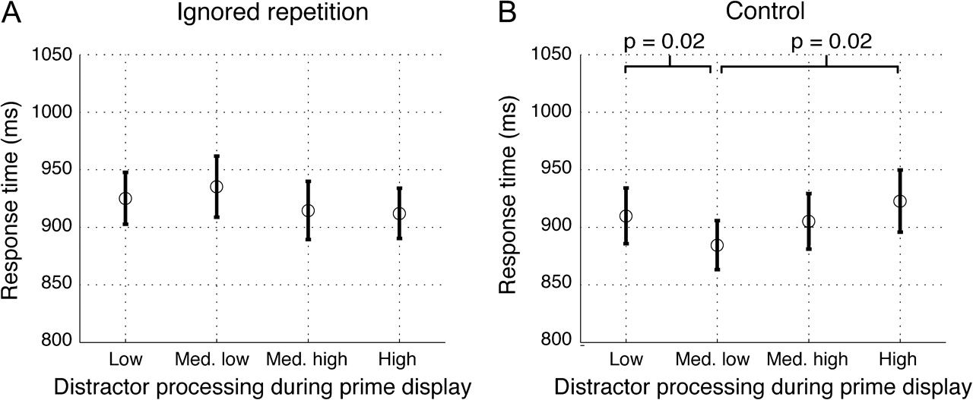
Figure 7. Comparison of RTs as a function of prime distractor processing for the ignored repetition and control ...
Notes:
Figure 7. Comparison of RTs as a function of prime distractor processing for the ignored repetition and control conditions. Each panel shows the mean RT of each quartile of trials when sorted by distractor processing during the prime. The relationship between distractor processing and RT in the ignored repetition condition (A) follows the same trend as was observed between distractor processing and negative priming. The relationship between distractor processing and RT in the control condition (B) shows the opposite relationship (i.e., the RTs were fastest for trials with medium-low distractor processing and slowest for trials with high distractor processing). Significance values reflect the reliability of the difference across subjects, calculated using a 2-tailed paired-samples t-test. Error bars indicate standard errors (across subjects) on the mean RT within each quartile.
Unless provided in the caption above, the following copyright applies to the content of this slide: © The Author 2010. Published by Oxford University Press. All rights reserved. For permissions, please e-mail: journals.permissions@oxfordjournals.org

Slide 8
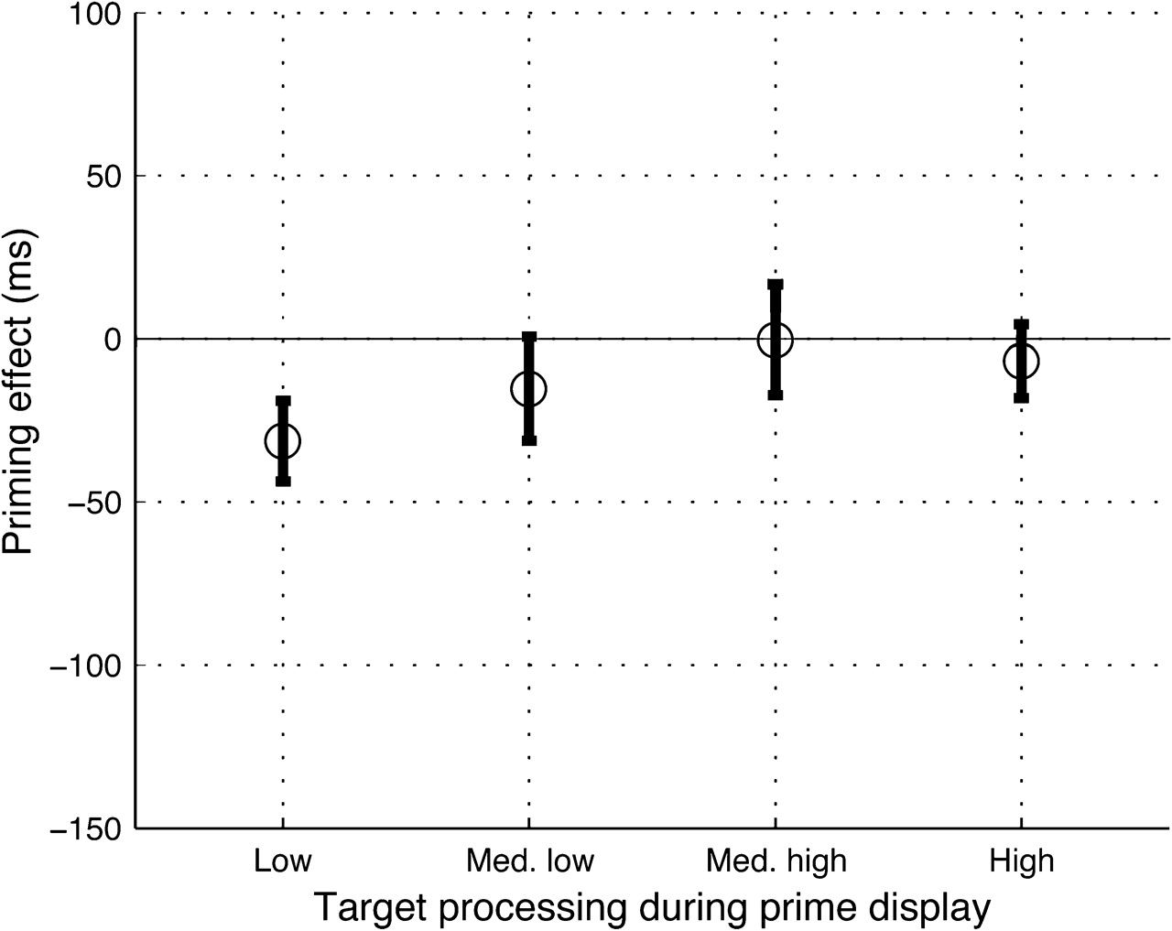
Figure 8. Comparison of priming effects as a function of prime target processing. Trials were split into quartiles ...
Notes:
Figure 8. Comparison of priming effects as a function of prime target processing. Trials were split into quartiles based on the level of prime target processing, and then, priming effects were computed separately for each quartile. None of the pairwise comparisons of the quartile priming effects were significant. Error bars indicate standard errors (across subjects) on the mean priming effect within each quartile.
Unless provided in the caption above, the following copyright applies to the content of this slide: © The Author 2010. Published by Oxford University Press. All rights reserved. For permissions, please e-mail: journals.permissions@oxfordjournals.org

