Slide 1
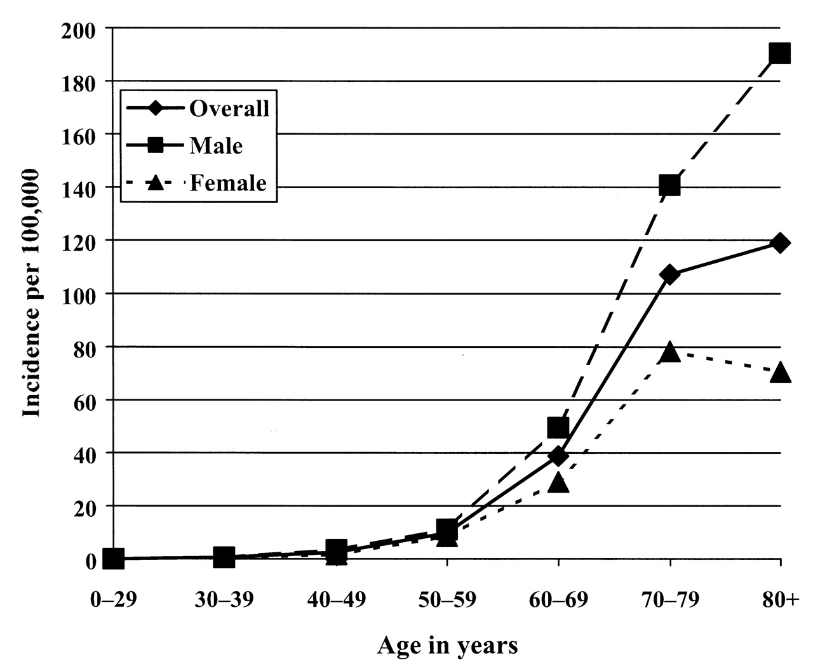
FIGURE 1. Incidence of Parkinson’s disease by age and gender, Kaiser Permanente, 1994–1995.
Notes:
FIGURE 1. Incidence of Parkinson’s disease by age and gender, Kaiser Permanente, 1994–1995.
Unless provided in the caption above, the following copyright applies to the content of this slide:

