Slide 1
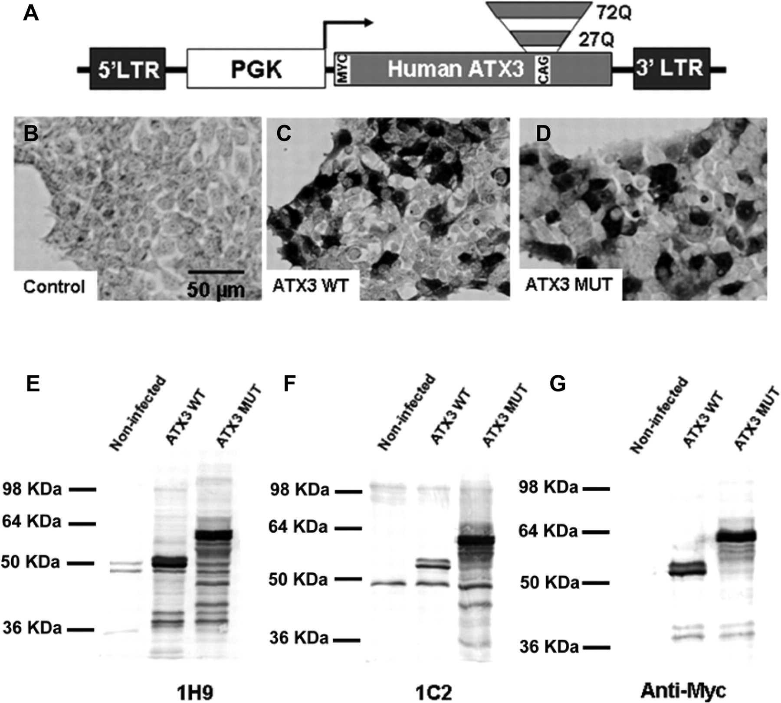
Figure 1. (A) Schematic representation of the lentiviral constructs used in the development of the animal model of ...
Notes:
Figure 1. (A) Schematic representation of the lentiviral constructs used in the development of the animal model of Machado-Joseph disease. cDNAs encoding human wild-type (27 CAG repeats) or mutant ataxin-3 (72 CAG repeats) were cloned in the SIN-W transfer vector. (B–D) Infection of 293T cells with wild-type human ataxin-3 (ATX3 WT /27Q) (C) or mutant human ataxin-3 (ATX3 MUT/72Q) (D) encoding vectors containing a human Myc epitope tag at the 5′ end [anti-Myc tag (OP10) antibody (1:200)]. (E–G) The western blot analysis of 293T cells infected with lentiviral vectors encoding ATX3 WT or ATX3 MUT at 1 week post-infection. The membranes were probed with the antibodies anti-ataxin-3 (1H9) (E), 1C2 (F) and anti-Myc tag (G).
Unless provided in the caption above, the following copyright applies to the content of this slide: © The Author 2008. Published by Oxford University Press. All rights reserved. For Permissions, please email: journals.permissions@oxfordjournals.org

Slide 2
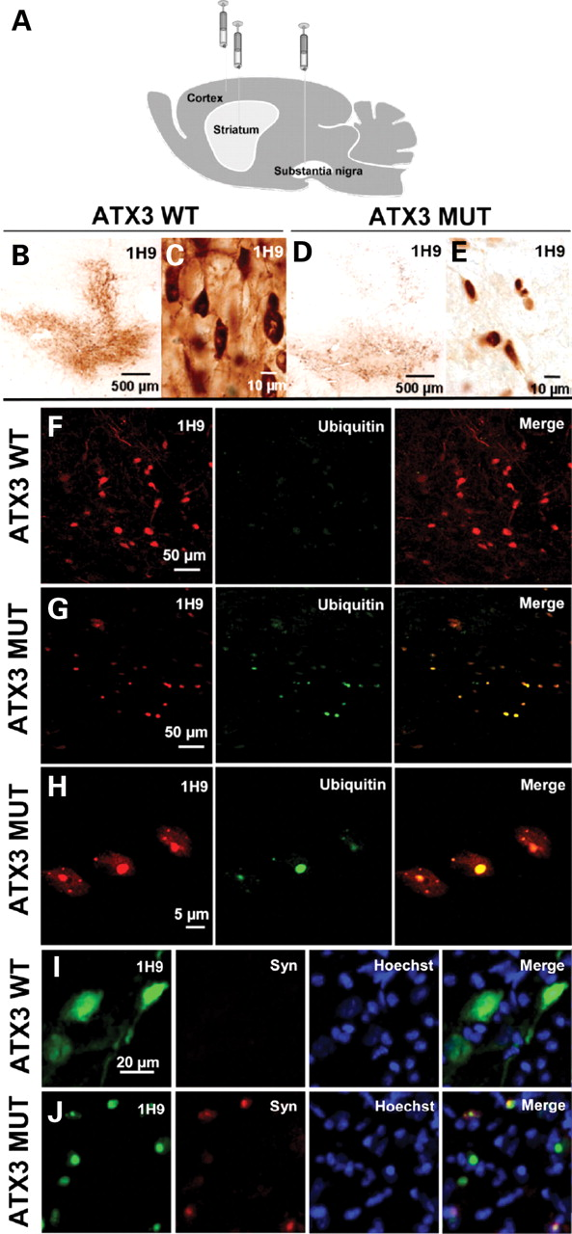
Figure 2. (A) Rat brain regions targeted with the human ataxin-3-encoding lentiviral vectors. Human ataxin-3 ...
Notes:
Figure 2. (A) Rat brain regions targeted with the human ataxin-3-encoding lentiviral vectors. Human ataxin-3 overexpression in the adult rat brain at 2 months; (B) intranigral injection of wild-type or (D) mutant ataxin-3 in adult rats; (C) anti-ataxin-3 staining (1H9) showing the expression of the wild-type protein in the cytoplasm and (E) the translocation of the mutant ataxin-3 to the nucleus. (G and H at high magnification) Overexpression of mutant ataxin-3 in substantia nigra neurons promotes formation of ubiquitinated ataxin-3 aggregates. (F) In contrast, no evidences of aggregation were observed when wild-type ataxin-3 was overexpressed. (I and J) Counterstaining with the Hoechst dye demonstrates that overexpression of mutant ataxin-3 in substantia nigra induces the formation of α-synuclein-positive aggregates in the nucleus (J), whereas overexpression of wild-type ataxin-3 does not promote the formation of α-synuclein positive nuclear aggregates (I).
Unless provided in the caption above, the following copyright applies to the content of this slide: © The Author 2008. Published by Oxford University Press. All rights reserved. For Permissions, please email: journals.permissions@oxfordjournals.org

Slide 3
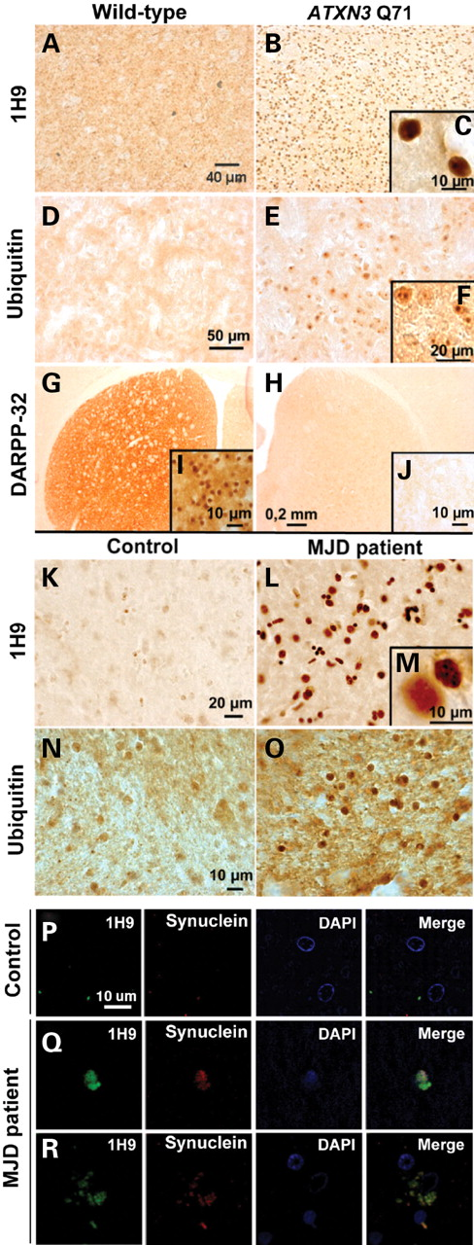
Figure 7. Ataxin-3 (1H9) immunohistochemical staining in wild-type mice (A) and ATXN3 Q71C homozygous transgenic mice ...
Notes:
Figure 7. Ataxin-3 (1H9) immunohistochemical staining in wild-type mice (A) and ATXN3 Q71C homozygous transgenic mice (B). (B) Ataxin-3 immunoreactive aggregates are observed in ATXN3 Q71C homozygotes. (C) At higher magnification, nuclear inclusions adjacent to the nucleolus are observed. (E and F with a high magnification) Ubiquitin-positive inclusions are present in ATXN3 Q71C homozygotes and are not observed in wild-type animals (D). (H and J with high magnification) ATXN3 Q71C homozygotes express lower levels of DARPP-32 than wild-type mice suggesting possible neuronal dysfunction (G and I with high magnification). (N) The striata of MJD patients contain ubiquitin-(O) and ataxin-3-(L) positive aggregates with distinct nuclear inclusions (M) when compared with the control brains (N and K, respectively). (P–R) Ataxin-3 and α-synuclein immunoreactivity in brain sections from a MJD patient. Shown are representative confocal laser micrographs from the striata of a MJD patient showing co-localization of α-synuclein and ataxin-3. (Q) and (R) show intranuclear (Q) and intracytoplasmic (R) co-localization of ataxin-3 and α-synuclein.
Unless provided in the caption above, the following copyright applies to the content of this slide: © The Author 2008. Published by Oxford University Press. All rights reserved. For Permissions, please email: journals.permissions@oxfordjournals.org

Slide 4
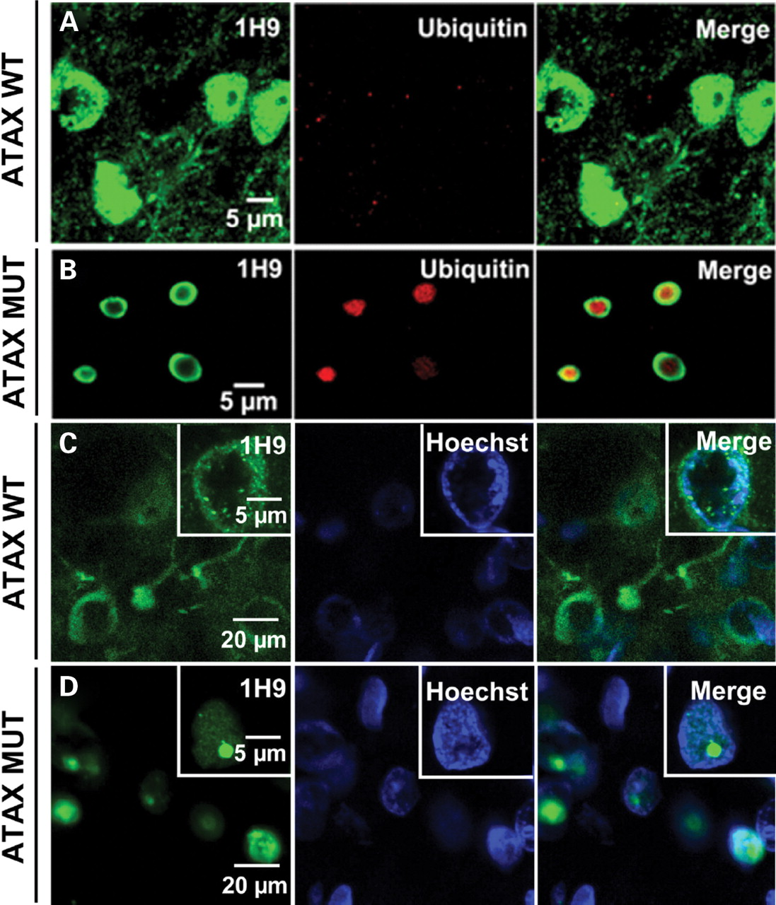
Figure 6. Overexpression of wild-type or mutant human ataxin-3 in the adult rat striatum, subcellular distribution and ...
Notes:
Figure 6. Overexpression of wild-type or mutant human ataxin-3 in the adult rat striatum, subcellular distribution and interaction with different proteins. (B) Expression of mutant human ataxin-3 induces the formation of aggregates which are ubiquitinated particularly within the central core of the intranuclear inclusions; (A) whereas expression of wild-type ataxin-3 is cytoplasmatic and does not promote the formation of intranuclear ubiquitin-positive inclusions; (C) cell nuclei counterstained with Hoechst dye demonstrate that expression of wild-type ataxin-3 is predominantly perinuclear and cytoplasmatic whereas mutant ataxin-3 is nuclear (D).
Unless provided in the caption above, the following copyright applies to the content of this slide: © The Author 2008. Published by Oxford University Press. All rights reserved. For Permissions, please email: journals.permissions@oxfordjournals.org

Slide 5
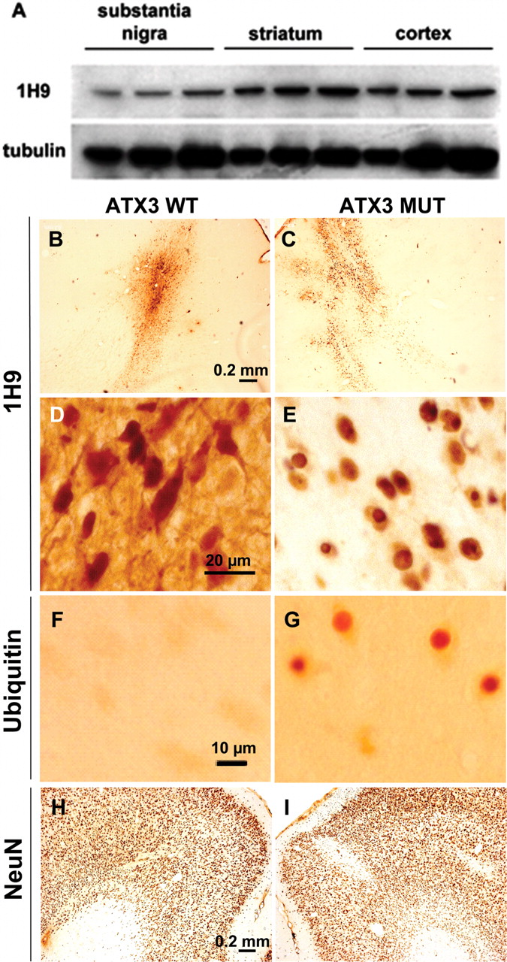
Figure 4. (A) Western blot showing the endogenous expression of ataxin-3 in the substantia nigra, striatum and cortex ...
Notes:
Figure 4. (A) Western blot showing the endogenous expression of ataxin-3 in the substantia nigra, striatum and cortex of the adult rat brain. For each brain region, 10, 20 or 30 µg of protein were loaded, respectively. (B and C) Anti-ataxin-3 staining (1H9) showing the efficient transduction of adult rat cortical neurons with human ataxin-3 expressing lentiviral vectors. (D) Expression of wild-type protein occurs both in the cytoplasm and nucleus, whereas mutant ataxin-3 is translocated to the nucleus (E) promoting the formation of ubiquitin-positive nuclear inclusions, at 3 months (G). No overt change in NeuN staining was observed after wild-type (H) or mutant (I) ataxin-3 expression in the rat cortex, excepting the needle tract area.
Unless provided in the caption above, the following copyright applies to the content of this slide: © The Author 2008. Published by Oxford University Press. All rights reserved. For Permissions, please email: journals.permissions@oxfordjournals.org

Slide 6
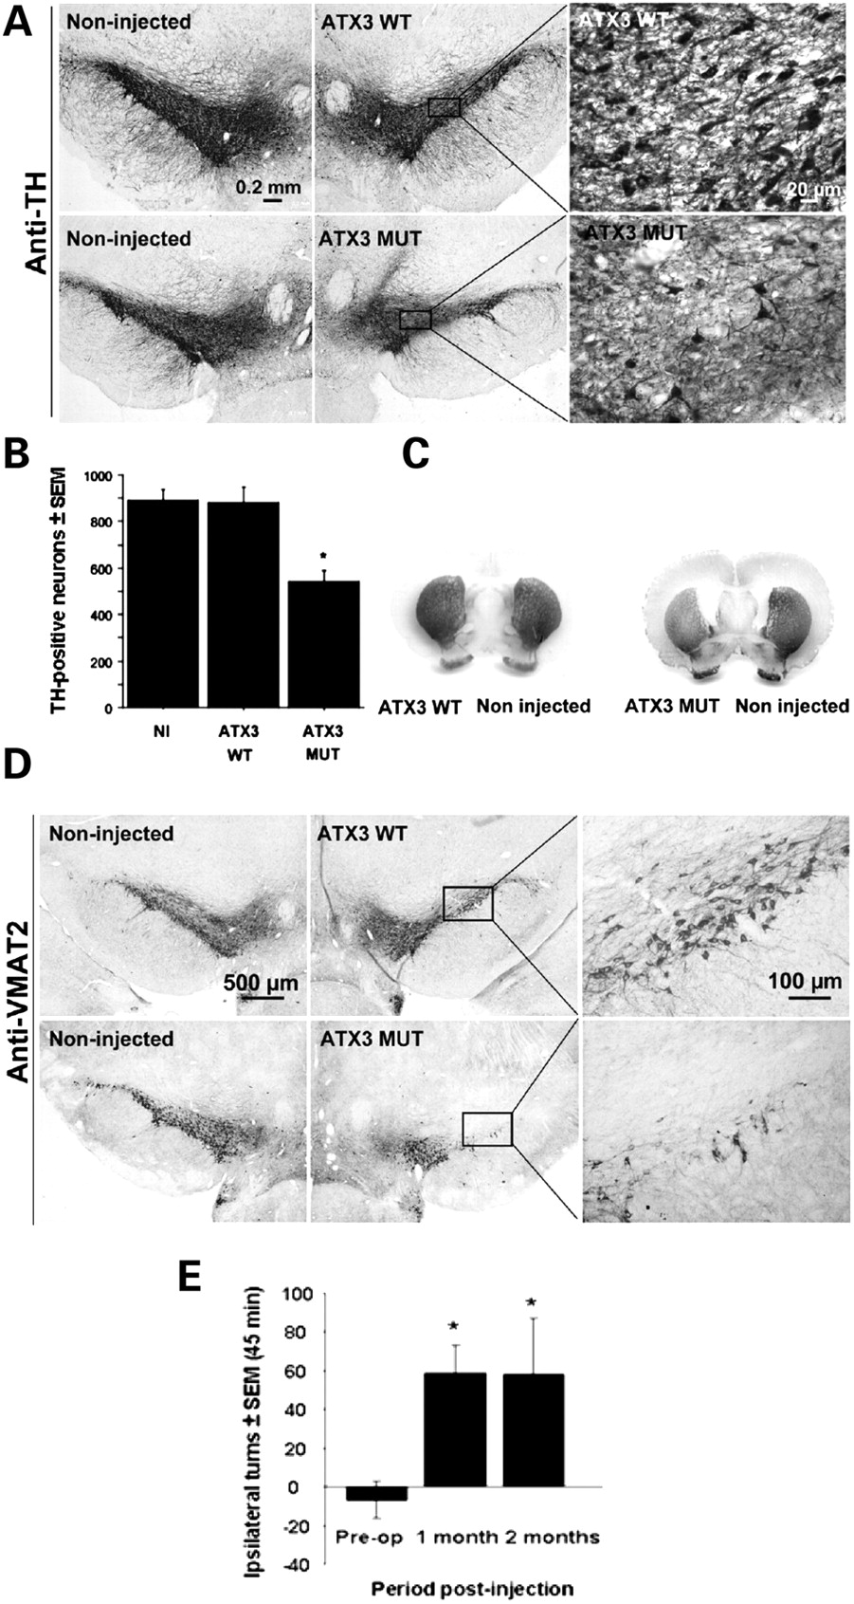
Figure 3. Neuropathology. (A) Depletion of tyrosine hydroxylase (TH)-positive neurons in the substantia nigra caused by ...
Notes:
Figure 3. Neuropathology. (A) Depletion of tyrosine hydroxylase (TH)-positive neurons in the substantia nigra caused by overexpression of mutant ataxin-3, suggesting neuronal dysfunction; whereas overexpression of wild-type ataxin-3 has no deleterious effect at 2 months (i.e. no significant difference between injected and non-injected (NI) hemispheres). (B) Quantitative analysis of the number of TH-positive neurons in adult rat brains injected in the susbstantia nigra with human ataxin-3 (*P < 0,001 when compared with all groups). (C) Striatal TH down-regulation in animals injected in the substantia nigra with mutant ataxin-3, suggesting degeneration of the nigro-striatal pathway. The intranigral injection of wild-type ataxin-3 does not induce TH downregulation in the striatum. (D) Reduction of the number of vesicular monoamine transporter type 2 (VMAT2)-immunoreactive neurons in the substantia nigra caused by overexpression of mutant ataxin-3, suggesting neuronal dysfunction; whereas overexpression of wild-type ataxin-3 has no deleterious effect at 2 months (no significant difference between injected and non-injected (NI) hemispheres). (E) Behavioral analysis: apomorphine-induced turning in adult rats unilaterally lesioned with mutant ataxin-3 in the substantia nigra. Results are expressed as the net difference between the total number of turns after and before lesion. Ipsilateral turns were counted as positive turns, whereas contralateral turns were counted as negative turns. Rotational behavior statistical significance was evaluated using the Friedman test, a non-parametric test for paired samples (P = 0.018).
Unless provided in the caption above, the following copyright applies to the content of this slide: © The Author 2008. Published by Oxford University Press. All rights reserved. For Permissions, please email: journals.permissions@oxfordjournals.org

Slide 7
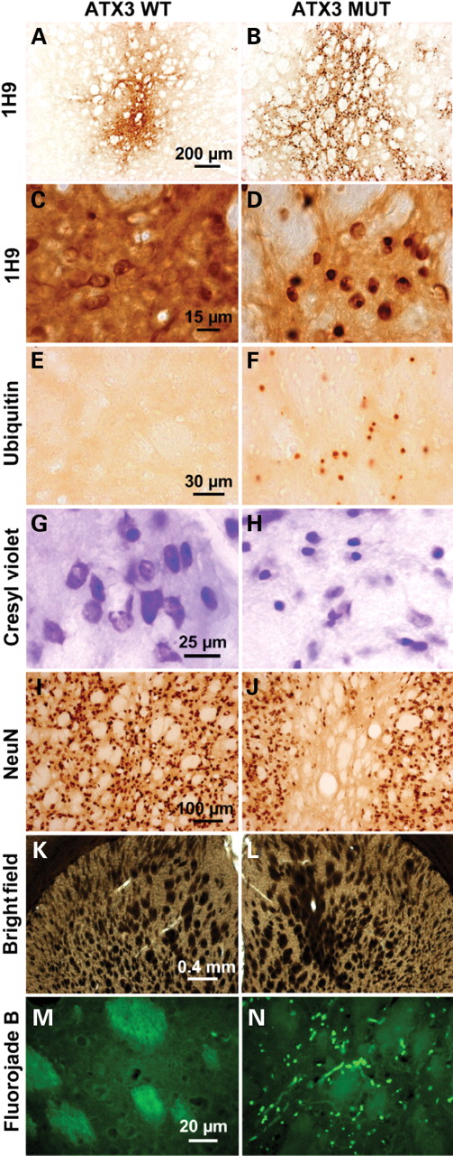
Figure 5. (A and B) Striatal injection of wild-type and mutant human ataxin-3 in the adult rat brain. Anti-ataxin-3 ...
Notes:
Figure 5. (A and B) Striatal injection of wild-type and mutant human ataxin-3 in the adult rat brain. Anti-ataxin-3 staining (1H9) showing expression of the wild-type protein in the cytoplasm (C) and translocation of the mutant ataxin-3 to the nucleus (D) inducing the formation of ubiquitin-positive aggregates at 2 months (F). (H) Pycnotic nuclei are visible on cresyl violet stained sections suggesting possible cell injury and striatal degeneration after injection of vectors encoding mutant ataxin-3 in adult rats, at 2 months. (J) A considerable loss of NeuN-immunoreactive neurons was observed in the region expressing mutant ataxin-3, whereas wild-type ataxin-3 (I) has no toxic effect. (L) Coalescence of the internal capsule of the striatum was observed after mutant ataxin-3 expression at 2 months on a bright-field photomicrograph, suggesting degeneration. (K) In contrast, no signs of coalescence were observed when wild-type ataxin-3 was expressed. (N) Striatal degeneration in mutant ataxin-3-injected rats observed at 2 months post-injection on Fluorojade B stained sections in contrast with wild-type ataxin-3-injected rats (M).
Unless provided in the caption above, the following copyright applies to the content of this slide: © The Author 2008. Published by Oxford University Press. All rights reserved. For Permissions, please email: journals.permissions@oxfordjournals.org

