Slide 1
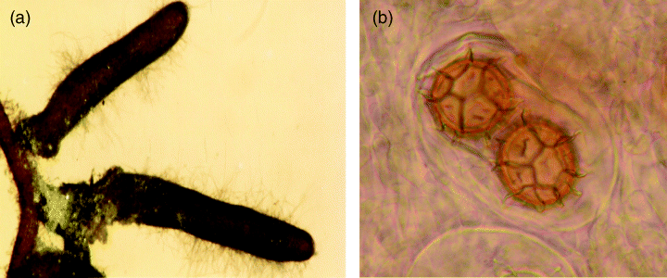
1 Tuber magnatum mycorrhizae (a) and ascospores (b).
Notes:
1 Tuber magnatum mycorrhizae (a) and ascospores (b).
Unless provided in the caption above, the following copyright applies to the content of this slide: © 2006 Federation of European Microbiological Societies

Slide 2
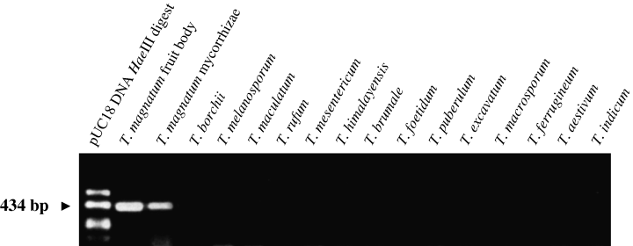
2 Internal transcribed spacer regions amplification with specific primers P7/M3 from fruitbody and mycorrhizae ...
Notes:
2 Internal transcribed spacer regions amplification with specific primers P7/M3 from fruitbody and mycorrhizae of Tuber magnatum and from different Tuber spp. Only T. magnatum shows a 434bp band. First lane: molecular size marker pUC18 DNA HaeIII digest. (Modified from Fig. 2 in Melloet al,1999.)
Unless provided in the caption above, the following copyright applies to the content of this slide: © 2006 Federation of European Microbiological Societies

Slide 3
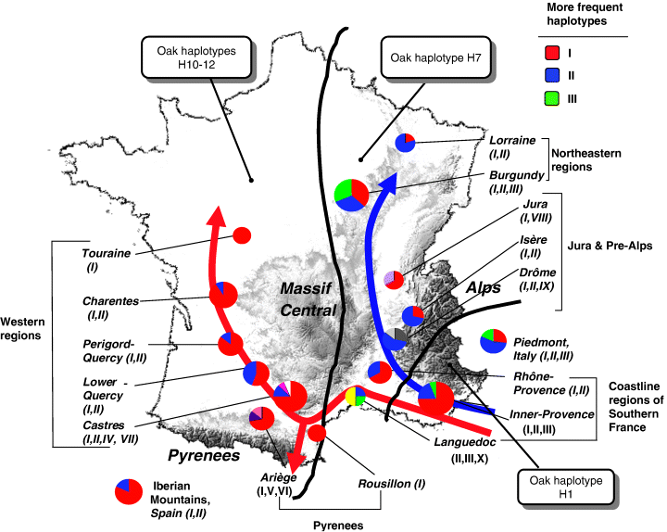
3 Distribution of the 10 internal transcribed spacer (ITS) haplotypes of Tuber melanosporum in France. The pie ...
Notes:
3 Distribution of the 10 internal transcribed spacer (ITS) haplotypes of Tuber melanosporum in France. The pie chart diameters are proportional to the number of ascocarps analyzed per region. Black lines delimit areas of distribution of the chloroplastic DNA (cpDNA) haplotypes of oaks in France (Petitet al,2002): haplotype 1 was found in the southern corner of France; haplotype-7 in the Rhone valley, and haplotypes 10–12 in western France. Arrowed lines show potential postglacial recolonization routes for the Perigord truffle: the Atlantic red route and the Rhone valley blue route (adapted from Fig. 2 in Muratet al,2004).
Unless provided in the caption above, the following copyright applies to the content of this slide: © 2006 Federation of European Microbiological Societies

Slide 4
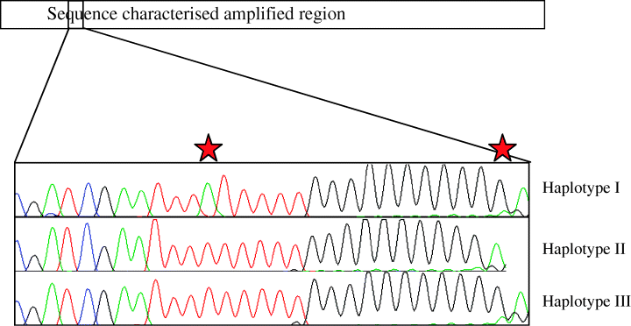
4 Three haplotypes of Tuber magnatum originated by two single nucleotide polymorphisms, indicated by a star in ...
Notes:
4 Three haplotypes of Tuber magnatum originated by two single nucleotide polymorphisms, indicated by a star in an oligonucleotide sequence (the different colours indicate nucleotides: T, red; C, blue; G, black; A, green). Two haplotypes are present in the northern Italian population (adapted from Fig. 2 in Melloet al,2005).
Unless provided in the caption above, the following copyright applies to the content of this slide: © 2006 Federation of European Microbiological Societies

