Slide 1
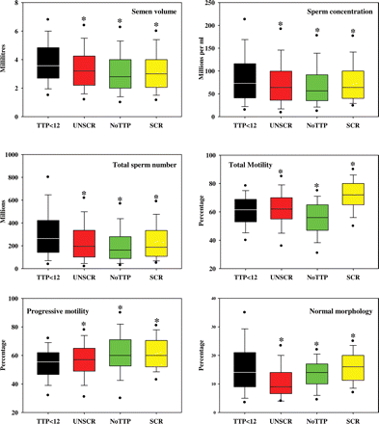
Figure 1 Box and whisker plots of semen analysis data. Semen volume, sperm concentration, total sperm numbers per ...
Notes:
Figure 1 Box and whisker plots of semen analysis data. Semen volume, sperm concentration, total sperm numbers per ejaculate, total percentage motility, percentage progressive motility and percentage normal morphology from fathers with time-to-pregnancy ≤12 months (TTP < 12, black), unscreened men from the general population (UNSCR, red), fathers with no known time-to-pregnancy (NoTTP, green) and screened men selected for normozoospermia (SCR, yellow). The boxes represent the quartiles and the lines within them are the medians; the whiskers extend from the 10th to the 90th centiles and the dots represent the 5th and 95th centiles. *significantly different from fathers with TTP ≤ 12 months.
Unless provided in the caption above, the following copyright applies to the content of this slide: © World Health Organization [2009]. All rights reserved. The World Health Oragnization has granted Oxford University Press permission for the reproduction of this article

Slide 2
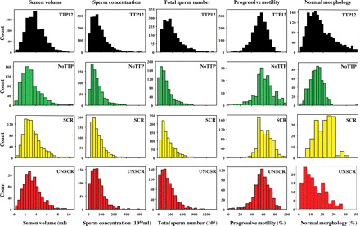
Figure 2 Frequency histograms of semen analysis data from fathers, the general population and men screened for ...
Notes:
Figure 2 Frequency histograms of semen analysis data from fathers, the general population and men screened for normozoospermia. Distribution of semen volumes (ml, First Column), sperm concentration (106/ml, Second Column), total sperm numbers (106, Third Column), progressively motile spermatozoa (%, Fourth Column) and morphologically normal spermatozoa (%, Fifth Column) in ejaculates from fathers with time to pregnancy 12 months or less (TTP12, Top Row, black), fathers with no known time to pregnancy (NoTTP, Second Row, green), men screened for normozoospermia (SCR, Third Row, yellow) and unscreened men from the general population (UNSCR, Bottom Row, red).
Unless provided in the caption above, the following copyright applies to the content of this slide: © World Health Organization [2009]. All rights reserved. The World Health Oragnization has granted Oxford University Press permission for the reproduction of this article

