Slide 1
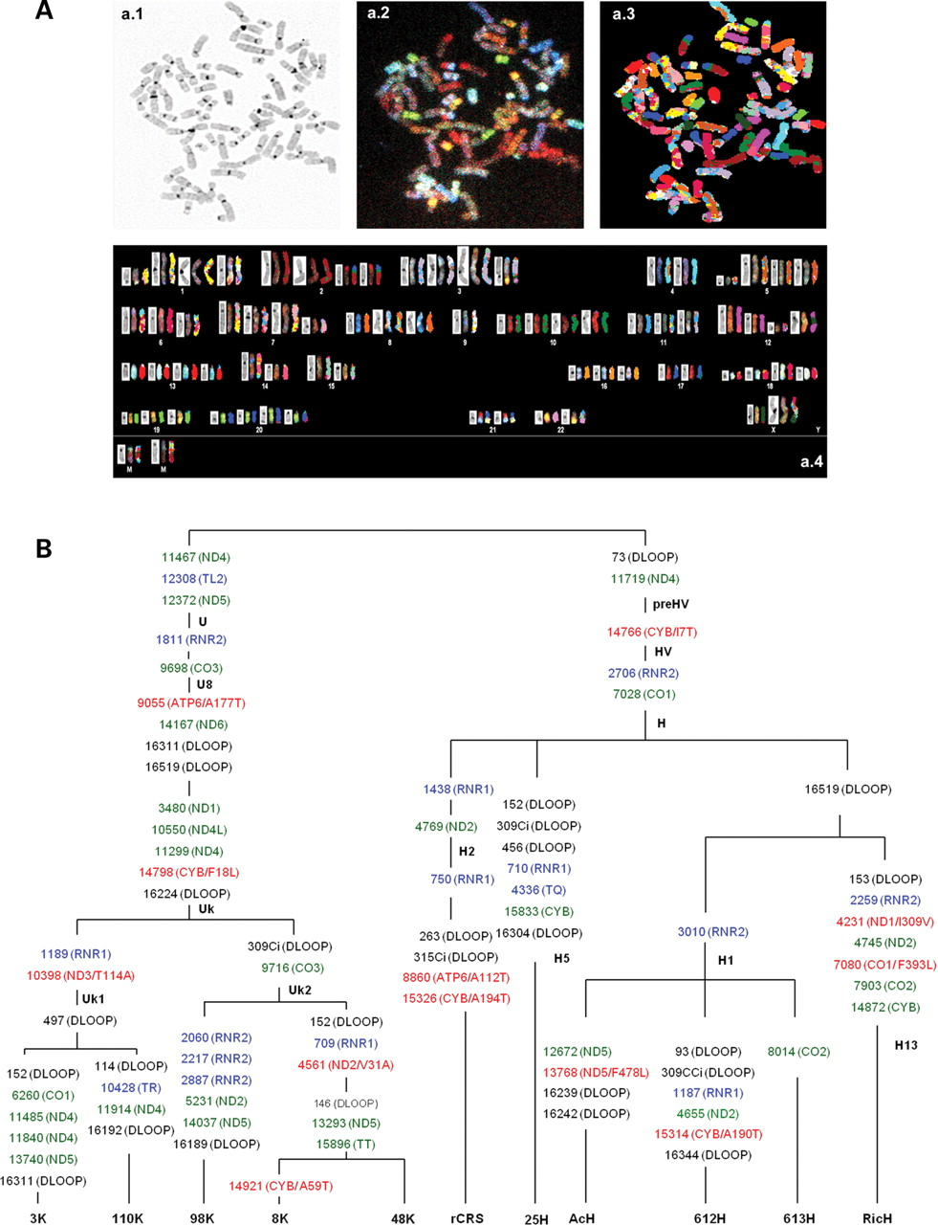
Figure 1. Nuclear and mitochondrial genome analysis in cybrids H and Uk. (A) Spectral karyotyping (SKY) analysis of the ...
Notes:
Figure 1. Nuclear and mitochondrial genome analysis in cybrids H and Uk. (A) Spectral karyotyping (SKY) analysis of the cybrids. Metaphase after DAPI stain (a.1), SKY hybridization (a.2) or classified colors (a.3). In this karyotype of one cybrid cell 48K (a.4), structurally rearranged chromosomes are grouped according to the chromosomal type of their major component. Every chromosome from pictures a.1 to a.3 is aligned in this karyotype. (B) Phylogenetic tree of the cybrids' mtDNA. Black, green, red and blue colors define control region, protein synonymous, protein non-synonymous and RNA mutations, respectively. The affected mtDNA gene or sequence is showed in parenthesis. For non-synonymous mutations, amino acid substitution and position in the protein is also indicated. rCRS means revised Cambridge reference sequence (45).
Unless provided in the caption above, the following copyright applies to the content of this slide: © The Author 2010. Published by Oxford University Press. All rights reserved. For Permissions, please email: journals.permissions@oxfordjournals.org

Slide 2
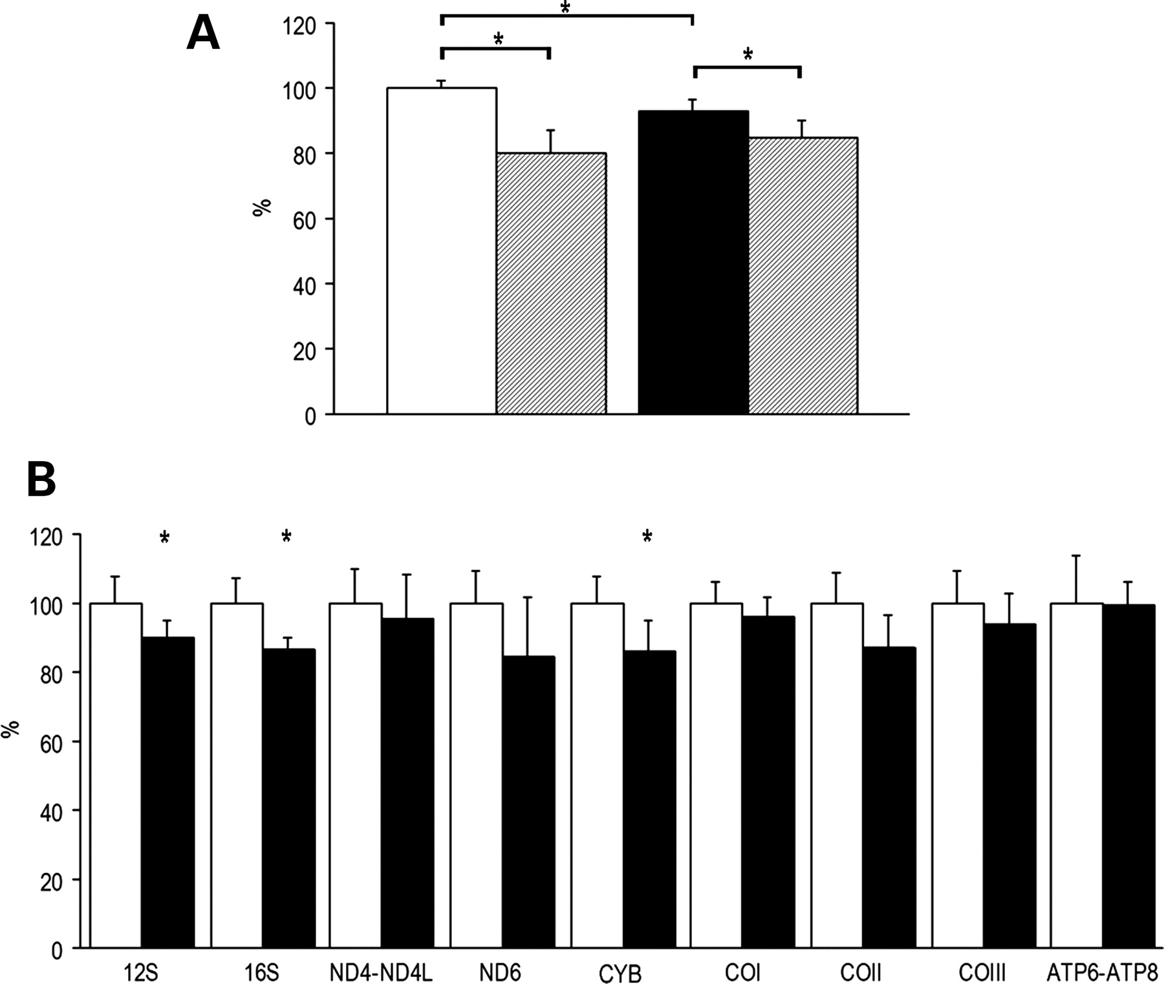
Figure 2. Nucleic acid levels in cybrids H and Uk. White and black bars represent mean values for cybrids H and Uk, ...
Notes:
Figure 2. Nucleic acid levels in cybrids H and Uk. White and black bars represent mean values for cybrids H and Uk, respectively. (A) mtDNA levels. The mean value for cybrids H without NAC has been set to 100%. H, 100.0 ± 2.6% (5); H (NAC), 79.8 ± 7.0% (5); Uk, 92.7 ± 3.6% (5); Uk (NAC), 85.0 ± 5.2 (5). *P ≤ 0.026. Striped bars represent the mtDNA levels after treatment with 5 mm NAC. (B) mtRNA levels. The mean value for cybrids H has been set to 100%. 12S: H, 100.0 ± 7.8% (5); Uk, 89.9 ± 5.0% (5); 16S: H, 100.0 ± 7.2% (5); Uk, 86.9 ± 2.9% (5); ND4-ND4L: H, 100.0 ± 10.2% (5); Uk, 95.5 ± 12.6% (5); ND6: H, 100.0 ± 9.4% (5); Uk, 84.3 ± 17.5% (5); Cytb: H, 100.0 ± 7.9% (5); Uk, 85.9 ± 8.9% (5); COI: H, 100.0 ± 7.9% (5); Uk, 96.0 ± 5.9% (5); COII: H, 100.0 ± 9.0% (5); Uk, 87.2 ± 9.4% (5); COIII: H, 100.0 ± 9.2% (5); Uk, 94.0 ± 9.0% (5); ATP6-ATP8: H, 100.0 ± 13.9% (5); Uk, 99.2 ± 6.7% (5). *P ≤ 0.041.
Unless provided in the caption above, the following copyright applies to the content of this slide: © The Author 2010. Published by Oxford University Press. All rights reserved. For Permissions, please email: journals.permissions@oxfordjournals.org

Slide 3
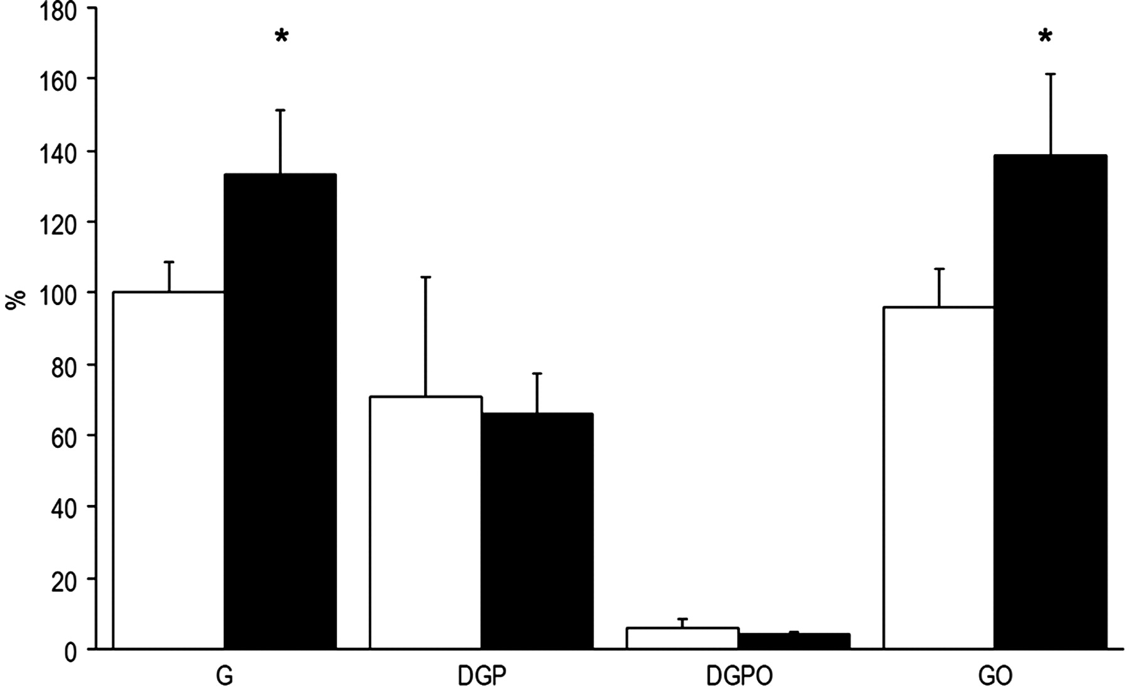
Figure 3. ATP levels in cybrids H and Uk. G, DGP, DGPO and GO are abbreviations for glucose, 2-deoxy-glucose plus 1 mm ...
Notes:
Figure 3. ATP levels in cybrids H and Uk. G, DGP, DGPO and GO are abbreviations for glucose, 2-deoxy-glucose plus 1 mm pyruvate, 2-deoxy-glucose plus 1 mm pyruvate and 2.5 µg/ml oligomycin and glucose plus 2.5 µg/ml oligomycin, respectively. The mean value for cybrids H in glucose has been set to 100%. G: H, 100.0 ± 8.3% (5); Uk, 132.9 ± 18.3% (5); DGP: H, 71.1 ± 33.2% (5); Uk, 66.2 ± 10.9% (5); DGPO: H, 5.9 ± 2.6% (5); Uk, 4.3 ± 0.6% (5); GO: H, 96.2 ± 10.7% (5); Uk, 138.3 ± 22.8% (5). *P = 0.009. White and black bars represent the mean values for cybrids H and Uk, respectively.
Unless provided in the caption above, the following copyright applies to the content of this slide: © The Author 2010. Published by Oxford University Press. All rights reserved. For Permissions, please email: journals.permissions@oxfordjournals.org

Slide 4
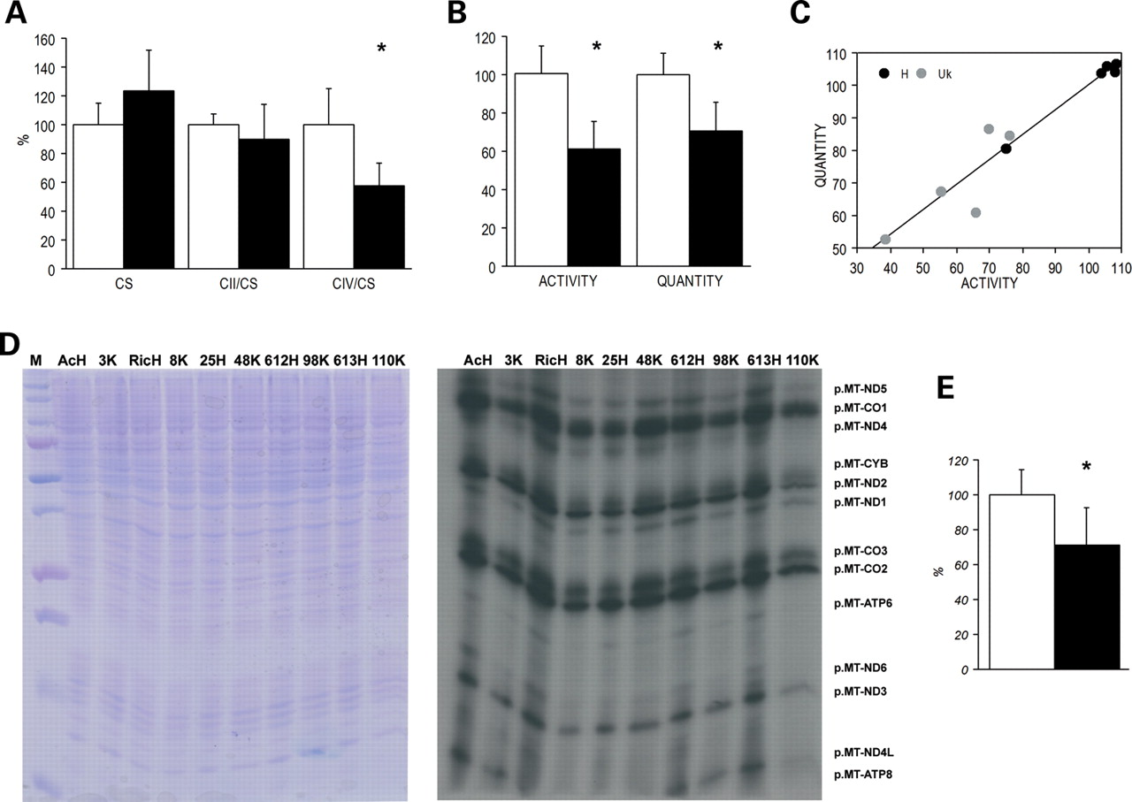
Figure 4. Mitochondrial enzyme and protein synthesis analysis. White and black bars represent the mean values for ...
Notes:
Figure 4. Mitochondrial enzyme and protein synthesis analysis. White and black bars represent the mean values for cybrids H and Uk, respectively. The mean value for cybrids H has been set to 100% in A, B, C and E. (A) Enzyme activities. CS: H, 100.0 ± 12.6% (5); Uk, 123.5 ± 27.3% (5); CII/CS: H, 100.0 ± 7.8% (5); Uk, 90.2 ± 23.7% (5); CIV/CS: H, 100.0 ± 24.6% (5); Uk, 57.2 ± 15.9% (5); *P = 0.001. (B) CIV study. CIV specific activities: H, 100.0 ± 14.4% (5); Uk, 61.1 ± 14.7% (5); CIV levels: H, 100.0 ± 10.9% (5); Uk, 70.6 ± 14.8% (5). *P ≤ 0.007. (C) % Activity/% amount relationship. y = 1.68 + 0.141 x. R2 = 0.96, P = 0.0001. (D) Mitochondrial translation products. Gels showing the loading control and electrophoretic patterns of mitochondrial translation products from the cybrid cell lines. M, molecular weight marker. (E) Quantification of mitochondrial protein synthesis. H: 100.0 ± 14.5% (5) and Uk: 71.0 ± 21.4% (5); *P = 0.037.
Unless provided in the caption above, the following copyright applies to the content of this slide: © The Author 2010. Published by Oxford University Press. All rights reserved. For Permissions, please email: journals.permissions@oxfordjournals.org

Slide 5
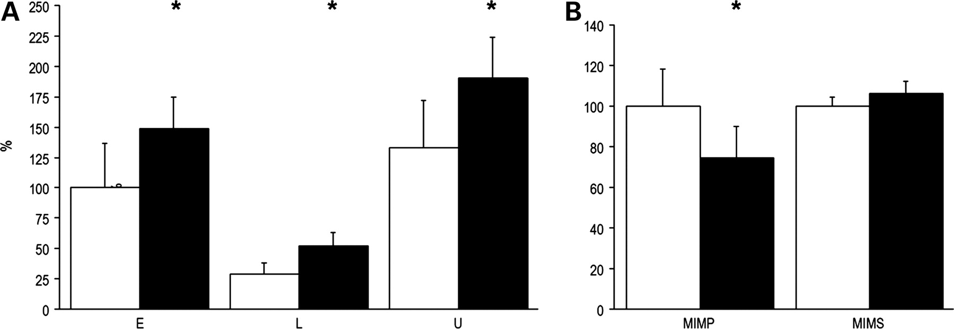
Figure 5. Oxygen consumption and mitochondrial inner membrane potential (MIMP) and surface (MIMS) in cybrids H and Uk. ...
Notes:
Figure 5. Oxygen consumption and mitochondrial inner membrane potential (MIMP) and surface (MIMS) in cybrids H and Uk. White and black bars represent the mean values for cybrids H and Uk, respectively. (A) Corrected oxygen consumption (oxygen consumption per ETC unit). E, L and U code for endogenous, leaking and uncoupled respiration, respectively. The mean value for E respiration in cybrids H has been set to 100%. E: H, 100.0 ± 36.9% (5); Uk, 148.3 ± 26.5% (5); L: H, 28.7 ± 9.3% (5); Uk, 51.7 ± 11.9% (5); U: H, 132.5 ± 39.1% (5); Uk, 190.2 ± 34.1% (5); *P ≤ 0.045. (B) MIMP and MIMS. The mean value for cybrids H has been set to 100%. MIMP: H, 100.0 ± 18.6% (5); Uk, 74.4 ± 15.5% (5); *P = 0.046. MIMS: H, 100.0 ± 4.4% (5); Uk, 106.0 ± 6.4% (5).
Unless provided in the caption above, the following copyright applies to the content of this slide: © The Author 2010. Published by Oxford University Press. All rights reserved. For Permissions, please email: journals.permissions@oxfordjournals.org

Slide 6
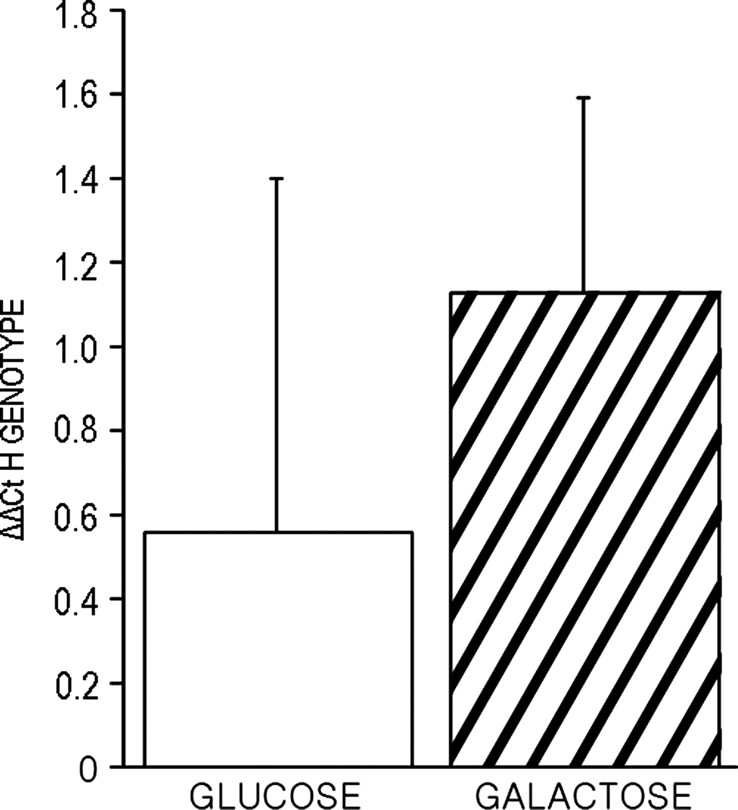
Figure 6. Growth capacity of cybrids H and Uk. White and striped bars represent the genotype H shift, compared with its ...
Notes:
Figure 6. Growth capacity of cybrids H and Uk. White and striped bars represent the genotype H shift, compared with its initial situation, when growing in glucose and galactose, respectively. Glucose and galactose indicate glucose minus initial and galactose minus initial genotype H percentage, respectively. ΔΔCt codes for threshold cycle differences. Glucose: 0.56 ± 0.85 (16); galactose: 1.13 ± 0.47 (16). *P = 0.023.
Unless provided in the caption above, the following copyright applies to the content of this slide: © The Author 2010. Published by Oxford University Press. All rights reserved. For Permissions, please email: journals.permissions@oxfordjournals.org

