Slide 1
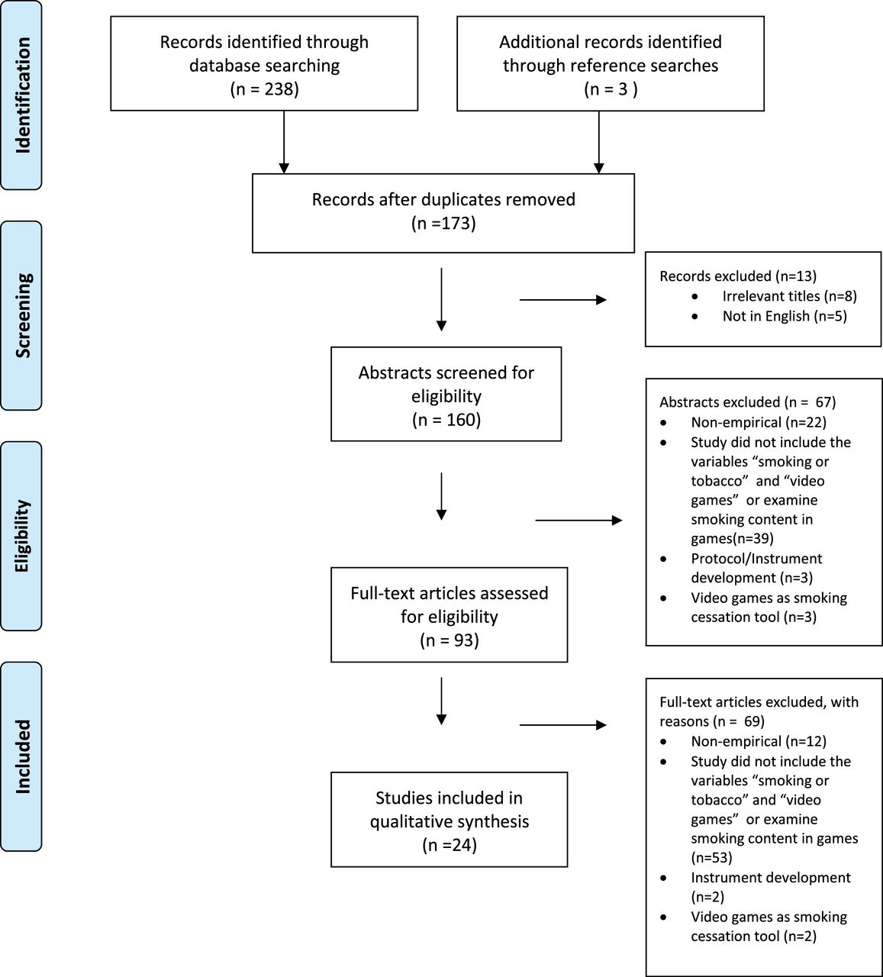
Figure 1. PRISMA 2009 flow diagram.
Notes:
Figure 1. PRISMA 2009 flow diagram.
Unless provided in the caption above, the following copyright applies to the content of this slide: © The Author 2015. Published by Oxford University Press on behalf of the Society for Research on Nicotine and Tobacco. All rights reserved. For permissions, please e-mail: journals.permissions@oup.com.

