Slide 1
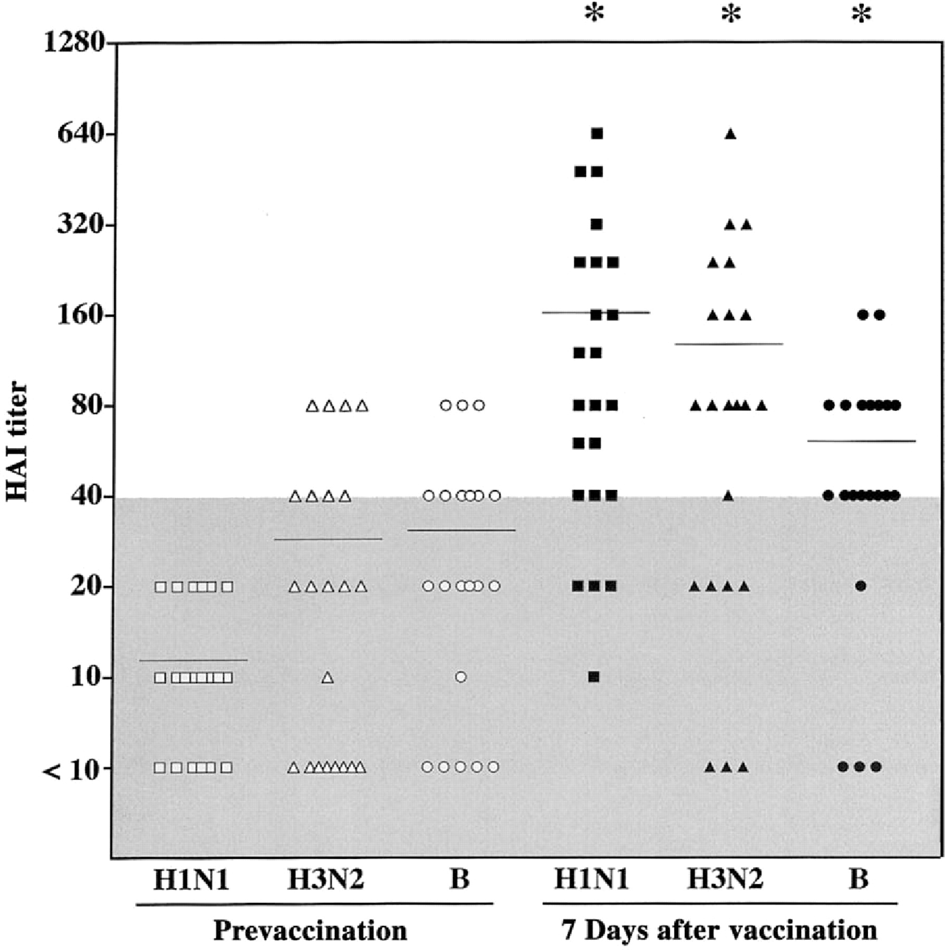
Figure 1 Mean serum hemagglutination inhibition (HAI) titer against 3 vaccine viruses (H1N1, H3N2, and B strains) for ...
Notes:
Figure 1 Mean serum hemagglutination inhibition (HAI) titer against 3 vaccine viruses (H1N1, H3N2, and B strains) for each subject (n= 23) immediately before (open symbols) and 7 days after (solid symbols) vaccination. The horizontal bar in each column represents the mean value. The shaded area indicates nonprotective HAI titers (<40). *Significant difference between prevaccination and day-7 samples (P < .05, by paired t test).
Unless provided in the caption above, the following copyright applies to the content of this slide: © 2002 by the Infectious Diseases Society of America

Slide 2
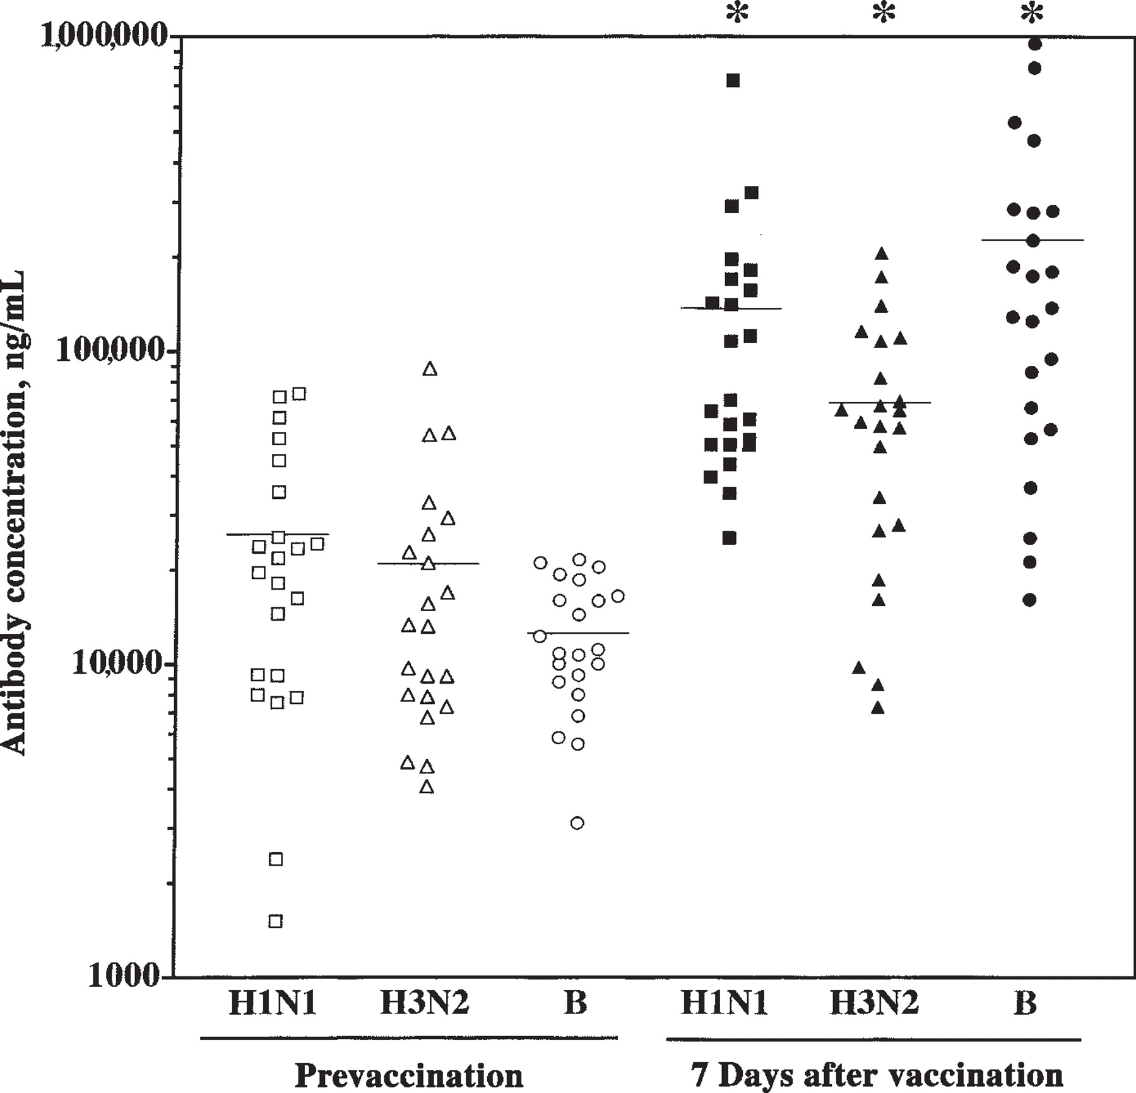
Figure 2 Total concentration of influenza virus-specific antibodies to 3 vaccine viruses (H1N1, H3N2, and B strains) ...
Notes:
Figure 2 Total concentration of influenza virus-specific antibodies to 3 vaccine viruses (H1N1, H3N2, and B strains) for each subject (n = 23) in serum immediately before (open symbols) and 7 days after (solid symbols) vaccination. The horizontal bar in each column indicates the mean value. *Significant difference between prevaccination and day-7 samples (P < .05, by paired t test).
Unless provided in the caption above, the following copyright applies to the content of this slide: © 2002 by the Infectious Diseases Society of America

Slide 3
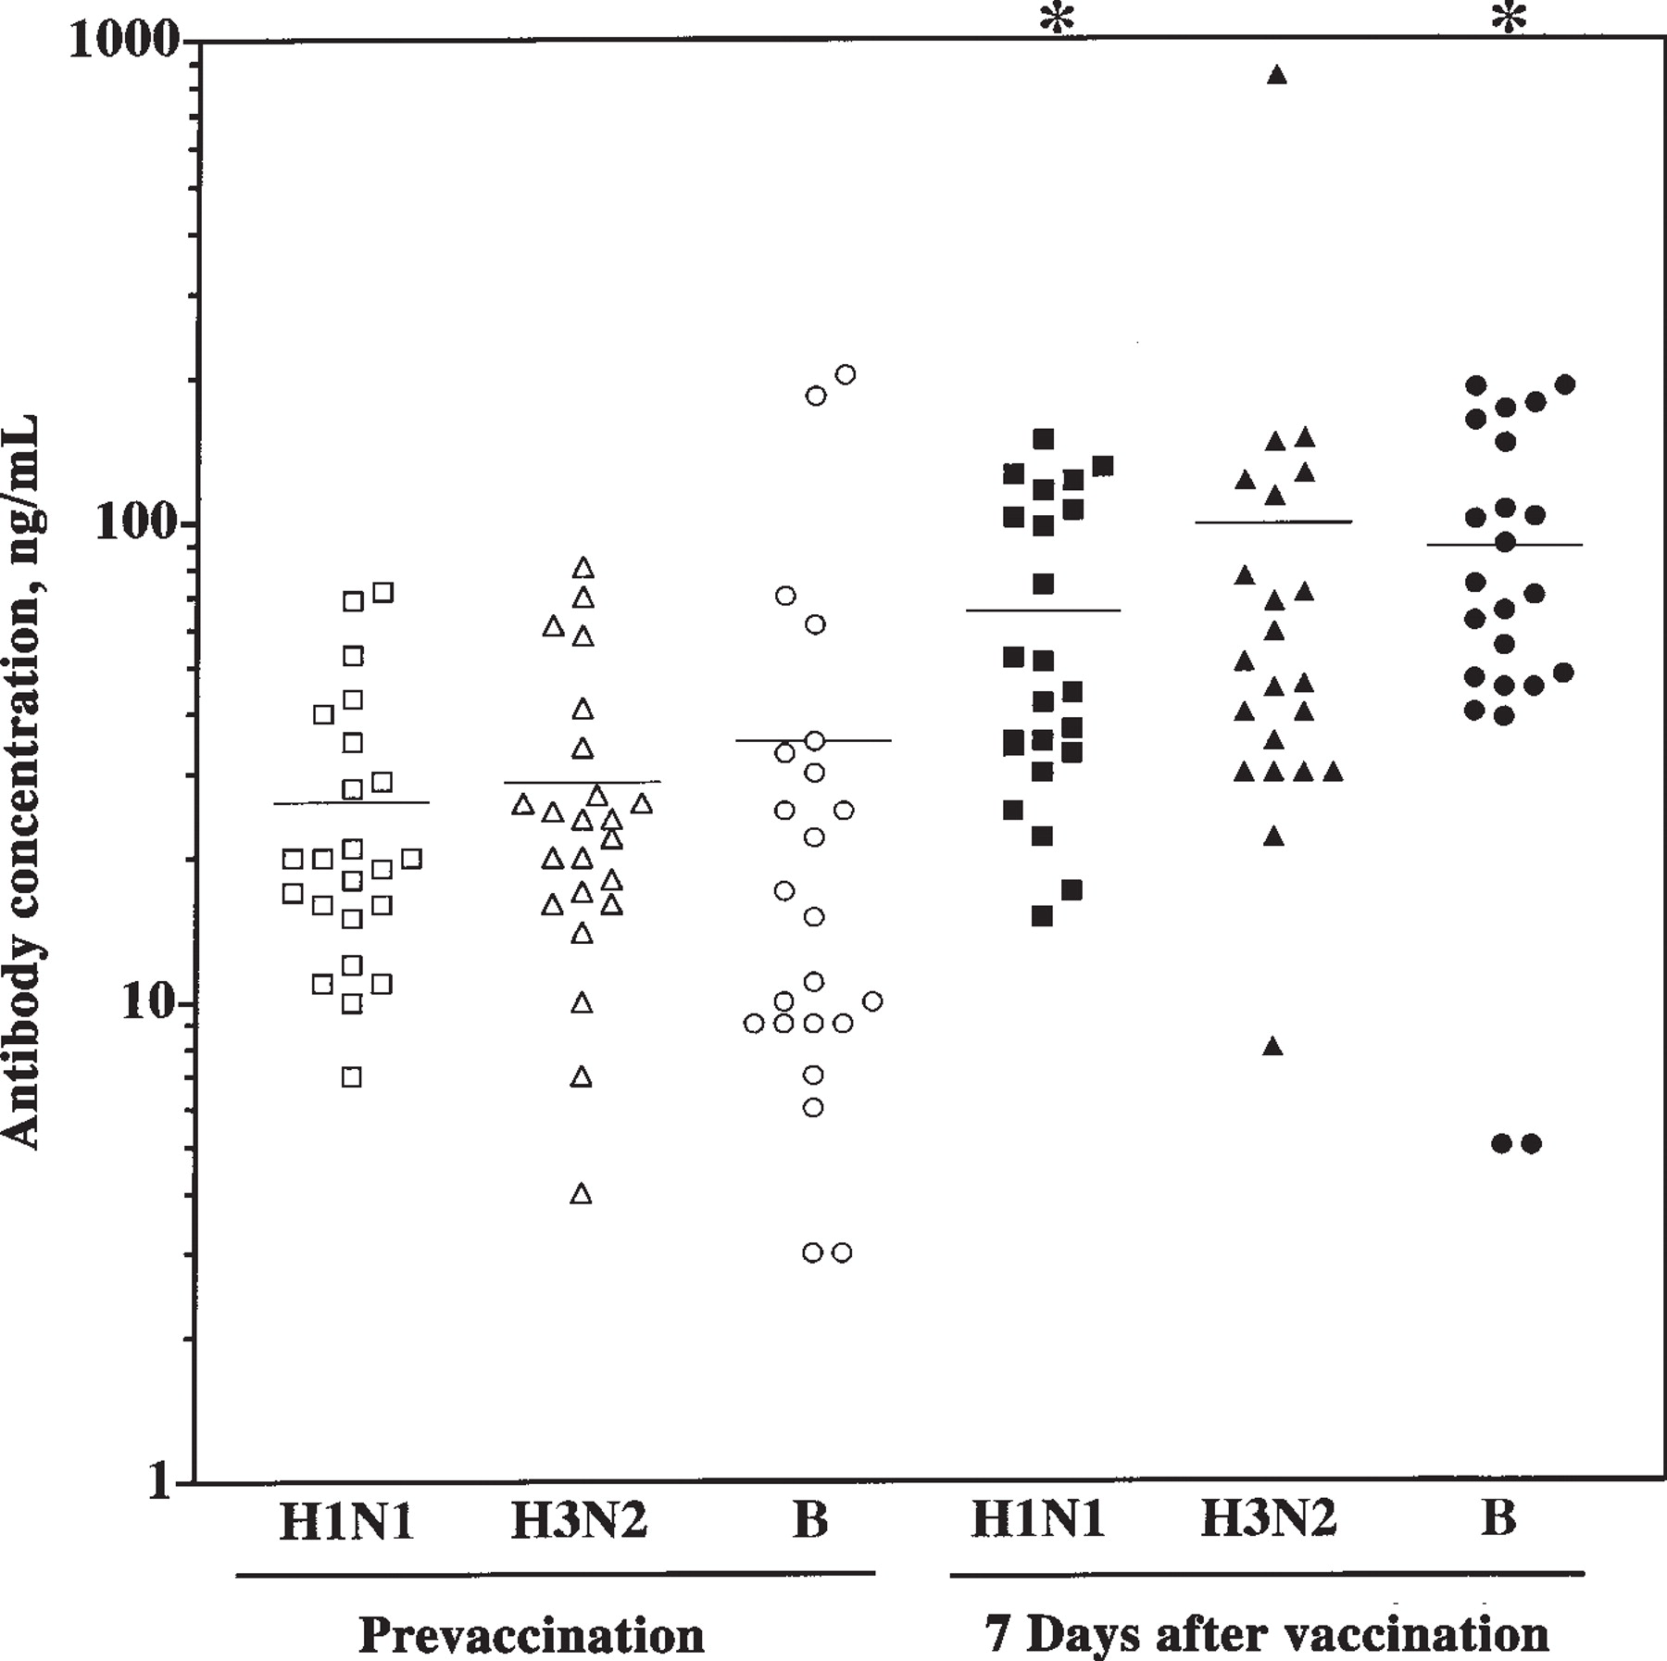
Figure 3 Total concentration of influenza virus-specific antibodies to 3 vaccine viruses (H1N1, H3N2, and B strains) ...
Notes:
Figure 3 Total concentration of influenza virus-specific antibodies to 3 vaccine viruses (H1N1, H3N2, and B strains) for each subject (n = 23) in oral fluid immediately before (open symbols) and 7 days after (solid symbols) vaccination. The horizontal bar in each column indicates the mean value. *Significant difference between prevaccination and day-7 samples (P < .05, by paired t test).
Unless provided in the caption above, the following copyright applies to the content of this slide: © 2002 by the Infectious Diseases Society of America

Slide 4
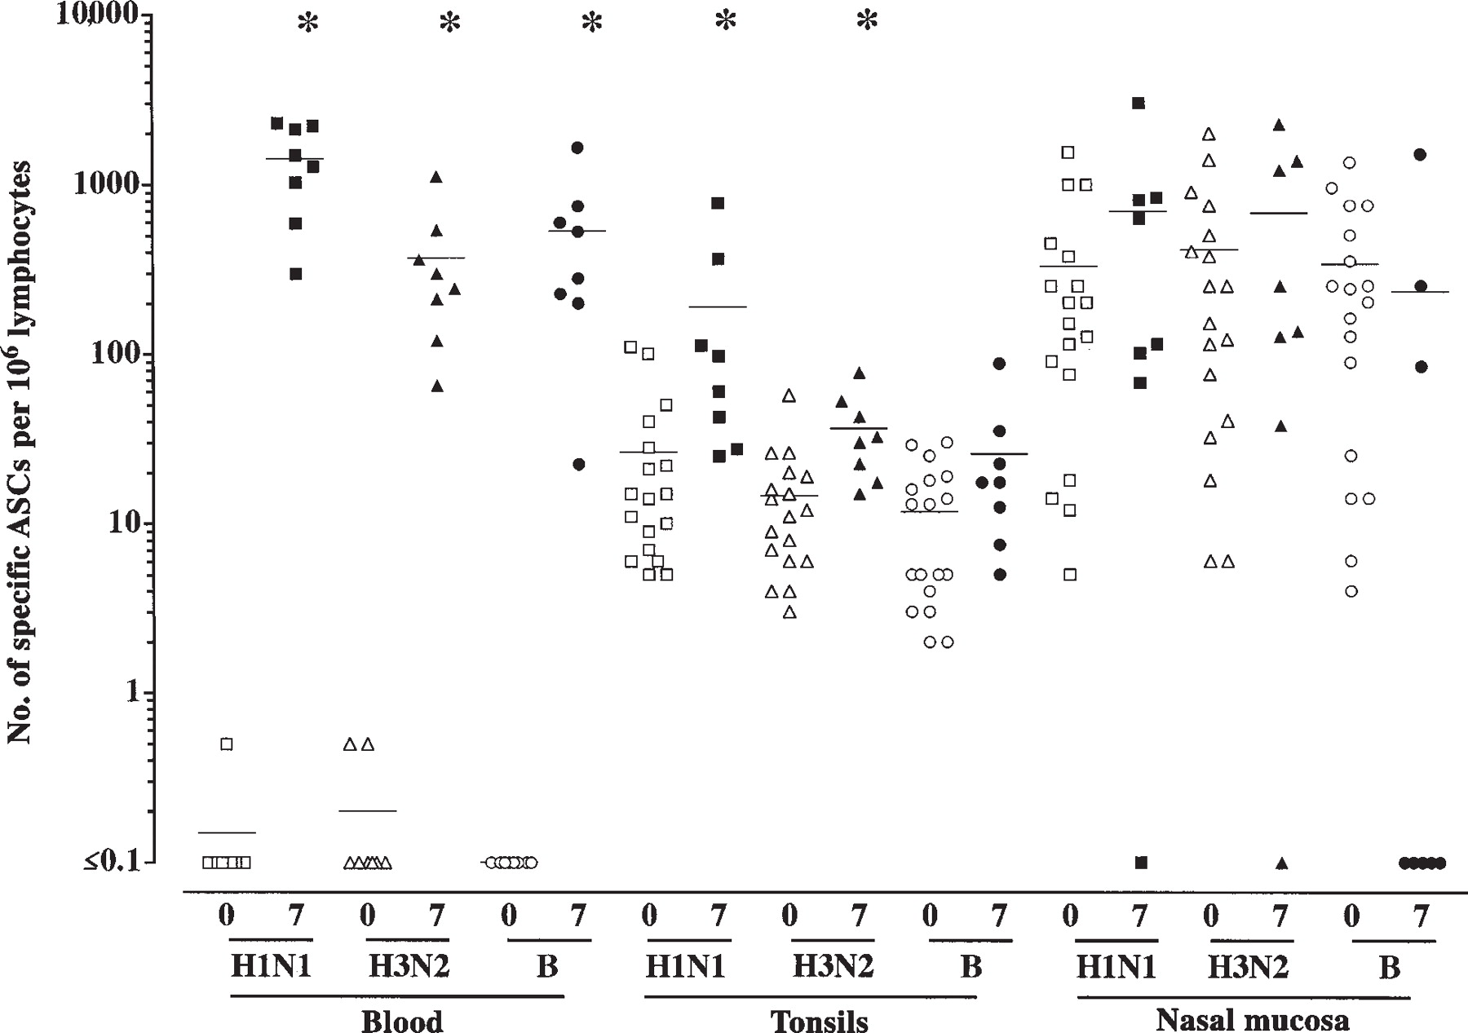
Figure 4 No. of influenza virus-specific antibody-secreting cells (ASCs) to 3 vaccine viruses (H1N1, H3N2, and B) for ...
Notes:
Figure 4 No. of influenza virus-specific antibody-secreting cells (ASCs) to 3 vaccine viruses (H1N1, H3N2, and B) for each subject in peripheral blood, tonsils, and nasal mucosa immediately before vaccination (or in nonvaccinated subjects) (open symbols; day 0) and 7 days after (solid symbols) influenza virus vaccination. (Because we lacked prevaccination samples from tonsils and nasal mucosa, comparable data from nonvaccinated subjects were obtained from a recent study [5].) The horizontal line in each column indicates the mean value. *Significant difference between this sample and the paired basal level sample (P < .05, by paired t test for blood and by unpaired t test for tonsils and nasal mucosa).
Unless provided in the caption above, the following copyright applies to the content of this slide: © 2002 by the Infectious Diseases Society of America

