Slide 1
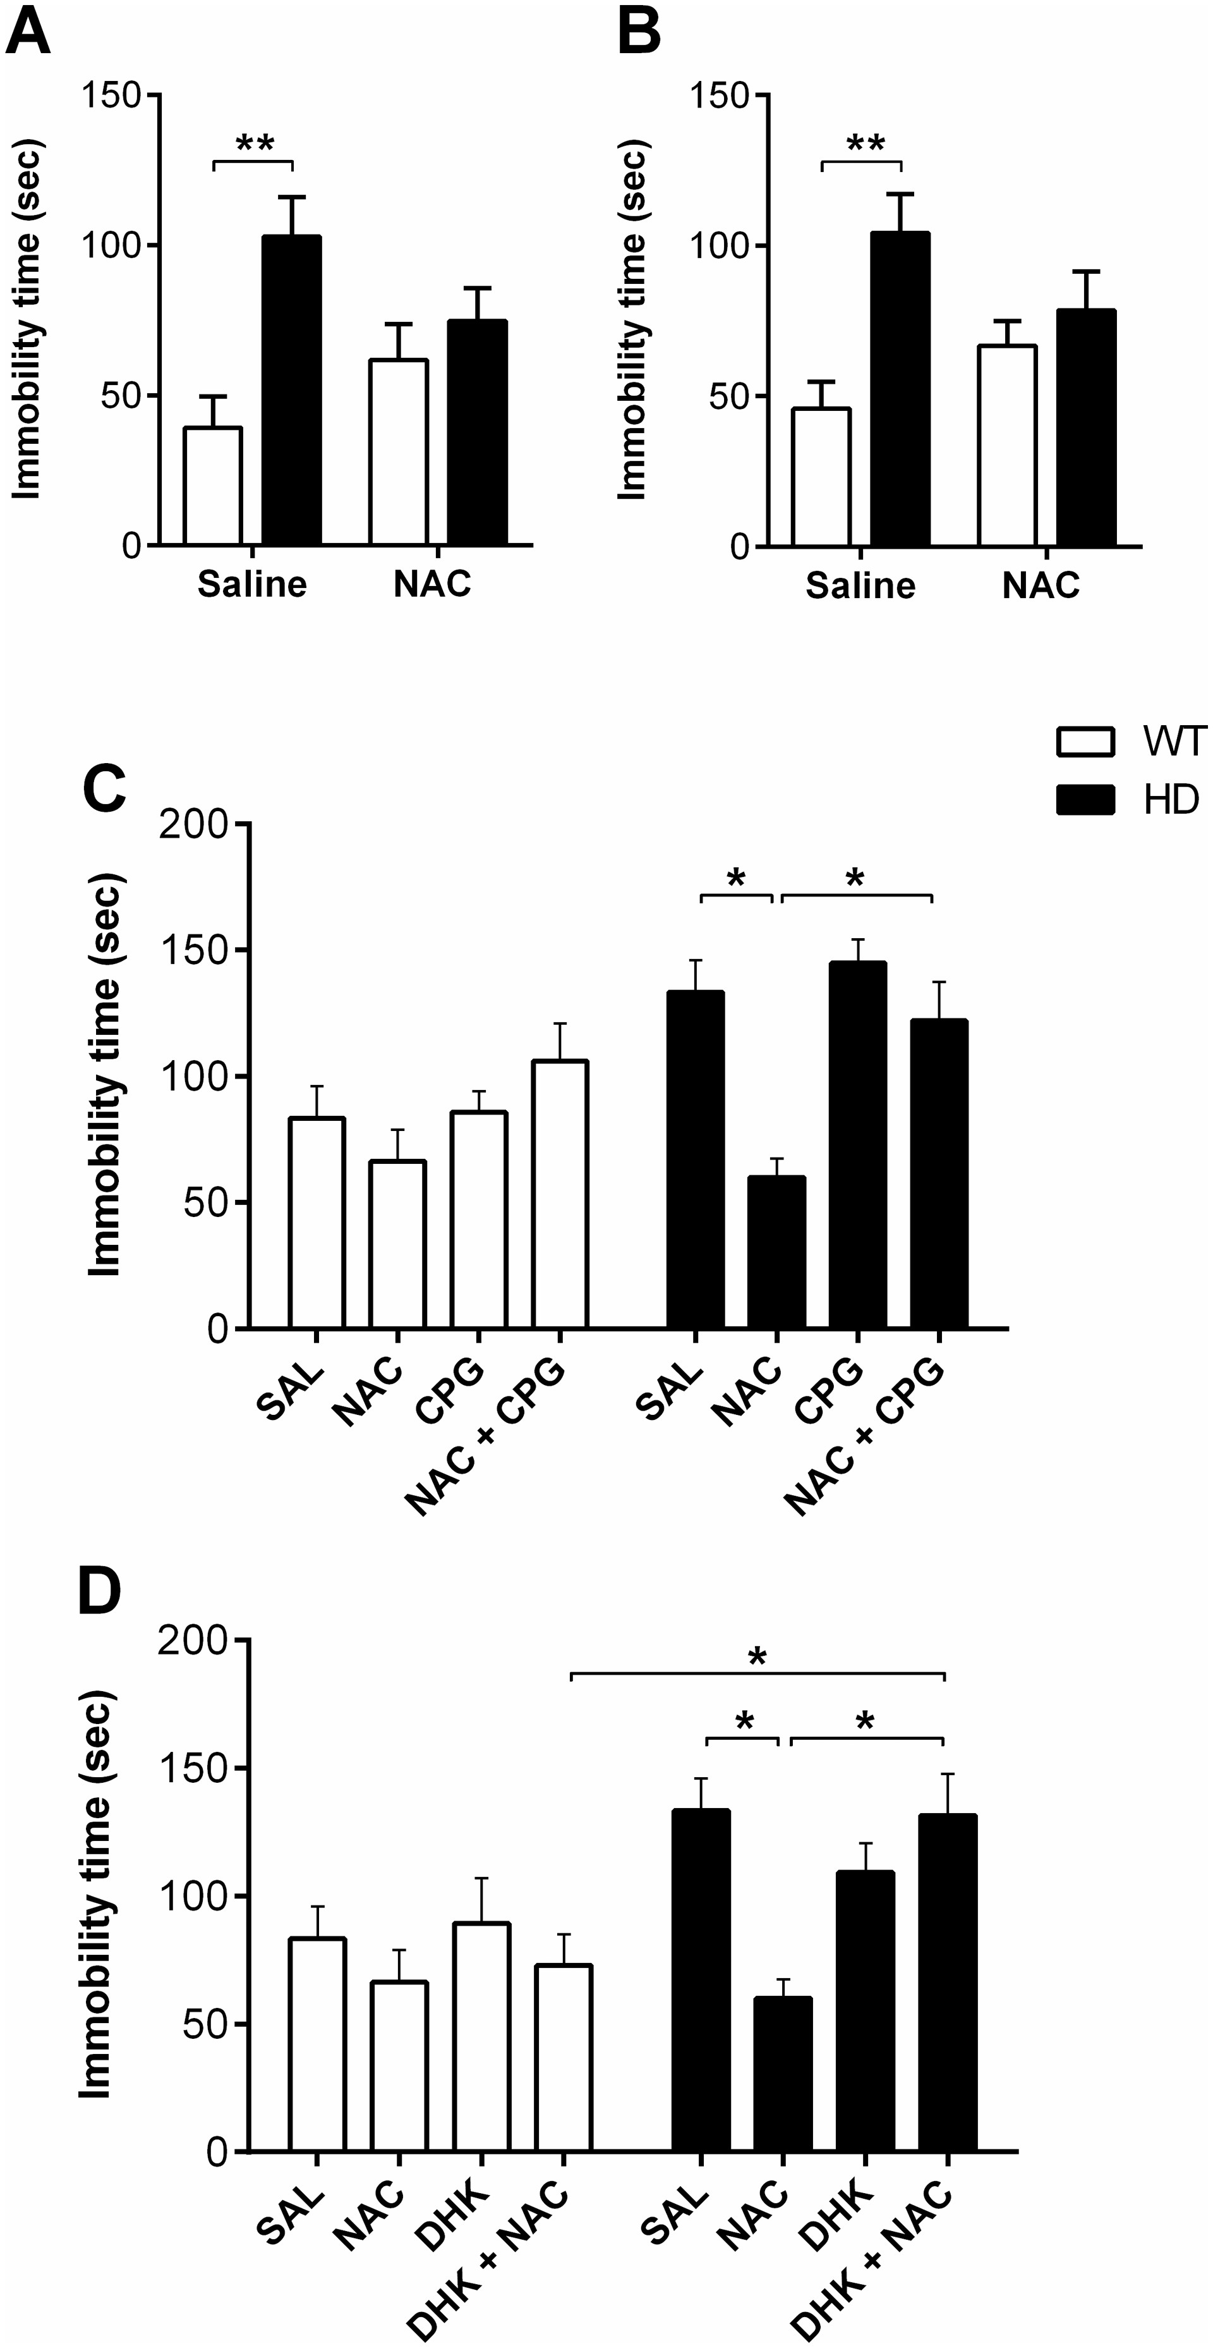
Figure 1. The antidepressant effect of NAC is mediated by glutamate transporters. (A) Acute and (B) chronic treatment ...
Notes:
Figure 1. The antidepressant effect of NAC is mediated by glutamate transporters. (A) Acute and (B) chronic treatment with NAC (500 mg/kg/d) has an antidepressant-like effect on HD mice in the FST. For both acute and chronic tests, a significant interaction between genotype and treatment was found. Post-hoc tests revealed that HD-saline mice spent more time immobile than WT-saline mice. No other groups displayed a difference. (C) The system xc- inhibitor, CPG (200 mg/kg) was then co-administered with NAC prior to the FST. A significant genotype-by-treatment interaction was found. Post-hoc tests revealed that NAC-HD mice showed less immobility compared with Saline-HD mice. NAC-HD mice did not differ from Saline-WT mice on levels of immobility. The addition of CPG to NAC treatment ablated much of the effect of NAC, such that the immobility of NAC + CPG-HD mice was significantly higher than the NAC-HD mice and did not differ from Saline-HD mice. (D) NAC (500 mg/kg) was co-administered with the GLT-1- inhibitor, DHK (20 mg/kg) prior to administering the FST. A significant genotype effect and a significant treatment effect were found. Post-hoc tests revealed that NAC-HD mice showed less immobility compared with Saline-HD mice. NAC-HD mice showed levels of immobility that did not differ from Saline-WT mice. The addition of DHK ablated the effect of NAC, such that NAC + DHK-HD mice were significantly more immobile than NAC-HD mice and did not differ from Saline-HD mice. Error bars represent mean ± SEM; n = 9-15; Post-hoc comparisons *P < 0.05, **P < 0.01.
Unless provided in the caption above, the following copyright applies to the content of this slide: © The Author 2016. Published by Oxford University Press. All rights reserved. For permissions, please e-mail: journals.permissions@oup.com

Slide 2
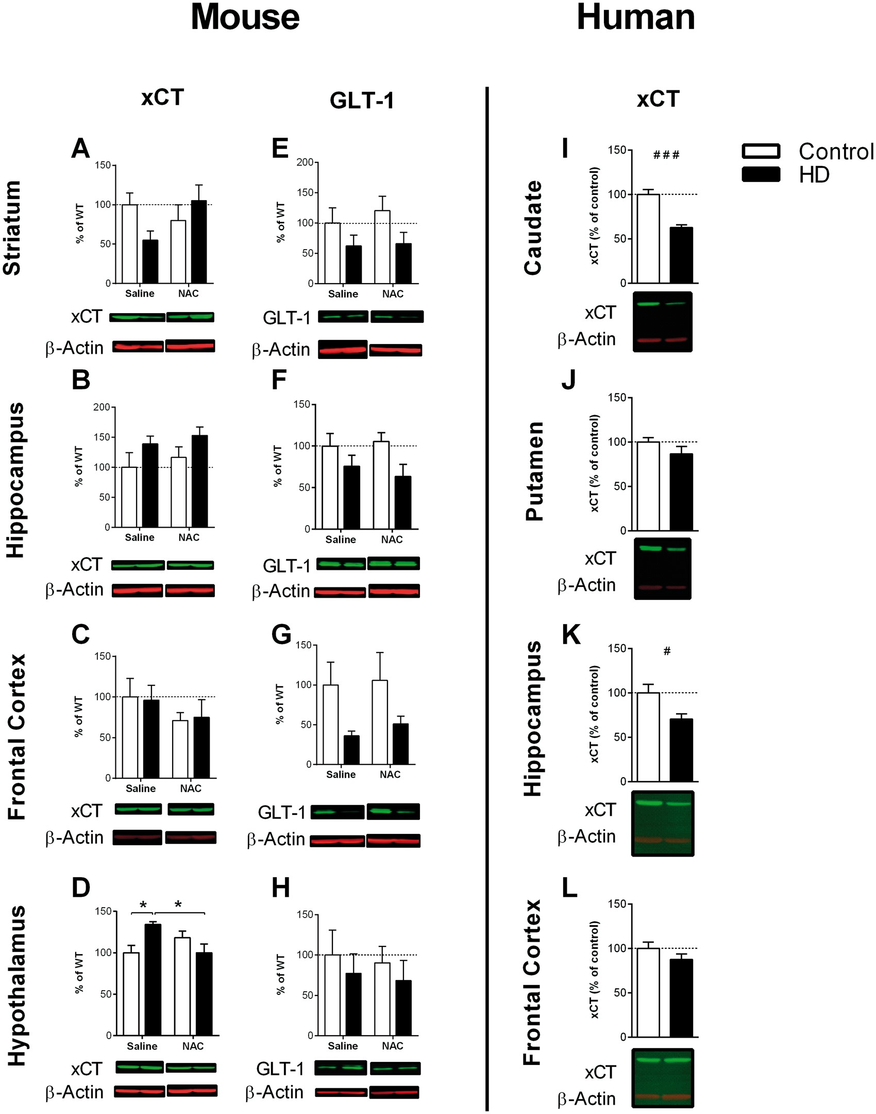
Figure 2. Human post-mortem and mouse protein levels of xCT (system x_{c-}) and GLT-1. (A) A significant ...
Notes:
Figure 2. Human post-mortem and mouse protein levels of xCT (system xc-) and GLT-1. (A) A significant genotype-by-treatment interaction was found in the expression of xCT in the striatum. Post-hoc differences were not significant; (B) An increase in xCT expression was seen in the hippocampus of HD mice; (C) no differences between groups were found in the frontal cortex; and (D) a significant genotype-by-treatment interaction was found in xCT expression in the hypothalamus. Post-hoc tests revealed Saline-HD mice had higher expression than Saline-WT and NAC-HD mice. (E) No difference in GLT-1 between groups was observed in the striatum; (F) a decrease in GLT-1 was seen in the hippocampus and (G) frontal cortex of HD mice; and (H) no difference in GLT-1 was seen between groups in the hypothalamus. In human HD post-mortem tissue, xCT was lower in the (I) caudate and (K) hippocampus. No changes in xCT were found in the (J) putamen or (L) frontal cortex. Error bars represent mean ± SEM; n = 6–12; genotype effects: #P < 0.05; ###P < 0.001. Post-hoc comparisons: *P < 0.05.
Unless provided in the caption above, the following copyright applies to the content of this slide: © The Author 2016. Published by Oxford University Press. All rights reserved. For permissions, please e-mail: journals.permissions@oup.com

Slide 3
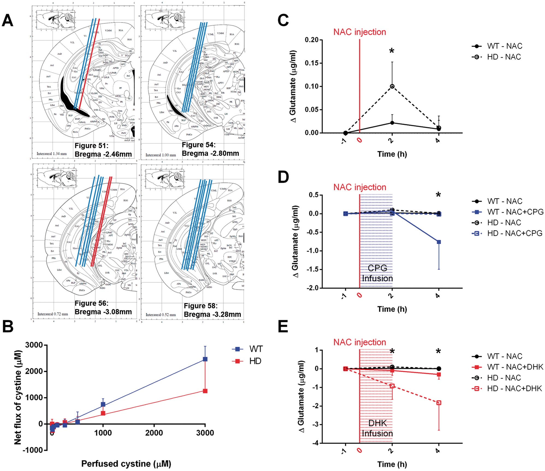
Figure 3. In vivo microdialysis for cystine and glutamate. (A) Probe insertion sites were validated within perfused ...
Notes:
Figure 3. In vivo microdialysis for cystine and glutamate. (A) Probe insertion sites were validated within perfused slices. All probe insertion sites occurred 2.46–3.30 mm posterior of bregma (figure 51–58 of Franklin and Paxinos mouse brain atlas27). Mice whose probe insertion site fell outside of the hippocampus (red lines) were removed from statistical analyses. (B) Cystine no-net-flux analysis was conducted to assess basal levels of cystine within the hippocampus. HD mice have a significantly lower gradient than WT mice indicating lower levels of cystine (P < 0.01; n = 7). (C) HD mice show increased extracellular glutamate in response to NAC (i.p. 500 mg/kg). A significant effect of time was found with post-hoc tests revealing that HD mice show higher extracellular glutamate compared with WT, 2 h after injection. CPG (100 μM) and DHK (50 μM) were infused after systemic NAC administration (i.p. 500 mg/kg). (D) A significant effect of time was found with post-hoc tests revealing that WT mice given a CPG infusion had lower extracellular glutamate at 4 h post NAC administration, compared with all other groups. (E) A significant effect of time was found with post-hoc tests revealing that HD mice given a DHK infusion had lower extracellular glutamate at 2 and 4 h post NAC administration, compared with all other groups. Error bars represent mean ± SEM; n = 4–10; post-hoc comparisons: *P < 0.05.
Unless provided in the caption above, the following copyright applies to the content of this slide: © The Author 2016. Published by Oxford University Press. All rights reserved. For permissions, please e-mail: journals.permissions@oup.com

Slide 4
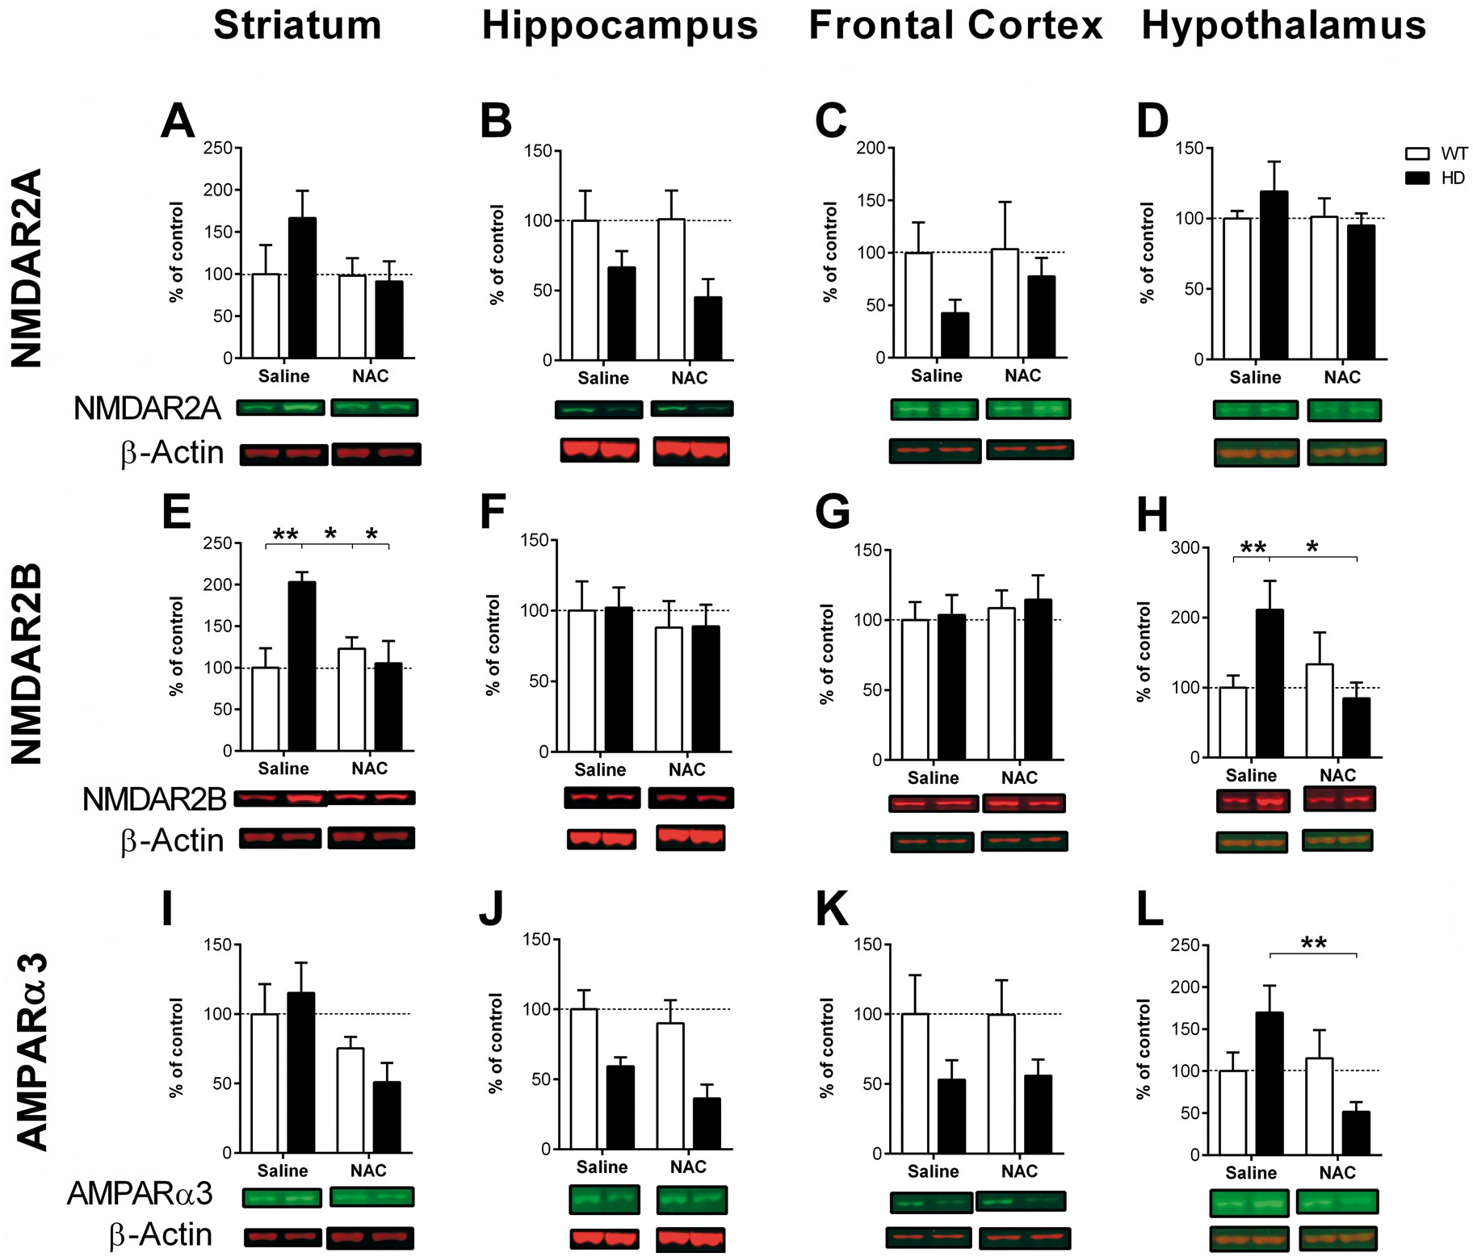
Figure 4. Protein levels of glutamate receptors in mice. No changes in NMDAR2A expression were seen in the (A) ...
Notes:
Figure 4. Protein levels of glutamate receptors in mice. No changes in NMDAR2A expression were seen in the (A) striatum, (C) frontal cortex or (D) hypothalamus. (B) However, a reduction was seen in the hippocampus of HD mice. (E) A significant genotype-by-treatment interaction was found in levels of NMDAR2B in the striatum. Post-hoc tests revealed that HD-saline mice had higher expression than all other groups; (F) No differences in NMDAR2B expression were seen in the hippocampus or (G) frontal cortex. (H) A significant treatment-by-genotype interaction was found in the hypothalamus, with post-hoc tests revealing that Sal-HD mice showed higher levels of NMDAR2B relative to both Sal-WT and NAC-HD. (I) AMPAα3 expression was lower in the striatum of NAC-treated mice. HD mice showed decreased expression in both the (J) hippocampus and (K) frontal cortex. (L) A significant treatment-by-genotype interaction was found in the hypothalamus, with post-hoc tests revealing a difference between HD-saline mice and HD-NAC mice. Error bars represent mean ± SEM; n = 6-8; post-hoc comparisons: *P < 0.05, **P < 0.01.
Unless provided in the caption above, the following copyright applies to the content of this slide: © The Author 2016. Published by Oxford University Press. All rights reserved. For permissions, please e-mail: journals.permissions@oup.com

Slide 5
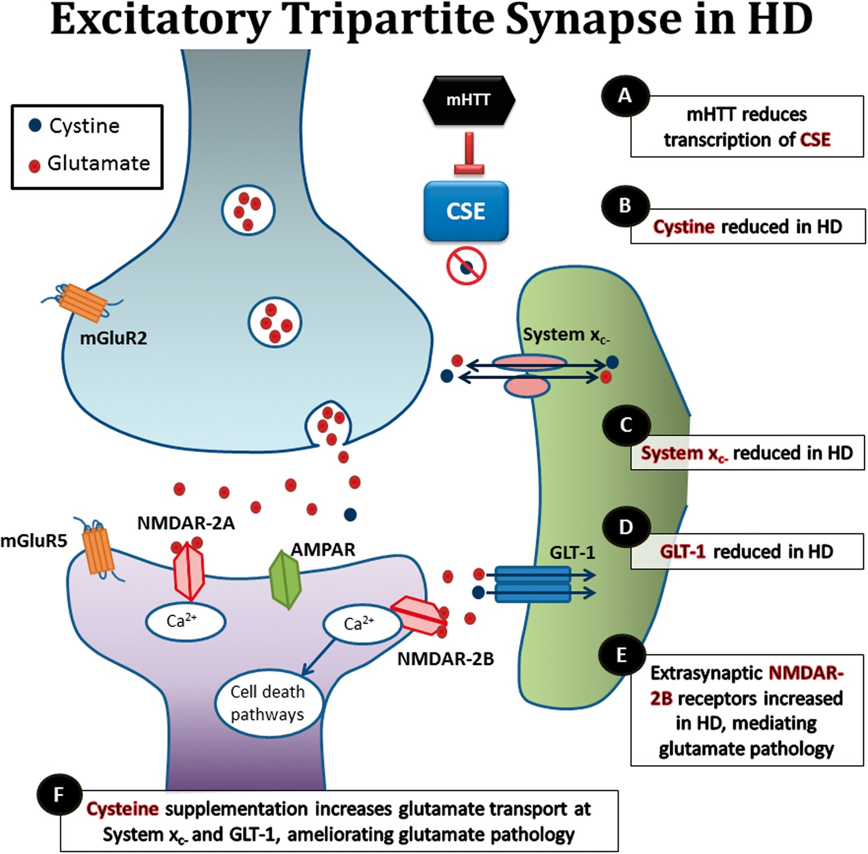
Figure 5. A proposed model of pathogenesis mediating abnormal glutamate homeostasis and dysfunction of excitatory ...
Notes:
Figure 5. A proposed model of pathogenesis mediating abnormal glutamate homeostasis and dysfunction of excitatory tripartite synapses. (A) mHTT inhibits transcription of CSE, (B) leading to reductions in extracellular cysteine and cystine. Lower cystine disrupts transport of glutamate through both system xc- and GLT-1. Specifically, (C) cystine is not taken up into astrocytes through system xc-, reducing export of glutamate, whilst (D) glutamate is not removed from the extracellular space via GLT-1. (E) Increased extrasynaptic glutamate is then able to activate aberrant NMDAR2B, leading to glutamate-related pathologies. (F) Supplementing cysteine using NAC, increased synaptic glutamate transport via GLT-1 and system xc-.
Unless provided in the caption above, the following copyright applies to the content of this slide: © The Author 2016. Published by Oxford University Press. All rights reserved. For permissions, please e-mail: journals.permissions@oup.com

