Slide 1
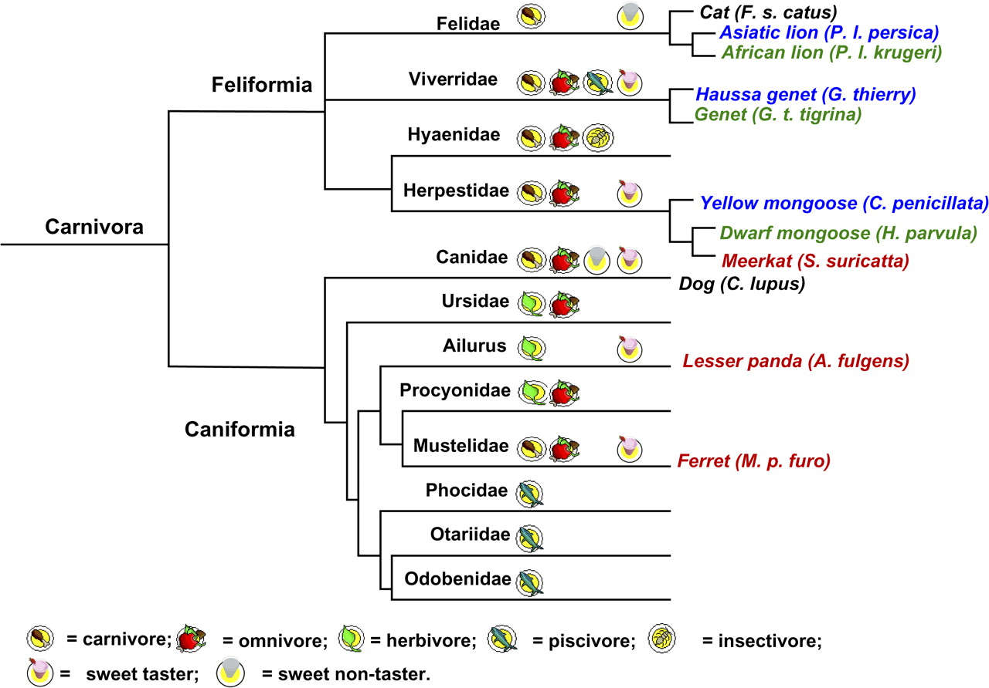
Figure 1 A simplified evolutionary tree of the Order Carnivora ( Flynn 2005 ; Nowak 2005 ). The 2 major branches of ...
Notes:
Figure 1 A simplified evolutionary tree of the Order Carnivora ( Flynn 2005 ; Nowak 2005 ). The 2 major branches of the Order Carnivora, Feliformia, and Caniformia, diverged approximately 45 Ma. The dish symbols represent the different diets preferred within each family. A cup of strawberry smoothie indicates the animals tested within the family prefer sweet stimuli over plain water, and a glass of water indicates the animals tested within the family show no preference to sweet stimuli over plain water. At the end of each branch, species used in both sequencing and taste testing are marked in red, species only used in behavioral testing are marked in blue, and species only used in sequencing are marked in green.
Unless provided in the caption above, the following copyright applies to the content of this slide: © The American Genetic Association. 2009. All rights reserved. For permissions, please email: journals.permissions@oxfordjournals.org.

Slide 2
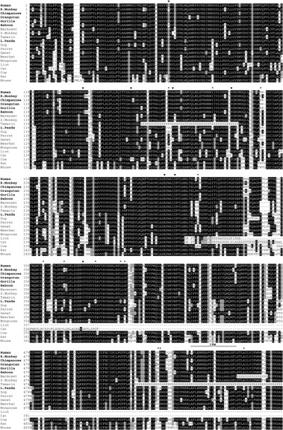
Figure 2 Alignment of deduced amino acid sequence of T1R2 from 20 mammalian species. Among the 20 species listed, ...
Notes:
Figure 2 Alignment of deduced amino acid sequence of T1R2 from 20 mammalian species. Among the 20 species listed, human, chimpanzee, orangutan, gorilla, rhesus monkey, baboon, and lesser panda are aspartame tasters (marked in bold); marmoset, squirrel monkey, tamarin, dog, ferret, genet, meerkat, mongoose, lion, cat, cow, rat, and mouse are aspartame non tasters. The sequences of human, cow, rat and mouse are from GenBank, and sequences from the rest of the species are generated and deposited in GenBank by our group. Amino acids that are identical among species are shaded in black, conservative amino acid substitutions are shaded in gray, and non conservative amino acid substitutions are not shaded. The cat T1R2 sequence shows high similarity with that of lion: They both have premature stop codon and predict a truncated protein. The underlined amino acids in cat beginning at 313 and lion at 312 show the frameshift caused by the microdeletion in exon 3. Note that the deduced T1R2 amino acid sequences of lesser panda, ferret, genet, meerkat, and mongoose predict apparently normal protein showing high similarity with those reference sequences from other mammals. The transmembrane (TM) prediction was based on human T1R2 using computer program ( http://www.ebi.ac.uk/∼moeller/transmembrane.html#TMHMMs ). The TMs of each species were similar among those species having normal T1R2 proteins. The asterisks show the amino acid sites that differentiate lesser panda from other species. For example, at position 185, lesser panda is S (Ser), the rest of species either have P (Pro) or A (Ala). These sites are potentially important for interaction with artificial sweeteners in lesser panda. The heart symbols indicate the 8 ligand-binding sites in mGluR1, presumably also the ligand-binding sites in T1R2 ( Li et al. 2002 ; Xu et al. 2004 ). “X” indicates the missing sequences.
Unless provided in the caption above, the following copyright applies to the content of this slide: © The American Genetic Association. 2009. All rights reserved. For permissions, please email: journals.permissions@oxfordjournals.org.

Slide 3
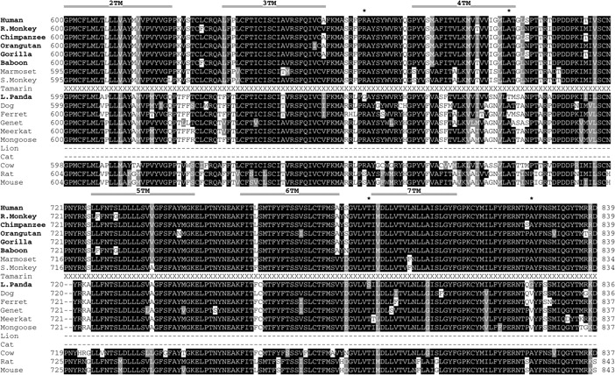
Figure 2 Alignment of deduced amino acid sequence of T1R2 from 20 mammalian species. Among the 20 species listed, ...
Notes:
Figure 2 Alignment of deduced amino acid sequence of T1R2 from 20 mammalian species. Among the 20 species listed, human, chimpanzee, orangutan, gorilla, rhesus monkey, baboon, and lesser panda are aspartame tasters (marked in bold); marmoset, squirrel monkey, tamarin, dog, ferret, genet, meerkat, mongoose, lion, cat, cow, rat, and mouse are aspartame non tasters. The sequences of human, cow, rat and mouse are from GenBank, and sequences from the rest of the species are generated and deposited in GenBank by our group. Amino acids that are identical among species are shaded in black, conservative amino acid substitutions are shaded in gray, and non conservative amino acid substitutions are not shaded. The cat T1R2 sequence shows high similarity with that of lion: They both have premature stop codon and predict a truncated protein. The underlined amino acids in cat beginning at 313 and lion at 312 show the frameshift caused by the microdeletion in exon 3. Note that the deduced T1R2 amino acid sequences of lesser panda, ferret, genet, meerkat, and mongoose predict apparently normal protein showing high similarity with those reference sequences from other mammals. The transmembrane (TM) prediction was based on human T1R2 using computer program ( http://www.ebi.ac.uk/∼moeller/transmembrane.html#TMHMMs ). The TMs of each species were similar among those species having normal T1R2 proteins. The asterisks show the amino acid sites that differentiate lesser panda from other species. For example, at position 185, lesser panda is S (Ser), the rest of species either have P (Pro) or A (Ala). These sites are potentially important for interaction with artificial sweeteners in lesser panda. The heart symbols indicate the 8 ligand-binding sites in mGluR1, presumably also the ligand-binding sites in T1R2 ( Li et al. 2002 ; Xu et al. 2004 ). “X” indicates the missing sequences.
Unless provided in the caption above, the following copyright applies to the content of this slide: © The American Genetic Association. 2009. All rights reserved. For permissions, please email: journals.permissions@oxfordjournals.org.

