Slide 1
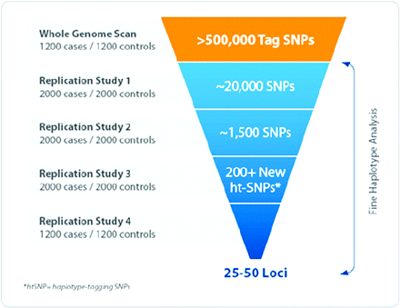
Fig. 1 Multistage design for GWAS (from http://cgems.cancer.gov). It should be noticed that the numbers of phases ...
Notes:
Fig. 1 Multistage design for GWAS (from http://cgems.cancer.gov). It should be noticed that the numbers of phases and of subjects in each phase is not fixed. With continuously falling prices for genotyping, the current trend is to have a whole-genome scan phase as large as possible (e.g. 2000 case–control pairs).
Unless provided in the caption above, the following copyright applies to the content of this slide: © The Author 2008. Published by Oxford University Press on behalf of the UK Environmental Mutagen Society. All rights reserved. For permissions, please e-mail: journals.permissions@oxfordjournals.org.

