Slide 1
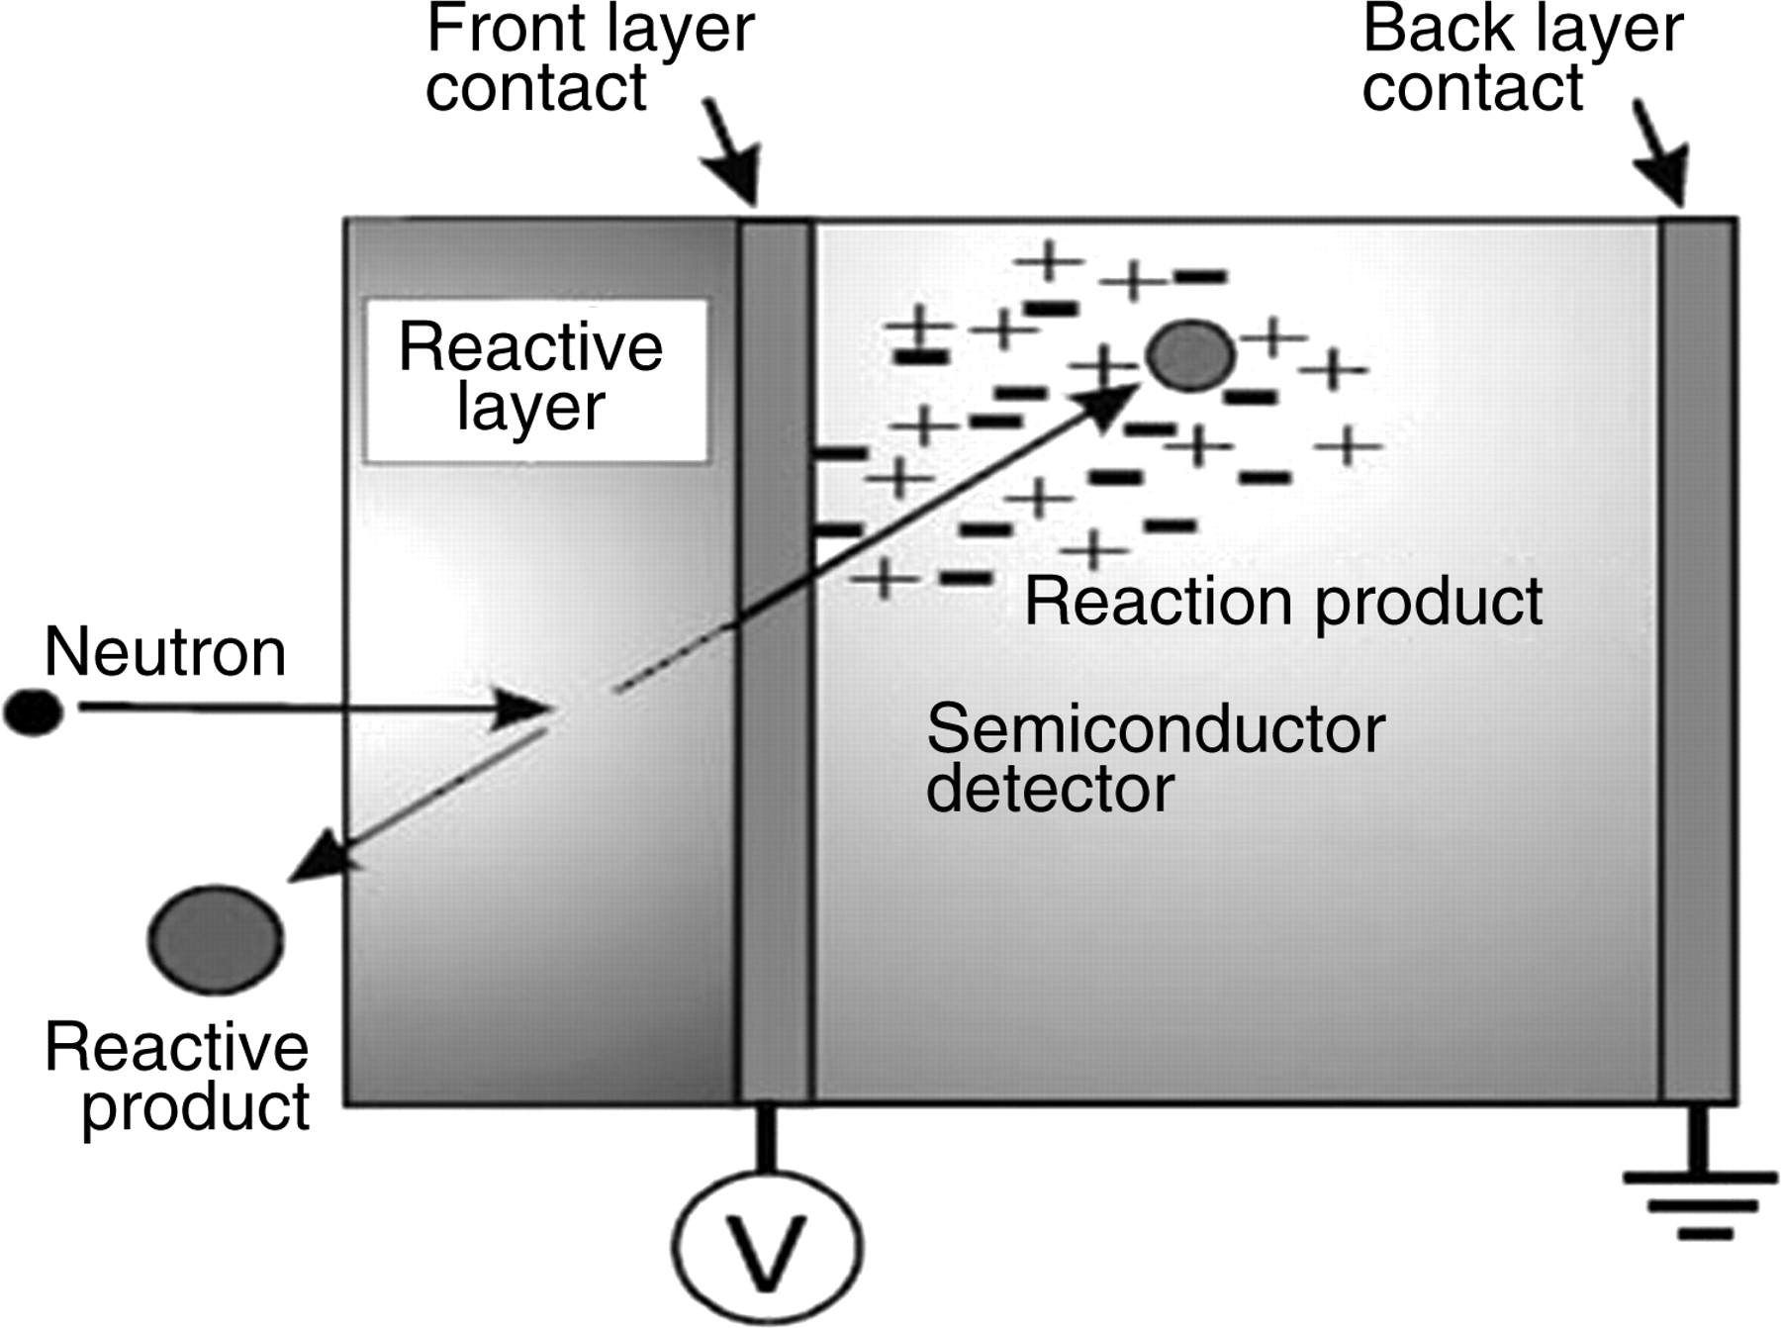
Figure 1. The basic layout of the thin-film SBD, illustrating the recoiling reactive products generated by the neutron ...
Notes:
Figure 1. The basic layout of the thin-film SBD, illustrating the recoiling reactive products generated by the neutron capture reaction(3).
Unless provided in the caption above, the following copyright applies to the content of this slide: © The Author 2010. Published by Oxford University Press. All rights reserved. For Permissions, please email: journals.permissions@oup.com

