Slide 1
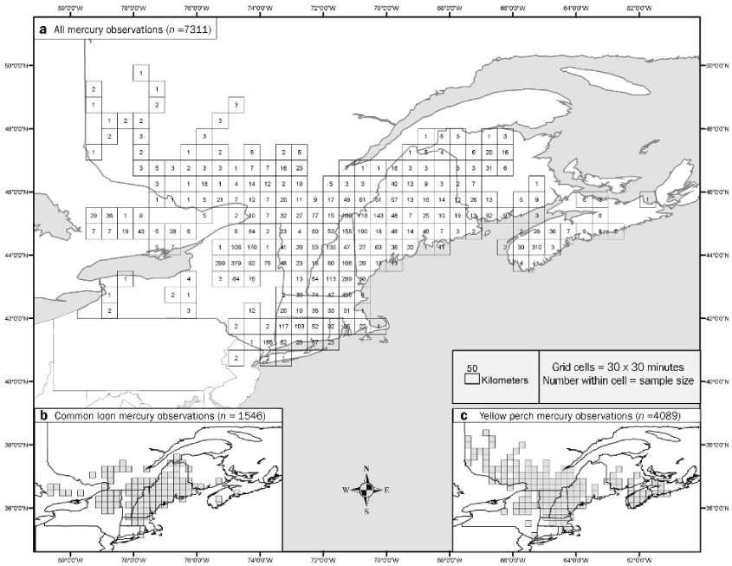
Figure 1. (a) Distribution of biotic mercury (Hg) observations across the northeastern United States and southeastern ...
Notes:
Figure 1. (a) Distribution of biotic mercury (Hg) observations across the northeastern United States and southeastern Canada, and specific distribution of Hg observations for (b) the common loon and (c) yellow perch.
Unless provided in the caption above, the following copyright applies to the content of this slide: © 2007 American Institute of Biological Sciences

Slide 2
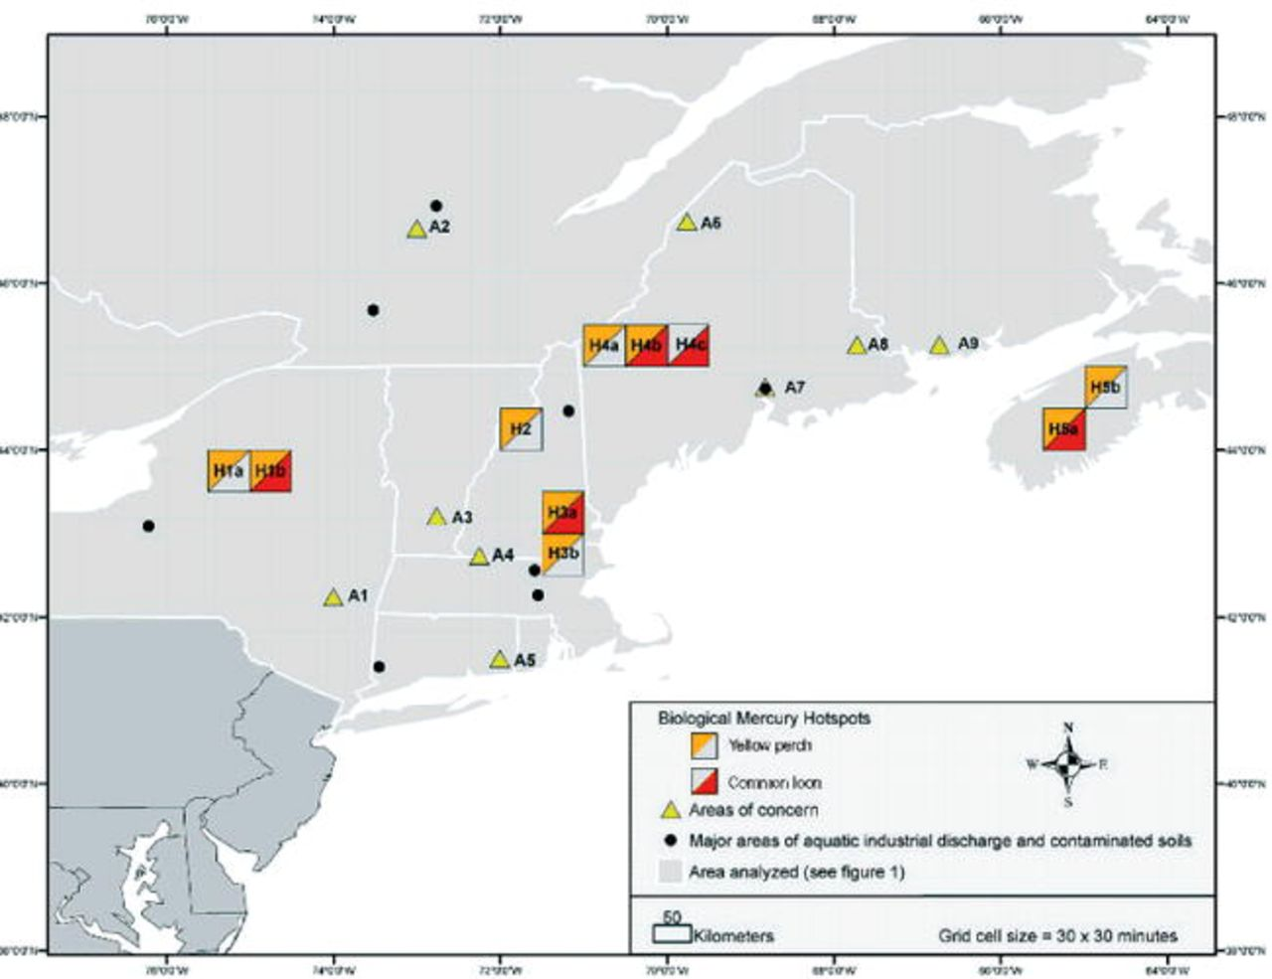
Figure 2. Distribution of biological mercury hotspots (H1a–H5b) and areas of concern (A1–A9). Areas of concern: A1, ...
Notes:
Figure 2. Distribution of biological mercury hotspots (H1a–H5b) and areas of concern (A1–A9). Areas of concern: A1, Catskill Mountains, New York; A2, LaMauricie region, Quebec, Canada; A3, Deerfield River, Vermont; A4, north-central Massachusetts; A5, lower Thames River, Connecticut; A6, upper St. John River, Maine; A7, lower Penobscot River, Maine; A8, Downeast region, Maine; A9, Lepreau region, New Brunswick, Canada. Hotspots: H1a, western Adirondack Mountains, New York; H1b, central Adirondack Mountains, New York; H2, upper Connecticut River, New Hampshire and Vermont; H3a, middle Merrimack River, New Hampshire; H3b, lower Merrimack River, Massachusetts and New Hampshire; H4a, upper Androscoggin River, Maine and New Hampshire; H4b, western upper Kennebec River, Maine; H4c, eastern upper Kennebec River, Maine; H5a, Kejimkujik National Park, Nova Scotia, Canada; H5b, central Nova Scotia.
Unless provided in the caption above, the following copyright applies to the content of this slide: © 2007 American Institute of Biological Sciences

Slide 3
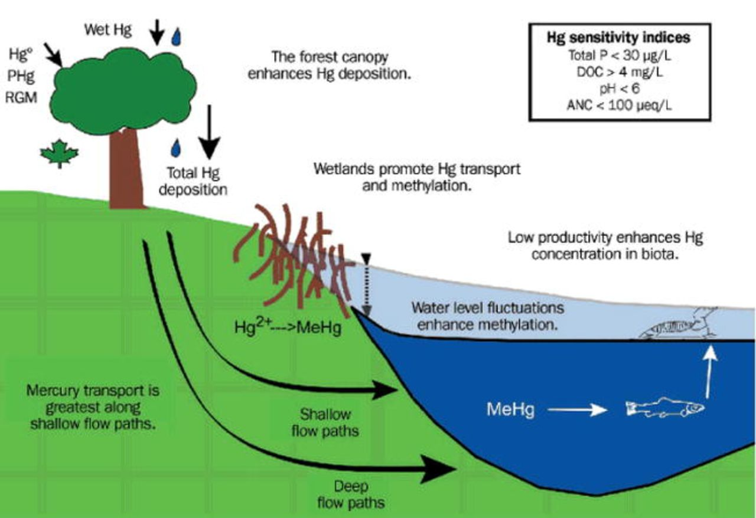
Figure 3. Conceptual figure illustrating important processes controlling the sensitivity of forest and linked aquatic ...
Notes:
Figure 3. Conceptual figure illustrating important processes controlling the sensitivity of forest and linked aquatic ecosystems to atmospheric mercury (Hg) deposition and artificial water level regulation. The forest canopy enhances dry Hg deposition. Water transported along shallow flow paths supplies greater quantities of Hg than water in deep flow paths. Wetlands are important in the supply of dissolved organic carbon (DOC), which enhances the transport of ionic Hg and methylmercury (MeHg), and are important sites for the production of MeHg. The nutrient status and productivity of surface waters also control concentrations of MeHg in aquatic biota. Indicators of lakes sensitive to Hg inputs are shown in the insert (after Driscoll et al. 2007). Reservoir creation and water-level fluctuation will stimulate MeHg production in the littoral region. Abbreviations: ANC, acid neutralizing capacity; Hg0, elemental Hg; P, phosphorus; PHg (i.e., Hg[p]), particulate Hg; RGM (i.e., Hg[II]), reactive gaseous Hg.
Unless provided in the caption above, the following copyright applies to the content of this slide: © 2007 American Institute of Biological Sciences

Slide 4
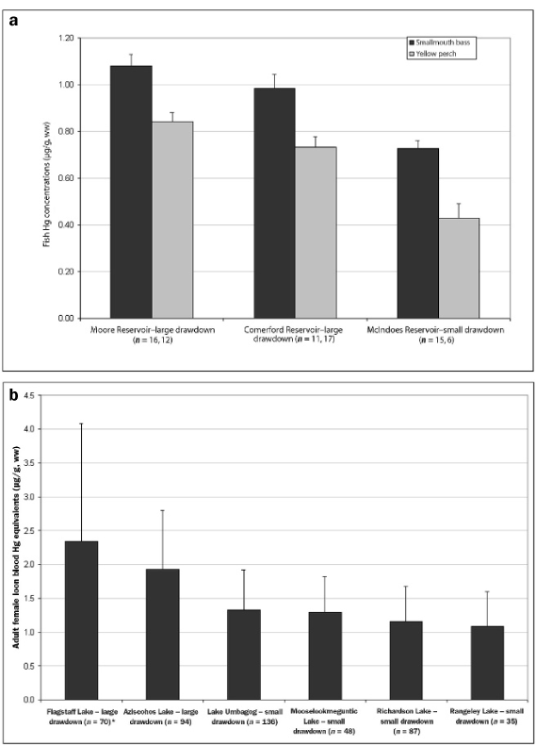
Figure 4. (a) Fillet mercury (Hg) concentrations for smallmouth bass and yellow perch (mean ± standard deviation [sd]) ...
Notes:
Figure 4. (a) Fillet mercury (Hg) concentrations for smallmouth bass and yellow perch (mean ± standard deviation [sd]) at three interconnected Connecticut River reservoirs in Vermont and New Hampshire and (b) blood Hg concentrations for the common loon (mean ± sd) at five interconnected Androscoggin River reservoirs in Maine and New Hampshire and one reservoir (Flagstaff Lake) in the upper Kennebec River watershed, Maine. (Although it is not hydrologically connected to the grid in the upper Androscoggin River watershed, Flagstaff Lake is illustrative of headwater reservoirs in that region that have large drawdowns.) Reservoir drawdowns from June through September that are less than 1 m are considered small, and those greater than 3 m are considered large. Kruskal-Wallis tests indicate significant differences between reservoirs with large and small drawdowns.
Unless provided in the caption above, the following copyright applies to the content of this slide: © 2007 American Institute of Biological Sciences

Slide 5
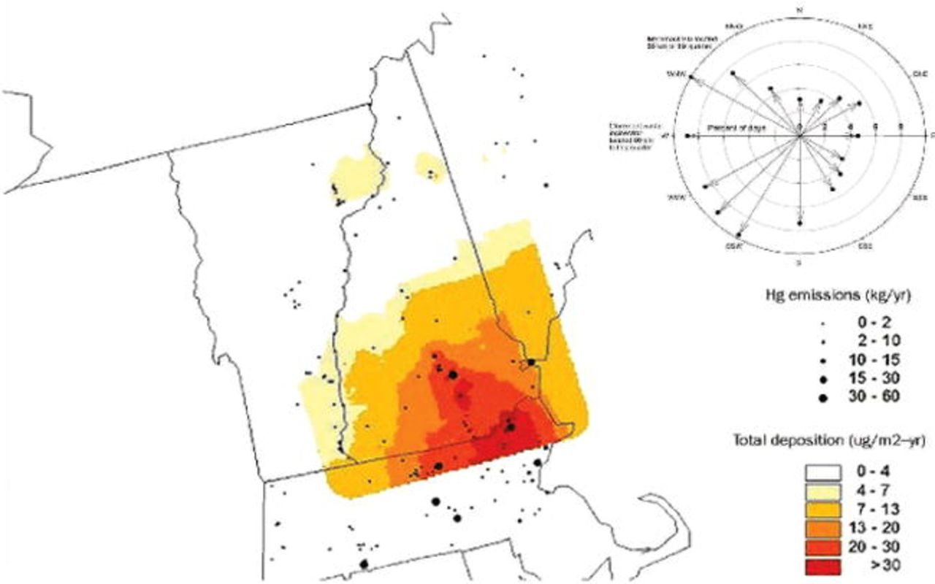
Figure 5. Left, map showing total mercury (Hg) deposition for 2002, estimated using the industrial source complex ...
Notes:
Figure 5. Left, map showing total mercury (Hg) deposition for 2002, estimated using the industrial source complex short-term model, or ISCST3; right, wind rose showing the direction of air flow for May through August 1999 to 2002 in southern New Hampshire, based on weekly wind roses from the NOAA (National Oceanic and Atmospheric Administration) Air Resources Laboratory's READY (Real-time Environmental Applications and Display System) analyses (NOAA 2006).
Unless provided in the caption above, the following copyright applies to the content of this slide: © 2007 American Institute of Biological Sciences

Slide 6
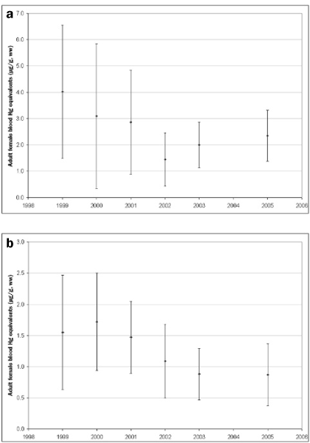
Figure 6. Temporal patterns for adult loon blood mercury (Hg) equivalents (μg per g, wet weight; mean ± standard ...
Notes:
Figure 6. Temporal patterns for adult loon blood mercury (Hg) equivalents (μg per g, wet weight; mean ± standard deviation) in (a) the middle Merrimack River watershed (n = 53) and (b) the upper Merrimack River watershed (n = 43), New Hampshire. Note: The magnitude of the y axis, adult female blood Hg equivalents, differs between figure 6a and 6b.
Unless provided in the caption above, the following copyright applies to the content of this slide: © 2007 American Institute of Biological Sciences

Slide 7
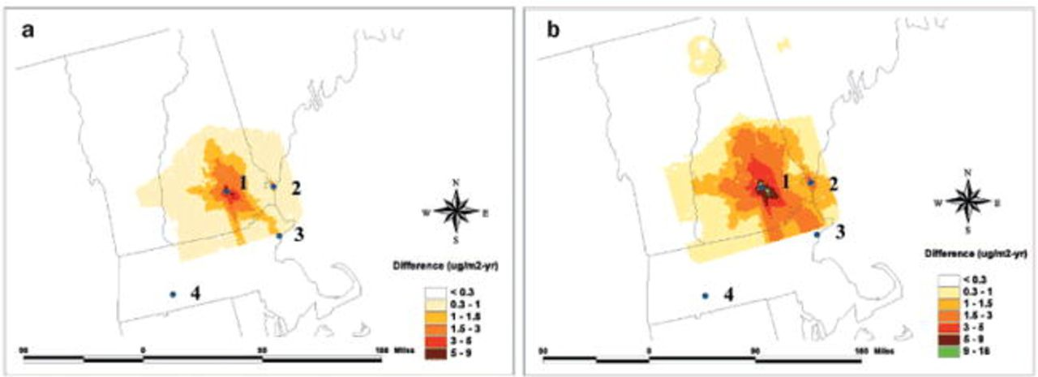
Figure 7. Total differences in mercury (Hg) deposition (μg per m² per year) statewide in New Hampshire (a) ...
Notes:
Figure 7. Total differences in mercury (Hg) deposition (μg per m2 per year) statewide in New Hampshire (a) with 50% emission reduction and (b) with 90% emission reduction from four coal-fired utilities in New England. Power plant Hg emission sources: (1) Merrimack Station, (2) Schiller Station, (3) Salem Harbor Station, (4) Mount Tom Station.
Unless provided in the caption above, the following copyright applies to the content of this slide: © 2007 American Institute of Biological Sciences

