Slide 1
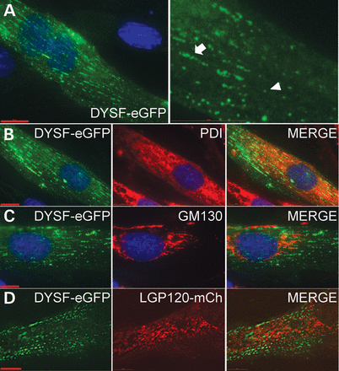
Figure 1. Dysferlin-eGFP localizes to a population of distinct vesicles in differentiated L6 myotubes. (A) ...
Notes:
Figure 1. Dysferlin-eGFP localizes to a population of distinct vesicles in differentiated L6 myotubes. (A) Dysferlin-containing vesicles are arranged in linear arrays throughout the cytoplasm of L6 myotubes. High magnification of (A) shows that dysferlin-containing vesicles are isolated (arrowhead, right panel), and also accumulate in regularly distributed vesicle clusters (arrow, right panel). Antibody labeling of fixed L6 myotubes shows that cytoplasmic dysferlin-containing vesicles do not colocalize with endogenous ER marker PDI (B), or Golgi marker GM130 (C). (D) Dysferlin-eGFP and lysosomal marker mCherry-LGP120 localize to distinct vesicle populations in differentiated L6 myotubes. Scale bar = 10 µm.
Unless provided in the caption above, the following copyright applies to the content of this slide: © The Author 2013. Published by Oxford University Press. All rights reserved. For Permissions, please email: journals.permissions@oup.com

Slide 2
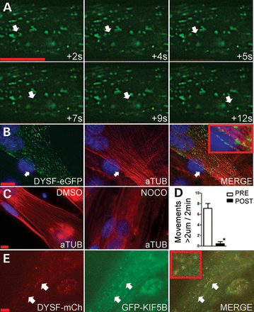
Figure 2. Dysferlin-containing vesicles move along microtubules via KIF5B motors in differentiated L6 myotubes. (A) ...
Notes:
Figure 2. Dysferlin-containing vesicles move along microtubules via KIF5B motors in differentiated L6 myotubes. (A) Live-cell imaging of dysferlin-eGFP-expressing L6 myotubes shows that dysferlin-containing vesicles undergo long-range movements along the longitudinal axis of L6 myotubes (Supplementary Material, Movie S1). (B) Antibody labeling of α-tubulin in dysferlin-eGFP-expressing L6 myotubes reveals that dysferlin-containing vesicles colocalize with microtubules in L6 myotubes; DAPI = blue. (C) Antibody labeling of α-tubulin in differentiated L6 myotubes shows that microtubules form a dense, longitudinally oriented lattice in L6 myotubes (C, left panel) and are disrupted following treatment with a microtubule depolymerizing agent, nocodazole (C, right panel); DAPI = blue. (D) Microtubule disruption inhibits long-range movement of dysferlin-containing vesicles in skeletal muscle myotubes. Dysferlin-eGFP-expressing myotubes were imaged 2 min prior to, and following treatment with nocodazole, and vesicle movements >2 µm were quantified for each condition (n = 13, P < 0.001). (E) Both non-motile and motile dysferlin-containing vesicles label with KIF5B motors in skeletal muscle myotubes. Data are representative of 16 cotransfected myotubes (Supplementary Material, Movie S2). Scale bar = 10 µm.
Unless provided in the caption above, the following copyright applies to the content of this slide: © The Author 2013. Published by Oxford University Press. All rights reserved. For Permissions, please email: journals.permissions@oup.com

Slide 3
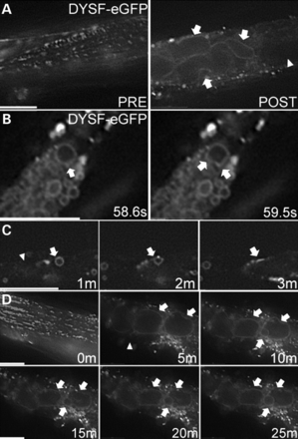
Figure 3. Membrane damage induces fusion of dysferlin-containing vesicles leading to the formation of extremely large ...
Notes:
Figure 3. Membrane damage induces fusion of dysferlin-containing vesicles leading to the formation of extremely large vesicles in L6 myotubes. (A) Membrane disruption induces the formation of large dysferlin-containing vesicles in L6 myotubes. L6 myotubes expressing dysferlin-eGFP were subjected to live-cell imaging prior to and after membrane disruption with a glass micropipette. Prior to damage, dysferlin-containing vesicles appear regularly distributed throughout the cytoplasm (left panel). Following damage (arrowhead), dysferlin-containing vesicles (shown in left panel) undergo rapid vesicle–vesicle fusion to form extremely large vesicles adjacent to membrane lesion (white arrows) and throughout the cytoplasm (Supplementary Material, Movie S3). (B) Large damage-induced dysferlin-containing vesicles result from fusion of smaller dysferlin-containing vesicles in L6 myotubes. Analysis of high magnification, consecutive live-cell images shows small vesicles (arrowheads) undergo fusion with a large vesicle to form an incrementally larger vesicle (Supplementary Material, Movie S4). (C) Example of large dysferlin-containing vesicle collapsing with the plasma membrane following membrane disruption (Supplementary Material, Movie S5). (D) The majority of damage-induced dysferlin-containing vesicles persist for many minutes following membrane disruption. Scale bar = 10 µm.
Unless provided in the caption above, the following copyright applies to the content of this slide: © The Author 2013. Published by Oxford University Press. All rights reserved. For Permissions, please email: journals.permissions@oup.com

Slide 4
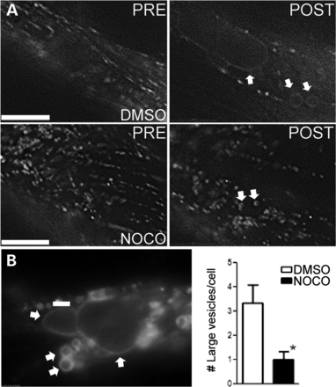
Figure 4. Disruption of microtubules reduces the formation of large dysferlin-containing vesicles following membrane ...
Notes:
Figure 4. Disruption of microtubules reduces the formation of large dysferlin-containing vesicles following membrane wounding in L6 myotubes. (A) Effect of pharmacological inhibition of microtubules on large vesicle formation following wounding in L6 myotubes. Prior to damage, dysferlin-containing vesicles show typical arrangement in linear arrays throughout the cytoplasm of differentiated L6 muscle cells (left panels). In DMSO-treated control cells dysferlin-containing vesicles fuse to form large vesicles following membrane disruption (arrows, top-right panel). Disruption of microtubules by pre-treatment with nocodazole markedly reduces the formation of large dysferlin-containing vesicles following wounding (middle panels). (B) Quantification of large dysferlin-containing vesicle formation. The left panel is a representative image showing multiple vesicles (arrows) >2 µm in size (white bar). The total number of large vesicles per cell was quantified for DMSO and nocodazole treatment (bar graph). Treatment with nocodazole significantly reduced the number of large vesicles formed following wounding compared with DMSO control (n = 15 cells for DMSO; n = 9 cells for nocodazole; P < 0.05). See Supplementary Material, Movie S5 (DMSO), and 7 (nocodazole); scale bar = 10 µm.
Unless provided in the caption above, the following copyright applies to the content of this slide: © The Author 2013. Published by Oxford University Press. All rights reserved. For Permissions, please email: journals.permissions@oup.com

Slide 5
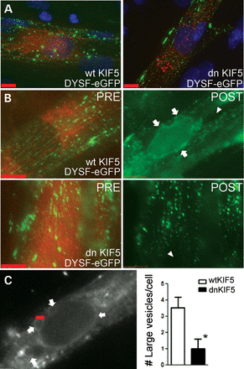
Figure 5. Expression of dnKIF5 inhibits formation of large dysferlin-containing vesicles following membrane wounding in ...
Notes:
Figure 5. Expression of dnKIF5 inhibits formation of large dysferlin-containing vesicles following membrane wounding in L6 myotubes. (A) Expression of dominant negative KIF5 does not dramatically alter dysferlin-containing vesicle localization in L6 myotubes. Representative deconvolved images of fixed L6 myotubes co-expressing dysferlin-eGFP (green) and either mCherry-labeled wtKIF5 (left, red) or mCherry-labeled dnKIF5 (right, red); DAPI = blue. (B) Dominant negative KIF5 inhibits formation of large dysferlin-containing vesicles following membrane disruption in L6 myotubes. L6 myotubes expressing dysferlin-eGFP and mCherry-wtKIF5 control or mCherry-dnKIF5 constructs were analyzed prior to (left panels) and following mechanical wounding (right panels) using live-cell imaging. Formation of damage-induced large dysferlin vesicles is diminished in dnKIF5 expressing (bottom-right) but not wtKIF5 expressing myotubes (arrows, top-right). (C) Quantification of large dysferlin-containing vesicle formation. The left panel is a representative image showing multiple vesicles (arrows) >2 µm in size (red bar). The total number of large vesicles per cell was quantified for myotubes expressing dysferlin-eGFP with mCherry-wtKIF5 or mCherry-dnKIF5 (bar graph). Expression of dnKIF5 significantly reduces the formation of large dysferlin-containing vesicles following mechanical disruption in L6 myotubes. wtKIF5 n = 13 cells, dnKIF5 n = 10 cells; P < 0.05. Supplementary Material, Movie S8 (wtKIF5) and 9 (dnKIF5); scale bar = 10 µm.
Unless provided in the caption above, the following copyright applies to the content of this slide: © The Author 2013. Published by Oxford University Press. All rights reserved. For Permissions, please email: journals.permissions@oup.com

Slide 6
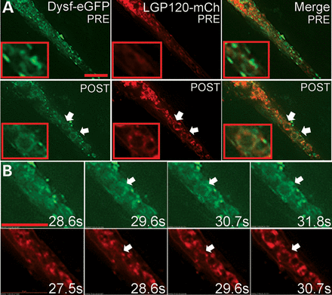
Figure 6. Dysferlin-eGFP interacts with lysosomal membranes following mechanical wounding in differentiated L6 cells. ...
Notes:
Figure 6. Dysferlin-eGFP interacts with lysosomal membranes following mechanical wounding in differentiated L6 cells. (A) Dysferlin-eGFP and LGP120-mCh occupy distinct compartments in unwounded L6 myotubes (top panels), and form large colabeled cytosolic vesicles following mechanical wounding (bottom panels). (B) High magnification time-lapse imaging of dysferlin-eGFP (top panels, starting from left) and LGP120-mCh (bottom panels, starting from left) from cell shown in panel (A). Small interspersed dysferlin-containing vesicles and LGP120-containing membranes undergo heterotypic fusion to form a large vesicle adjacent to the membrane lesion (time indicated is time post-wounding). See Supplementary Material, Movie S10. Scale bar = 10 µm.
Unless provided in the caption above, the following copyright applies to the content of this slide: © The Author 2013. Published by Oxford University Press. All rights reserved. For Permissions, please email: journals.permissions@oup.com

