Slide 1
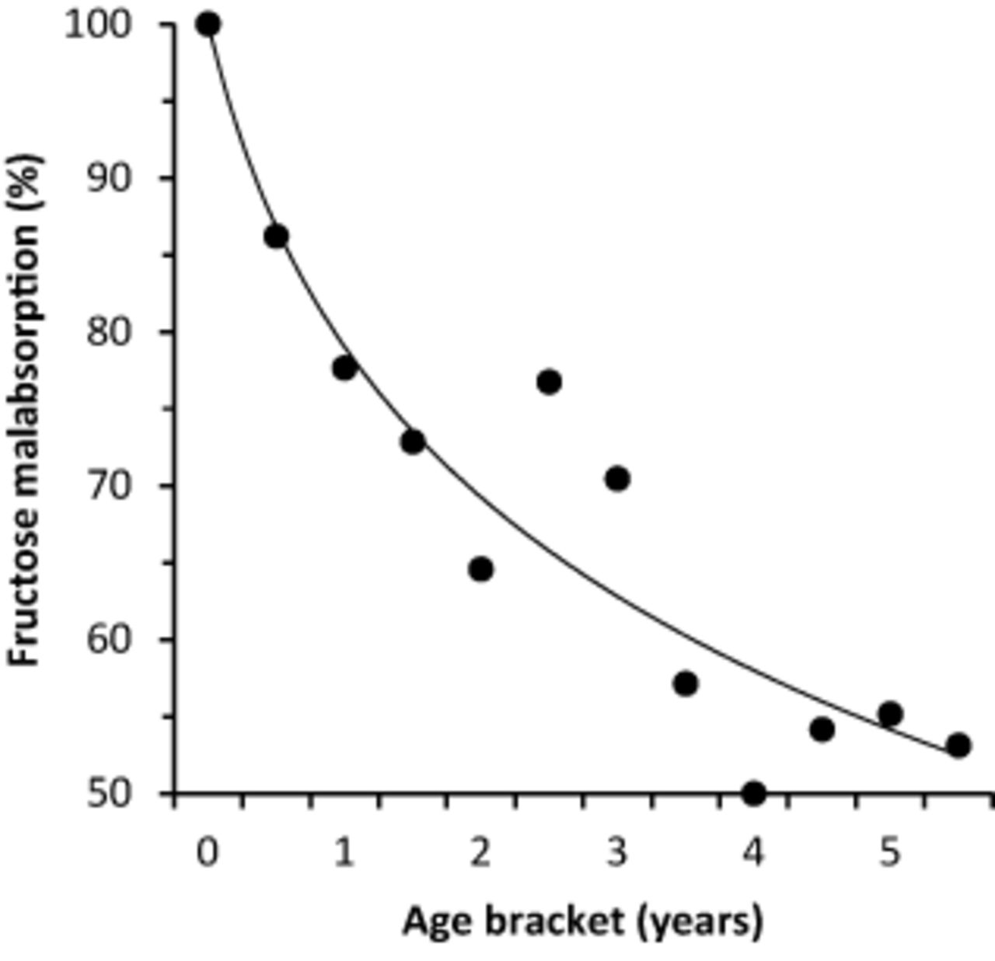
Figure 1 Percentage of symptomatic children <6 years old ( n = 508) attending a gastroenterology breath testing ...
Notes:
Figure 1 Percentage of symptomatic children <6 years old ( n = 508) attending a gastroenterology breath testing clinic who tested positive for malabsorption on a fructose BHT, grouped in 6-month age brackets (r = 0.94, P < 0.0001, logarithmic regression, SPSS 19 for Windows). Adapted from dataset described in Jones et al. (2011) 3 .
Unless provided in the caption above, the following copyright applies to the content of this slide: © 2013 International Life Sciences Institute

