Slide 1
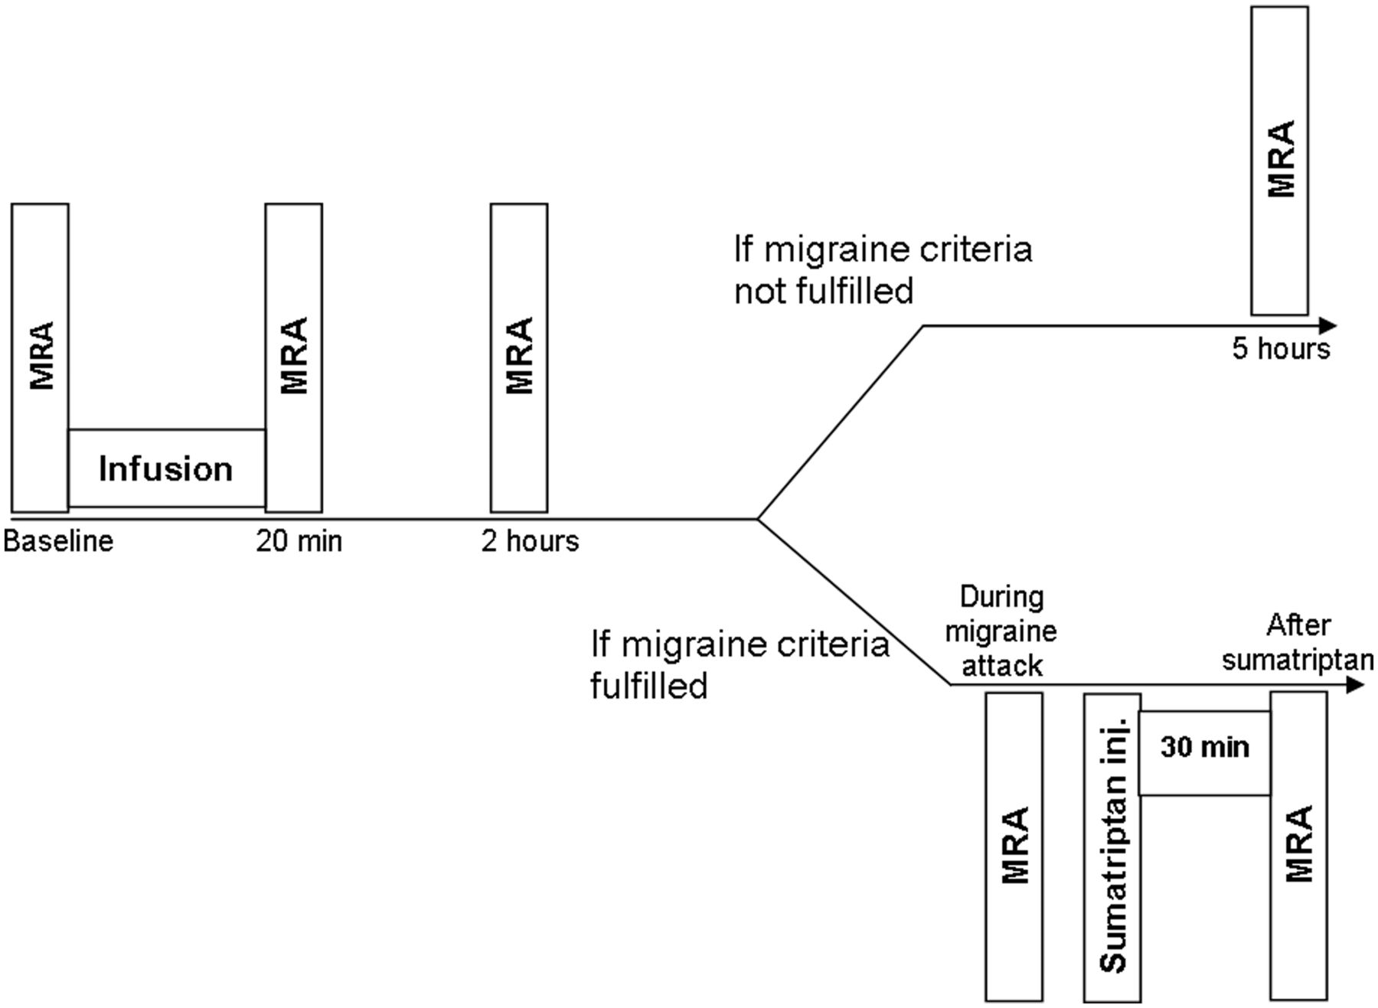
Figure 1 Flow chart of the methodological procedures during the hospital phase. MRA, blood pressure, heart rate, ...
Notes:
Figure 1 Flow chart of the methodological procedures during the hospital phase. MRA, blood pressure, heart rate, PetCO2, respiratory frequency, and blood levels of PACAP38, VIP, tryptase, haemoglobin, and haematocrit were recorded at baseline. Subsequently, infusion of either PACAP38 or VIP was started for 20 min. The MRA recordings were repeated at 20 min, 2 h and if no migraine-like attack, at 5 h. If the patient reported a migraine-like attack, an immediate MRA was done followed by treatment with 6 mg subcutaneous sumatriptan injection, and another MRA 30 min after the injection. Blood levels of PACAP38, VIP and tryptase were taken at time points 60 min and 300 min. Headache characteristics, blood pressure, heart rate, PetCO2, and respiratory frequency were recorded every 5 to 10 min until 90 min and every 30 min until 5 h.
Unless provided in the caption above, the following copyright applies to the content of this slide: © The Author (2014). Published by Oxford University Press on behalf of the Guarantors of Brain. All rights reserved. For Permissions, please email: journals.permissions@oup.com

Slide 2
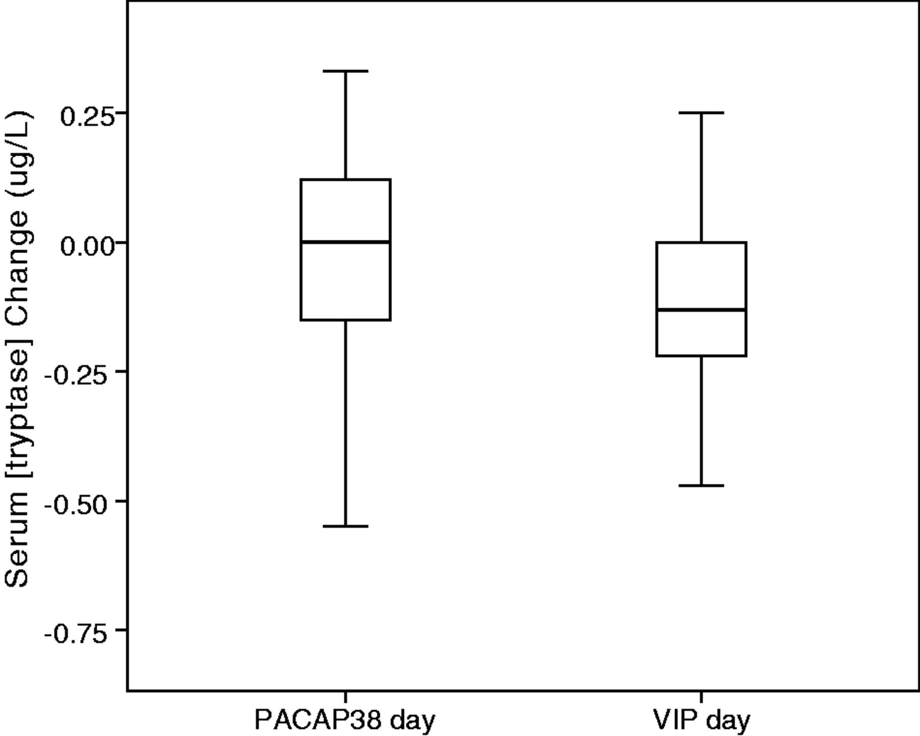
Figure 7 Mean changes in serum concentration of tryptase at 60 min after PACAP38 and VIP infusions in 21 migraine ...
Notes:
Figure 7 Mean changes in serum concentration of tryptase at 60 min after PACAP38 and VIP infusions in 21 migraine patients. The serum tryptase levels did not differ after infusion of PACAP38 (−0.05 µg/l) and after VIP (−0.16 µg/l) (P = 0.128).
Unless provided in the caption above, the following copyright applies to the content of this slide: © The Author (2014). Published by Oxford University Press on behalf of the Guarantors of Brain. All rights reserved. For Permissions, please email: journals.permissions@oup.com

Slide 3
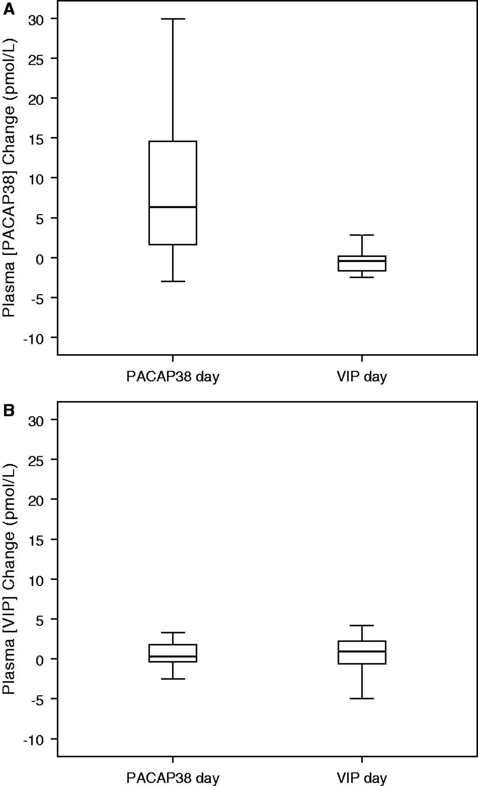
Figure 6 Mean changes in plasma concentration of PACAP38 (A) and VIP (B) after PACAP38 and VIP infusions in 20 ...
Notes:
Figure 6 Mean changes in plasma concentration of PACAP38 (A) and VIP (B) after PACAP38 and VIP infusions in 20 patients. Comparison of the change in plasma PACAP38 after PACAP38 (8.7 pmol/l) and after VIP (−1.1 pmol/l) infusions showed significant difference (P = 0.00005) (A). There was no difference in plasma VIP between the PACAP38 (0.7 pmol/l) and VIP (0.2 pmol/l) days (P = 0.506) (B).
Unless provided in the caption above, the following copyright applies to the content of this slide: © The Author (2014). Published by Oxford University Press on behalf of the Guarantors of Brain. All rights reserved. For Permissions, please email: journals.permissions@oup.com

Slide 4
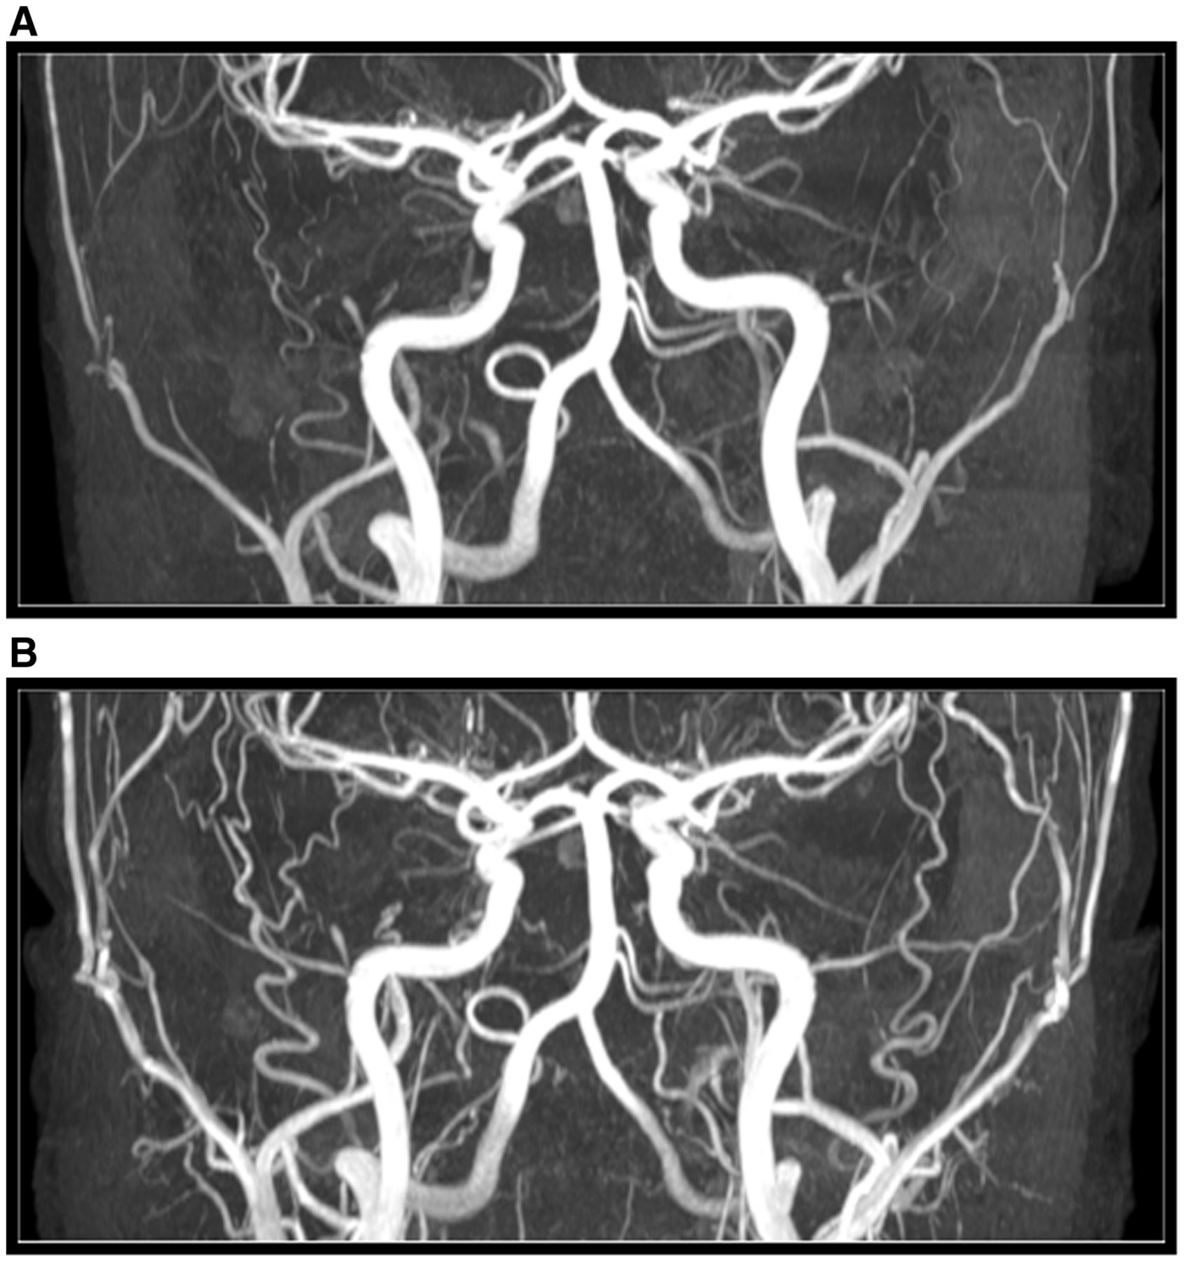
Figure 5 MRA before (A) and 2 h after (B) the start of PACAP38 infusion. PACAP38 (10 pmol/kg) was infused ...
Notes:
Figure 5 MRA before (A) and 2 h after (B) the start of PACAP38 infusion. PACAP38 (10 pmol/kg) was infused intravenously over 20 min.
Unless provided in the caption above, the following copyright applies to the content of this slide: © The Author (2014). Published by Oxford University Press on behalf of the Guarantors of Brain. All rights reserved. For Permissions, please email: journals.permissions@oup.com

Slide 5
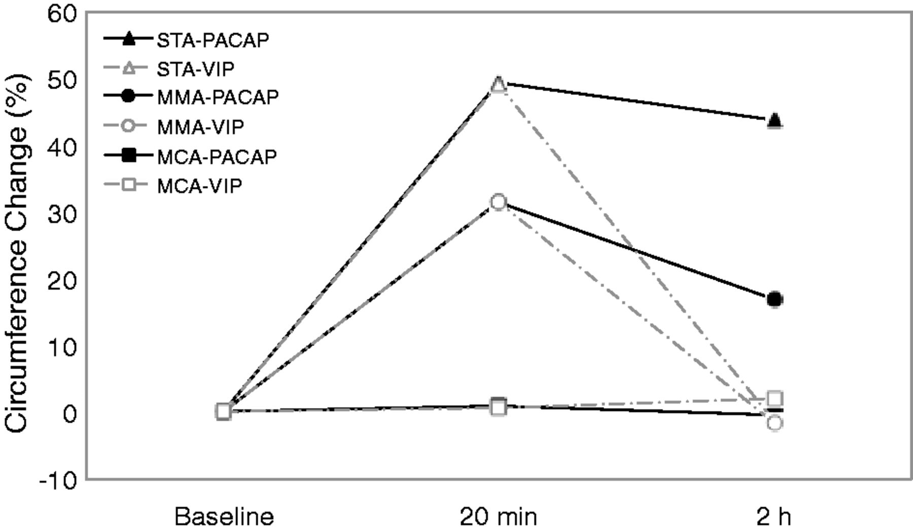
Figure 4 Per cent circumference changes of the superficial temporal artery (STA), middle meningeal artery (MMA), and ...
Notes:
Figure 4 Per cent circumference changes of the superficial temporal artery (STA), middle meningeal artery (MMA), and middle cerebral artery (MCA) after PACAP38 and VIP infusion. The superficial temporal artery dilated 49.5% (95% CI 30.5 to 68.6) at 20 min and 43.9% (95% CI 34.1 to 53.7) at 2 h after PACAP38 (filled triangle). The changes after VIP were 49.1% (95% CI 42.0 to 56.1) at 20 min and −1.3% (95% CI −5.4 to 2.7) at 120 min (open triangle). The per cent circumference changes of the middle meningeal artery were 31.6% (95% CI 23.7 to 39.5) and 17.0% (95% CI 8.4 to 25.6) at 20 and 120 min after PACAP38 (filled circle). The changes after VIP were 31.4% (95% CI 16.3 to 46.5) at 20 min and −1.6% (95% CI −11.2 to 8.0) at 120 min (open circle). The middle cerebral artery changed 0.9% (95% CI −2.6 to 4.4) and −0.4% (95% CI −3.4 to 2.6) at 20 and 120 min after PACAP38 (filled square). The changes after VIP were 0.6% (95% CI −5.3 to 6.4) at 20 min and 2.1% (95% CI −3.0 to 7.1) at 120 min (open square). AUC for the superficial temporal artery was larger (230) after PACAP38, than after VIP (126), (P = 0.002). AUC was also larger (111) for the middle meningeal artery after PACAP38, than after VIP (66) (P = 0.028). There was no difference in the AUC for the middle cerebral artery (PACAP38: 2 and VIP: 46) (P = 0.348).
Unless provided in the caption above, the following copyright applies to the content of this slide: © The Author (2014). Published by Oxford University Press on behalf of the Guarantors of Brain. All rights reserved. For Permissions, please email: journals.permissions@oup.com

Slide 6
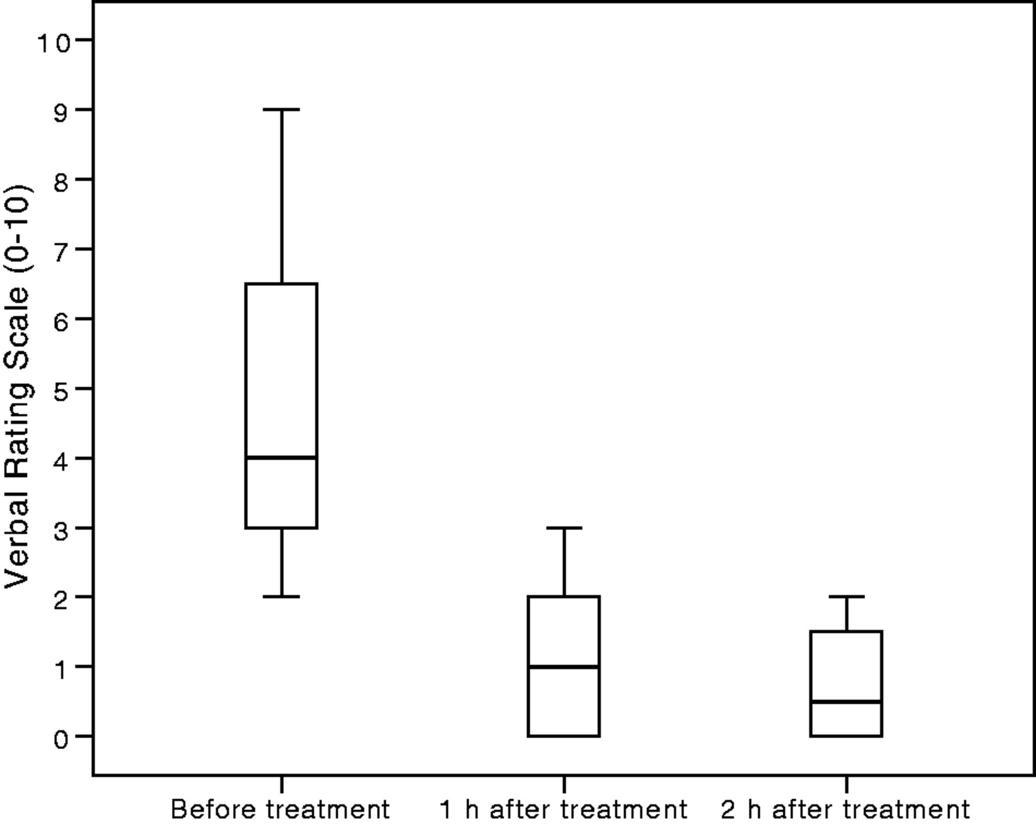
Figure 3 Headache intensity on the verbal rating scale (0–10) before and after treatment with a triptan in 12 patients ...
Notes:
Figure 3 Headache intensity on the verbal rating scale (0–10) before and after treatment with a triptan in 12 patients with PACAP38-induced head pain. Median time to treatment was 5 h 10 min (range 1 h 15 min to 13 h). Median headache intensity was 4 (range 2 to 9) before treatment, 1 (range 0 to 9) at 1 h after treatment (P = 0.001), and 0.5 (range 0 to 7) at 2 h after treatment (P = 0.0001). The post-treatment data are not available for one patient (Patient VP16).
Unless provided in the caption above, the following copyright applies to the content of this slide: © The Author (2014). Published by Oxford University Press on behalf of the Guarantors of Brain. All rights reserved. For Permissions, please email: journals.permissions@oup.com

Slide 7
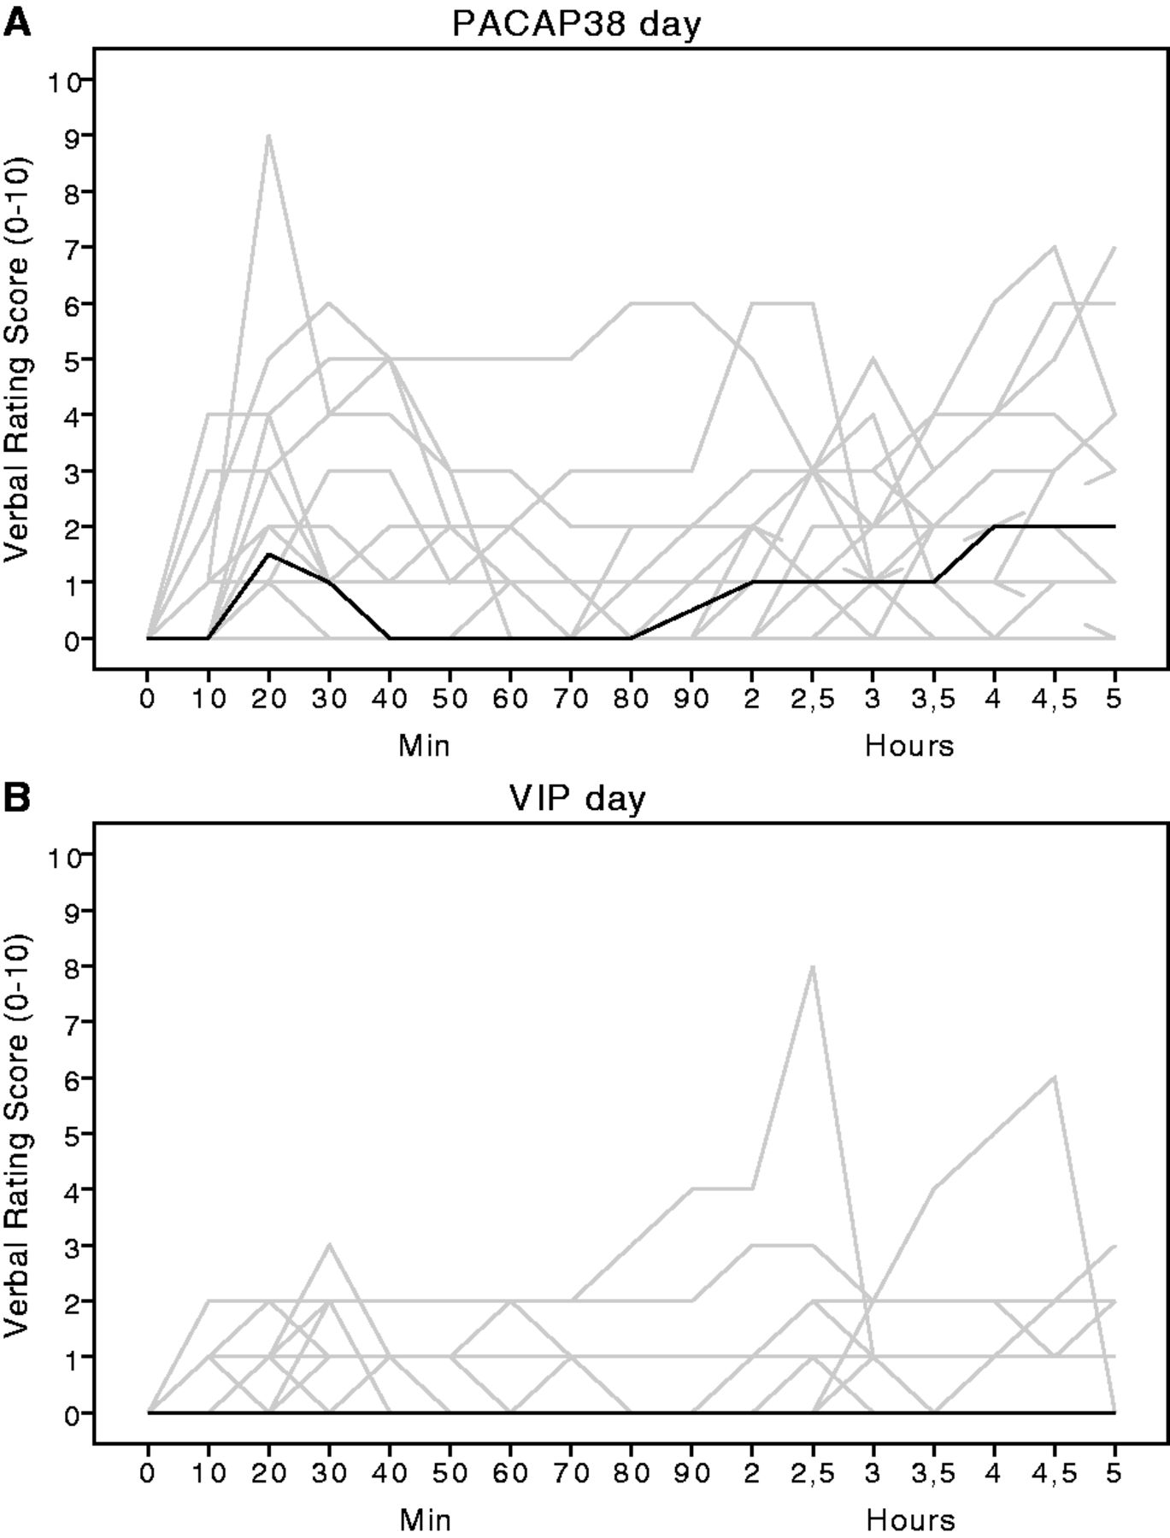
Figure 2 Individual and median (thick line) headache intensity scores on a verbal rating scale from 0–5 h after ...
Notes:
Figure 2 Individual and median (thick line) headache intensity scores on a verbal rating scale from 0–5 h after PACAP38 (A) and VIP (B) infusion in 22 patients with migraine. The AUC for PACAP38-induced headache during the early phase (AUC0-2 h: 126) was larger than after VIP (AUC0-2 h: 46.8) (P = 0.03). The AUC for PACAP38-induced headache was also larger in the delayed phase (AUC2-5 h: 297) compared to after VIP (AUC2-5 h: 102) (P = 0.003).
Unless provided in the caption above, the following copyright applies to the content of this slide: © The Author (2014). Published by Oxford University Press on behalf of the Guarantors of Brain. All rights reserved. For Permissions, please email: journals.permissions@oup.com

Slide 8
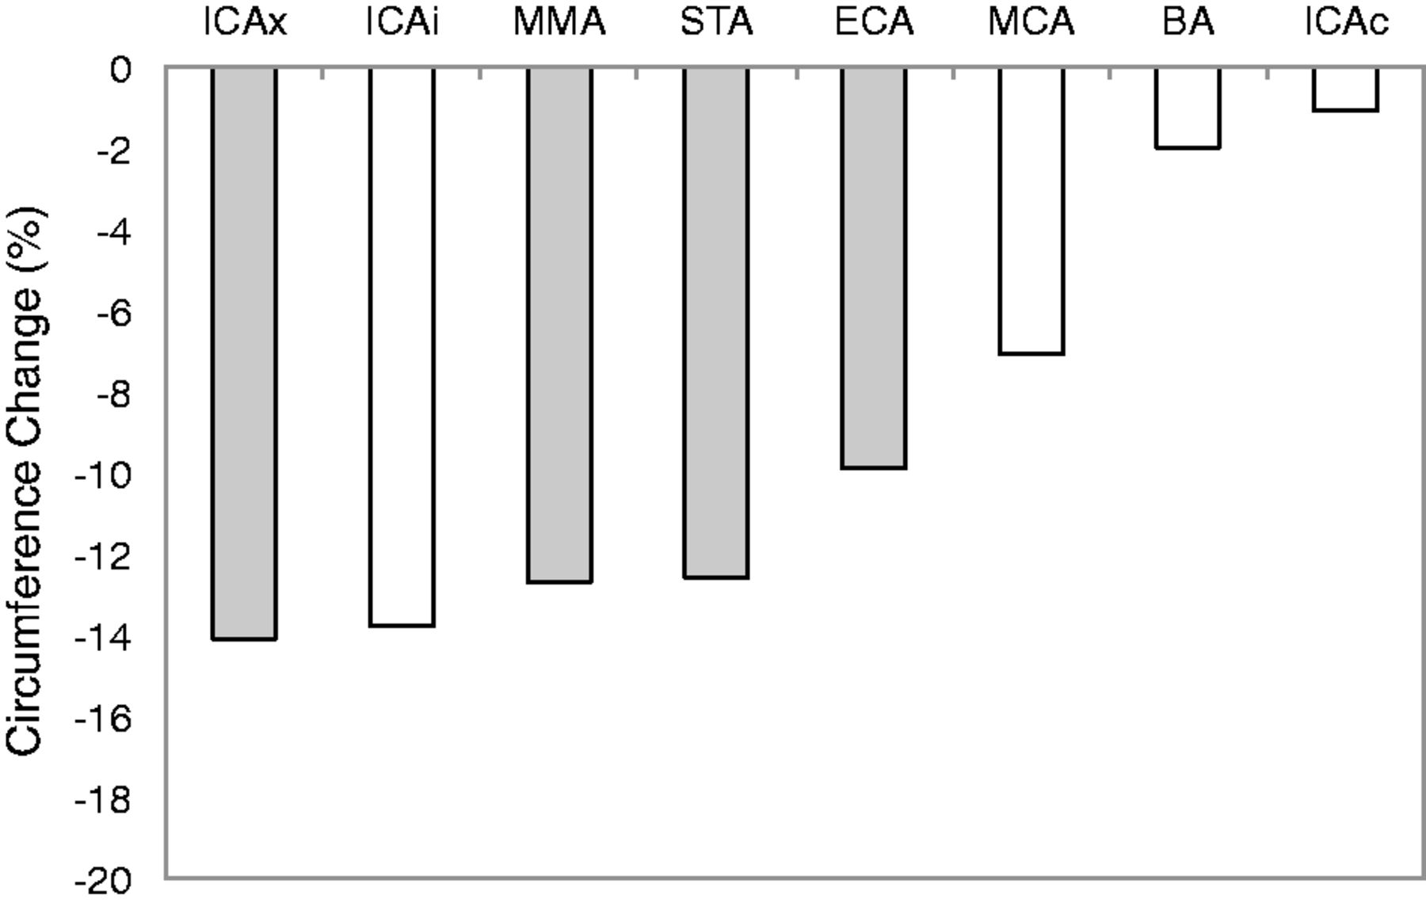
Figure 8 Mean per cent circumference change of extracranial (grey) and intracranial (white) arteries between before ...
Notes:
Figure 8 Mean per cent circumference change of extracranial (grey) and intracranial (white) arteries between before and 30 to 60 min after treatment with subcutaneous injection of 6 mg sumatriptan in six patients with PACAP38-induced migraine-like attacks. The circumference change of the ICAx (cervical part) was −14.1% (95% CI −19.5 to −8.6); ICAi (cavernous) −13.8% (95% CI −16.6 to −11.1); middle meningeal artery −12.7% (95% CI −23.6 to −1.8); superficial temporal artery −12.6% (95% CI −26.0 to 0.7); external carotid artery −9.9% (95% CI −19.9 to 0.1); middle cerebral artery −7.1% (95% CI −16.0 to 1.8); basilar artery −2.0% (95% CI −4.7 to 0.8); and ICAc (cerebral) −1.1% (95% CI −6.3 to 4.2). ICAx = cervical part of the internal carorid artery; ICAi = cavernous part of the internal carotid artery; MMA = middle meningeal artery; STA = superficial temporal artery; ECA = external carotid artery; MCA = middle cerebral artery; BA = basilar artery; ICAc = cerebral part of the internal carotid artery. Paired samples t-test: ***P < 0.0001; **P < 0.005; *P < 0.05.
Unless provided in the caption above, the following copyright applies to the content of this slide: © The Author (2014). Published by Oxford University Press on behalf of the Guarantors of Brain. All rights reserved. For Permissions, please email: journals.permissions@oup.com

Slide 9
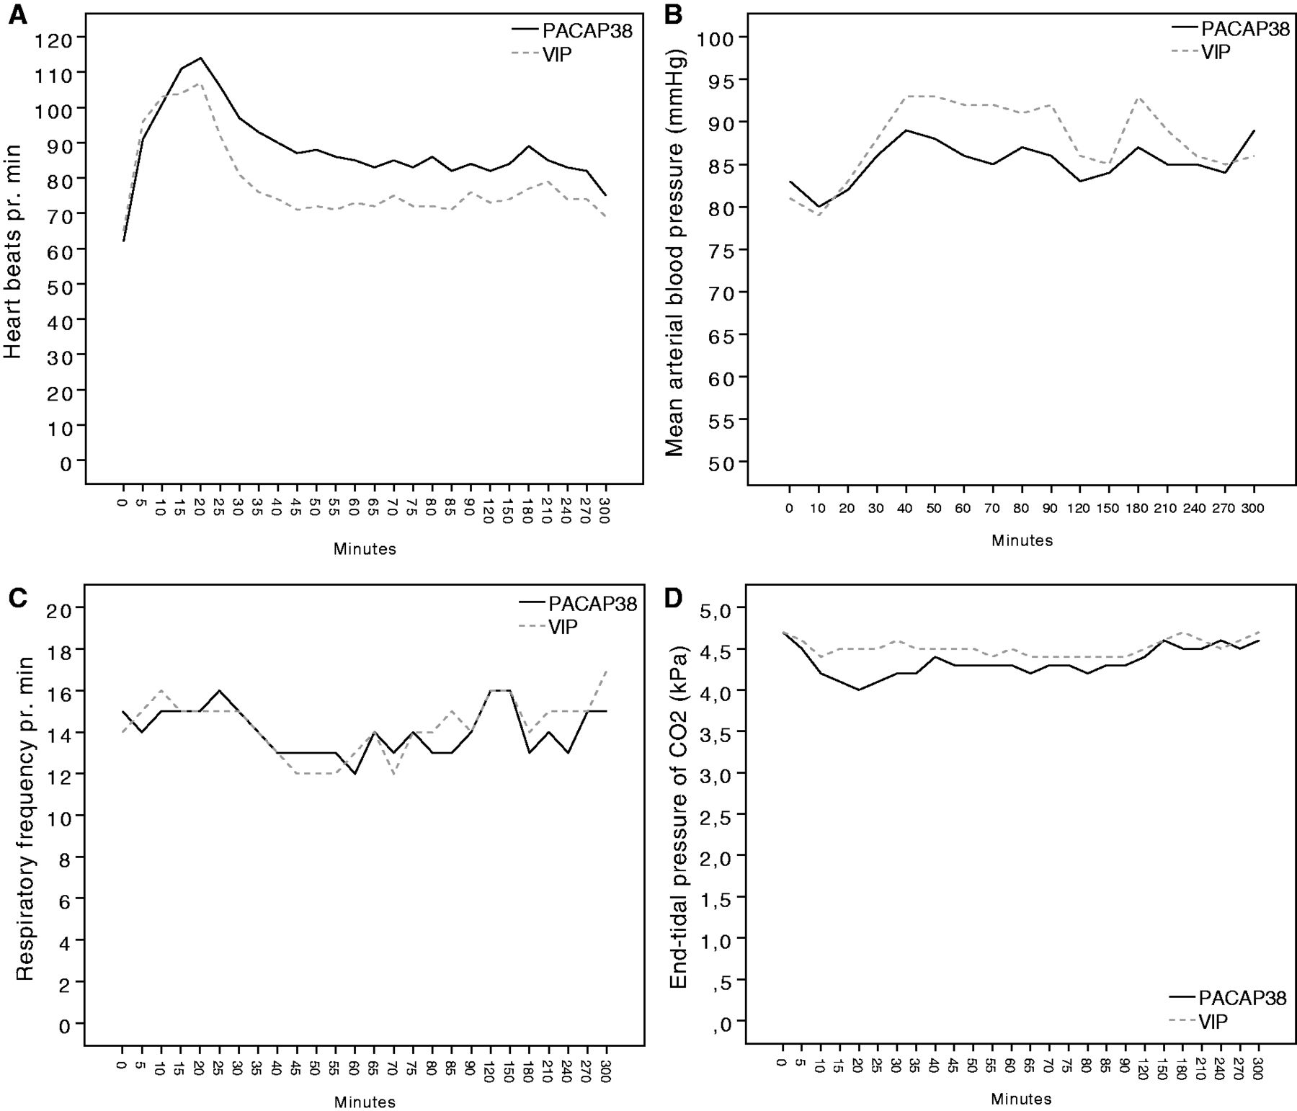
Figure 9 The effect of PACAP38 and VIP on heart rate (A), mean arterial blood pressure (B), respiratory frequency (C), ...
Notes:
Figure 9 The effect of PACAP38 and VIP on heart rate (A), mean arterial blood pressure (B), respiratory frequency (C), and the PetCO2 (D) in early (0–2 h, n = 22) and delayed (2–5 h, n = 17) phases after infusion. The AUC for heart rate was larger in the early and delayed phases after PACAP38 compared to VIP (P = 0.00009 and P = 0.007). The AUC for mean arterial blood pressure was larger in the early and delayed phases after VIP compared to PACAP38 (P = 0.001 and P = 0.018). The AUC for respiratory frequency and PetCO2 was larger in the early, but not delayed phases after VIP compared to PACAP38 (respiratory frequency, P = 0.020 and P = 0.079; PetCO2, P = 0.039 and 0.294).
Unless provided in the caption above, the following copyright applies to the content of this slide: © The Author (2014). Published by Oxford University Press on behalf of the Guarantors of Brain. All rights reserved. For Permissions, please email: journals.permissions@oup.com

