Slide 1
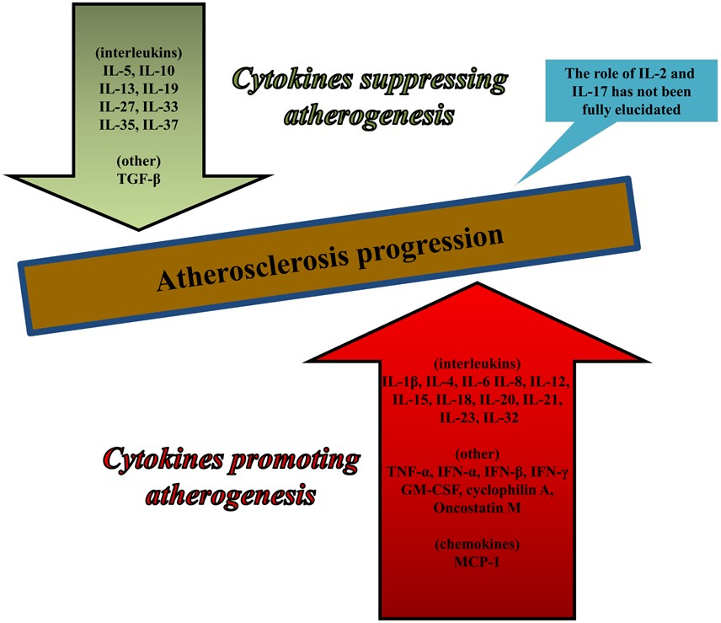
Figure 1 Pro- and anti-atherogenic cytokines. Cytokines can be divided into two groups depending on whether they ...
Notes:
Figure 1 Pro- and anti-atherogenic cytokines. Cytokines can be divided into two groups depending on whether they promote or suppress atherogenesis. Notably, there are also cytokines such as interleukin-2 and interleukin-17 whose exact role in atherogenesis has not been fully elucidated. GM-CSF, granulocyte-macrophage colony-stimulating factor; IFN-α,β,γ, interferon-α, -β, and -γ; IL, interleukin (e.g. IL-1β, interleukin-1β); MCP-1, monocyte chemoattractant protein-1; TGF-β, transforming growth factor-β; TNF-α, tumour necrosis factor-α.
Unless provided in the caption above, the following copyright applies to the content of this slide: Published on behalf of the European Society of Cardiology. All rights reserved. © The Author 2016. For permissions please email: journals.permissions@oup.com.

Slide 2
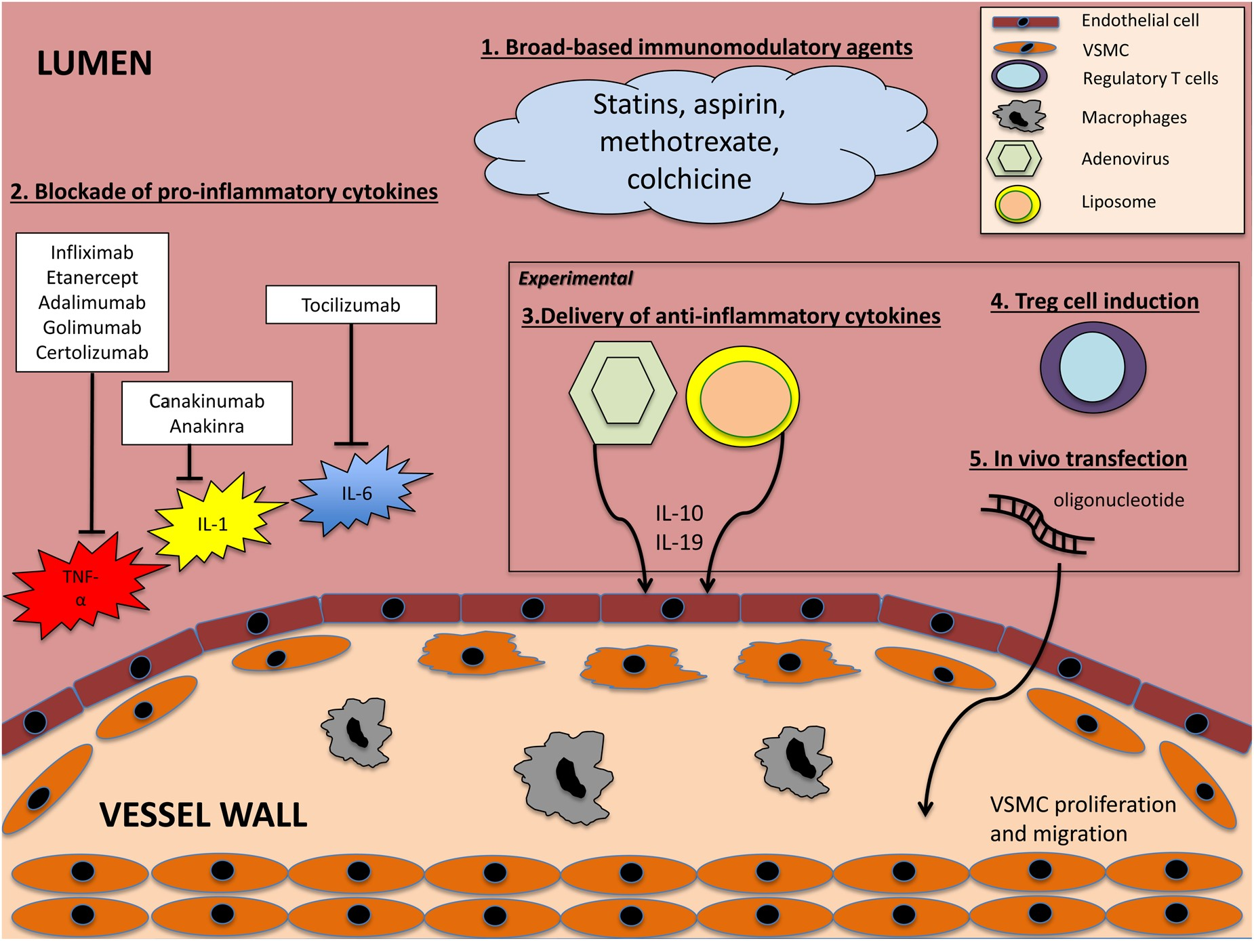
Figure 2 Cytokine-related therapeutic approaches in atherosclerosis. In the context of atherosclerosis, several ...
Notes:
Figure 2 Cytokine-related therapeutic approaches in atherosclerosis. In the context of atherosclerosis, several methods have been studied to modify the inflammatory cascade. 1. Broad-based immunomodulatory agents. 2. Blockade of pro-inflammatory cytokines. 3. Delivery of anti-inflammatory cytokines with adenovirus vectors or liposomes. 4. Induction of regulatory T cells. 5. In vivo transfection with oligonucleotides. IL, interleukin; TNF-α, tumour necrosis factor-α; VSMC, vascular smooth muscle cell.
Unless provided in the caption above, the following copyright applies to the content of this slide: Published on behalf of the European Society of Cardiology. All rights reserved. © The Author 2016. For permissions please email: journals.permissions@oup.com.

Slide 3
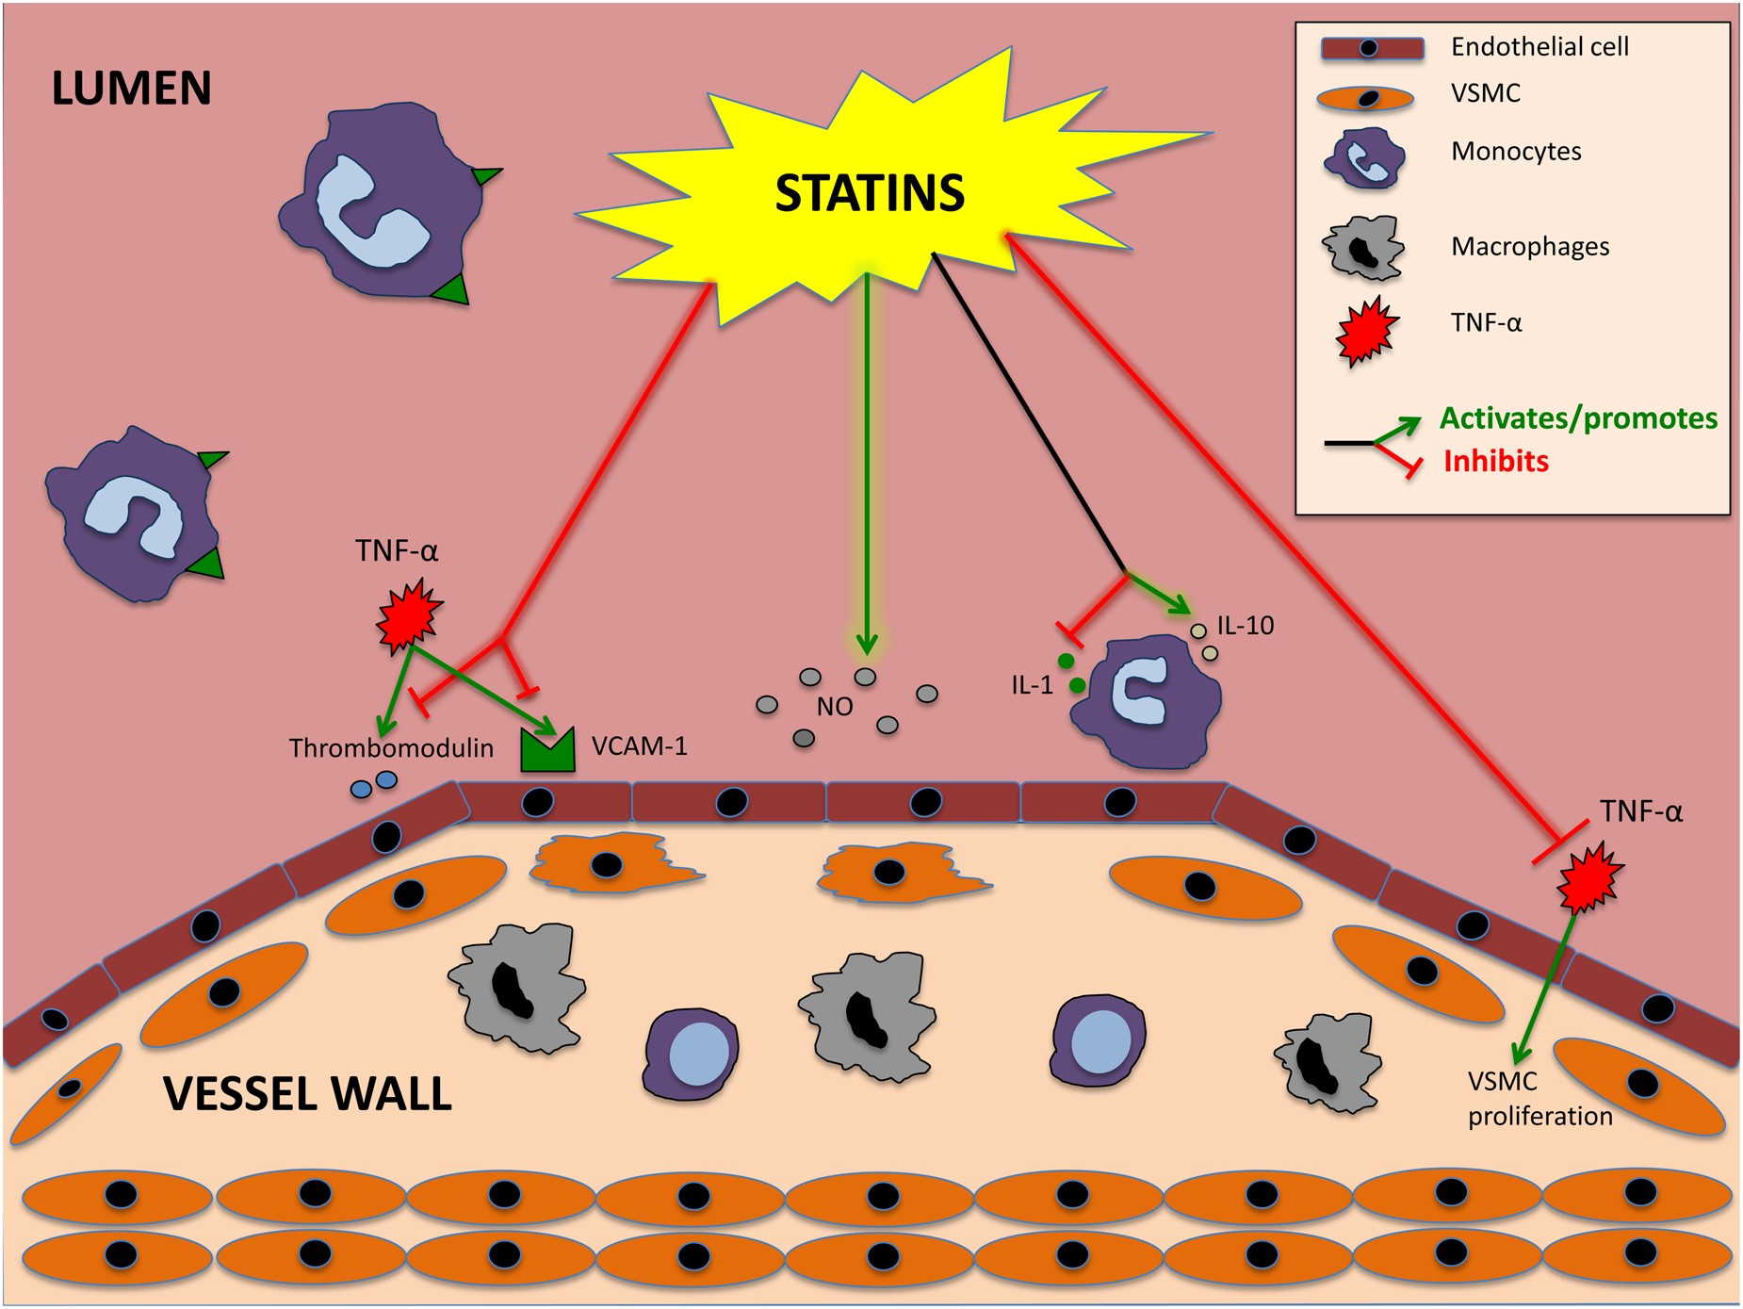
Figure 3 Examples of cytokine-related statin effects in the microenvironment of an atherosclerotic plaque. Statins ...
Notes:
Figure 3 Examples of cytokine-related statin effects in the microenvironment of an atherosclerotic plaque. Statins have been shown to antagonize the effects of inflammatory cytokines. For example, simvastatin neutralizes the pro-atherogenic actions of tumour necrosis factor-α through inhibition of the tumour necrosis factor-α-induced expression of vascular cell adhesion molecule 1 and suppression of thrombomodulin, whereas atorvastatin improves vascular nitric oxide bioavailability. Simvastatin can potently down-regulate the production of known pro-inflammatory cytokines such as interleukin-1 while also up-regulating the expression of anti-inflammatory cytokines such as interleukin-10. Finally, simvastatin is also able to counteract the combined pro-proliferative effects of tumour necrosis factor-α and interleukin-18 on aortic smooth muscle cells. IL, interleukin; TNF-α, tumour necrosis factor-α; VCAM-1, vascular cell adhesion molecule 1; VSMC, vascular smooth muscle cell.
Unless provided in the caption above, the following copyright applies to the content of this slide: Published on behalf of the European Society of Cardiology. All rights reserved. © The Author 2016. For permissions please email: journals.permissions@oup.com.

