Slide 1
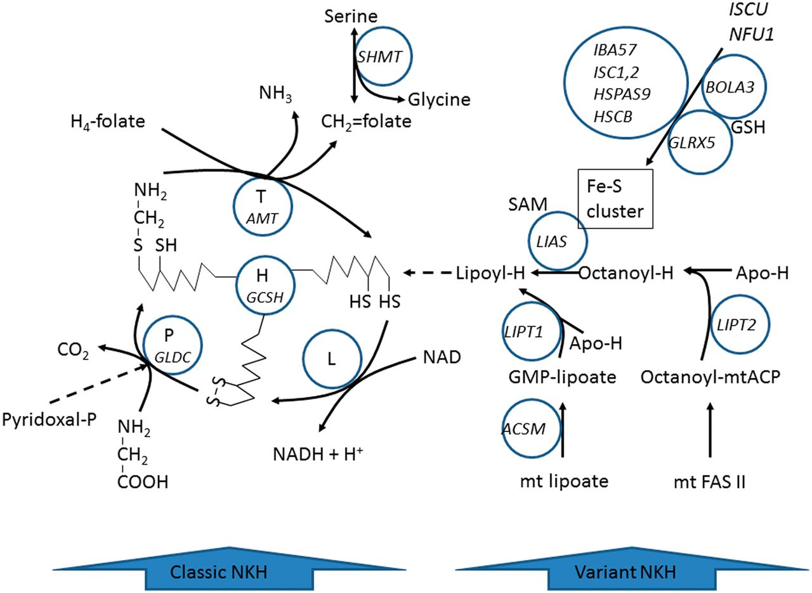
Figure 1 Metabolic pathway of the glycine cleavage enzyme system and the synthesis of its lipoate cofactor. Disorders ...
Notes:
Figure 1 Metabolic pathway of the glycine cleavage enzyme system and the synthesis of its lipoate cofactor. Disorders of components of the glycine cleavage enzyme (GLDC and AMT) cause classic NKH. Disorders of the biosynthesis of lipoyl-H (LIAS, GLRX5, BOLA3) cause variant NKH.
Unless provided in the caption above, the following copyright applies to the content of this slide: © The Author (2013). Published by Oxford University Press on behalf of the Guarantors of Brain. All rights reserved. For Permissions, please email: journals.permissions@oup.com

Slide 2
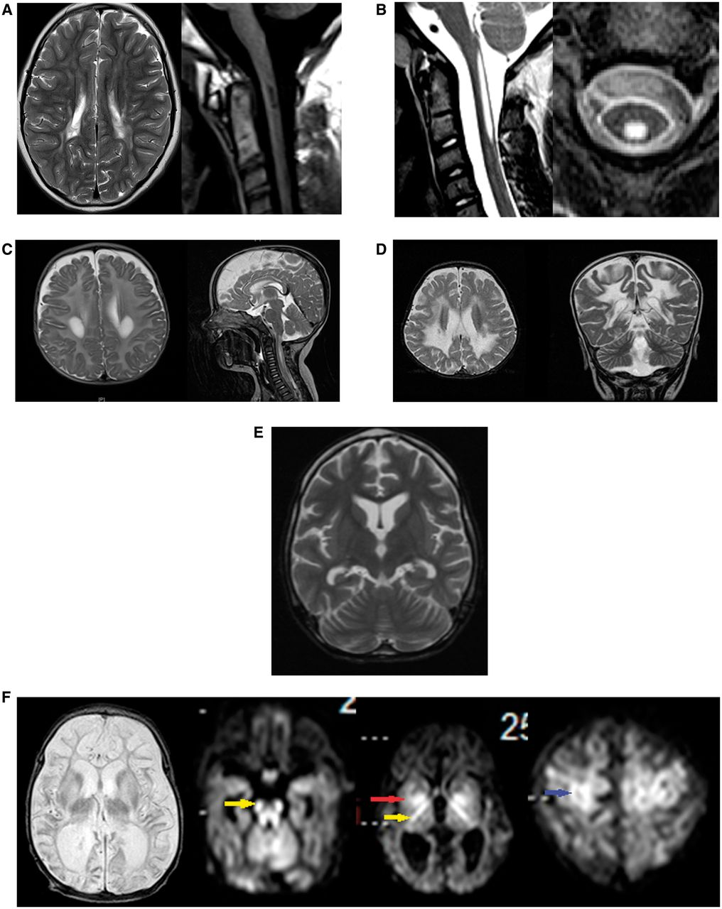
Figure 2 Neuroimaging of patients with variant nonketotic hyperglycinemia. (A) Brain MRI of Patient 1 at 10 years of ...
Notes:
Figure 2 Neuroimaging of patients with variant nonketotic hyperglycinemia. (A) Brain MRI of Patient 1 at 10 years of age shows multifocal lesions of increased signal affecting the cerebrum on T2 sequence of the brain on axial images (left), and lesions of decreased signal intensity in the upper cervical spinal cord as shown on T1 sequence (right). (B) Spinal MRI images of Patient 2 show central lesions of the upper spinal cord of increased intensity on T2 sequence on axial and sagittal series. (C) Brain MRI of Patient 4 at 6 months of age shows lesions of increased signal on T2 sequence in the periventricular white matter (left) and central cervical spinal cord (right). (D) Brain MRI of Patient 5 at age 18 months shows extensive central lesions of increased signal on T2 sequence on axial and coronal images. (E) Brain MRI of Patient 6 at 9 years of age shows mild cerebral and cerebellar atrophy on T2 sequences. (F) Brain MRI of Patient 8 at 20 days of age, shows cerebral atrophy particularly of the white matter and increased signal in thalami and basal ganglia on T2 sequences. In the diffusion weighted images, there is diffusion restriction in the long tracts of the brainstem (yellow arrow) and white matter of the cerebellum, the posterior crux of the internal capsule (yellow arrow) and the basal ganglia (red arrow), and in cortical areas (blue arrow).
Unless provided in the caption above, the following copyright applies to the content of this slide: © The Author (2013). Published by Oxford University Press on behalf of the Guarantors of Brain. All rights reserved. For Permissions, please email: journals.permissions@oup.com

Slide 3
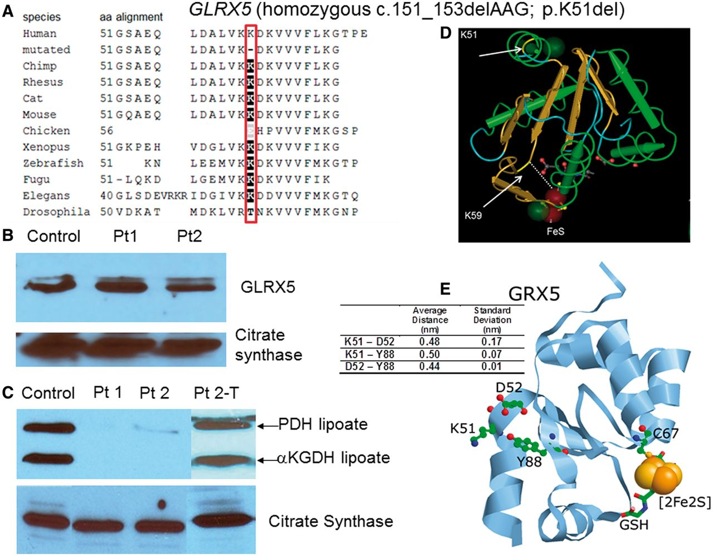
Figure 3 Mutations in GLRX5. (A) On phylogenetic alignment, the deleted amino acid K51 is completely conserved from ...
Notes:
Figure 3 Mutations in GLRX5. (A) On phylogenetic alignment, the deleted amino acid K51 is completely conserved from human to Drosophila. (B) The amount of GLRX5 protein on western blot is not reduced. (C) Western blot of lipoylated proteins in fibroblast lysate shows normal signal for the lipoylated E2 components of pyruvate dehydrogenase (PDH) and αKGDH in controls. In fibroblasts from Patients (Pt) 1 and 2 this band is almost completely absent, but it is clearly present after transfection of the fibroblasts of Patient 2 with a full-length construct of GLRX5 (Pt2-T). Images of citrate synthase shown as a loading control. (D) Three-dimensional modelling of the GLRX5 protein (PDB: 2WUL) shows the deleted lysine K51 to be located at the interface of the first α-helix and the first β-sheet. The active site K59 and the iron-sulphur cluster are indicated. (E) K51 (deleted in Patients 1–3) is in close proximity to residues D52 and Y88 (ball and stick). Average distances between residues in all four chains of the tetrameric crystal structure as well as standard deviations are shown in the table (insert). Distances were measured between the NZ of K51, closest O of D52 and OH of Y88. The relative positions of C67, which ligates the iron-sulphur cluster (orange and yellow spheres), and the bound glutathione (stick) are also shown.
Unless provided in the caption above, the following copyright applies to the content of this slide: © The Author (2013). Published by Oxford University Press on behalf of the Guarantors of Brain. All rights reserved. For Permissions, please email: journals.permissions@oup.com

Slide 4
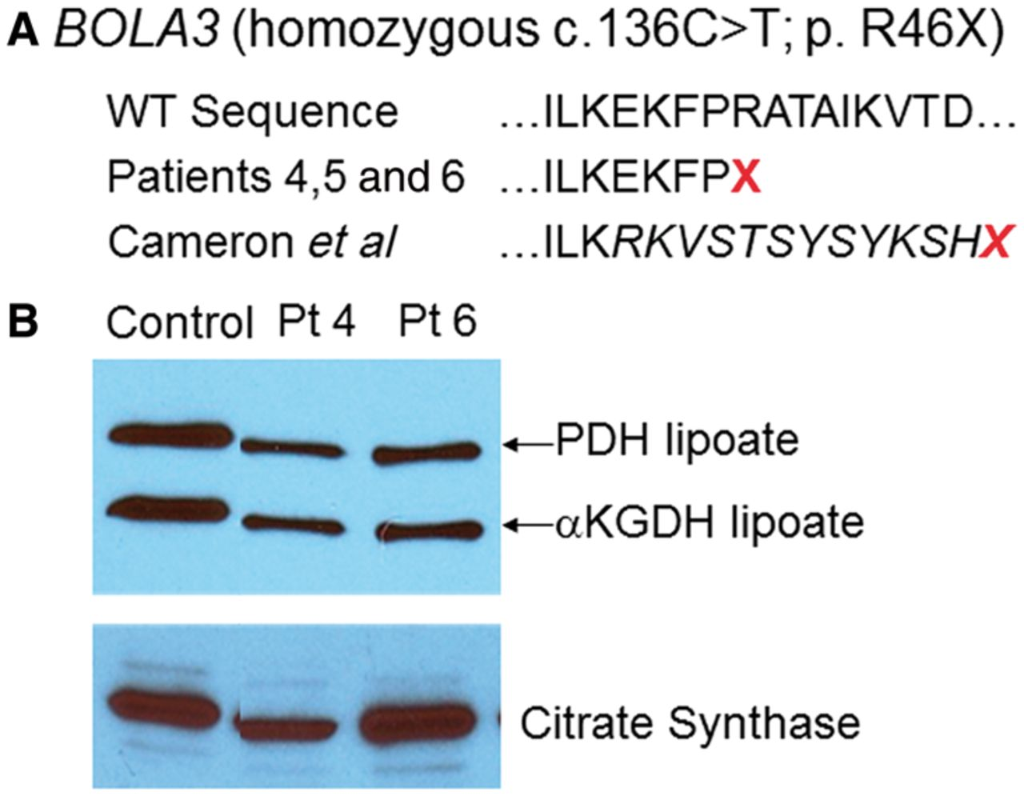
Figure 4 Mutations in BOLA3. (A) The location of the missense mutation in Patients 4, 5 and 6 at R46 is indicated in ...
Notes:
Figure 4 Mutations in BOLA3. (A) The location of the missense mutation in Patients 4, 5 and 6 at R46 is indicated in relation to the wild-type sequence and the mutation reported in Cameron et al. (2011). (B) Western blot of lipoylated proteins in fibroblast lysates shows normal signal for the lipoylated E2 components of pyruvate dehydrogenase (PDH) and α-ketoglutarate dehydrogenase (αKGDH) in controls. In Patients 4 and 6 this band is substantially reduced in intensity. Images of citrate synthase shown as a loading control.
Unless provided in the caption above, the following copyright applies to the content of this slide: © The Author (2013). Published by Oxford University Press on behalf of the Guarantors of Brain. All rights reserved. For Permissions, please email: journals.permissions@oup.com

Slide 5
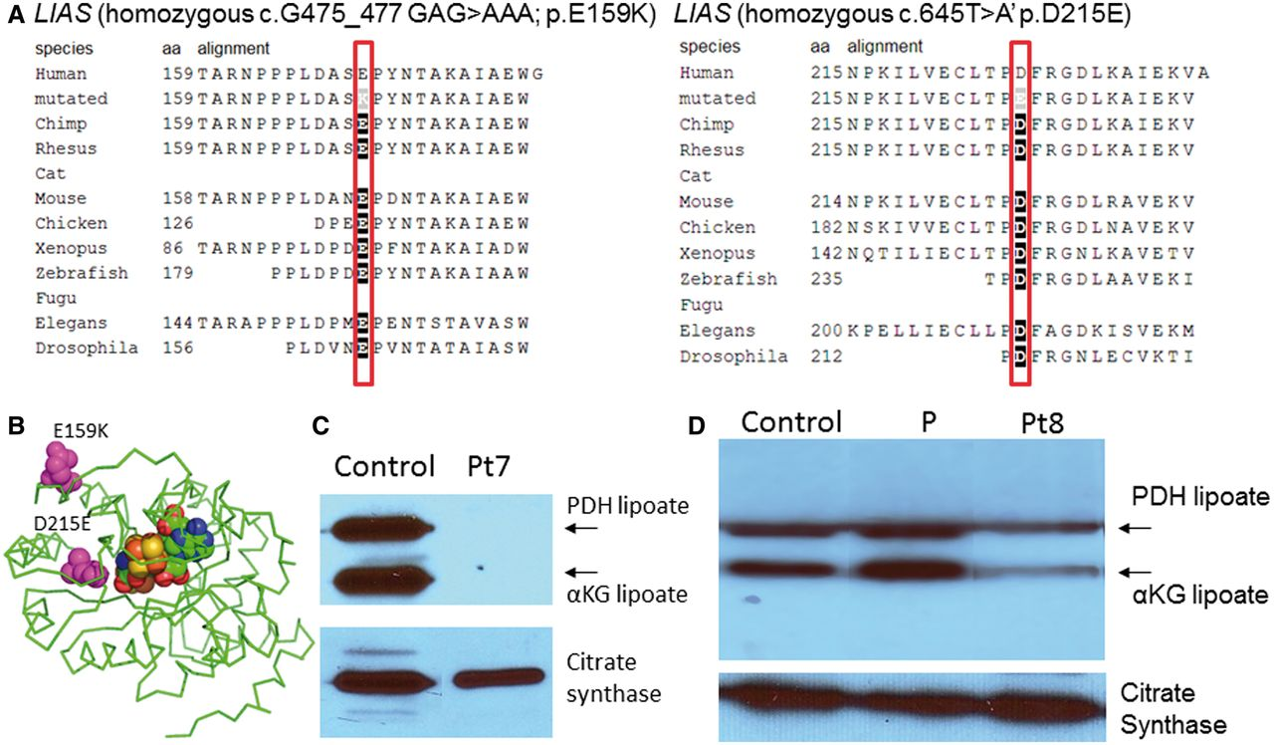
Figure 5 Mutations in lipoate synthase. (A) On phylogenetic alignment, the mutated amino acids E159 and D215 are ...
Notes:
Figure 5 Mutations in lipoate synthase. (A) On phylogenetic alignment, the mutated amino acids E159 and D215 are completely conserved from human to Drosophila. (B) Three-dimensional modelling of the lipoate synthase protein shows the mutated amino acids in relation to the iron-sulphur cluster. (C) Western blot of lipoylated proteins in fibroblast lysate shows normal signal for the lipoylated E2 components of pyruvate dehydrogenase (PDH) and αKGDH in controls. In Patient 7 (Pt7), this band is absent (C), whereas in Patient 8 it is reduced (D). A ninth patient with variant non-ketotic hyperglycinaemia but with normal lipoylation is shown (P). Images of citrate synthase shown as a loading control.
Unless provided in the caption above, the following copyright applies to the content of this slide: © The Author (2013). Published by Oxford University Press on behalf of the Guarantors of Brain. All rights reserved. For Permissions, please email: journals.permissions@oup.com

