Slide 1
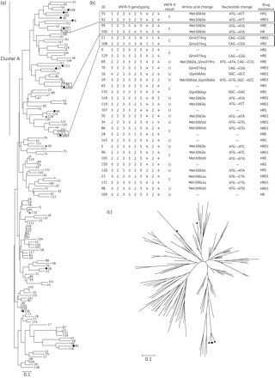
Figure 1. Phylogenetic analysis of MDR-TB isolates, and characteristics of VNTR-9 genotyping, embB mutations and drug ...
Notes:
Figure 1. Phylogenetic analysis of MDR-TB isolates, and characteristics of VNTR-9 genotyping, embB mutations and drug resistance patterns of isolates with the clustered VNTR-7 genotypes. (a) Phylogenetic map generated by the neighbour-joining (NJ) method, based on VNTR-7 genotyping data of 138 MDR-TB isolates. Numbers indicate strain ID. Filled circles indicate ethambutol-susceptible embB306 mutants, while open circles indicate ethambutol-resistant counterparts. Filled squares indicate ethambutol-susceptible embB497 mutants, while open squares indicate ethambutol-resistant embB497 counterparts. Filled triangles indicate ethambutol-susceptible embB406 mutants. (b) VNTR-9 genotypes, embB mutations and drug resistance patterns of isolates showing the clustered VNTR-7 genotypes. Blocks highlight three pairs of isolates with identical VNTR-16 genotypes and embB mutations, but opposite ethambutol resistance. C indicates isolates with identical VNTR-9 genotyping patterns. U indicates isolates with unique VNTR-9 genotyping patterns. H, isoniazid; R, rifampicin; E, ethambutol; S, streptomycin. (c) Radial NJ phylogeny based on VNTR-7 genotyping data of MDR-TB isolates, which shows the genetic background of six EmbB Met306Leu mutants. Filled circles represent strains with a Met→Leu amino acid substitution.
Unless provided in the caption above, the following copyright applies to the content of this slide: © The Author 2011. Published by Oxford University Press on behalf of the British Society for Antimicrobial Chemotherapy.This is an Open Access article distributed under the terms of the Creative Commons Attribution Non-Commercial License (http://creativecommons. org/licenses/by-nc/2.5), which permits unrestricted non-commercial use, distribution, and reproduction in any medium, provided the original work is properly cited.

