Slide 1
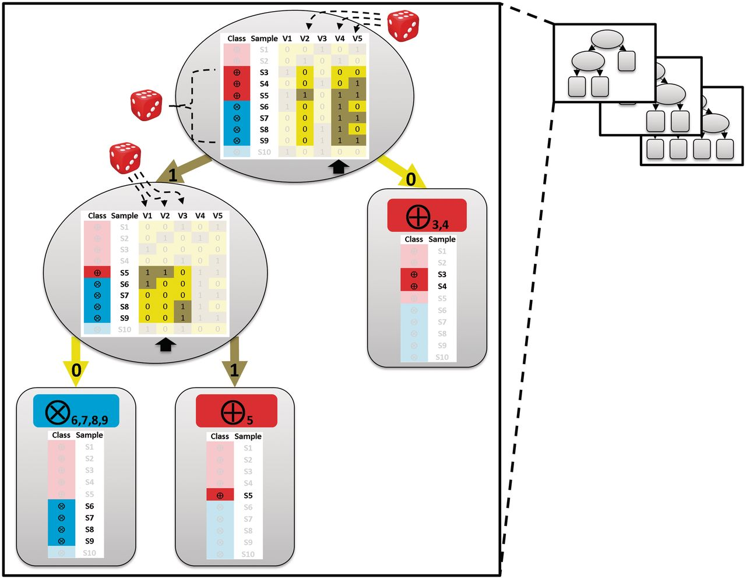
Figure 1: Training of an individual tree of an RFM. The tree is built based on a data matrix (shown within the ...
Notes:
Figure 1: Training of an individual tree of an RFM. The tree is built based on a data matrix (shown within the ellipses). This matrix consists of samples (S1–S10; e.g. individuals) belonging to two classes (encircled crosses or encircled plus signs; e.g. healthy and ill) and measurements for each sample for different variables (V1-V5; e.g. SNPs). Dice: random selection. Dashed lines: randomly selected samples and variables. For each tree, a bootstrap set is created by sampling samples from the data set at random and with replacement until it contains as many samples as there are in the data set. The random selection will contain about 63% of the samples in the original data set. In this example, the bootstrap set contains seven unique samples (samples S3–S9; non-selected samples S1, S2 and S10 are faded). For every node (indicated as ellipses) a few variables are randomly selected (here three; the other two non-selected variables are shown faded; by default RF selects the square root of the total number of variables) and evaluated for their ability to split the data. The variable resulting in the largest decrease in impurity is chosen to define the splitting rule. In case of the top node, this is V4 and for the second node on the left hand side this is V2 (indicated with the black arrows). This process is repeated until the nodes are pure (so called leaves; indicated with round-edged boxes): they contain samples of the same class (encircled cross or plus signs).
Unless provided in the caption above, the following copyright applies to the content of this slide: © The Author 2012. Published by Oxford University Press.This is an Open Access article distributed under the terms of the Creative Commons Attribution Non-Commercial License (http://creativecommons.org/licenses/by-nc/3.0), which permits unrestricted non-commercial use, distribution, and reproduction in any medium, provided the original work is properly cited.

Slide 2
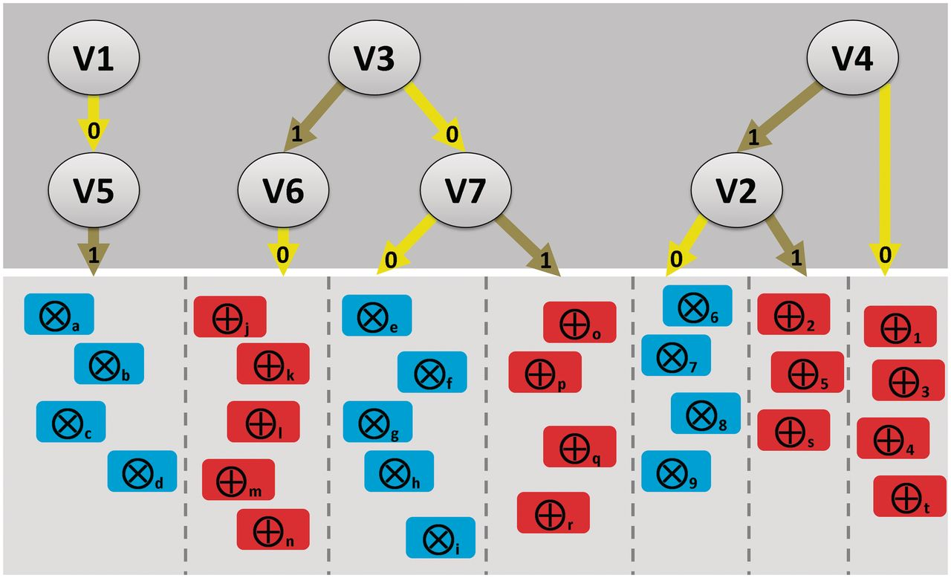
Figure 2: Concept visualization of how relations between variables and samples could be represented following the ...
Notes:
Figure 2: Concept visualization of how relations between variables and samples could be represented following the dissection of the trees in a random forest. In this hypothetical case, a supervised classification was performed on samples from two classes (encircled crosses or encircled plus signs; e.g. healthy individuals or patients). Dissection of the random forest trees might result in the further (unsupervised) distinction of subsets of samples. Top panel: variables (V1-Vn; e.g. SNPs in a GWAS study), their values (1 or 0) and interactions. Bottom panel: subsets (separated by the dashed lines) of samples from the pure classes that are predicted by a given interaction between variables. An interpretation example: provided that SNP4 (V4) is present, SNP2 (V2) allows the distinction between two subsets (consisting of healthy individuals 6, 7 8, 9 and patients 2, 5 and s). If SNP4 is absent, then the patient samples 1, 3, 4 and t can be classified. In case SNP1 (V1) is absent and SNP5 (V5) is present, a subset of healthy individuals consisting of samples a, b, c and d can be classified. Note that in this example, there can apparently no subset be distinguished if SNP1 (V1) is present or SNP5 (V5) is absent.
Unless provided in the caption above, the following copyright applies to the content of this slide: © The Author 2012. Published by Oxford University Press.This is an Open Access article distributed under the terms of the Creative Commons Attribution Non-Commercial License (http://creativecommons.org/licenses/by-nc/3.0), which permits unrestricted non-commercial use, distribution, and reproduction in any medium, provided the original work is properly cited.

