Slide 1
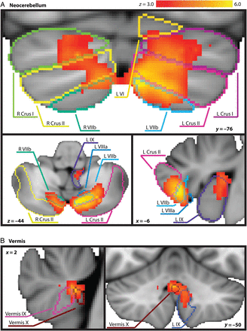
Figure 1. Significant cerebellar activity emerging from the whole-brain Animate > Random contrast is depicted on the ...
Notes:
Figure 1. Significant cerebellar activity emerging from the whole-brain Animate > Random contrast is depicted on the MNI standard space template in radiological orientation. Cerebellar lobule outlines from Diedrichsen's probabilistic cerebellar atlas normalized with FNIRT are overlaid on the active clusters as a reference. A (top) highlights neocerebellar clusters, while B (bottom) highlights vermal and paravermal regions.
Unless provided in the caption above, the following copyright applies to the content of this slide: © The Author 2014. Published by Oxford University Press. All rights reserved. For Permissions, please e-mail: journals.permissions@oup.com

Slide 2
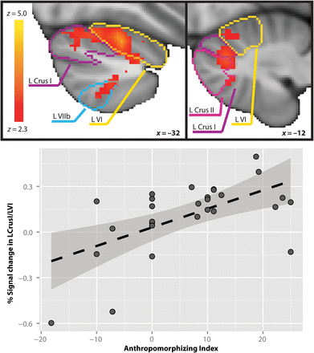
Figure 2. Left Crus I/left VI response to Animate (ANIM) > Random (RAND) is positively related to participants' AI. ...
Notes:
Figure 2. Left Crus I/left VI response to Animate (ANIM) > Random (RAND) is positively related to participants' AI. Top: Cerebellar activity associated with AI is depicted on the MNI standard space template in radiological orientation. Lobule outlines from Diedrichsen's probabilistic cerebellar atlas normalized with FNIRT are overlaid on the active clusters as a reference. Bottom: Percent signal change for the ANIM > RAND contrast extracted from AI-associated brain response in the cerebellar cluster depicted above, with fit line and 95% confidence interval.
Unless provided in the caption above, the following copyright applies to the content of this slide: © The Author 2014. Published by Oxford University Press. All rights reserved. For Permissions, please e-mail: journals.permissions@oup.com

Slide 3
Figure 3. Results of PPI analysis indicating regions of left posterior lobe of the cerebellum whose activity was ...
Notes:
Figure 3. Results of PPI analysis indicating regions of left posterior lobe of the cerebellum whose activity was significantly more strongly correlated with the timecourse of the seed region in right pSTS during Animate than Random trials. (A) Left: The mask of right pSTS from which the average timecourse was extracted to create the physiological regressor. (B) Right: The cluster that emerged from this analysis in left Crus II. Results labeled with MNI coordinates.
Unless provided in the caption above, the following copyright applies to the content of this slide: © The Author 2014. Published by Oxford University Press. All rights reserved. For Permissions, please e-mail: journals.permissions@oup.com

