Slide 1
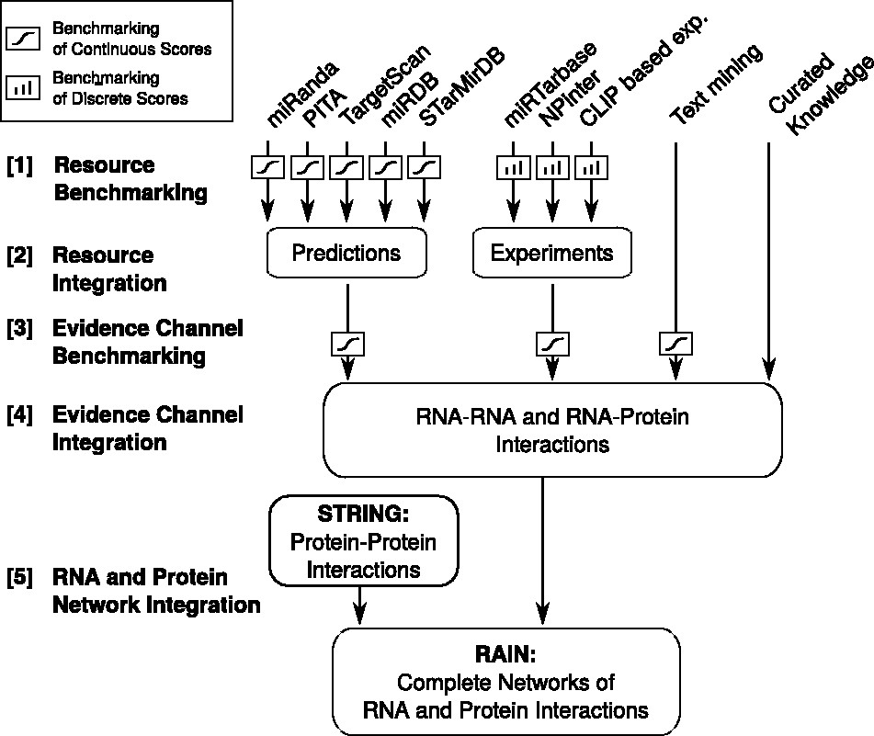
Figure 1 Flow chart illustrating the development of the RAIN database, ranging from establishing scoring schemes for ...
Notes:
Figure 1 Flow chart illustrating the development of the RAIN database, ranging from establishing scoring schemes for the individual sources of evidence, through integration of resources to evidence channels, to finally defining functional molecular networks.
Unless provided in the caption above, the following copyright applies to the content of this slide: © The Author(s) 2017. Published by Oxford University Press.This is an Open Access article distributed under the terms of the Creative Commons Attribution Non-Commercial License (http://creativecommons.org/licenses/by-nc/4.0/), which permits non-commercial re-use, distribution, and reproduction in any medium, provided the original work is properly cited. For commercial re-use, please contact journals.permissions@oup.com

Slide 2
Figure 2 Toy example describing the benchmarking and scoring scheme. (A) A true positive (TP) interaction is depicted ...
Notes:
Figure 2 Toy example describing the benchmarking and scoring scheme. (A) A true positive (TP) interaction is depicted as a black dot and represents a miRNA–mRNA pair found in the gold standard; a false positive (FP) interaction is depicted as a white dot and comprises interactions where the miRNA and mRNA constituents are in the gold standard, but their pair is not. Interactions where the miRNA or the mRNA were not part of the gold standard are depicted as gray dots. Only TP and FP interactions are used to establish the transfer function, which subsequently is applied to assign confidence scores to all interactions. (B) A discrete transfer function is established as the fraction of correctly predicted interactions in each of the discrete raw score bins. (C) A continuous transfer function is established based on the TP and FP interactions found in sliding windows. The mean raw interaction score and fraction of correctly predicted interactions were computed for each window, followed by the fitting of a sigmoid transfer function.
Unless provided in the caption above, the following copyright applies to the content of this slide: © The Author(s) 2017. Published by Oxford University Press.This is an Open Access article distributed under the terms of the Creative Commons Attribution Non-Commercial License (http://creativecommons.org/licenses/by-nc/4.0/), which permits non-commercial re-use, distribution, and reproduction in any medium, provided the original work is properly cited. For commercial re-use, please contact journals.permissions@oup.com

Slide 3
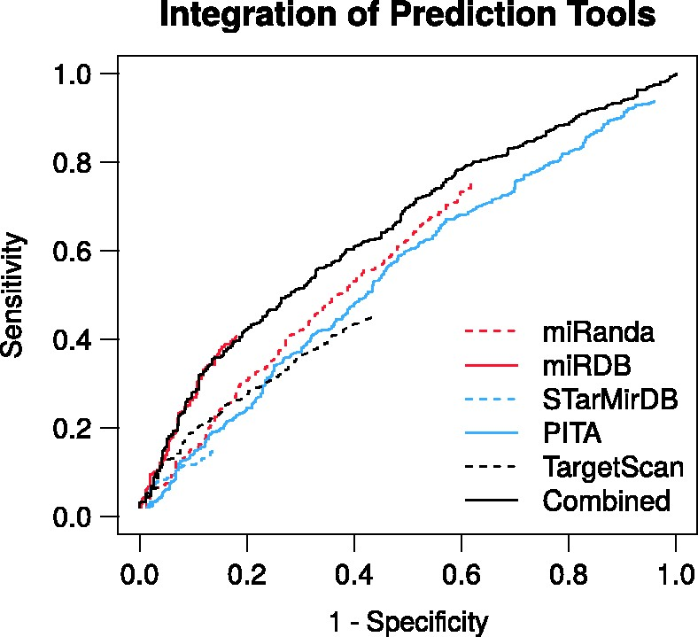
Figure 3 Receiver-operating characteristics of the RAIN prediction channel and the respective miRNA target prediction ...
Notes:
Figure 3 Receiver-operating characteristics of the RAIN prediction channel and the respective miRNA target prediction tools benchmarked against an independent validation set of miRNA–mRNA interactions. The integration of the respective prediction tools yields improved predictive performance. Where specificity =TN/N, sensitivity =TP/P, P is the number of positive and n the number of negative miRNA–mRNA pairs.
Unless provided in the caption above, the following copyright applies to the content of this slide: © The Author(s) 2017. Published by Oxford University Press.This is an Open Access article distributed under the terms of the Creative Commons Attribution Non-Commercial License (http://creativecommons.org/licenses/by-nc/4.0/), which permits non-commercial re-use, distribution, and reproduction in any medium, provided the original work is properly cited. For commercial re-use, please contact journals.permissions@oup.com

Slide 4
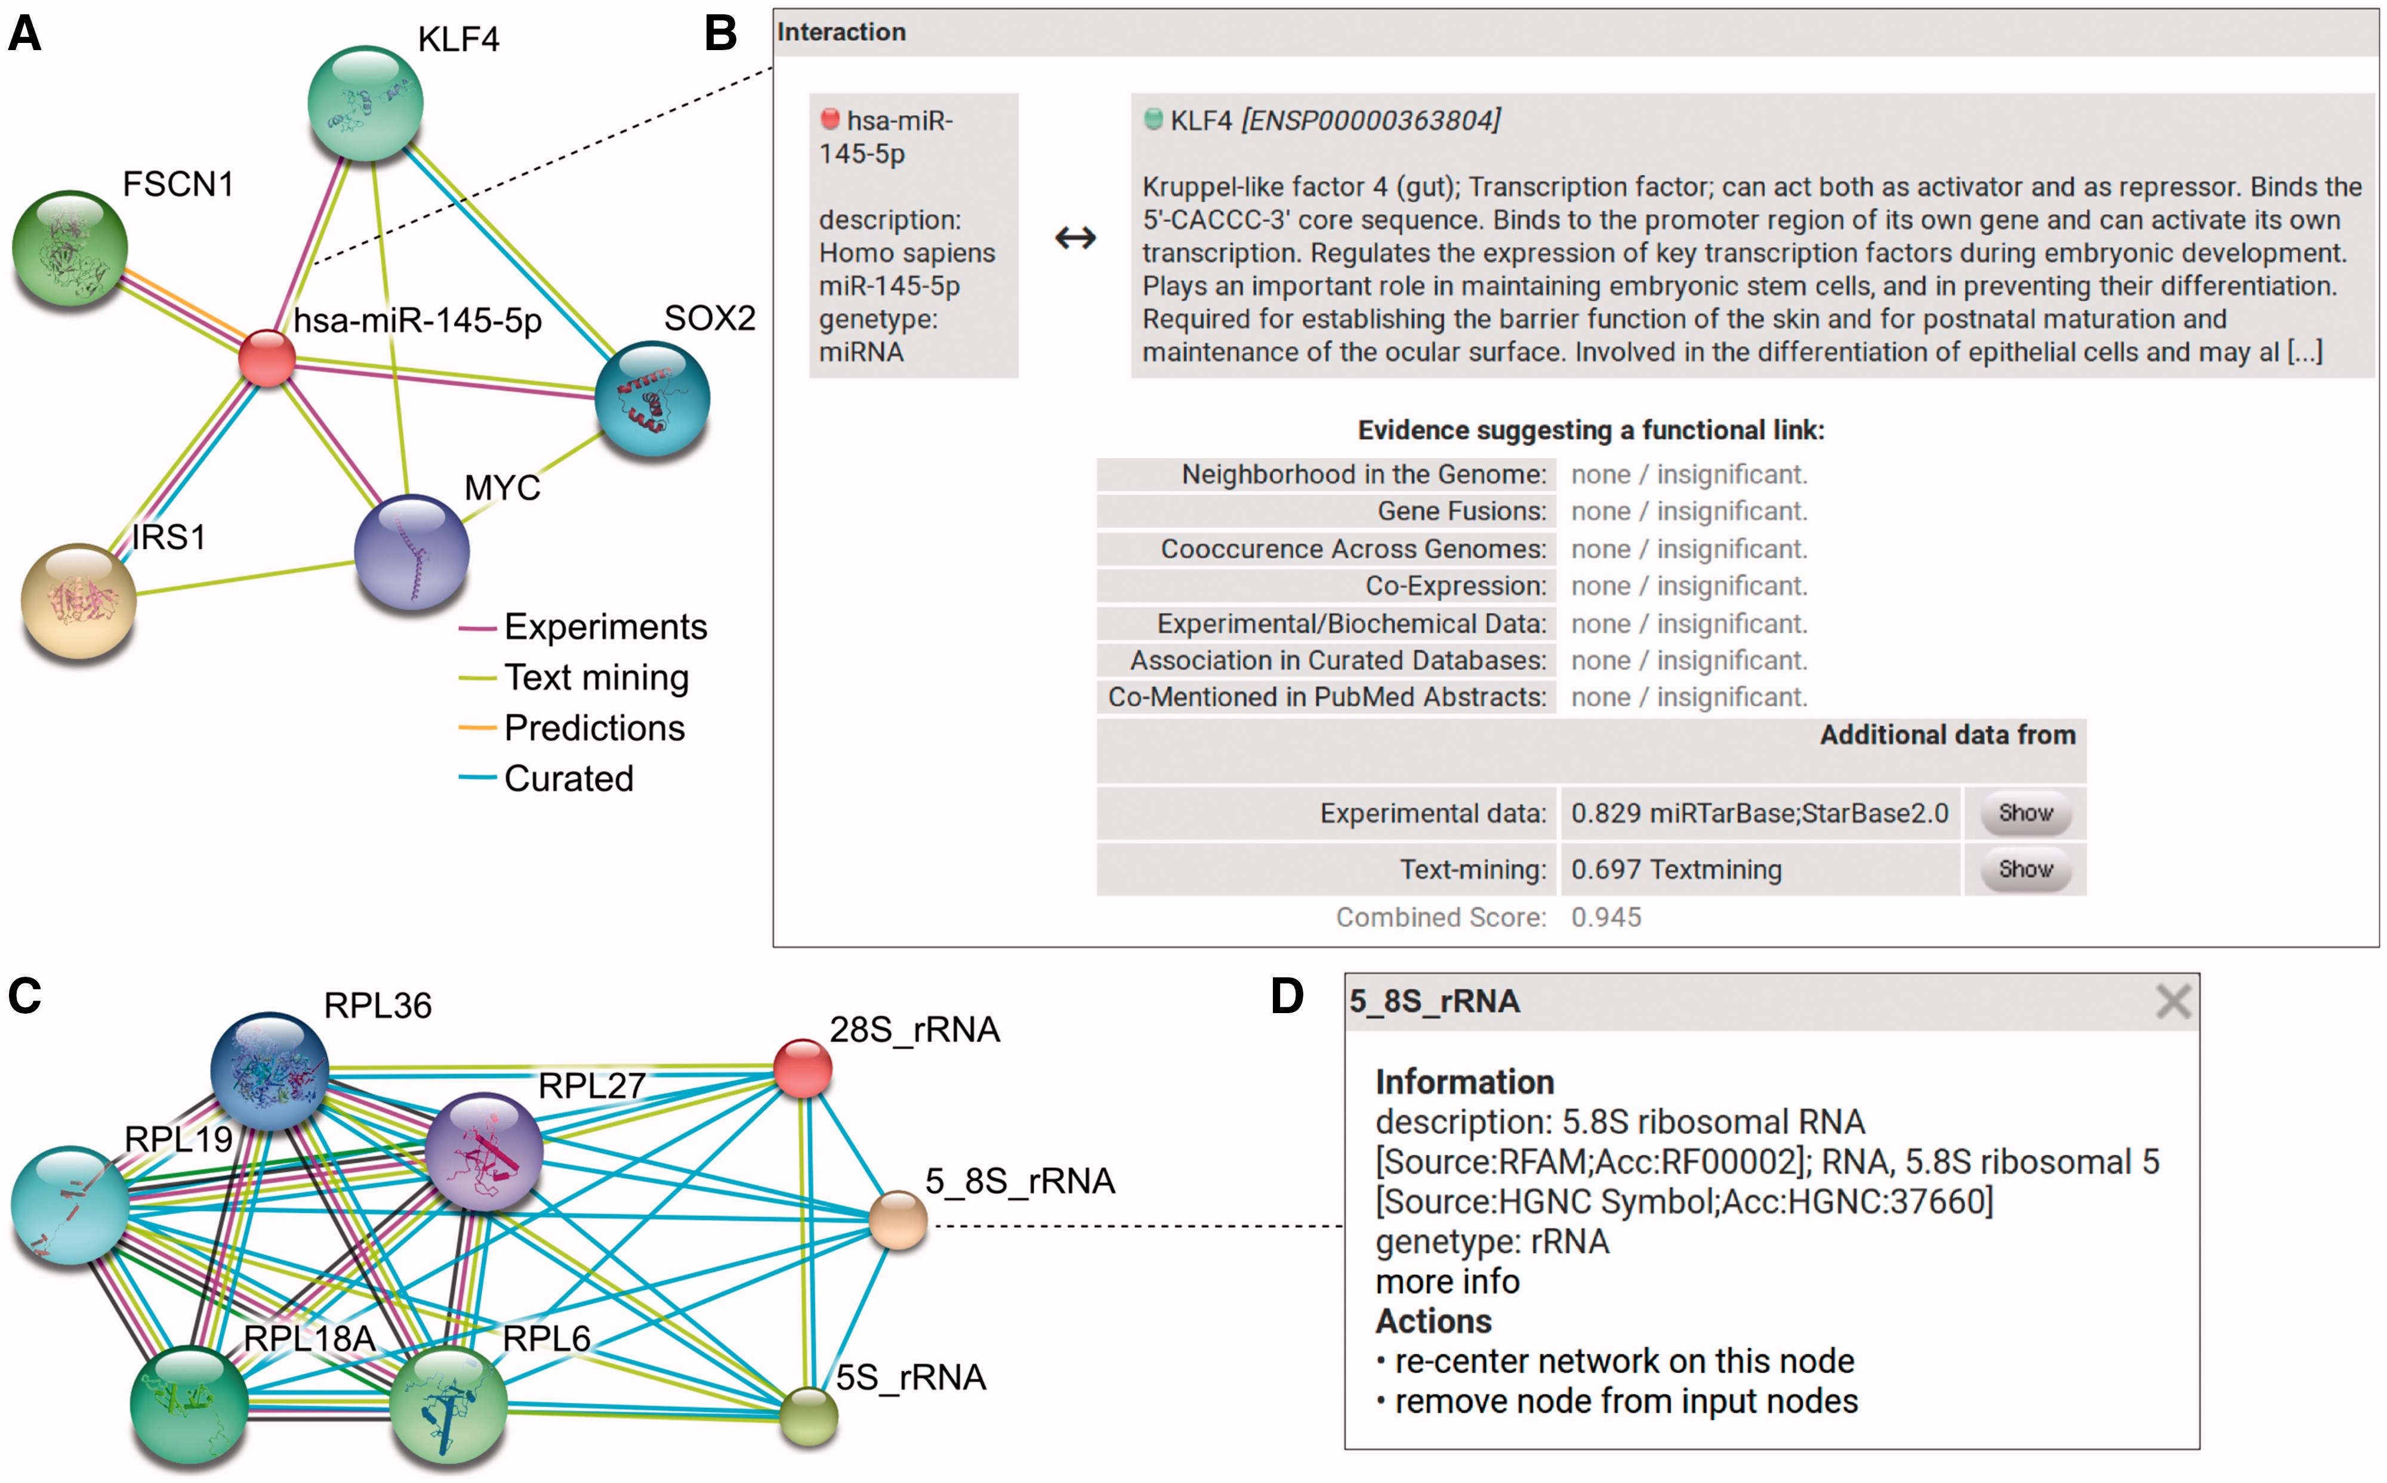
Figure 4 RAIN use case. (A) Querying RAIN for human miR-145-5p (miR-145), suggested to act as tumor-suppressor in ...
Notes:
Figure 4 RAIN use case. (A) Querying RAIN for human miR-145-5p (miR-145), suggested to act as tumor-suppressor in breast and colon cancer (40, 41), finds multiple oncogenes such as KLF4 and SOX2 (42, 43) as putative targets of miR-145. Evidence channels supporting each interaction are encoded as edge colors. (B) Sources of evidence for each association, e.g. between miR-145 and KLF4, are presented in a pop-up opened after clicking an edge in the network. RAIN confidence scores are collected in the ‘Additional data’ table. Information about KLF4 is provided by STRING. Clicking the ‘Show’ button leads to a website that links to research articles presenting experimental evidence and displaying detailed text mining evidence, where available. (C) In contrast to single identifier search (A), the RAIN multiple identifier search can be used to specifically view interactions between three ribosomal RNAs (28S_rRNA, 5_8S_rRNA, 5S_rRNA) and a subset of five ribosomal proteins part of the large ribosomal subunit. These interactions were extracted from Reactome (10) or found by text mining. (D) Clicking an ncRNA node in the network opens a popup with basic information about the ncRNA, e.g. 5.8S rRNA.
Unless provided in the caption above, the following copyright applies to the content of this slide: © The Author(s) 2017. Published by Oxford University Press.This is an Open Access article distributed under the terms of the Creative Commons Attribution Non-Commercial License (http://creativecommons.org/licenses/by-nc/4.0/), which permits non-commercial re-use, distribution, and reproduction in any medium, provided the original work is properly cited. For commercial re-use, please contact journals.permissions@oup.com

