Slide 1
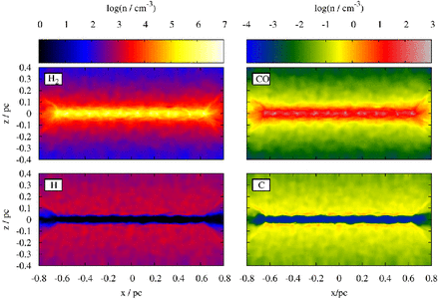
Figure 1. Spatial distribution of H, H₂, C, and CO at the end of the simulation with a parallel magnetic ...
Notes:
Figure 1. Spatial distribution of H, H2, C, and CO at the end of the simulation with a parallel magnetic field, G0 = 1.7, and a CRIR of 1.3 × 10−17 s−1 along a slice through the centre of the filament.
Unless provided in the caption above, the following copyright applies to the content of this slide: © 2016 The Authors Published by Oxford University Press on behalf of the Royal Astronomical Society

Slide 2
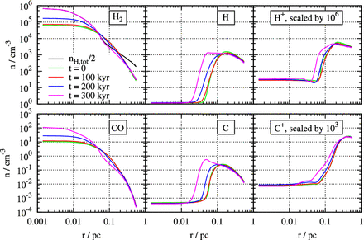
Figure 2. From left to right: radial dependence of the density of H₂, H, H⁺ (top row), and CO, C, ...
Notes:
Figure 2. From left to right: radial dependence of the density of H2, H, H+ (top row), and CO, C, and C+ (bottom row) at t = 0, 100, 200, and 300 kyr after the start of the same simulation as in Fig. 1. Note that at t = 0, the chemical distribution corresponds to that after an initial relaxation phase of 500 kyr. In order to use the same y-axis, $n_{\rm H^+}$ and $n_{\rm C^+}$ are scaled up by a factor of 106 and 103, respectively. The black line in the upper-left panel shows the total hydrogen density divided by 2.
Unless provided in the caption above, the following copyright applies to the content of this slide: © 2016 The Authors Published by Oxford University Press on behalf of the Royal Astronomical Society

Slide 3
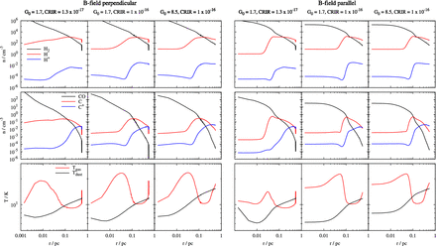
Figure 3. Radial dependence of H₂, H, H⁺ (top row), CO, C, C⁺ (middle row) as well as ...
Notes:
Figure 3. Radial dependence of H2, H, H+ (top row), CO, C, C+ (middle row) as well as the gas and dust temperature (bottom row) at the end of each simulation. Left-hand panel: runs with a perpendicular magnetic field. Right-hand panel: runs with a parallel magnetic field.
Unless provided in the caption above, the following copyright applies to the content of this slide: © 2016 The Authors Published by Oxford University Press on behalf of the Royal Astronomical Society

