Slide 1
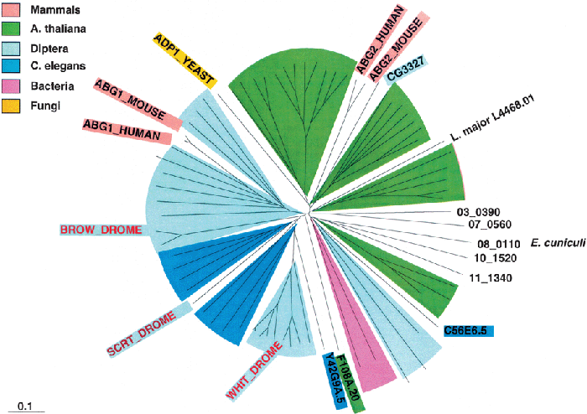
4 Unrooted phylogenetic tree of WHI subfamily ABC transporters. Same conventions and symbols as in Fig. 2.
Notes:
4 Unrooted phylogenetic tree of WHI subfamily ABC transporters. Same conventions and symbols as in Fig. 2.
Unless provided in the caption above, the following copyright applies to the content of this slide: © 2002 Federation of European Microbiological Societies

Slide 2
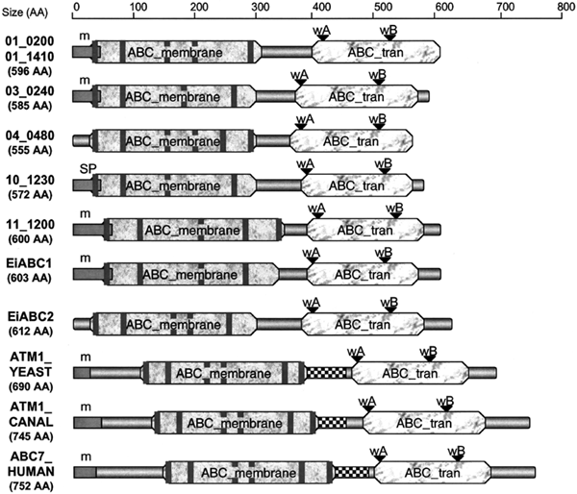
3 Conserved domains in the HMT subfamily of ABC transporters. Square boxes in the N-terminus of the ABC ...
Notes:
3 Conserved domains in the HMT subfamily of ABC transporters. Square boxes in the N-terminus of the ABC transport proteins (except EiABC2) are labeled by a ‘m’ for mitochondrial pre-sequence prediction, or ‘SP’ for signal peptide. Vertical bars figure the transmembrane domains predicted by the TMpred program (segment size: minimum 17 and maximum 33 amino acids). The Pfam database information (ABC7_HUMAN and ATM1_YEAST) or the Pfam prediction (cut-off level for E-value = 1) are figured by the ABC_membrane or ABC_tran boxes and by a checked motif representing a conserved region in ATM1-like proteins (B377 in PfamB corresponding to the PD168165 PRODOM motif). The ABC_membrane is representative of the transmembrane region of ABC transporters with six transmembrane segments (INTERPRO accession number: IPR001140). The ABC_tran corresponds to the ATP-binding site of ABC transporters which is conserved between the Walker motifs A and B (INTERPRO accession number: IPR003439). Walker motifs A and B were found by multiple alignment of proteins with the ClustalW program.
Unless provided in the caption above, the following copyright applies to the content of this slide: © 2002 Federation of European Microbiological Societies

Slide 3
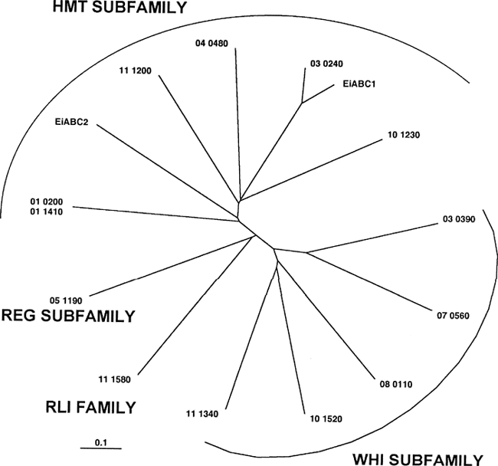
1 Unrooted phylogenetic tree of available sequences of microsporidian ABC systems. The phylogenetic tree was ...
Notes:
1 Unrooted phylogenetic tree of available sequences of microsporidian ABC systems. The phylogenetic tree was computed from multiple alignment of sequences as indicated in Section 2. The names of the ORFs are defined as in Table 1. EiABC1 and EiABC2 are the two ABC transporters identified in E. intestinalis. The scale at the bottom of the figure corresponds to 10% divergence between sequences.
Unless provided in the caption above, the following copyright applies to the content of this slide: © 2002 Federation of European Microbiological Societies

Slide 4
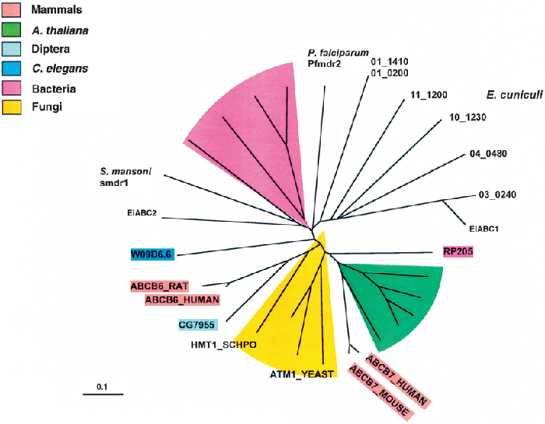
2 Unrooted phylogenetic tree of HMT subfamily ABC transporters. The phylogenetic tree was computed from a ...
Notes:
2 Unrooted phylogenetic tree of HMT subfamily ABC transporters. The phylogenetic tree was computed from a multiple alignment of sequences as indicated in Section 2. The names of the E. cuniculi ORFs are given as in Table 1. E. intestinalis EiABC1 and EiABC2 were included in the multiple alignment. Systems found in different taxa were indicated by specific background colors. Only the names of the most well-known systems are given. The protein name in the SwissProt database was given when available. The scale at the bottom of the figure corresponds to 10% divergence between sequences.
Unless provided in the caption above, the following copyright applies to the content of this slide: © 2002 Federation of European Microbiological Societies

Slide 5
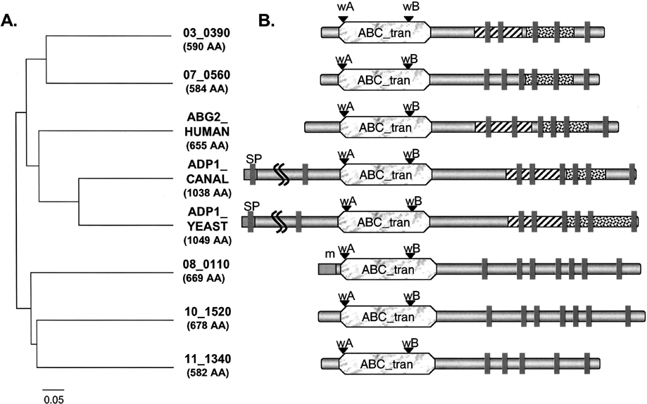
5 Conserved domains in the WHI subfamily of ABC transporters. A: Dendrogram. The scale corresponds to 5% ...
Notes:
5 Conserved domains in the WHI subfamily of ABC transporters. A: Dendrogram. The scale corresponds to 5% divergence between sequences. B: Conserved domains. Square boxes in the N-terminus of some proteins are labeled either by a ‘m’ as in Fig. 3 or by a ‘SP’ for signal peptide prediction. Vertical bars figure the transmembrane domains predicted by the TMpred program. The dashed and dotted boxes represent conserved helical motifs called respectively B44 (corresponding to the PD001016 PRODOM motif) and B775 (corresponding to the PD078237 PRODOM motif) in PfamB. Both are specific of ABC transport proteins and are characteristic of transmembrane regions. The ABC_tran Pfam predicted motif has the same signification as in Fig. 3. The curved lines in the yeast proteins indicate truncation of part of the N-terminus region for the schematic representation.
Unless provided in the caption above, the following copyright applies to the content of this slide: © 2002 Federation of European Microbiological Societies

