Slide 1
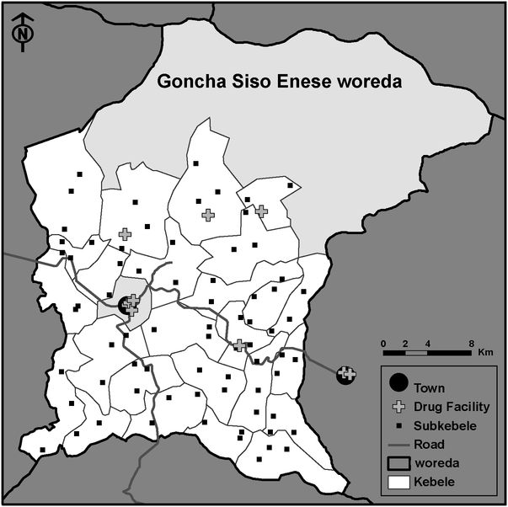
Figure 1 Map of the woreda (district) of Goncha Siso Enese in the Amhara Region of Ethiopia. The study area is ...
Notes:
Figure 1 Map of the woreda (district) of Goncha Siso Enese in the Amhara Region of Ethiopia. The study area is highlighted in white. Each of the 25 kebeles in the study area was divided into three subkebeles; subkebele markers on the map correspond to the locations where trachoma monitoring occurred. The central kebele (grey) contained the town of Gindewoin, and was not included in the study area. There were 12 drug-dispensing facilities accessible to the study area, including six facilities located in Gindewoin.
Unless provided in the caption above, the following copyright applies to the content of this slide: © Royal Society of Tropical Medicine and Hygiene 2011

Slide 2
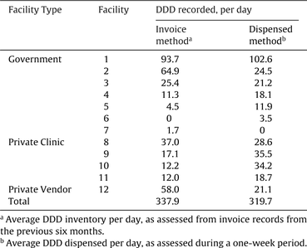
Table 1 Characteristics of 72 subkebeles in a rural area in Ethiopia
Notes:
Table 1 Characteristics of 72 subkebeles in a rural area in Ethiopia
Unless provided in the caption above, the following copyright applies to the content of this slide: © Royal Society of Tropical Medicine and Hygiene 2011

Slide 3
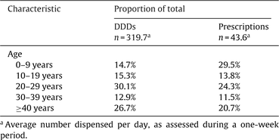
Table 2 Facility workers' opinions of the most to least frequently dispensed antibiotics in a rural area of Ethiopia
Notes:
Table 2 Facility workers' opinions of the most to least frequently dispensed antibiotics in a rural area of Ethiopia
Unless provided in the caption above, the following copyright applies to the content of this slide: © Royal Society of Tropical Medicine and Hygiene 2011

Slide 4
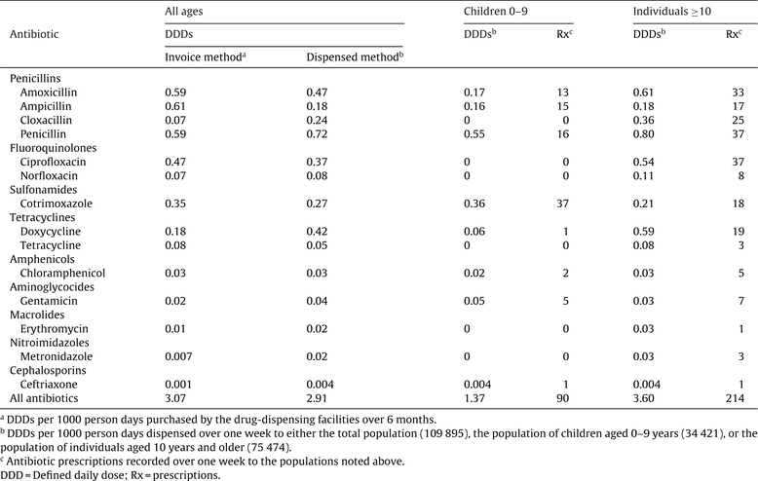
Table 3 Defined Daily Doses (DDD) recorded by drug-dispensing facilities in a rural area of Ethiopia
Notes:
Table 3 Defined Daily Doses (DDD) recorded by drug-dispensing facilities in a rural area of Ethiopia
Unless provided in the caption above, the following copyright applies to the content of this slide: © Royal Society of Tropical Medicine and Hygiene 2011

Slide 5
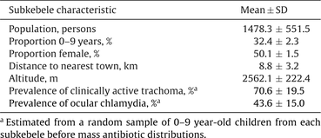
Table 4 Proportion of Defined Daily Doses (DDD) and prescriptions dispensed per day in a rural area of Ethiopia, ...
Notes:
Table 4 Proportion of Defined Daily Doses (DDD) and prescriptions dispensed per day in a rural area of Ethiopia, classified according to age of consumer
Unless provided in the caption above, the following copyright applies to the content of this slide: © Royal Society of Tropical Medicine and Hygiene 2011

Slide 6
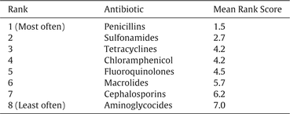
Table 5 Antibiotic utilization in a rural area of Ethiopia, classified according to antibiotic class and age
Notes:
Table 5 Antibiotic utilization in a rural area of Ethiopia, classified according to antibiotic class and age
Unless provided in the caption above, the following copyright applies to the content of this slide: © Royal Society of Tropical Medicine and Hygiene 2011

