Slide 1
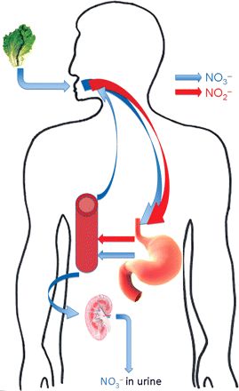
Figure 1 Simplified representation of the entero-salivary circulation of nitrate. Nitrate (represented by the blue ...
Notes:
Figure 1 Simplified representation of the entero-salivary circulation of nitrate. Nitrate (represented by the blue arrows) derived from the diet is swallowed. It is rapidly and completely absorbed in the upper gastrointestinal tract. Approximately 25% is concentrated in the salivary glands and secreted into the mouth. Here it is reduced to nitrite (represented by the red arrows) by facultative anaerobes on the dorsum of the tongue and swallowed. Some of the nitrite undergoes acidic reduction to NO in the stomach, with the remainder being absorbed. The fate of nitrite is discussed in depth later. Sixty per cent of ingested nitrate is lost in the urine within 48 h.
Unless provided in the caption above, the following copyright applies to the content of this slide: Published on behalf of the European Society of Cardiology. All rights reserved. © The Author 2010. For permissions please email: journals.permissions@oxfordjournals.org.

Slide 2
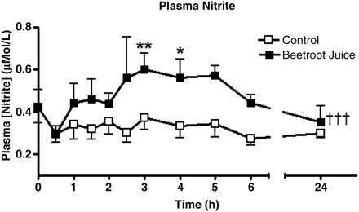
Figure 2 The effect of oral inorganic nitrate (from beetroot juice, administered at time 0) on plasma nitrite. Peak ...
Notes:
Figure 2 The effect of oral inorganic nitrate (from beetroot juice, administered at time 0) on plasma nitrite. Peak plasma nitrite concentrations occur 3 h following ingestion of nitrate.40
Unless provided in the caption above, the following copyright applies to the content of this slide: Published on behalf of the European Society of Cardiology. All rights reserved. © The Author 2010. For permissions please email: journals.permissions@oxfordjournals.org.

Slide 3
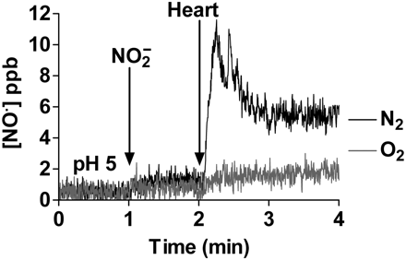
Figure 3 The addition of rat heart homogenate enhances the release of NO from acidified nitrite.¹⁵
Notes:
Figure 3 The addition of rat heart homogenate enhances the release of NO from acidified nitrite.15
Unless provided in the caption above, the following copyright applies to the content of this slide: Published on behalf of the European Society of Cardiology. All rights reserved. © The Author 2010. For permissions please email: journals.permissions@oxfordjournals.org.

