Slide 1
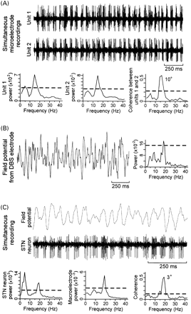
Fig. 1 Examples of an intra‐operative recording from a pair of microelectrodes (A), a post‐operative ...
Notes:
Fig. 1 Examples of an intra‐operative recording from a pair of microelectrodes (A), a post‐operative recording from a DBS electrode (B), and the spectral analysis of an intra‐operative simultaneous recording from a microelectrode and a macroelectrode (C). The dashed line in the plots represents the significance level for the power spectra estimates (P < 0.01) and for the coherence function (P < 0.01). The units of the power spectra are arbitrary. The number beside the peak in the coherence spectrums is the phase difference in degrees. (A) Raw traces of extracellular microelectrode recordings of two simultaneously recorded STN TCs with high‐frequency oscillations. The tips of the two microelectrodes were separated by 670 µm. The frequency spectra of the neuronal oscillatory discharges and the corresponding coherence function are shown below (1.95 Hz resolution). Spectra and coherence were calculated over a 10‐s interval that included the period shown in the recordings. (B) A segment of a bipolar recording of STN field potentials from a pair of DBS contacts (low pass filtered below 55 Hz). The frequency spectrum of this signal is shown to the right (0.78 Hz resolution) and was calculated from 10 s of data containing this segment. (C) Simultaneous microelectrode and macroelectrode intra‐operative recordings in Patient N. The tips of the electrodes were positioned 2 mm within the dorsal border of the STN. The raw traces shown are an example of a period of highly significant coherence (note that the field potential data was low pass filtered below 55 Hz). The lower left and middle plots show the power spectrums (0.98 Hz resolution) for the single STN neurone recorded with the microelectrode and a monopolar field potential recorded through a 30 gauge cannula, respectively (see Methods). The lower right plot shows the coherence between the two signals. Spectra and coherence were calculated over a 70‐s period. Coherence between the macroelectrode recording and the single unit was limited to the high frequency component of each signal.
Unless provided in the caption above, the following copyright applies to the content of this slide:

Slide 2
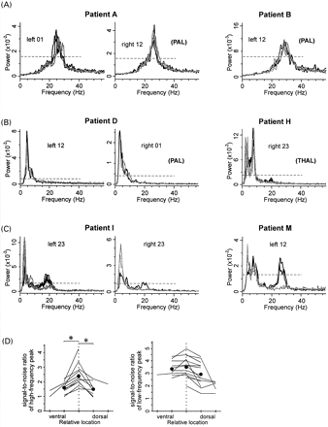
Fig. 2 Representative examples of STN field potential spectra recorded from two patients displaying only ...
Notes:
Fig. 2 Representative examples of STN field potential spectra recorded from two patients displaying only high‐frequency oscillations (A), only low‐frequency oscillations (<12 Hz) (B), and significant low‐ and high‐frequency field potential oscillations (recorded during rest) (C). Black lines in these plots show the spectra of individual trials recorded while the patients were at rest; grey lines show the spectra of individual trials recorded during sustained isometric contractions of the wrist extensors. High‐frequency field potential activity was reduced by voluntary movements only in patients displaying spectra with both low‐ and high‐frequency activity. Labels in each graph such as ‘left 01’ indicate that bipolar recordings of the field potentials were performed between contact 0 and contact 1 of the left STN. The dashed horizontal line in each graph represents the upper bound for a 99.8% confidence interval with respect to the mean spectral noise (calculated between 0 and 55 Hz from the recordings performed with the patients at rest). Spectral estimates above this line indicate statistically significant frequencies. PAL = previous pallidotomy; THAL = previous thalamotomy. (D) The signal‐to‐noise ratio of the high‐frequency (left) and low‐frequency (right) spectral peaks recorded from the three pairs of DBS contacts when the patients were at rest (all recorded sides shown). Values from the same DBS electrode are joined by a line and multiple trials were averaged. Data were aligned with respect to the location of the greatest signal‐to‐noise ratio from each side (dashed vertical line). The mean signal‐to‐noise ratio is indicated by a filled circle. *P < 0.01, one‐way ANOVA (analysis of variance). The relative distance between the bipolar recordings from adjacent DBS contacts was 3 mm.
Unless provided in the caption above, the following copyright applies to the content of this slide:

Slide 3
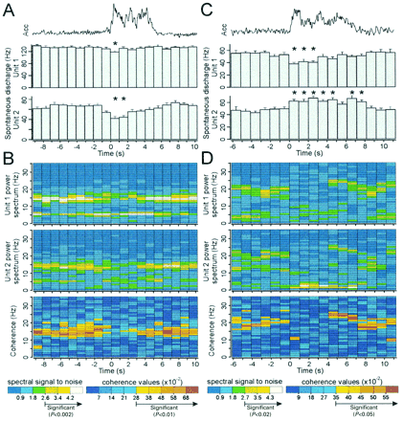
Fig. 3 The suppression of synchronized high‐frequency oscillations of pairs of STN neurones during voluntary ...
Notes:
Fig. 3 The suppression of synchronized high‐frequency oscillations of pairs of STN neurones during voluntary pointing movements in two patients (right column versus left column). Data were calculated with respect to the onset of movement (0 s in plots, see Methods). The top trace of both columns is the rectified and averaged accelerometer signal (Acc). (A and C) Plots of the mean firing rate of each neurone (1.024 s bins, ±SE). The patient whose data are displayed in the left column performed 15 trials of the task and the patient whose data are displayed in the right column performed eight trials of the task. The firing rates of all four neurones were modulated by the movement [*P < 0.05 (ANOVA) versus discharge from 5.12 to 0 s before the onset of movement]. (B and D) Time–frequency plots of the spectra of each neurone (top and middle) and the coherence between them (bottom, 1.024 s bins). Both pairs of neurones displayed a movement‐related desynchronization and post‐movement synchronization of their high‐frequency oscillations (i.e. significant coherence before and after the movement). The legends for these plots are located at the bottom of each column.
Unless provided in the caption above, the following copyright applies to the content of this slide:

Slide 4
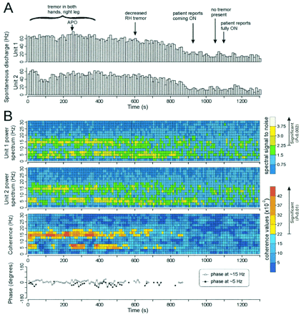
Fig. 4 The effect of APO administration on neuronal activity of a pair of STN TCs with high‐frequency ...
Notes:
Fig. 4 The effect of APO administration on neuronal activity of a pair of STN TCs with high‐frequency oscillations. (A) Histograms of the firing rate of the pair of STN neurones (10 s bins) demonstrate that APO reduced the spontaneous discharge of the two neurones. (B) Abolition of high‐frequency synchronization of the same pair of STN TCs following the administration of APO. The top two panels show the power spectra (1.95 Hz resolution) over the same time period and bin size as the firing rate histograms in (A). Both neurones displayed tremor‐related activity and high‐frequency oscillations before the administration of APO. The third plot shows the coherence between the oscillatory activity of the two neurones. The bottom panel is the phase of significantly coherent oscillations at tremor frequency (∼5 Hz) and at high frequency (∼15 Hz).
Unless provided in the caption above, the following copyright applies to the content of this slide:

Slide 5
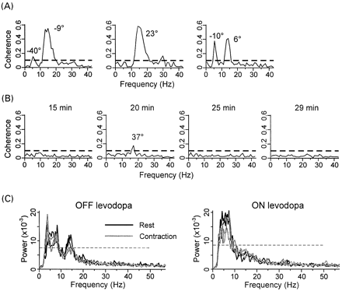
Fig. 5 Dopaminergic modulation of high‐frequency synchronized oscillations in neurone pairs recorded ...
Notes:
Fig. 5 Dopaminergic modulation of high‐frequency synchronized oscillations in neurone pairs recorded before (A) and after (B) APO administration and in field potential activity in another patient (C). (A) Coherence plots (0.98 Hz resolution) of three pairs of STN neurones recorded before APO administration. All neurones displayed tremor‐related activity and two pairs (right and left plots) were synchronized in the tremor frequency range (∼3–8 Hz). The dashed line in the plots is the significance level for the coherence function (P < 0.01). The number beside the peaks is the phase difference in degrees. All neurone pairs in (A) and (B) were sampled for 3 min. (B) Coherence plots of four pairs of STN neurones recorded after APO administration when the patient was ON (the time of recording after APO dosing is indicated above each plot). (C) Effect of levodopa on high‐frequency field potential signals recorded from Patient H. The high‐frequency oscillations recorded during the OFF levodopa state were localized to the dorsal contacts of the DBS electrodes. Note the reduction of high‐frequency activity during the levodopa‐induced ON period or with contraction in the OFF state (two alternate trials of 60 s each).
Unless provided in the caption above, the following copyright applies to the content of this slide:

